Slide 1
Learn at Lunch Advancing 2018 Affordable Housing & Homelessness policies
Welcome to the webinar!
Please note:
All participants are muted.
Questions during the webinar are encouraged! Please submit questions via the control panel to the right. We will do our best to respond during the webinar, but may need to follow up later over email.
A recording of this webinar and the slides will be posted at wliha.org/resources/webinars-and-tools
Thank you for attending! We will begin shortly.

Slide 2
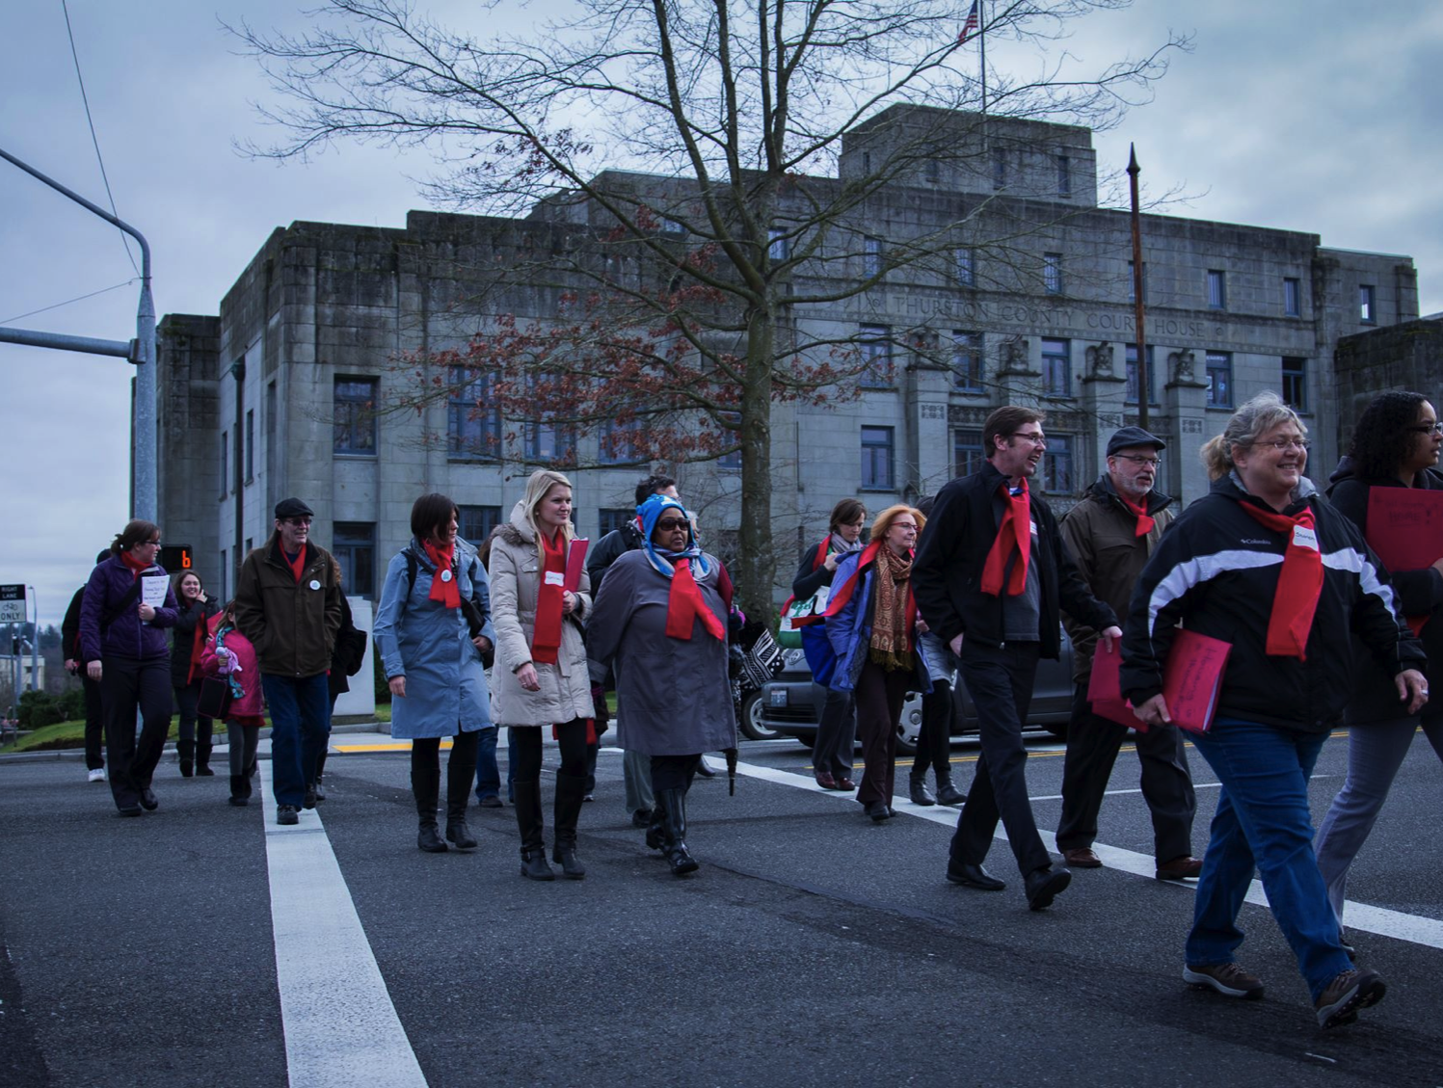
The Washington Low Income
Housing Alliance
Everyone should have the opportunity to live in a safe, healthy and
affordable home.
Notes:
Holding slide. Have up while people are dialing in.

Slide 3
Learn at Lunch Advancing 2018 Affordable Housing & Homelessness policies
Today’s Agenda
Welcome and Go To Webinar pointers
Introduction to the Housing Alliance and the Housing Alliance Action Fund
What to Expect? Overview of Housing Alliance 2018 state legislative agenda
2018 Affordable Housing and Homelessness priorities
Leveraging your voice!
Notes:
DG 12:00 – 12:04 Welcome, overview of today’s webinar (agenda), and webinar trouble shooting (asking questions, etc.)
MT 12:04 – 12:07: Brief intro to the Housing Alliance and Action Fund, and overview of how we set our agenda. Make sure to note our support agenda.
Housing Alliance
Housing Action Fund
How we set our 2018 agenda:
- input
- PPC (and what that is)
- Board role
We consider if it will have a statewide impact, if it will make a significant impact on access to affordable housing, on homelessness or on equity.
We have a support agenda where we list additional issues that we endorse, but which other partners lead on. That will be decided in December.

Slide 4
Learn at Lunch Advancing 2018 Affordable Housing & Homelessness policies
Key things to know about the 2018 State Legislative Session
Two vastly different political landscapes. Which one will we face?
2018 is slated to be a short, 60-day session.
The November 2018 election will significantly impact the next legislative session.
Notes:
MT 12:07 – 12:12
In order to succeed, we need to build housing and homelessness lawmaker champions and we need to reckon with that fact that who in charge matters: The majority sets the agenda in Olympia and decides which bills live or die.
Building champions is both c3 friendly work – meaning you can do it with a c3 hat on (if you work at one, or are a board member). And it is also electoral to get champions elected which you can do as an individual, part of the Housing Alliance Action Fund.
- We aren’t taking anything for granted for next year, because it has been proven that majorities matter. Many of our key issues have been stymied by the Senate over the last 5 years and we need to try to change that dynamic with a double-pronged strategy of growing more champions and getting more champions elected.
1) The realm of what is possible will be greatly impacted by the November election results, specifically what happens in the 45th LD which impacts who controls the Senate.
2) The session is short, 60 days, starting on January 8th. This means that there is only half of what we had during the 2017 regular session to move bills through the many step process. This will constrain how many bills get passed.
3) In November 2018 the whole House of Representatives will be up for re-election and half of the Senate will be too. This just means that many will be weighing their votes with the question of how it will impact their ability to get re-elected.

Slide 5
Learn at Lunch Advancing 2018 Affordable Housing & Homelessness policies
Secure significant funding for the
Housing Trust Fund
Pass a Capital Budget with at least $106 million for affordable housing, and increase biennial funding with a supplemental Capital Budget.
Notes:
MT 12:12 – 12:20 (8 min total)
- This ask is both to ensure that we maintain the funding level in the agreed upon Capital Budget, but that the legislatures PASS a Capital Budget.
- Hirst (very briefly) with focus on unprecedented, unrelated policy issue, we need bipartisan support regardless of what happens in November. 5 R votes needed.
- Supplemental Budget or not?
- Timing of the CB is critical – share what we’ve learned from our survey.

Slide 6
Housing Trust Fund Investments in Affordable Housing 1989 – 2015
Multiple Counties (scattered-site projects)
358 homes
$6.7 M
Whatcom
1,229 homes + 9 Beds
$32 M
Pend Oreille
152 homes
$2.3 M
San Juan
236 homes
$9.9M
Okanogan
361 homes + 47 beds
$9.3 M
Ferry
177 homes
$2.6 M
Skagit
715 homes + 6 Beds
$19.8 M
Island
163 homes +
17 Beds
$6.4 M
Stevens
183 homes
$5.7 M
Clallam
666 homes
$21.7 M
Snohomish
2,569 homes +
55 Beds
$57.5 M
Kitsap
960 homes +
80 Beds
$28.2 M
Chelan
926 homes +
6 Beds
$30 M
Jefferson
109 homes + 4 Beds
$5 M
Douglas
150 homes +
18 Beds
$9.6 M
King
15,320 homes +
2,098 Beds
$370.3 M
Lincoln
39 homes +
16 Beds
$2.5 M
Spokane
2,907 homes + 177 Beds
$81 M
Grays Harbor
231 homes +
25 Beds
$5.3 M
Mason
279 homes +
$8.5 M
Grant
1,390 homes +
$31.4 M
Pierce
2,738 homes +
224 Beds
$76.6 M
Kittitas
183 homes
$3.7 M
Adams
438 homes +
$12.6 M
Whitman
239 homes
$9.3 M
Thurston
926 homes +
88 Beds
$32.4 M
Pacific
68 homes +
8 Beds
$6.2 M
Franklin
388 homes
$11.4 M
Lewis
386 homes + 6 Beds
$13.1 M
Garfield
10 homes
$94.1 K
Yakima
1,421 homes +
108 Beds
$47.6 M
Wahkiakum
19 homes
$1.1 M
Cowlitz
474 homes +
41 Beds
$16 M
Skamania
142 homes
$4.6 M
Benton
515 homes +
8 Beds
$12.3 M
Walla Walla
603 homes +
151 Beds
$28.3 M
Columbia
8 homes
$42.3 K
Asotin
56 homes
$1.1 M
Klickitat
63 homes + 6 Beds
$2.3 M
Statewide Totals:
39,833 homes + 3,293 Beds $1.1 Billion includes:
HTF $946.3M + HOME $120.7M
Clark
2,036 homes +
95 Beds
$42.8 M
“Beds” refer to shelters, group-home, seasonal farmworker, barrack-style beds. Not all counties include beds.
“homes” refer to all types of rental homes such as studios, 1-bedroom, 2-bedrooms, etc.
Notes:
MT 12:20 – 12:21
Thanks to the Washington State Department of Commerce for this slide
This is included in the webinar so we can show that investments have been made statewide

Slide 7
Learn at Lunch Advancing 2018 Affordable Housing & Homelessness policies
The Ask: Pass a Capital Budget with at least $106 million for affordable housing, and increase biennial funding with a supplemental Capital Budget.
Talking points
• The Housing Trust Fund is critical in solving our community’s affordable housing struggles. It builds safe, healthy, and affordable homes for seniors, veterans, youth, people with disabilities and mental illness, families, and other struggling households.
• The Housing Trust Fund is the most important investment that Washington makes to ensure that everyone has the opportunity to live in a safe, healthy, affordable home.
• $106 million from the Housing Trust Fund will build or preserve at least 3,066 safe, healthy and permanently affordable homes across Washington State.
Notes:
MT 12:21 – 12:25
The most effective messaging starts with a value statement that many would agree with, then states the problem, then offers the solution. Use this frame while crafting your own message, or while personalizing the sample solution talking points that we are talking about today.
Briefly review one or two of the talking points.
Tell people to be ready to answer questions about cost and if the investments are worth it. If so, you can respond with:
- The HTF investments in housing that is required to remain safe, healthy and affordable for at least 40 years. This is a long-term investment in our communities and the cost today will be spread over those 40 years.
- The state is the biggest driver of costs, it requires that the building of affordable housing provides good, living wage jobs and that each building meets important environmental standards.

Slide 8
Learn at Lunch Advancing 2018 Affordable Housing & Homelessness policies
Secure and increase funding for programs that prevent and end homelessness.
Pass HB 1570/Macri to eliminate the sunset on over 60% of state homelessness funds, increase the Homeless Housing Assistance Surcharge, and fix the 45% mandate.
Notes:
MT 12:25 – 12:28 brief overview of the Washington Housing Opportunities Act
Eliminate the sunset (which was extended to 2023 last session)
Fix the 45% mandate
Increase dollars for preventing and ending homelessness by increasing the DRF. Note that the amended form makes it a local, councilmanic option to increase it by up to $50. The original bill had it as a statewide increase. The compromise was required because of the political constraints of the last legislative session. If the 45th LD flips, we may have new opportunities to seek a statewide increase. We are pushing for that.

Slide 9
Learn at Lunch Advancing 2018 Affordable Housing & Homelessness policies
The Ask: Pass HB 1570/Macri to eliminate the sunset on over 60% of state homelessness funds, increase the Homeless Housing Assistance Surcharge, and fix the 45% mandate.
Talking points
ESHB 1570 will prevent a massive cut in state homelessness funds by eliminating the sunset once and for all, ensuring stability for this critical resource that saves over 98,000 households from homelessness each year.
Because of the interventions funded by the surcharge, homelessness in our state decreased by 17.7% between 2006 and 2016.
At its current level, the Homeless Housing Assistance Surcharge represents just 1/64th of 1% of the overall price of the median priced home in our state ($309,000). If counties choose to increase it up to the full $50, the fee will represent just 1/31st of 1% of the overall price of the median valued home.
Notes:
MT 12:28 – 12:35
Note that this is just a sampling of our talking points
Note that the Realtor opposition, hence the third bullet since they say it would discourage folks from buying a home. Note that there can be a difference between the association and individual realtors…..and that two Realtors testified in favor of the bill (Tonya Henning and Sol Villareal)
Warn that people will get questions about the effectiveness of these investments. Sample response:
Homelessness has decreased by 18% overall since the fee was enacted. But the rise in recent homelessness is due to the skyrocketing rents and the out of reach housing prices. One accident or sickness threatens many of Washington’s families with homelessness.
Note our Drivers of Homelessness fact sheet and that we will share it.

Slide 10
Learn at Lunch Advancing 2018 Affordable Housing & Homelessness policies
Questions
Notes:
MT: 12:35 – 12:37
Reserved for a key question if we received one? If not, just remind people how to submit a Q.

Slide 11
Learn at Lunch Advancing 2018 Affordable Housing & Homelessness policies
Leverage federal Medicaid dollars for permanent supportive housing.
Ensure full Operating Budget authority for the supportive housing services Medicaid benefit in the state’s Medicaid Transformation Demonstration.
Notes:
MT: 12:37 – 12:40
What is the Medicaid Transformation Demonstration? Very brief overview.
Note that is a budget ask and that we successfully ensured that it received authority in the budget.
Next year is largely protecting it. The final agreement with the Feds is expected soon.

Slide 12
Learn at Lunch Advancing 2018 Affordable Housing & Homelessness policies
The Ask: Ensure full Operating Budget authority for the supportive housing services Medicaid benefit in the state’s Medicaid Transformation Demonstration.
Talking points
Permanent supportive housing is an evidence based housing and services model that connects people with disabilities who are experiencing chronic homelessness to affordable housing and to health services.
Permanent supportive housing is proven to result in a significant return on investment that is often greater than the cost of the housing and supportive services. These cost savings come from reduced use of emergency health services, avoided hospitalizations, reduced involvement with the criminal justice system, and a reduced utilization of local emergency response.
The Medicaid Transformation Demonstration is an opportunity for Washington to benefit from federal investments in homelessness which are increasingly scarce, and these investments will transform lives while saving the state money.
Notes:
MT 12:40 – 12:43
It is important to make sure LM know what PSH is:
Permanent supportive housing is a nationally recognized, evidence-based best practice that ends homelessness. It permanent, safe, healthy, and affordable housing with services to help people experiencing long-term homelessness access and retain housing—including people with disabilities, young adults and families with high-needs, and elderly adults.
This a great example of how the cost benefits make a compelling argument even to LM who are not going to otherwise be sold on the life saving and humane arguments for PSH.
Obviously, there are LM who will oppose anything tied to Medicaid Expansion such as this is. Try to steer towards PSH and the cost savings in those scenarios.

Slide 13
Learn at Lunch Advancing 2018 Affordable Housing & Homelessness policies
Outlaw discrimination against renters based on use of rental assistance or income support.
Pass HB 1633/Riccelli, SB 5407/Frockt to make it unlawful to categorically deny housing to otherwise qualified tenants.
Notes:
MT: 12:43 – 12:46
Briefly share what this is and what the bill will do:
- Outlaw discrimination against tenants using rental assistance or a public benefit to help pay the rent.
- This discrimination is a loophole in our Fair Housing Laws that allows landlords to freely discriminate against people based on race, family status (single parent households with children), the elderly, the disabled and veterans.
- The bill also addresses the attempts of landlords to use income multipliers to get around the protection. Modeled off of Vancouver’s local ordinance, the bill says that if landlords use an minimum income calculation then they have to subtract the value of the rental or income assistance. If you want more information, we can send it to you.

Slide 14
Learn at Lunch Advancing 2018 Affordable Housing & Homelessness policies
The Ask: Pass HB 1633/Riccelli, SB 5407/Frockt to make it unlawful to categorically deny housing to otherwise qualified tenants.
Talking points
Housing discrimination based on source of income is a loophole in Washington’s fair housing laws that significantly limits housing options for people of color, single-parent headed households, seniors, veterans, and people with disabilities.
Stereotypes and stigmas against low-income tenants create unfair barriers to housing that significantly impair the role of the private for-profit rental market in preventing and ending homelessness.
Outlawing discrimination will give low-income households equal opportunity to compete for rental housing, ensuring a more diverse and equitable community.
Notes:
12:46 – 12:48
Focus on the first talking point, and note that we have a briefing paper on the bills that we can share with advocates.

Slide 15
Learn at Lunch Advancing 2018 Affordable Housing & Homelessness policies
Protect state rental & income assistance for disabled, elderly, low-income adults:
Housing and Essential Needs Program,
Aged, Blind, and Disabled income assistance,
and SSI Facilitation Services.
Pass HB 1239/Sullivan to increase access to medical records for people applying for federal SSI benefits.
Pass HB 1831/Pettigrew or SB 5609/Darneille. Both bills revise resource restrictions for public assistance programs.
Notes:
MT 12:48 – 12:51 (for all three slides)
Note that HEN was saved from being eliminated. Good job!
Go to next slide to share quickly what the programs are:

Slide 16
Learn at Lunch Advancing 2018 Affordable Housing & Homelessness policies
Overview of these key homelessness safety net programs:
Housing & Essential Needs (HEN) Program – Housing, utility, and “essential needs” assistance for people with temporary disabilities. HEN provides people with housing assistance while they are recovering.
Aged, Blind, and Disabled (ABD) Program – ABD provides elderly adults and people with permanent disabilities who are applying for federal benefits with a $197/month cash grant. This grant provides people with basic survival assistance while they are waiting to be accepted to other programs.
SSI Facilitation Services – Services funded by the state to help people with permanent disabilities apply to the federal Supplemental Security Income program.
Notes:
MT 12:48 – 12:51 (for all three slides)
MT: Quick, don’t go through all the details.
For reference for folks, in case they aren’t familiar with the programs.
Note that ABD serves elderly immigrants who are in the 5-year waiting period before they can be eligible for federal benefits.

Slide 17
Learn at Lunch Advancing 2018 Affordable Housing & Homelessness policies
The asks:
Pass HB 1239/Sullivan and pass HB 1831/Pettigrew or SB 5609/Darneille.
Talking points
The Housing and Essential Needs and Aged Blind (HEN) and Disabled (ABD) programs are an important part of our state's mental health housing safety net. For example, 74.7% of the people who receive ABD assistance and 80.7% of the people who are referred to HEN have a mental illness.
HB 1831 and SB 5609 will help people who are living on very low incomes access housing and meet their basic survival needs by raising the resource eligibility limit for critical housing and basic need programs. Currently, program rules limit a person's resources to $1,000 and a car worth $5,000 or less. No one should have to choose between experiencing homelessness or selling a car they depend on to get to work or take their children to school. These bills help more people access housing and assistance programs while also allowing people to keep more of their resources, so they are better able to reach economic security.
Notes:
MT 12:48 – 12:51 (for all three slides)
Additional talking point (couldn’t fit it in)
Washington is reimbursed by the federal government for the full cost of the Aged, Blind, and Disabled (ABD) cash grant when people successfully transition to the federal SSI program. HB 1239 is important because it will help people with permanent disabilities access a higher level of support ($735/month), and it will help the state leverage federal resources to cover the cost of providing the ABD grant.

Slide 18
Learn at Lunch Advancing 2018 Affordable Housing & Homelessness policies
Sol Villarreal, Realtor and Housing Alliance Board Member testifying in favor of The Washington Housing Opportunities Act, HB 1570/Macri

Slide 19
Learn at Lunch Advancing 2018 Affordable Housing & Homelessness policies
Reminder of 501c3 lobbying allowances
Advocacy: Educating on an issue. No limits.
Lobbying: Advocating for a specific piece of legislation or budget.
Some (generous) limits.
Two IRS options: “Substantial Part” test and 501(h) election.
Free lawyers: Alliance For Justice - Bolder Advocacy at www.afj.org.
Campaigning: Helping get someone elected.
Never allowed!
Notes:
DG 12:51 – 1:00

Slide 20
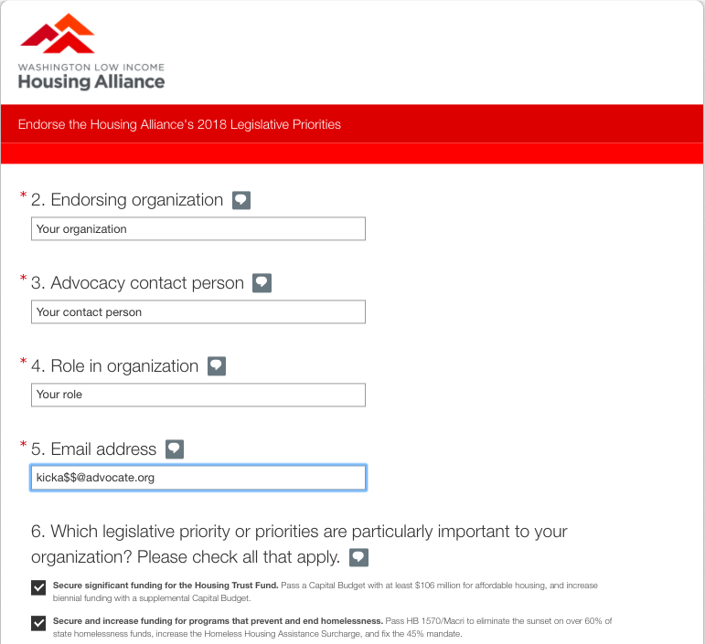
Notes:
DG 12:51 – 1:00
Everyone is in different places with their advocacy, and what advocacy looks like depends
needs of the district
work that’s being done,
resources at your disposal
current relationships with lawmakers
We’ve created an advocacy plan alongside our legislative endorsement process this year to help us understand how to best facilitate your advocacy.
This helps the Housing Alliance not only understand which advocates are the key stakeholders on some of our vital policies, but how we can best tailor our advocacy support.
Although we can’t promise to work with each organization individually, we will be referring to this information as we do important work to raise the profile of legislation via seeking testifiers, or finding organizations that may be willing to move lawmakers we are depending on. We’ll also keep this in mind as we promote HHAD and look for board advocates.

Slide 21
Notes:
DG 12:51 – 1:00
As advocates, you know what you need– and having a more tailored approach is important to us because we want to acknowledge and work to best facilitate the advocacy that is important and possible for you.
Whether you are starting to get in the habit of consistently completing and sharing action alerts, or you are a regular HHAD attendee, or you are on the first-name basis with your lawmaker, it is all valuable in contributing to the collective power of our movement.
The advocacy plan is meant to facilitate that for the Housing Alliance’s reference, as well as your own to see your power.
You’ll notice on this screenshot, we’ve provided some simple questions to inventory that power so to speak:
-do you receive action alerts?
-do you think you have reach to potential advocates?
-do you currently have relationships with lawmakers?

Slide 22
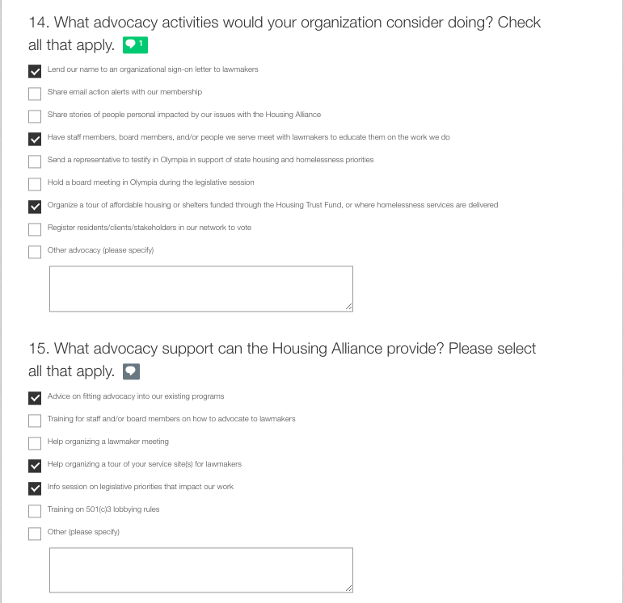
Notes:
DG 12:51 – 1:00
Finally, with this last screenshot I want to emphasize that what is especially critical in advocacy this year is that we continue to build relationships with our lawmakers.
Given that some of the lawmakers we advocate to this year may be familiar with our legislative priorities, it is vital that we continue to advance their understanding with advocacy activities that drive home the need (especially in their district), the benefits of legislation– particularly how your organization or community would benefit from this policy through providing services, authentic efforts to create a platform for people who have lived experience with homelessness, or creating co-benefits for other issues like closing the equity gap in education or creating better health outcomes.
We’ve broken up some of these recommendations into very distinct activities that the Housing Alliance may be able work with you to meet, but also for your organization to put some thought into for your own work.

Slide 23
Learn at Lunch Advancing 2018 Affordable Housing & Homelessness policies
Preparation for the 2018 Legislative Session:
What’s the lawmaker’s position on homelessness and affordable housing issues?
Does the lawmaker serve on any key policy committees? Do they hold a leadership position within their caucus?
What’s the lawmaker’s voting record on the legislation you care about?
What policy issues does the lawmaker have a history of supporting and opposing?
Notes:
DG 12:51 – 1:00

Slide 24
Learn at Lunch Advancing 2018 Affordable Housing & Homelessness policies
Housing & Homelessness Advocacy Day
February 1, 2018
Notes:
DG 12:51 – 1:00

Slide 25
Learn at Lunch Advancing 2018 Affordable Housing & Homelessness policies
Thank you for attending!
Michele Thomas, Director of Policy & Advocacy
Michele@wliha.org
Dimitri Groce, Member Organizer
DimitriG@wliha.org
Notes:
DG 12:51 – 1:00

