Slide 1
2017 special session advocacy
Michele Thomas
Policy Director
michele@wliha.org
206-442-9455 x205
Dimitri Groce
Member Organizer
dimitrig@wliha.org
206-442-9445 x208
Notes:
Good afternoon, and thank you for joining our Learn at Lunch webinar on 2017 Special Session Advocacy. My name is Dimitri and I am the Member Organizer at the Housing Alliance, and I am joined by my colleague, Michele Thomas, Policy Director.
If you are tuned in, it probably means that you have been watching the legislative session pretty closely, and that you know that our job as advocates isn’t over yet. It has been a long four-five months, but thank you for sticking it out.

Slide 2
Overview
Housing and homelessness advocacy this session
What is Special Session and how is it unique?
Review of legislative priorities and budget proposals
How Special Session advocacy is unique
What is our role as advocates during the Special Session?
Key lawmakers and tracking what’s going on
Tips and resources for in-district lawmaker meetings and site visits during Special Session

Slide 3
Record advocacy this session!
Number of advocates | 2038
Advocates who testified | 89
Advocacy Day attendees | 637
Actions taken | 3008
Emails/phone calls made | 8382
Lawmakers who heard from advocates | 147+1

Slide 4
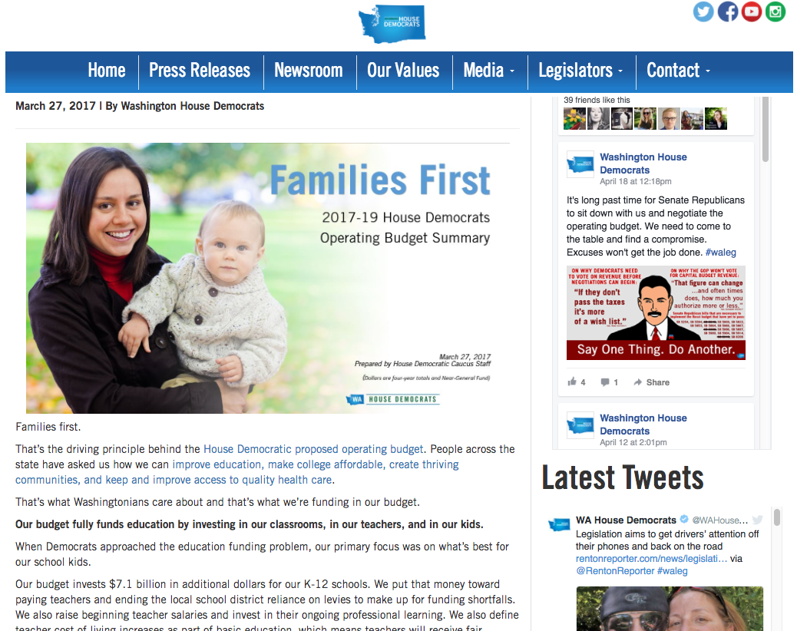
Advocacy and collaboration has shifted the debate!

Slide 5
What is Special Session and why does it happen?
Biennium– 2-year legislative cycle
1st year (odd years)– 105 days, pass a budget for 2017-2019
2nd year (even years)– 60 days, adjust w/supplemental budgets
*Special Session– 30 day extensions; if no budget passed by 6/30, government shut-down
1st Special Session: 4/24-5/23
4/21, Senate majority “playing chicken” over tax package– SB 5111, before budget negotiations
Stunt to undercut House tax revenue package, HB 2186
Differing proposals on how to fund K-12 education ➔
Higher taxes to fund schools and social safety net vs. shifting from local levies to the state

Slide 6
Review of 2017 legislative priorities
Invest $200 million into the Housing Trust Fund
Prevent the cliff in state homelessness funding
Outlaw discrimination based on a renter’s source of income
Protect and fully fund homelessness safety net programs
The Housing and Essential Needs Program,
The Aged, Blind and Disabled Program,
Medical Care Services,
SSI Facilitation Services.
Ensure full Operating Budget authority for the 1115 Medicaid Waiver for Permanent Supportive Housing
Proposed $99m-106m, pending Capital Budget negotiations
SHB 1570/Macri, “necessary to implement the budget,” waiting to be scheduled
HB 1633/Riccelli, no reading on House floor; SB 5407/Frockt died in committee. On-going negotiations
Operating Budget line items, pending budget negotiations (and various policy bills) ➔
Deep cuts or eliminated in Senate, fully funded in House via revenue package (HB 2186)

Slide 7
What is our role as advocates during Special Session?
Special Session is our opportunity to focus on budget decisions for the biennium. Homelessness funding and the Housing Trust Fund are both at stake!
Special Session advocacy consists of three major roles:
Tracking budget negotiations and decisions
Lawmaker education of current proposals/opportunities with in-district meetings and site visits
Follow-up and laying groundwork for the interim and 2018

Slide 8
http://leg.wa.gov/legislature/Pages/Calendar.aspx

Slide 9
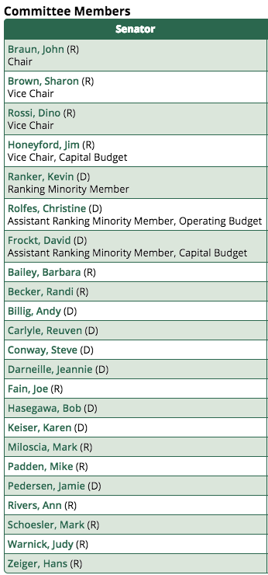
Every lawmaker is key during Special Session
House Capital Budget Cmt.
Senate Ways and Means Cmt.
http://leg.wa.gov/legislature/Pages/CommitteeListing.aspx

Slide 10
How do we track what is going on during Special Session?
Action Alerts—less consistent, more urgent!
Direct calls and emails from Housing Alliance staff
Make time with your networks to check-in about the legislature
Board and staff meetings
Community meetings and local advocacy groups (EAP and RAP network)
Classmates, friends, family
Sign-up for your legislators’ newsletters
*Find out who your legislators are at app.leg.wa.gov/DistrictFinder/

Slide 12
Shift in tactics: Home Field Advantage

Slide 13
Special Sessions are critical opportunities for in-district meetings and site visits.
Elevate the problem and solutions. 2550 bills this year—opportunity to highlight the need for affordable housing and homelessness services.
Help lawmakers deepen their understanding of complex issues—show, rather than tell, the urgency and their ability to make a difference, impact of funding.
Strengthen relationships and become a legitimate source of info for your lawmaker.
*Get the ball rolling for interim advocacy and 2018 legislative session.

Slide 14
Organizing your in-district meeting or site visit
Background on lawmaker
Schedule meeting
Plan and collaborate
Show time! Make an ask!
Track and follow-up

Slide 15
10 critical lawmaker meeting tips:
Do your homework on the lawmaker, tailor the meeting accordingly.
Take advantage of building relationships with staffers.
Prioritize issues to cover based on your ask.
Don’t assume the lawmaker knows the issue.
Stay focused—only share what they need to know.

Slide 16
10 critical lawmaker meeting tips (cont.):
Include unique perspectives—folks directly impacted, board members, “non-traditional” partners.
Expect and take advantage of dialogue—become a source of info.
Don’t answer something you don’t know or aren’t sure.
Make a hard ask and highlight the impact it can make!
Follow-up with a thank you message.

Slide 17
Values-based messaging
“Subsidizing rent for people who don’t work is counterproductive because it is a disincentive.”
Ask for clarity.
Identify the common value and debunk the myth.
Bring it back to a problem-solution frame.
“Could you tell me more about that—what kind of people? Incentive for what?”
“Work is important for self-sufficiency and strong communities. But not everyone can work—youth, some people who are older or have disabilities, for instance. These people live in our community.”
“People who can’t work must rely on other supports to stay inside. This helps them and our community…”

Slide 18
Housing Alliance resources: http://wliha.org/resources/overview

Slide 19
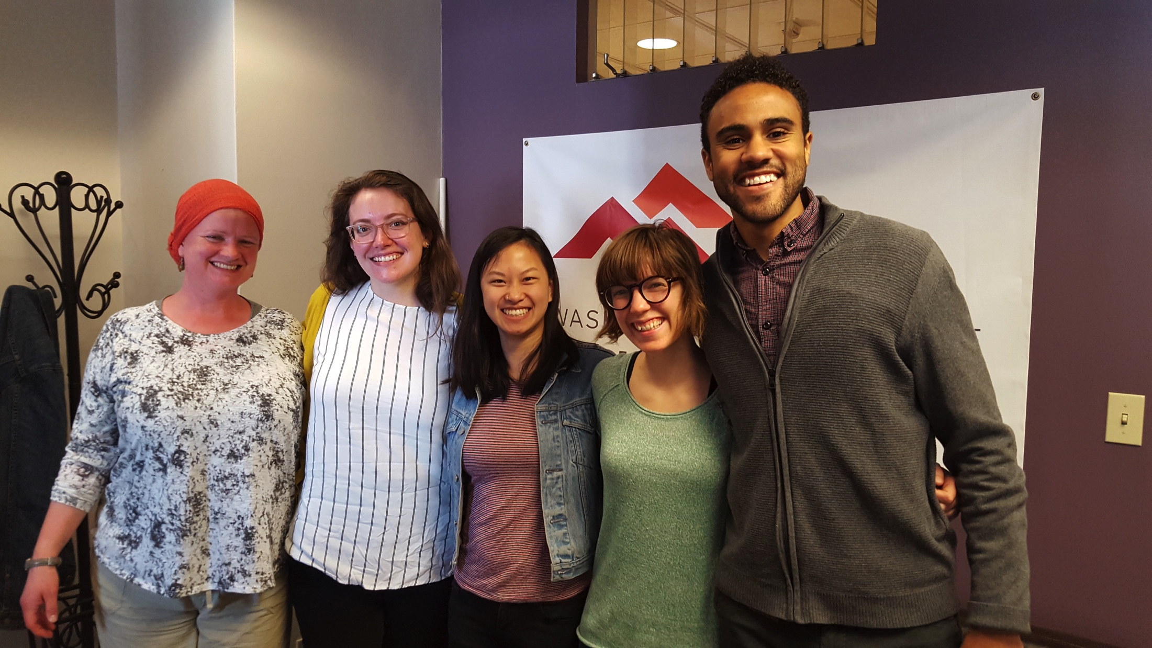
Housing Alliance resources: http://wliha.org/resources/overview
Need support in planning an in-district meeting? Contact:
dimitrig@wliha.org

Slide 20
Thank you!
Next Learn at Lunch Webinars
http://wliha.org/resources/webinars-and-tools
Michele Thomas
Policy Director
michele@wliha.org
206-442-9455 x208
Dimitri Groce
Member Organizer
dimitrig@wliha.org
206-442-9445 x208

