Slide 1
Medical Assisted Treatment
Thomas “Tom” Fuchs, MEd, Adult Behavioral Health Manager
Asif Khan, MD, CEO of Northwest Integrated Health (NIH)

Slide 2
Learning Objectives
Gain a deeper understanding of Medication Assisted Treatment
Know the three types of MAT medications, Mechanisms of Action
Challenging the myths about Medication Assisted Treatment (MAT) for Opioid Use Disorder (OUD)
Understand the difference between Dependency and a Substance Use Disorder

Slide 3
Three Medications
Methadone
Buprenorphine, with Naloxone or without
  Suboxone, Zubsolv
  Subutex
Naltrexone, oral and injectable
  Oral
  Injectable, Vivitrol

Slide 4
Mechanisms of Action
Methadone- Full Agonist
Suboxone-Partial Agonist
Vivitrol-Antagonist

Slide 5
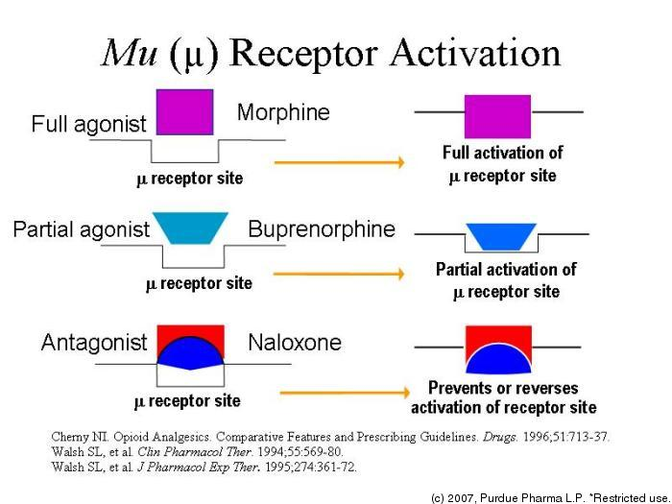
MU Receptor Activation

Slide 6
Role of MAT and Therapy
Stabilization
Recognition of difference between dependent and addiction
Each affect different parts of the brain
Stress/Conflict and its affect on relapse
Trauma

Slide 7
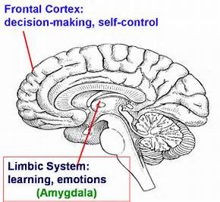
Brain function

Slide 8
Addiction or Dependent?
Dependent- the brain has adapted to the effects of a substance, requiring regular and consistent and increasing amounts of the substance to create the same effect.
Addiction- dependency with maladaptive behavior to access the substance, taking more than prescribed, by alternative methods, and significant preoccupations to find, acquire and use the substance through any means necessary.

Slide 9
MAT Options
Methadone: Dependency, Higher potential for some addictive behaviors, some diversion, Highly lethal
Suboxone: Dependency, more potential for diversion, potential for less addictive behavior, not lethal
Vivitrol: No Dependency, no potential for addictive behaviors from medication, no diversion, not lethal

Slide 10
CHALLENGING THE MYTHS ABOUT MEDICATION ASSISTED TREATMENT (MAT) FOR OPIOID USE DISORDER (OUD)
Used with Permission: FOR MORE INFORMATION, PLEASE CONTACT NICK SZUBIAK, DIRECTOR, CLINICAL EXCELLENCE IN ADDICTIONS, AT NICKS@THENATIONALCOUNCIL.ORG

Slide 11
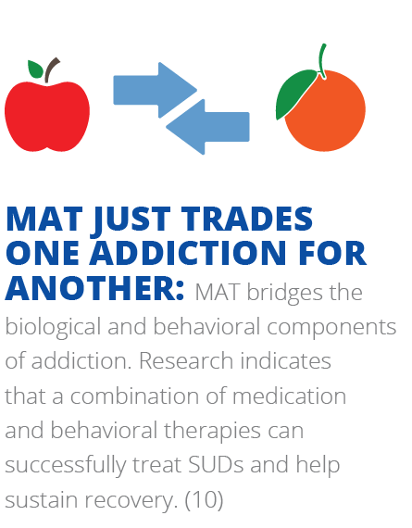

Slide 12
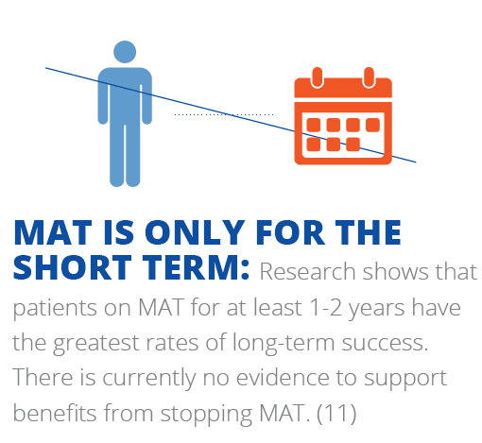

Slide 13
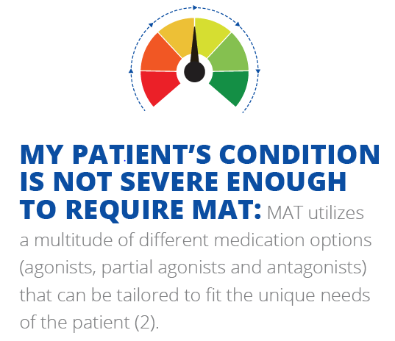

Slide 14
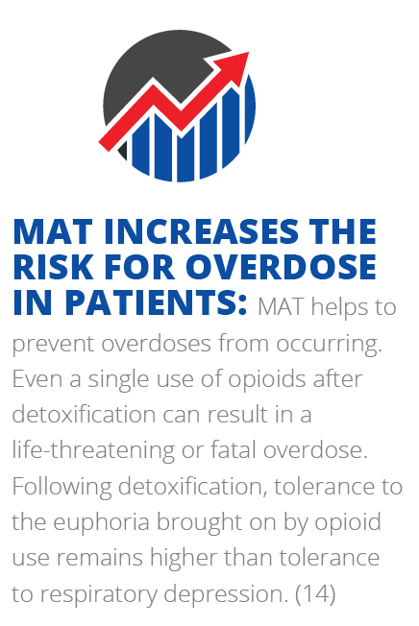

Slide 15
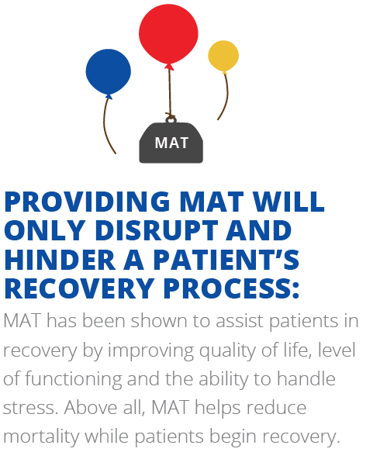

Slide 16
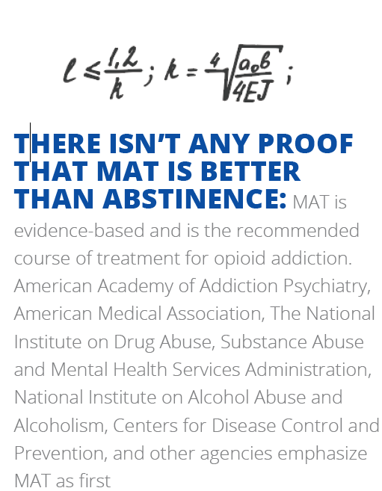

Slide 17
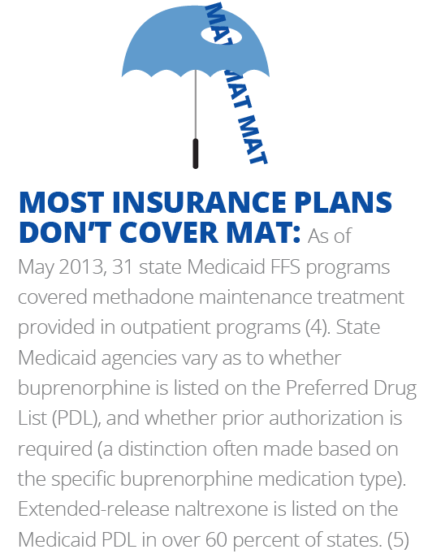

Slide 18
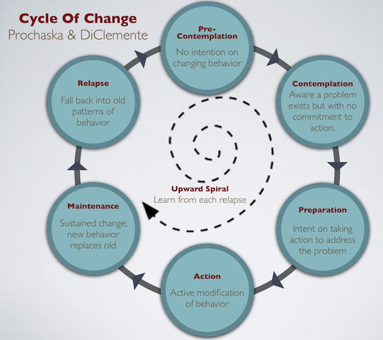
Stages of Change

Slide 19
Why not Vivitrol for all?
Brain changes
Length of SUD
Onset of use
Trauma
Stage of change
Detox needs
Co-occurring potential

Slide 20
Why not Methadone or
Suboxone for all?
Short duration of use
May not fit lifestyle
Stages of change
Inability to separate from using lifestyle
Societal/family pressure
Brain changes

Slide 21
Who/How to decide which MAT?
Patient
Chemical Dependency Professional
Doctors
ASAM Assessment
Judges, Drug Court treatment team
Personal bias plays a role in decision
Recognition of scope of practice
No definitive process

Slide 22
Principles of
Effective Treatment
Addiction is a complex but treatable disease that affects brain function and behavior.
No single treatment is right for everyone.
People need to have quick access to treatment.
Effective treatment addresses all of the patient’s needs, not just his or her drug use.
Staying in treatment long enough is critical.
Counseling and other behavioral therapies are the most commonly used forms of treatment.
Medications are often an important part of treatment, especially when combined with behavioral therapies.
Treatment plans must be reviewed often and modified to fit the patient’s changing needs.
Treatment should address other possible mental disorders.
Medically assisted detoxification is only the first stage of treatment.
Treatment doesn't need to be voluntary to be effective.
Drug use during treatment must be monitored continuously.
Treatment programs should test patients for HIV/AIDS, hepatitis B and C, tuberculosis, and other infectious diseases as well as teach them about steps they can take to reduce their risk of these illnesses. (NIDA)

