Slide 1
Homelessness on the Rise: Understanding and Communicating the Drivers of Homelessness
Conference on Ending Homelessness, May 10, 2017

Slide 2
Overview
Introductions
What are the drivers of homelessness?
Using data and storytelling together
Communications training
Practice!
Questions

Slide 3
Who are these people anyway?
Reiny Cohen,
Director of Communications, Washington Low Income Housing Alliance
Michael Anderson,
Director of the Housing Trust Fund Project,
Center For Community Change
Abi Velasco,
Development and Event Coordinator,
Washington Low Income Housing Alliance

Slide 4
Homelessness in Washington State has decreased since 2006, but 2013 marked a new rise
Data provided by the Department of Commerce

Slide 5
Data provided by the Department of Commerce

Slide 6
A study by the Journal of Urban Affairs found that every $100 increase in rent is associated with a 6% increase in homelessness in metropolitan areas and a 32% increase in non-metro areas, such as suburban communities

Slide 7
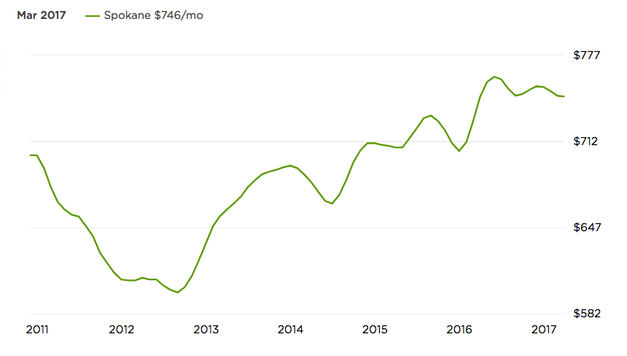
An Out of Reach Rental Market - Spokane
Source: https://www.zillow.com/spokane-wa/home-values/

Slide 8
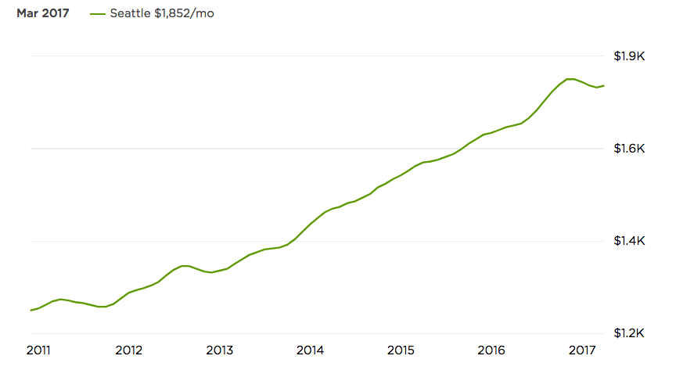
An Out of Reach Rental Market - Seattle
Source: https://www.zillow.com/seattle-wa/home-values/

Slide 9
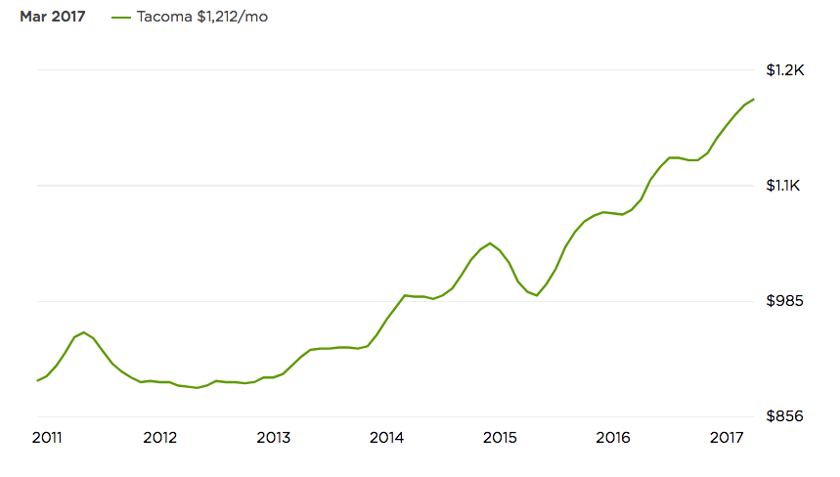
An Out of Reach Rental Market - Tacoma
Source: https://www.zillow.com/tacoma-wa/home-values/

Slide 10
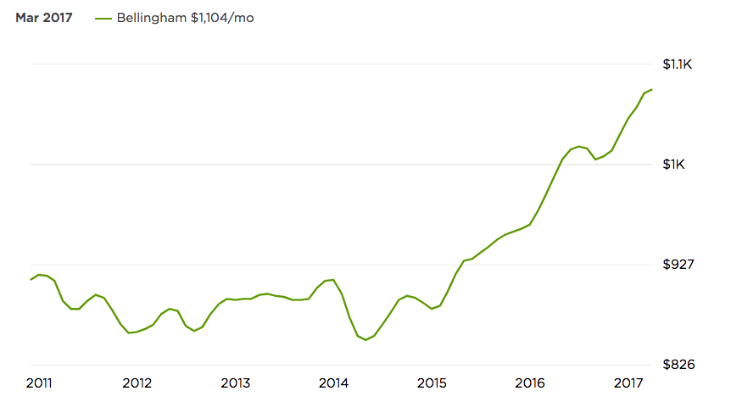
An Out of Reach Rental Market – Bellingham
Source: https://www.zillow.com/bellingham-wa/home-values/

Slide 11
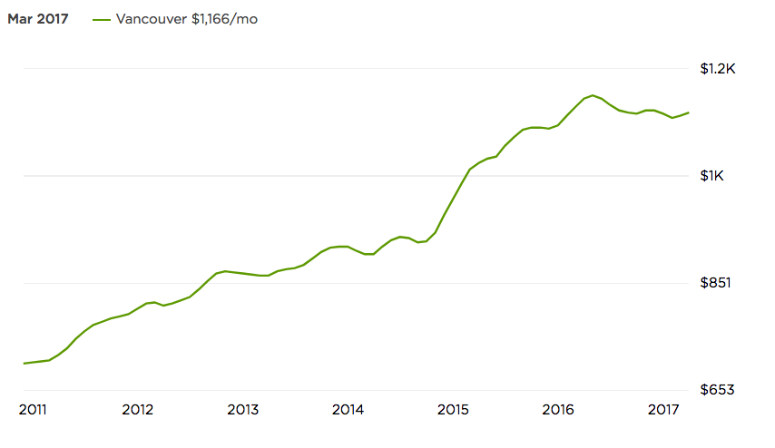
An Out of Reach Rental Market – Vancouver
Source: https://www.zillow.com/vancouver-wa/home-values/

Slide 12
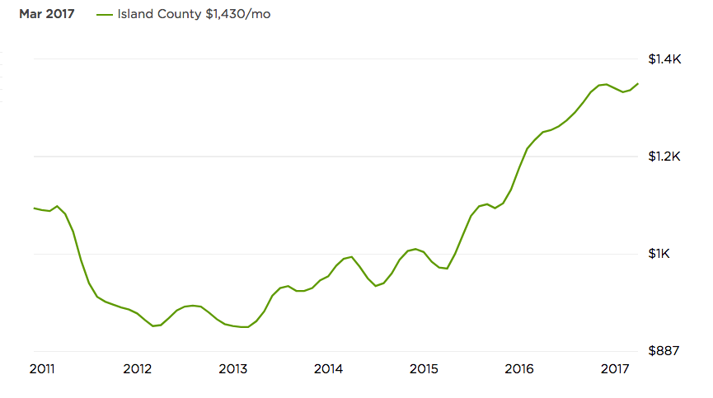
An Out of Reach Rental Market – Vancouver
Source: https://www.zillow.com/vancouver-wa/home-values/

Slide 13
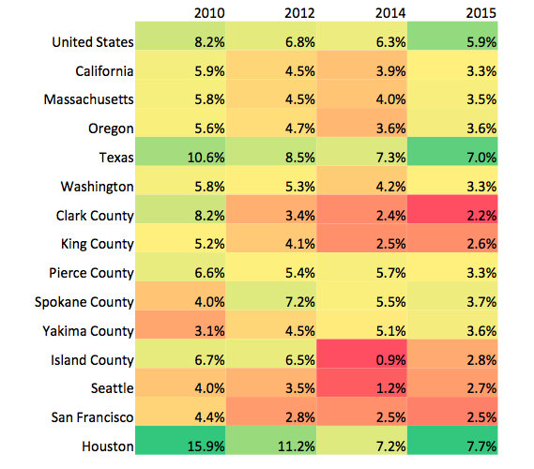
Vacancy Rates Have Hit Record Lows
Data Provided by the Department of Commerce

Slide 14
Rising Rents Affects Low Income Households the Hardest
There are only 30 affordable and available housing units for every 100 households who are extremely low income (ELI)
In Washington state, ELI is $16,050 for 1 person and $23,000 for a family of 4.
73% of ELI renters in Washington are extremely cost burdened
Sources: National Low Income Housing Alliance and Department of Commerce

Slide 15
Rents far outpace middle and low incomes

Slide 16
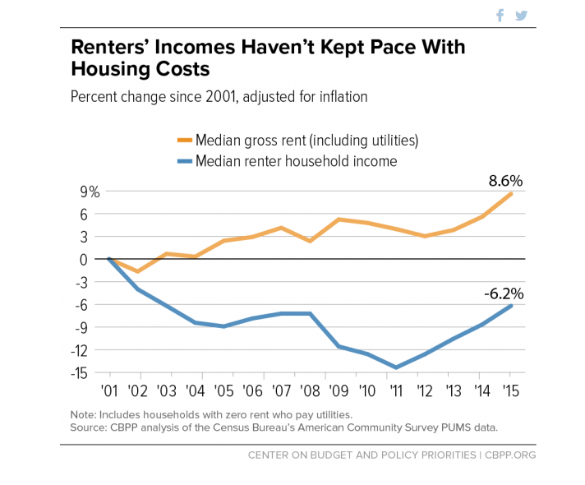

Slide 17
Income Needed to Afford a 1 Bedroom Apartment at FMR
Washington State | $18.39
King County | $23.56
Spokane County | $11.33
Pierce County | $16.79
Snohomish County | $23.56
Island County | $15.42
Whatcom County | $13.44
Clark County | $19.63
Federal Minimum Wage | $7.25
Washington State Minimum Wage | $11
Monthly SSI Payment | $779

Slide 18
Barriers to Rental Market
Discrimination against households who pay for rent using a subsidy, such as a Housing Choice Vouchers (section 8) is completely legal and happens often with no protections
In Kitsap County, section 8 voucher holders were only able to find housing 50% of the time
In King County, households only had a 48% success rate

Slide 19
Disparate Impact
60% of Housing Choice Voucher recipients are women
53% are women of color
Nearly all households using federal rental assistance include, children, seniors, or disabled folks
Sources: DSHS and Center on Budget and Policy Priorities

Slide 20
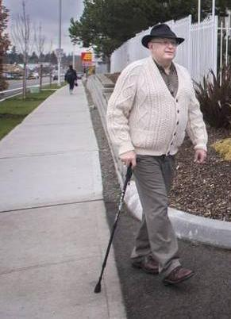
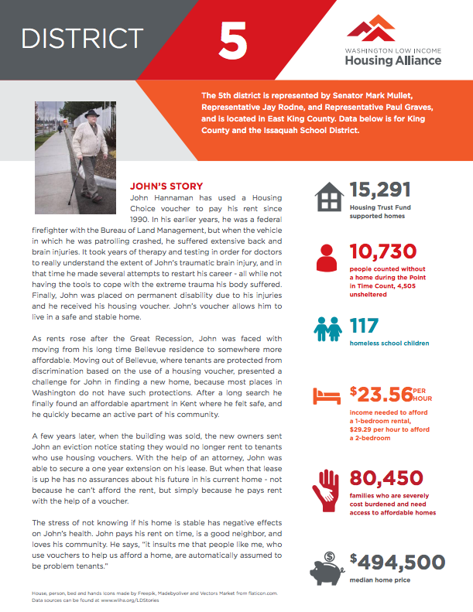
Use stories to illustrate your data
John Hannaman
Former firefighter
Suffers from a TBI
Uses a Housing Choice Voucher to pay rent
Struggles most with affordability
Read John’s full story at wliha.org/ldstories

Slide 21
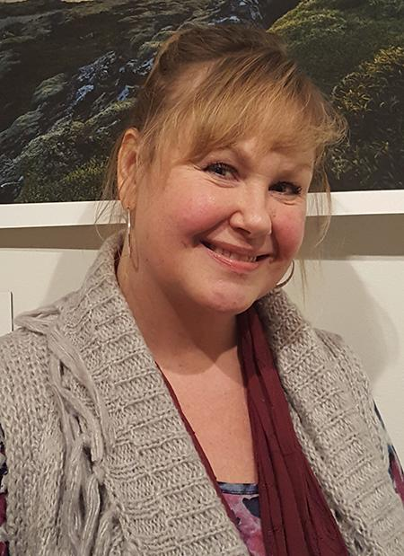
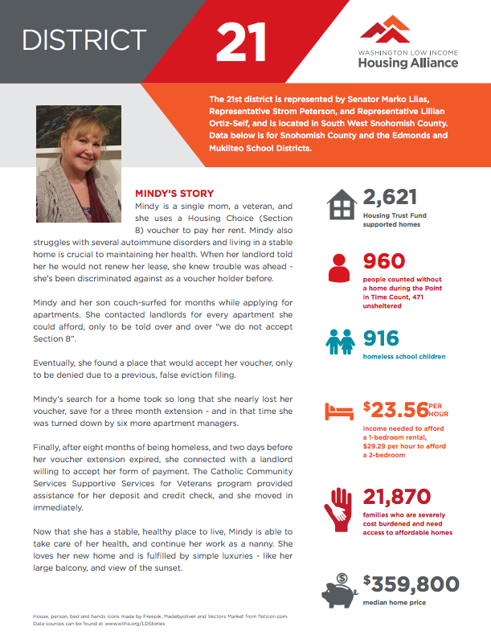
Use stories illustrate your data
Mindy Woods
Single mom
Veteran
Battles autoimmune illnesses
Uses a Housing Choice Voucher to pay her rent
Source of income discrimination is her biggest barrier
Read Mindy’s full story at wliha.org/ldstories

Slide 22
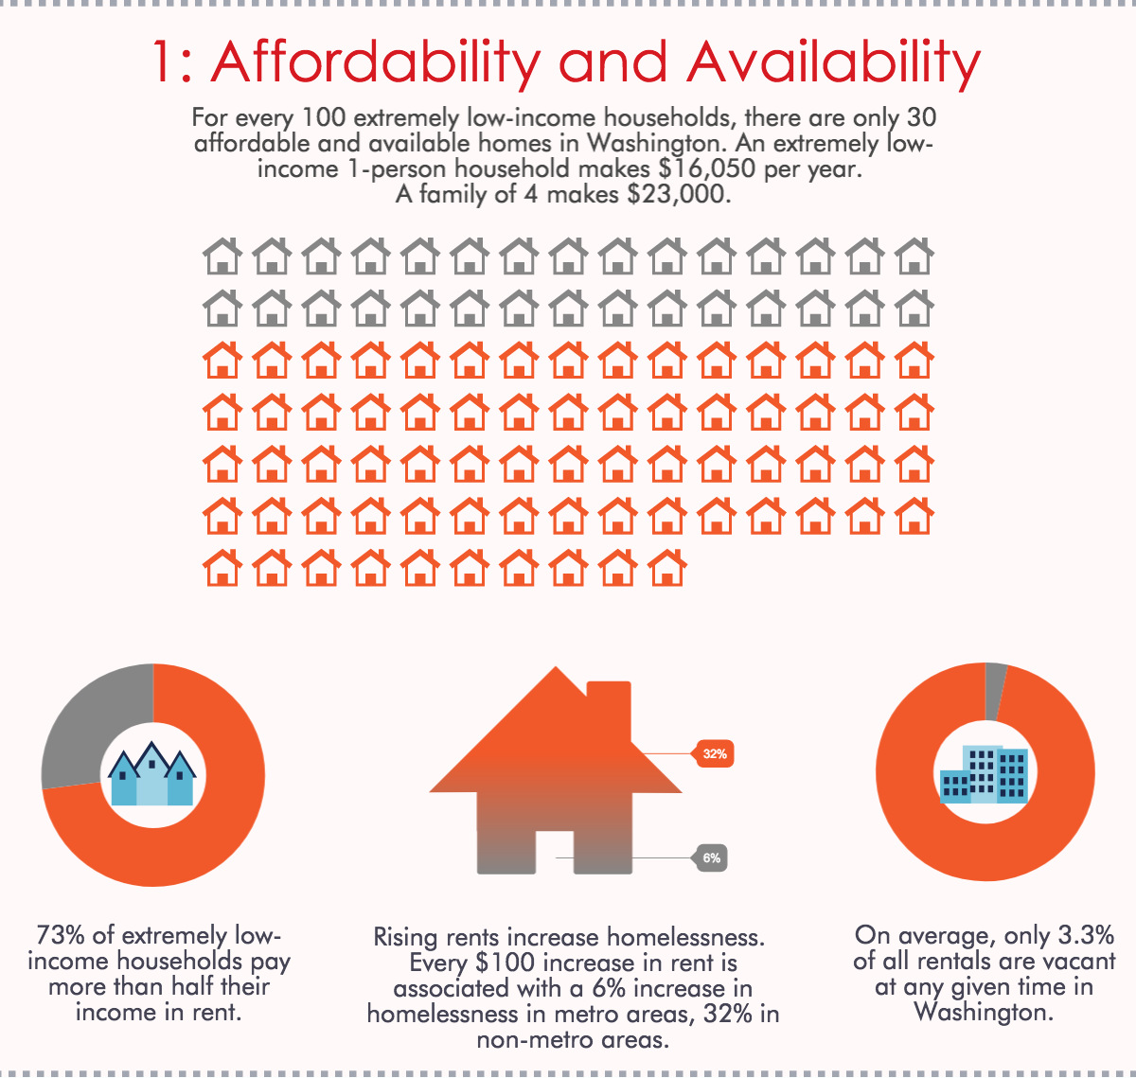

Slide 23
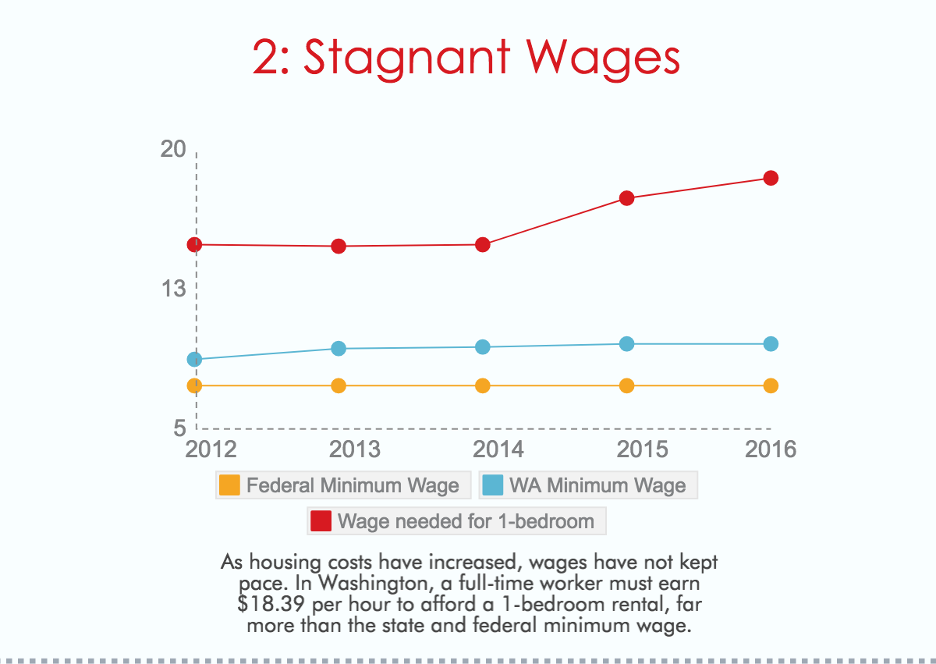

Slide 25
Go to bit.ly/conferenceaction

Slide 26
Framing Home: Lessons Learned from a Decade of Progress
Washington Conference on Ending Homelessness Tacoma, Washington May 10, 2017
Notes:
Welcome, and purpose
EXERCISE: Telling your story. What brings you here today? What motivates you to do what you do? How do you know that providing safe, decent homes for people makes a difference? Take a few minutes to brainstorm, the about 10 minutes to write your story down. It does not need to be perfect, and it shouldn’t be too long. 1-2 paragraphs is fine. When we are done writing, pair up with your neighbor and share your story. Then I will ask some brave volunteers to share their story with the group

Slide 27
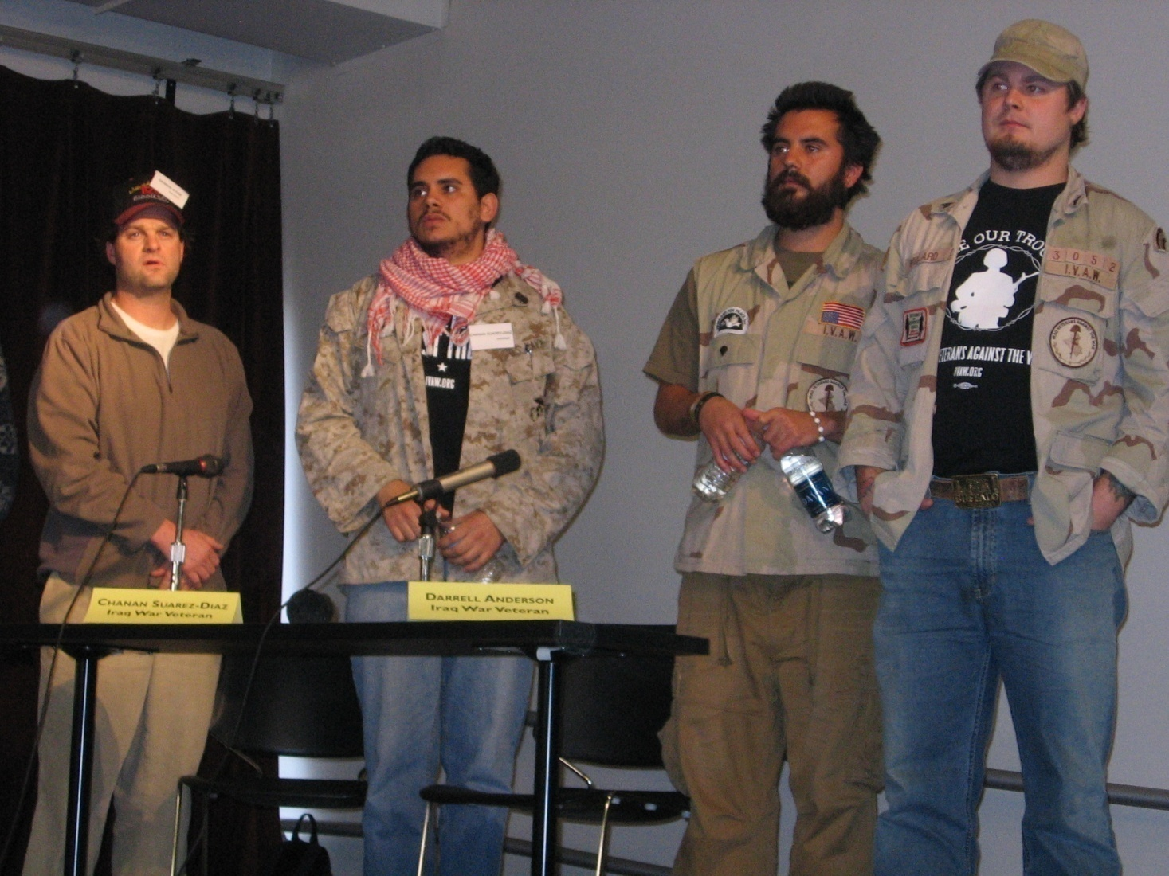
Develop tools to tell our story

Slide 28
“. . . A talent for speaking differently, rather than for arguing well, is the chief instrument of cultural change . . .”
- Richard Rorty
Notes:
28
DUPLICATE. (I PREFER THE PREVIOUS SLIDE)
Teach a bit about framing here.
The first thing we do to help shift perspective is look at good communications techniques. Now we said before the “stories” are important.
But, it’s important to realize that “new sotries are possible.”
City swamp; hole in the roof

Slide 29
The way the world is imagined determines at any time what [people] may do.
-Walter Lippman

Slide 30
We need to change the terrain on which discussions about our issues occur
Notes:
NOTE: Change this slide to GREEN
We believe that change must start by changing they very terrain upon which discussions about govnerment occur.
We cannot start our conversations on infertile soil.
Flip to view two.
We must instead create a new terrain….one in which we can have conversatons with Americans about the government to which we aspire.
Notes about slide: Is it okay to go back and forth between two pictures?
Also, should we instead show the crossroads again?

Slide 31
The Need to Reframe
Institutional
Accountability
Personal
Responsibility
Notes:
The Need to Reframe and Restore balance
Things are out of balance— we need to address imbalance to create an atmosphere where issues like making sure all people have a place to call home is a shared priority
People are not binary—we all have a mix of beliefs and values that we constantly weigh against one another.
Things have been out of balance for 40 years
Using communication strategically is how we shift the balance

Slide 32
patterns of association
cultural models
media
frames
knowledge
We are not blank slates
stories
experience
myths
stereotypes
Notes:
Should we add the words “frames” to this list? I’m trying to think about how we

Slide 33
Values-based Messaging. . .
reframes the conversation
changes the possibilities
Notes:
This is the heart of Why It Matters statements

Slide 34
What is a “frame”?
“…organizing principles that are socially shared and persistent over time, that work symbolically to meaningfully structure the social world…. Frames structure. That is, they impose a pattern on the social world.”
Stephen Reese in Framing Public Life, 2001

Slide 35
Framing
Framing is about how people derive meaning from the world around them. Linguists talk about frames as structures residing in our brain, like ready-made storylines, that let us “fill in the blanks” so cues in the world around us make sense.
Vol 16, BSMG
Notes:
Frames do not appear overnight, they are cultivated
Frames can lead people to draw totally different conclusions from same set of facts: War protestors

Slide 36
Frames Influence Decisions
“Every frame defines the issue, explains who is responsible, and suggests potential solutions. All of this is conveyed by images, stereotypes, or anecdotes.”
- Charlotte Ryan, Prime Time Activism, 1991

Slide 37
Just a few cues. . .
LIQMFI FSS
Notes:
EX (Large group): Orange box – 3 slides

Slide 38
. . . might surprise you
LIQMFI FSS
Notes:
This is the “match” our brains make, quickly and convincingly.

Slide 39
our brains are rapidly seeking to connect new information to the existing stories in our heads
DEMOS-Bresette
Notes:
We are judged on our ability to access relevance
When brain finds story to connect with, it relaxes
Commute example

Slide 40
It’s not what you say. It’s what they hear.
And what people hear is as much about them as it is about your message
Frank Luntz
Notes:
The goal of communication is to be understood and persuasive
What we say, what people hear can be very different
Typical traps for impassioned progressives
Data delirium; numbers make folks numb
Jargon galore
Need, need, need
People want solutions that align with their values; get lost in details
Plumber story

Slide 41
Lakoff’s three levels of analysis
Big ideas and universal values like fairness, equality, and justice
Level 1:
Level 2:
Level 3:
Adapted from The Frameworks Institute
http://www.frameworksinstitute.org
Issue types such as civil rights, the environment, and public health
Specific policy areas such as affordable housing, beer taxes, and toxic waste sites
Notes:
Define 3 levels
Basic premise: Level 1 frames trump Level 2 and Level 3 frames
Progressives tend to gravitate to level 2 and 3
Affirmative action in California state universities
Does not mean that level 2 and 3 frames are unimportant or inaccurate
Not as powerful

Slide 42
Research leads to understanding
Notes:
Public opinion research is key to understanding how to move audience
Expertise and professional analysis has provided some clear direction for communication strategies
When we understand our audience, we can change the discussion and build public support for housing by connecting our issue with widely held community values,
This is why public opinion research is so important
Why messenger matter
Understanding also means knowing how the public, media, elected officials and opinion leaders think and work is key to engaging them with message, gaining support

Slide 43
Decade Plus of Progress
We Need the People
Who Need Affordable Housing
Another rent increase.
Another new neighborhood.
Another year behind in school.
Notes:
We are beneficiaries of 10 years of progress and development of sophistication in affordable housing advocacy communications
Minnesota, Vermont, Illinois, North Carolina, Pennsylvania, Oregon, Washington, California, Arkansas, Michigan, as well as national research
developed new messages, new skills, new infrastructure
We need to take advantage of lessons learned

Slide 44
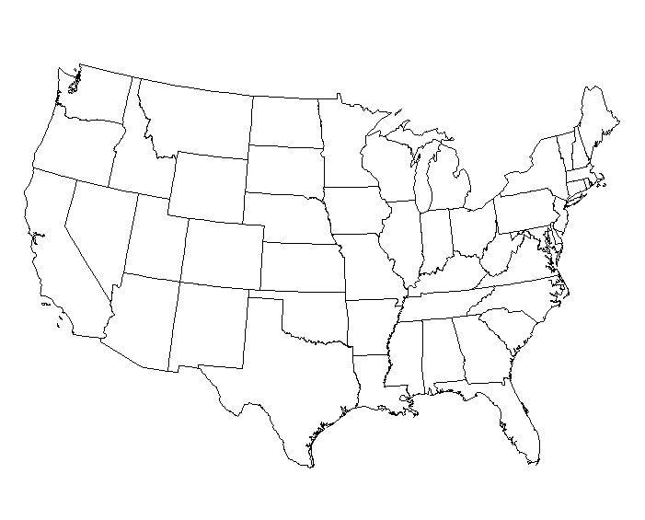
Public Opinion Research
Washington
Minnesota
Vermont
Oregon
Kalamazoo
MI
Rhode
Island
Pennsylvania
California
Illinois
North
Carolina
Arkansas
Alabama

Slide 45
What We Know
fairness
opportunity
home
Value frames that work for housing
security
stability
responsibility to care for the most vulnerable
reward for work

Slide 46
Washington Message Frames 2009
Everyone should have the opportunity to live in a safe, healthy affordable home
It should be possible for working people* to afford housing and still have enough money for the basics like groceries, gas and child care
Children deserve a chance to succeed in school and in life, which all begins with their families being able to aﬀord a decent place to live
It’s better for society, the environment and families if people can afford to live close to where they work.
* Can insert US military veterans, senior citizens, people with disabilities, and families

Slide 47
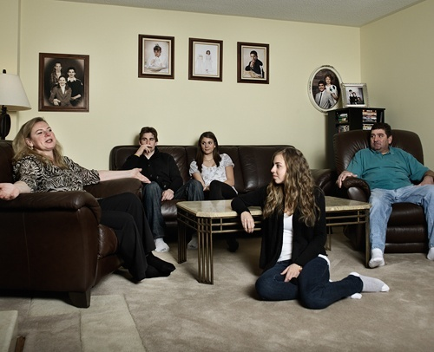
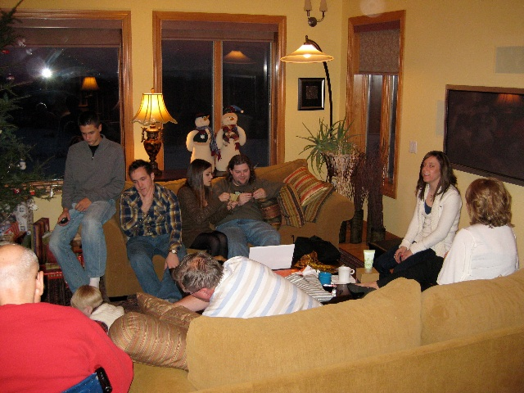
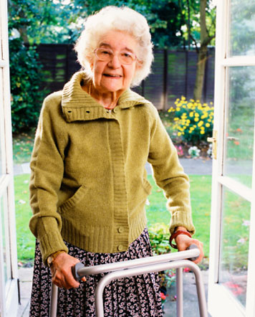
The Value of ‘Home’
Notes:
Specific lessons learned from affordable housing communication & public opinion research from Arkansas, Minnesota, Vermont, Illinois, North Carolina, Pennsylvania, Oregon, Washington, California, Rhode Island and national research.
People get the concept of home
There is a general but latent support for affordable housing among general public; 2010 Zogby Poll (86% said having affordable place to live a priority)
Talk about HOME, not housing
Other trends
Support for programs that help seniors, people with disabilities have strong support
Support drops when issue is of citing housing in direct proximity (i.e. NIMBY)

Slide 48
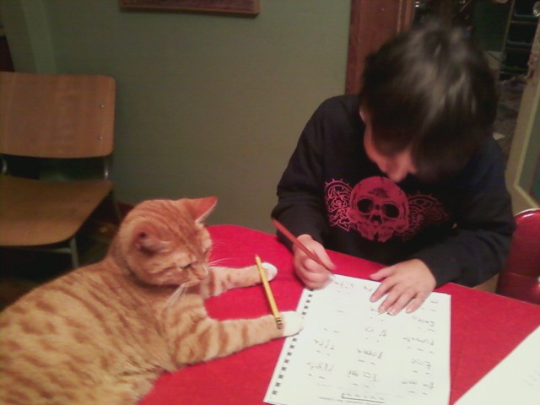
Expanding Frames into a Cohesive Narrative
Connect home to broader issues:
Education & childhood development
Notes:
Child doing homework on dining room table

Slide 49
Expanding Frames into a Cohesive Narrative
Connect home to broader issues:
Aging with dignity and security
Notes:
Seniors able to stay in the communities in which they have lived and to which they have contributed t

Slide 50
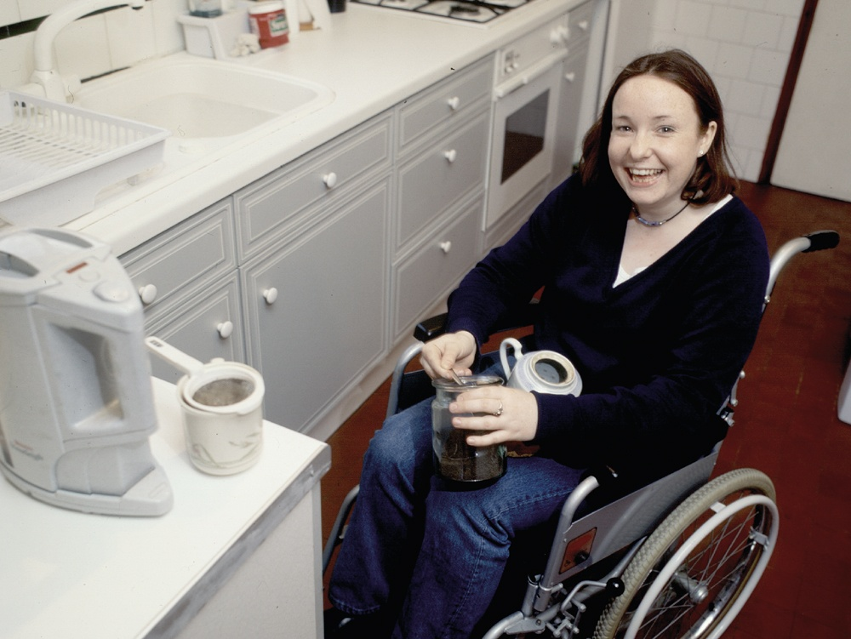
Expanding Frames into a Cohesive Narrative
Connect home to broader issues:
Equal access and opportunity for people with disabilities
Notes:
Stable, secure housing allows people with physical and mental disabilities the chance to thrive

Slide 51
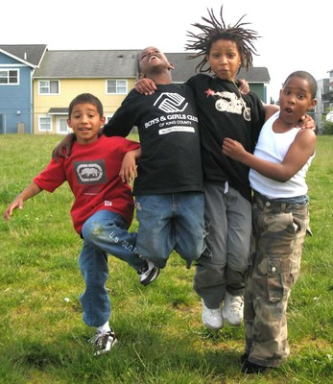
Expanding Frames into a Cohesive Narrative
Connect home to broader issues:
Public health & community well-being
Notes:
When people are not forced to move for economic issues, communities are stronger. Parents know each other, and feel safer about their kids playing outside

Slide 52
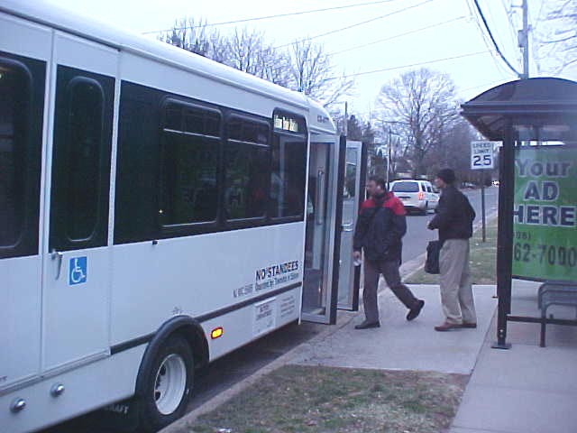
Expanding Frames into a Cohesive Narrative
Connect home to broader issues:
Where people live vs where people work
Transportation ridership & housing
Notes:
Both for the environment and because people hate being stuck in traffic, examining the imbalance between where people work and can afford to live can be a powerful argument

Slide 53
Make the campaign about PEOPLE

Slide 54
WLIHA Message Frames
Everyone should have the opportunity to live in a safe, healthy affordable home
It should be possible for working people* to afford housing and still have enough money for the basics like groceries, transportation and child care
Children deserve a chance to succeed in school and in life, which all begins with their families being able to aﬀord a decent place to live
It’s better for society, the environment and families if people can afford to live close to where they work.
* Can insert veterans, senior citizens, people with disabilities & families

Slide 55
Respondents indicated the messengers they would like to hear from most are:
families who need low income housing,
a formerly homeless person, and
a housing service provider
The action survey respondents were most likely to take after reading the messages was . . .
to VOTE!

Slide 56
Speaking with One Voice
Notes:
Staying on message is essential
Human do not always pay attention
New concepts take 5-7 times to stick
Message discipline and progressives: We must get beyond worry about stepping on toes

Slide 57
Repetition, Repetition, Repetition
establishes a steady drum beat
Notes:
Amazing generative effect > builds on its own momentum
Lingo among friends
PDC story

Slide 58
3 parts to making your case
Statement of concern:
Statement of the value/frame:
Statement of solution:
What is wrong?
Why it matters?
What is the policy?
Adapted from Berkeley Media Studies
http:// www.BMSG.org
Notes:
What’s wrong? The need is what we are good at. Too good at.
Why it matters? The most important element of message. Establishing why something matters is how people make hard choices, balance competing beliefs
What the solution? Affordable housing.
Depending, on audience could be a project or a policy
Be clear and brag.
Remember, people want solutions
How I used to act vs. Correct proportion

Slide 59
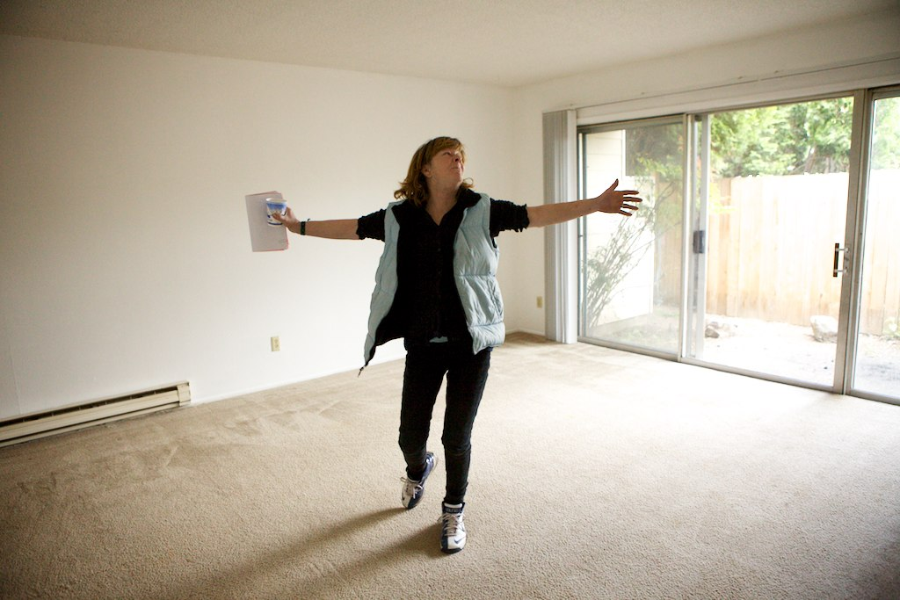
Home is the Solution

Slide 60
New Tool: The Message Box

Slide 61
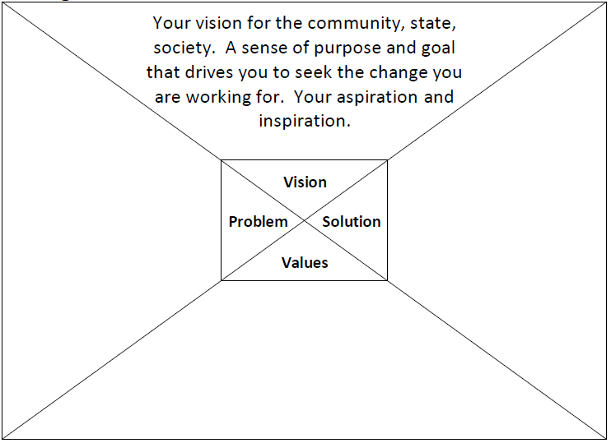
New Tool: The Message Box

Slide 62
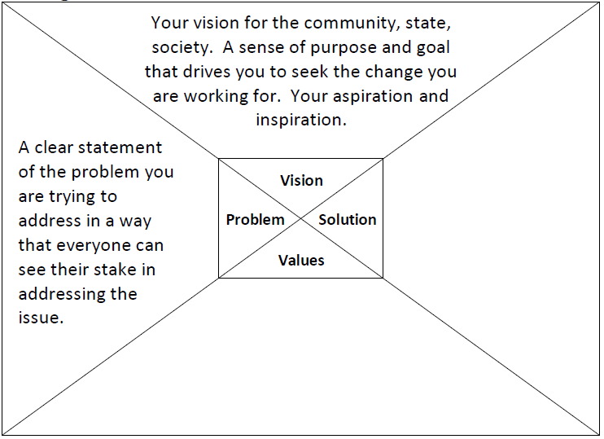
New Tool: The Message Box

Slide 63
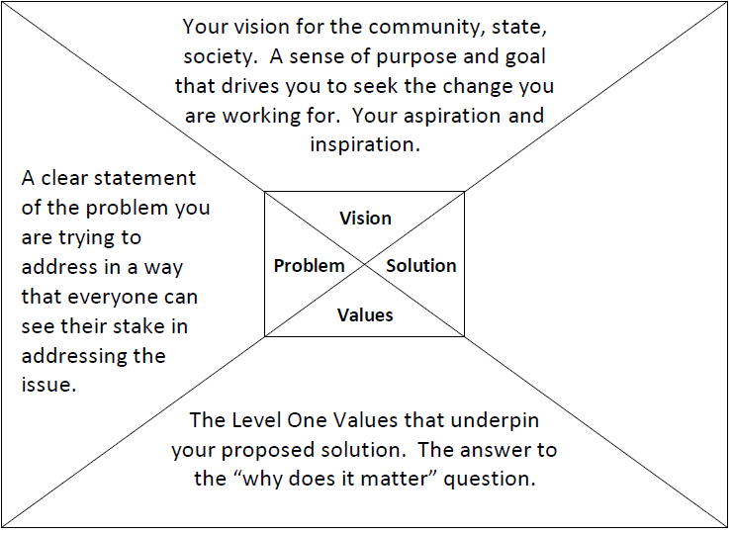
New Tool: The Message Box

Slide 64
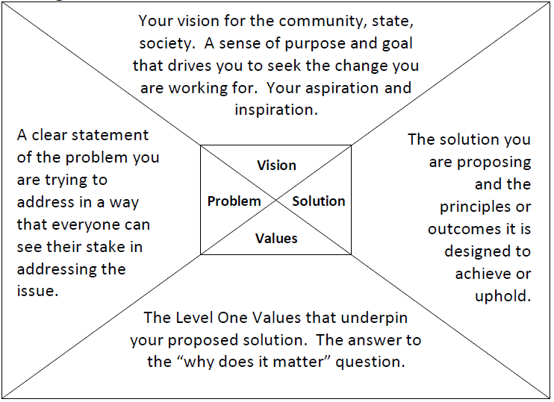
New Tool: The Message Box

Slide 65
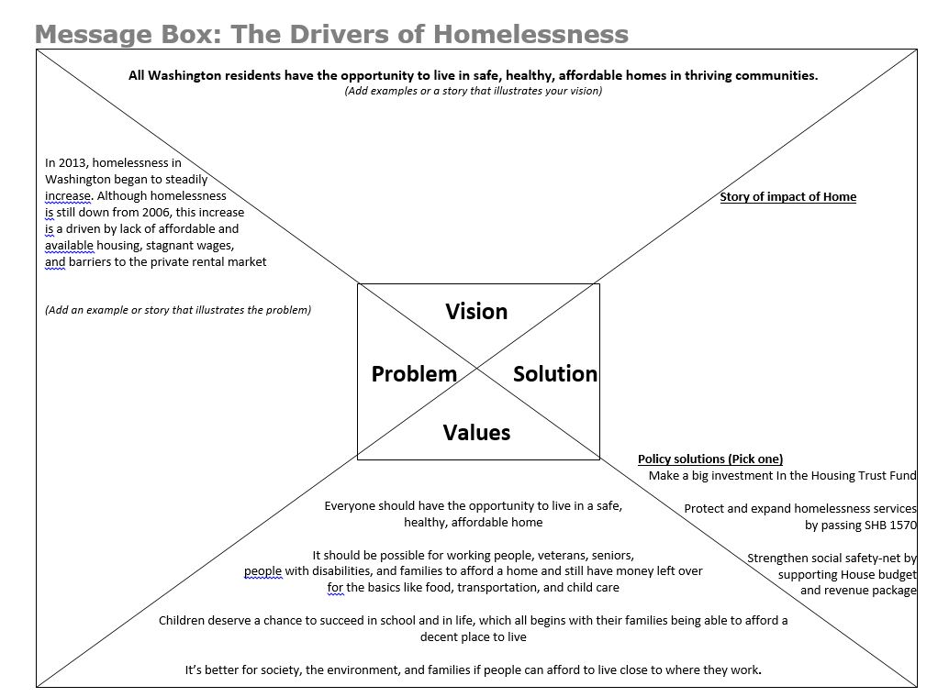

Slide 66
Exercise—Develop a pitch
Put together a basic one-minute pitch that has a vision of homes for all & all three parts of a message.
Statement of concern: What is wrong? Use an example from Problem quadrant
Statement of the value: Why it matters? Use example from Values quadrant
Statement of solution: What is the policy? Use example from Solutions quadrant

Slide 67
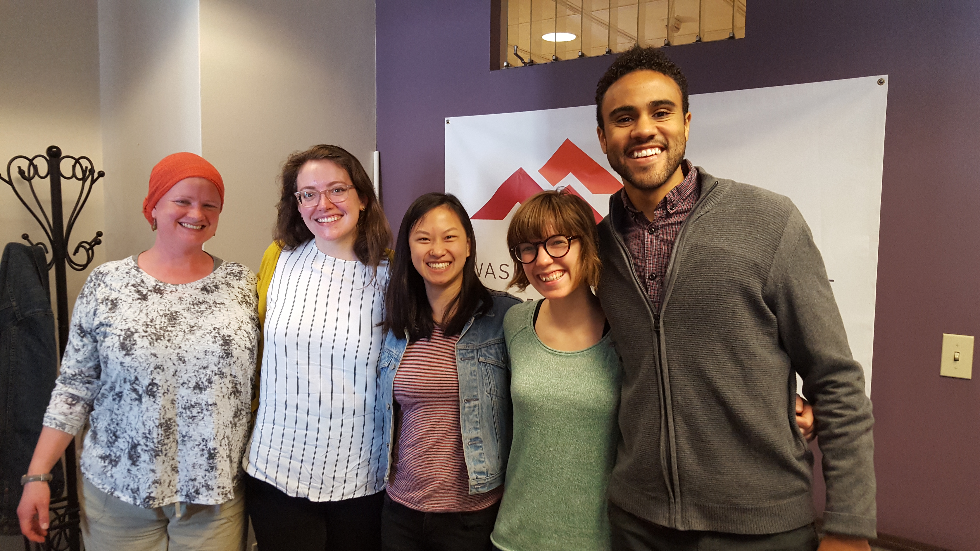
The Messenger Matters
“Non-traditional” partners and Board Members play important roles as advocates;
Community legitimacy
Organizational expertise
A different perspective
Unique relationships
Find out more at the Housing Alliance table or wliha.org/board-advocacy-project to get involved.
Notes:
We should rely on all types of community and organizational roles to do advocacy, especially “non-traditional” partners and Board Members. Just as when people directly impacted provide background on how housing instability and homelessness affect them, people from this community also play a unique role as a messenger by:community legitimacy
Community legitimacy– they represent a volunteer role where they are chosen because of their contributions to this other work
Organizational expertise– they know how an organization works and what is at stake in terms of people impacted, staff, and organizational partners
A different perspective– they may bring knowledge from another field of work like business, health care, education, workforce development/labor provide a different picture of the benefits or challenges
Unique relationships– they may already have strong relationships with lawmakers and public officials

Slide 68
To learn more, go to the
Making Your Case
section at
housingtrustfundproject.org

Slide 69
Questions?
Abi Velasco: abiv@wliha.org
Reiny Cohen: reinyc@wliha.org
Michael Anderson: manderson@communitychange.org
wliha.org | facebook/wliha | @wliha

Slide 70
Michael Anderson
Housing Trust Fund Project
Center for Community Change
3909 SE 51st Ave
Portland, OR 97206
(503) 308-0067
manderson@communitychange.org

