Slide 1
Breaking the Charity Mentality: Unconditional Respect in Homeless Services
Presented by
Julie Montgomery, Washington State Department of Commerce
Bary Hanson, Catholic Community Services – SW Shelter and Housing
Meg Martin, Interfaith Works Emergency Overnight Shelter

Slide 2
Who We Are
COLLABORATION & PARTNERSHIP

Slide 3
Julie Montgomery Washington State Department of Commerce
Consolidated Homeless Grant (CHG)/Homeless Management Information System (HMIS)
CHG Program Manager: 8 counties/9 contracts
Direct services work
CONSOLIDATED HOMELESS GRANT
A slice of the funding pie
CHG/TANF/HEN
Program management +

Slide 4
Bary Hanson Catholic Community Services
Division Director – Southwest Region – Shelter & Housing
Rural & Urban Housing Portfolio
8 separate programs in 4 counties (Pierce, Thurston, Kitsap, & Grays Harbor)
DREXEL HOUSE
Serves individual homeless adults (102 total)
50 Permanent Supportive Housing Units (Veterans) - 2017
36 Permanent Supportive Housing Units - 2007
16 Shelter Beds - 2007
Transition to HOUSING FIRST in 2014

Slide 5
Meg Martin, CPC, MSW Interfaith Works Emergency Overnight Shelter
Director of IW Emergency Overnight Shelter and Warming Center Programs
Designed Navigation Team Pilot Project
Coordinated partnerships with Amahoro House and Olympia Free Clinic
Working towards partnership with Providence and many local agencies to open Community Care Center, fall 2017.
IW EOS & WARMING CENTER
Shelter serves 42 individual single adults/couples and their
pets/night.
Warming Center served an average of 193/day
Navigation Team participatory advocacy
$33/night average for shelter with bolstered staffing/supervision
$5/Per day average for warming center shooting for increased budget in ’17

Slide 6
Our Community
THURSTON COUNTY

Slide 7
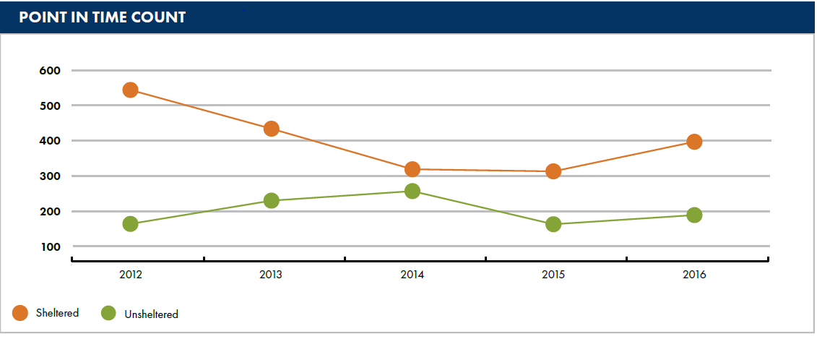
Our Community: Thurston County Stats
Mid-sized county. Population 272,690 (April 2016), about 2% growth from 2015
3,066 individuals were entered into homeless housing services 10/1/15 – 9/30/16
32% of those who were served were unsheltered upon entry

Slide 8
Our Community: Thurston County Influences on Homeless Services
Olympia, Lacey, Tumwater, Yelm, Tenino, Rainier, Bucoda
Mix of upcoming URBAN issues mixed with NIMBY & small town attitudes
Perception of increased homelessness in downtown Olympia
City legislation closes public spaces and bathroom issues around town
Real economic issues/very fast growth – for every $100 rent increase/39% increase in homelessness in non-metropolitan cities (Journal of Urban Affairs)
“Deserving” populations vs “Vulnerability Based Priorities”
Pressure on service providers – unfunded mandates
HOME Fund upcoming, CCC upcoming
Trying to come up with creative solutions

Slide 9
What is the CHARITY MENTALITY?
AND HOW DO WE BREAK IT?

Slide 10
Charity Mentality
Charity is about power and who holds it
Charity is seeing “the poor” as helpless victims
Introspection Needed
Why do you have the power you have?
Who gave it to you, and how should you use it?
Charity vs. Justice
Charity is a matter of personal attributes
Justice is a matter of public policy and human rights

Slide 11
Charity Mentality
The image of charity…
Sums up the spirit of charity
Charity rests on the foundations of guilt, privilege
The belief that “the poor will always be with us”
Charity is pity for those you are “helping”
A “needs based” approach with those who HAVE giving to those who HAVE NOT

Slide 12
Charity Mentality
NEEDS-BASED (focus on individual)
Want to help people survive and develop to their full potential
No moral or legal obligation on government to protect and assist
“Clients” are seen as objects of charity
Does not always take structural issues of oppression into account
RIGHTS-BASED (focus on society)
Want to help people survive and develop to their full potential
Includes legal and moral responsibility and accountability
“Clients” are encouraged and empowered to claim their rights
Always tries to incorporate the realities of structural oppression into program design

Slide 13
Break the Mentality!!!
Why the charity/needs based models of services won’t end homelessness
Treating the symptoms (the individual), not the sickness (society)
Tools of the Trade
Harm Reduction
Naloxone administration requirement/policy, drug user statement
Applicable WACs (Washington Administrative Code) or RCW (Revised Code Of Washington) Washington State law RCW69.50.315 (also known as the 911 Good Samaritan Overdose Law) allows a person acting in good faith to receive a naloxone prescription, possess naloxone, and administer naloxone to an individual suffering from an apparent opiate-related overdose. RCW69.50.315 prevents prosecution for drug possession for people who have an overdose or who seek medical help for someone else having an overdose.
HB1671 is now active law in WA State. This law seeks to scale-up access to naloxone by making naloxone distribution to laypersons more efficient. The law specifically permits naloxone to be prescribed directly to an "entity" such as a police department, homeless shelter or social service agency.
**While we can’t have drugs/drug use on the property, we want to create an environment where people can talk openly about their use. If you have used and are at risk of overdose or worried about your safety, please tell us! We are here to help and want you to be as safe as possible. Being open and honest with us will not jeopardize your stay here.
Principles apply not only to active drug use but mental health, conflict mediation, hygiene and general physical health issues.
A commitment, a way of life, an active, ongoing process of unlearning in many cases.

Slide 14
Break the Mentality!!!
Housing First
How low-barrier are you? How much lower can you go? Do you screen people in or out? Who is not allowed to stay with you and why? Are you actively working against your mission by barring people from housing and shelter programs?
Unconditional Respect
“Interfaith Works Emergency Overnight Shelter believes that our guests, regardless of their circumstance, condition or ability, are worthy of and deserve to feel respected, esteemed, and honored. The burden of respect is ours and is not dependent on the respect of our guests. We will hold our guests accountable for their choices and actions, but we do so in a manner that respects their rights as individuals and their worth as human beings.” From IW EOS Operations Manual, Core Values Section
Collective responsibility and accountability
We must care for our elders, our young and everyone in between. People can’t have a chance to succeed (regardless of their behavior/choices) if they die without access to care.
Hire people with lived experience
How do your hiring practices reflect the demographics and life experience of people you are serving?
Pre Interview questions, inviting staff/guests (work in progress) into interviews

Slide 15
Break the Mentality!!!
Housing is a human right.
How does that basic value inform our work?
Do your policies reflect your values as a program/org?

Slide 16
What does COLLECTIVE RESPONSIBILITY look like?
WHAT EACH PARTNER BRINGS TO THE TABLE

Slide 17
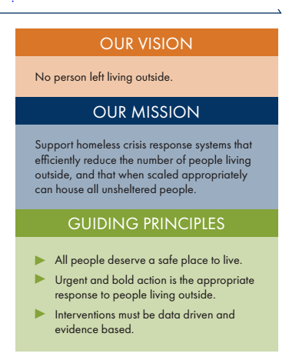
GOVERNMENT: Responsibility for ending homelessness
Politics of homeless services
State guidance/local control
The State Homeless Housing Strategic Plan - 2017
“…new statewide vision that directs our efforts and resources to ensure that people have a safe place to live.”
“…we need to ensure people most at risk of dying from violence or exposure to the outdoor elements receive assistance as rapidly as possible.”
“Homelessness is solvable”

Slide 18
HOUSING: True to the Mission
We Believe...
...in every child growing up in a safe, loving and nurturing environment.
…in elders living in security and dignity.
...in healthy family life being affirmed and supported in our communities.
...in every person having the right to a safe, affordable place to call home.
...in compassion, love and respect for all people, especially those who are poor and vulnerable.
...in joining with others to change the systems which oppress, discriminate or otherwise cause human suffering.
...in employees and volunteers working in an environment which offers respect, teamwork and excellence.
...in all these things for all people, whatever their color, whatever language they speak or however they worship
Who are we serving?
How are they being referred?
What services are in place?
Comb through all policies and procedures
Drug testing, sobriety requirements, criminal history
Eviction procedures, liability insurance, maintenance $
Who wore it best?
Who out there is killing it? Who is the best of the best?
Being honest about where you stand and who you are

Slide 19
SHELTER: Come so far, so far to go
Mission: To advance the social inclusion and empowerment of our neighbors experiencing homelessness through innovative practices of sheltering, mental health and emergency basic needs coordination.
Philosophy: Interfaith Works Emergency Overnight Shelter is dedicated to providing emergency services and support to those in need, not as charity but as an act of social justice. Homelessness, domestic violence, substance abuse, mental illness, and chronic physical health problems have left many in our community vulnerable and unsafe. The stigma associated with homelessness and poverty pushes those most in need further away, and refuses these individuals their basic human rights and dignity. The work of Interfaith Works Emergency Overnight Shelter is rooted in empowerment, social inclusion, and community education to end the unnecessary stigmatization of the most vulnerable.
Values: Dignity, Respect, Care, Compassion, Competence, Integrity.
Organizational Principles: Basic Belief In People, Services to Our Guests, Commitment To A Healthy Staff Team, Professionalism, Commitment to Rapport, Commitment to Community Involvement, Community Building and Social Inclusion, Harm Reduction and Trauma Informed Care.
Focus on our guests
Couples can stay together, LGBTQQIA+ acceptance prioritized, responding to racism/POC experience prioritized, pets allowed, sobriety not required, ID not required, program participation not required, personal belongings OK.
Target pop: Over 60, living with mental health, substance use, chronic health, permanent disability, high interaction with emergency services and experiencing chronic homelessness.
Encourage participation and pride in belonging to the shelter community.
Mental flexibility
Lead with “Yes” rather than “No” you can always do something to meet someone’s needs.
Are the systems in place working?
How do you evaluate and revisit systems? How do you get guest input about the way things run day to day? How often do you ask guests these types of questions?
Can you change the rules? Can you survey your guests about how things are going? Can you turn to them for answers about the real impacts your decisions will have on their lives as residents at the shelter?

Slide 20
What does UNCONDITIONAL RESPECT look like?
WHAT EACH PARTNER BRINGS TO THE TABLE

Slide 21
GOVERNMENT: Rights-based approach to policies and procedures
Consolidated Homeless Grant Guidelines
Waive Income Eligibility for households experiencing homelessness
Coordinated Entry and Unsheltered Prioritization
Flexible Funding
Coming (very) soon:
Low barrier option (July 2018)
Minimize documentation required at CE
Services must be voluntary

Slide 22
HOUSING: Lower barriers to meet you where you’re at
Lease violations and “behavior” based conversations HOUSING FIRST
Weathering the storm; we can disagree
Outlasting indifference, misunderstanding, and apathy
Everything we can do, we will HARM REDUCTION
Sobriety, safe use, supportive services, and a deep breath
No pre-requisites for respect and communication
Advocacy regardless TRAUMA INFORMED
Give up your power as a provider, you can’t control the outcome CARE
Past trauma and continuing drama

Slide 23
SHELTER: The burden of respect is ours and not based on the respect of our guests.
Focus on staff support as much as possible (there is so much we DON’T have control over) and always know that it will never be enough – that means support you and others in management too!
Self preservation and resiliency focus
Salary/Hourly pay always working towards a industry average/living wage (we are fighting poverty, right??)
“Benefits” package after 3 months for all front line staff including fill-in
Robust fill-in system, encourage staff taking space and time off
Supervision: Three group staff meetings per month, two one on one supervision meetings per month with management.
Fostering (and paying for) involvement from staff and encouraging transparency around decision making.
i.e. POC caucus

Slide 24
SHELTER: The burden of respect is ours and not based on the respect of our guests.
Focus on staff support as much as possible (there is so much we DON’T have control over) and always know that it will never be enough – that means support you and others in management too!
Self preservation and resiliency focus
Salary/Hourly pay always working towards a industry average/living wage (we are fighting poverty, right??)
“Benefits” package after 3 months for all front line staff including fill-in
Robust fill-in system, encourage staff taking space and time off
Supervision: Three group staff meetings per month, two one on one supervision meetings per month with management.
Fostering (and paying for) involvement from staff and encouraging transparency around decision making.
i.e. POC caucus

Slide 25
SHELTER: The burden of respect is ours and not based on the respect of our guests.
Mental flexibility
Accommodation as a smart staff retention plan which serves you in the end
Listen to the feedback you receive about how things can be better (do your best not to explain away why it can’t happen even if it really can’t happen—focus on what you can do to respond to the concern)
Are the systems in place working?
How do you evaluate and revisit systems? How do you get staff input about the way things run day to day? How often do you ask staff these types of questions?
Can you change the shift hours? Can you survey your staff about how things are going? Can you turn to them for answers about the real impacts your decisions will have on front line staff?
How to share expectations of what respect/violent language means, build communication skills, conflict mediation skills and sense of belonging within the guest population to increase likelihood of mutual respect.
What message are we sending and how can we hold people accountable for their actions if they don’t have access to the information?
? As individuals, as a staff team, as a city, etc.

Slide 26
Mental flexibility
Accommodation as a smart staff retention plan which serves you in the end
Listen to the feedback you receive about how things can be better (do your best not to explain away why it can’t happen even if it really can’t happen—focus on what you can do to respond to the concern)
Are the systems in place working?
How do you evaluate and revisit systems? How do you get staff input about the way things run day to day? How often do you ask staff these types of questions?
Can you change the shift hours? Can you survey your staff about how things are going? Can you turn to them for answers about the real impacts your decisions will have on front line staff?
How to share expectations of what respect/violent language means, build communication skills, conflict mediation skills and sense of belonging within the guest population to increase likelihood of mutual respect.
What message are we sending and how can we hold people accountable for their actions if they don’t have access to the information?
? As individuals, as a staff team, as a city, etc.

Slide 27
Even when…
YOU REPEATEDLY CALL 911 IN A NON-EMERGENCY…

Slide 28
Even when…
YOU PUNCH A STAFF MEMBER…

Slide 29
Even when…
YOU HAVE BODY LICE JUMPING FROM YOUR BEARD…

Slide 30
Even when…
YOU CAN’T PAY RENT ON TIME… OR AT ALL…

Slide 31
Even when…
YOU BRING IN A SQUIRREL AS YOUR SERVICE ANIMAL…

Slide 32
Even when…
YOU’VE BEEN DETAINED 14 TIMES IN 3 YEARS…

Slide 33
Even when…
YOU ARE SCREAMED AT, INSULTED AND THREATENED AS A STAFF…

Slide 34
Even when…
YOU ARE CAUGHT SMOKING METH (or whatever) IN THE BATHROOM (or wherever)…

Slide 35
Even when…
YOU ARE IN THE THROES OF DEMENTIA OR PSYCHOSIS OR…

Slide 36
Even when…
YOU TRY TO BURN THE BUILDING DOWN…

Slide 37
Questions…?
EXPLETIVES ALLOWED

Slide 38
What is one tool you can take with you today?
How soon can you implement it?

Slide 39
What is one bias / judgement / assumption you can leave behind?
How will you encourage others at your agency to do the same?

Slide 40
Julie Montgomery | Julie.montgomery@commerce.wa.gov | (360) 725-2963
Bary Hanson | baryh@ccsww.org | (360) 584 - 3867
Meg Martin | meg@iwshelter.org | (360) 951-6767
REFERENCES:
- https://lindaraftree.com/2010/10/27/enough-of-the-charity-mentality/
- www.commerce.gov
- Our own fucked up experiences

