Slide 1
Prioritization pays off
Conference on Ending Homelessness
Tacoma, WA
May 10, 2017

Slide 2
Agenda
Prioritization Summary – Kathie Barkow, Aspire Consulting
Skagit County Experience – Shelley Kjos
Grays Harbor Experience – Cassie Lentz and Nora LeBlanc
Q and A
Notes:
Got an hour, after lunch spot so going to get brains going with a few questions to get your brain back engaged.
Some people may pass #1 if never done or supervised direct services.

Slide 3

Prioritization Pays Off
WCOEH
May 10, 2017
Kathie Barkow
Principal

Slide 4
2017 PIT status?

Slide 5
Notable Declines in PIT
Nationally
Houston – 75% reduction unsheltered 2011 to 2016
Los Angeles – 19% reduction homeless families 2015 to 2016
Washington
40+ Cities/States for Vets
Notes:
RUN NATIONAL DECREASES THROUGH 2016
More than 40 Vets and/CH

Slide 6
How?
Prioritization

Slide 7
Prioritization
Definition
Assessing and determining who is
  greatest need
  highest need
  most severe service needs
Implicit: giving those with the greatest needs priority for the housing and homeless assistance available in the CoC.

Slide 8
Why Is Prioritization Needed And Helpful?
Clients have a more equitable access to services than the first-come first-served model
Programs know their role and population to be served, and save time by not screening clients for entry
System can make sure highest needs people are offered services
System can see where augmentation of services is needed and leverage them
System can effectively work toward functional zero
Mandate of Consolidated Homeless Grant (CHG) & HUD
Notes:
“Lead/subgrantees must prioritize unsheltered homeless households for services and programs.”
and
Part of coordinated entry requirement, CE systems must:
“Use a standardized assessment tool that matches households with services that will help them exit homelessness AND prioritizes households with the greatest need.”

Slide 9
Remember…
Prioritization ≠ Matching
Prioritization ≠ Eligibility

Slide 10
Examples Of Prioritization Factors
Where stayed last night (unsheltered, acuity of temp housing)
Vulnerability
Chronic homelessness
Length of time homeless
Housing barriers criteria
High-cost service user predictor
Combination
Vulnerability and unsheltered
Current housing situation and housing barriers acuity
High-risk age group, families, episodes of homelessness, extremely low/no income, disabilities and length of homeless
Notes:
Not going to endorse a specific tool.

Slide 11
Types Of Prioritization & Matching
Primarily two:
Bucket Prioritization
Continuous Prioritization

Slide 12
Sample Distribution of Scores
1 2 3 4 5 6 7 8 10 11 12 13 14 15 16 17 18

Slide 13
Score “Buckets” for Matching
Mainstream RRH PSH
1 2 3 4 5 6 7 8 9 10 11 12 13 14 15 16 17 18

Slide 14
Continuous Matching
Low Medium High
1 2 3 4 5 6 7 8 9 10 11 12 13 14 15 16 17 18
Notes:
High may get PSH, but gets next available resource, which in many communities may be RRH

Slide 15

What Works/Lessons Learned #1
KISS
Prioritization tool
Decision-making structures
Data for evaluation

Slide 16
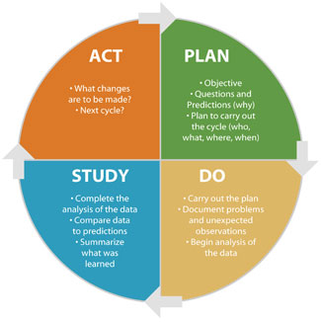
What Works/Lessons Learned #2
Plan, Do, Study, Act

Slide 17

What Works/Lessons Learned #3
Engage Community

Slide 18

What Works/Lessons Learned #4
Effectively Serve Those With Highest Needs

Slide 19
What Works/Lessons Learned #5
Compare current/prior year, for system & project type
% of people served with 1 disabling condition (and #)
% of people served with 2+ disabling conditions
% of people served who are chronically homeless
% exits to PH
% exits to homelessness
Be Data- Driven To Evaluate What Works

Slide 20
Prioritization in
Skagit County

Slide 21
Prioritization in
Skagit County: Timeline
February 2013: Housing Resource Center opening
Fall 2015: Drafting of local prioritization tool
January 2016: Tool approved, implemented at Housing
Resource Center
July 2016: Analysis of prioritization scores
Summer/Fall 2016: Expanded use of local tool

Slide 22
Prioritization in Skagit County: Successes
Increase in unsheltered households served
  2015: 33%
  2016: 46%
Faster access to services for highly vulnerable households
  2016 Average LOS on Housing Interest Pool: 105 Days
  Average LOS for 20 highest scoring households referred to case management: 23 Days

Slide 23
Prioritization in Skagit County: Challenges
Prioritization drives system and service model adjustment
  To serve a more vulnerable population, how does your service model adapt to continue to be relevant and effective?
More resources per household
  Increased investment of staff time and financial assistance per household
Housing vulnerable households in a highly competitive rental
market
System capacity
  How do we serve households of low to moderate vulnerability?

Slide 24
Prioritization in
Skagit County: Lessons
Prioritization is an ongoing process, the work is
never truly done
Importance of multiple voices
  Community partners
  Front-line staff
What works in theory vs. what’s really happening on the
ground

Slide 25
Prioritization in
Skagit County: Next Steps
Spring 2017: New CE Entry Point
Summer 2017: Evaluate and adjust prioritization tool

Slide 26
Pathway to Prioritizing
Grays Harbor County Public Health and Social Services
Cassie Lentz, Housing Resource Coordinator

Slide 27
Timeline
2015 – Coordinated Entry system discussion and design
Mid 2015 – Process designed to measure and report utilization of assistance programs by housing status. It is regularly presented to community stakeholders.
January 2016 – Coordinated Entry officially launched at Coastal Community Action Program
  Requirement for all county-funded programs
May 2016 – VISPDAT adopted as official assessment tool for Coordinated Entry
Summer 2016 – Began utilizing HMIS to capture VISPDAT data
2017 – Created report template in “Looker” to capture and analyze VISPDAT scores, program enrollment, and quantify need

Slide 28
Data
2015: 34% of all clients entering housing assistance programs were unsheltered
2016: 51% of clients entering housing assistance programs were unsheltered
“When I started this position at the end of January 2015 and began reviewing HMIS data CCAP was serving approximately 70% Prevention clients and 30% Literally Homeless clients with housing resources. Reviewing November’s HMIS reports the data shows a complete 180 degree shift. 70% of the clients CCAP served in November 2015 entered programs as Literally Homeless, and 30% were targeted prevention clients, and all of those prevention clients were being served by the HEN program” – e-mail from GHC staff to CCAP staff

Slide 29

Being inclusive and transparent
Invite community partners to share feedback – good and bad
Be up front about struggles and ask for help
Don’t sugar coat it – transparency about prioritization and the impacts is important

Slide 30

Balancing system and provider needs
Prioritization is a system-wide initiative
Individual providers may have conflicting criteria/policies – they don’t have to overhaul their mission to participate
Start small and where you have control

Slide 31

The Work is Never Done!

Slide 32
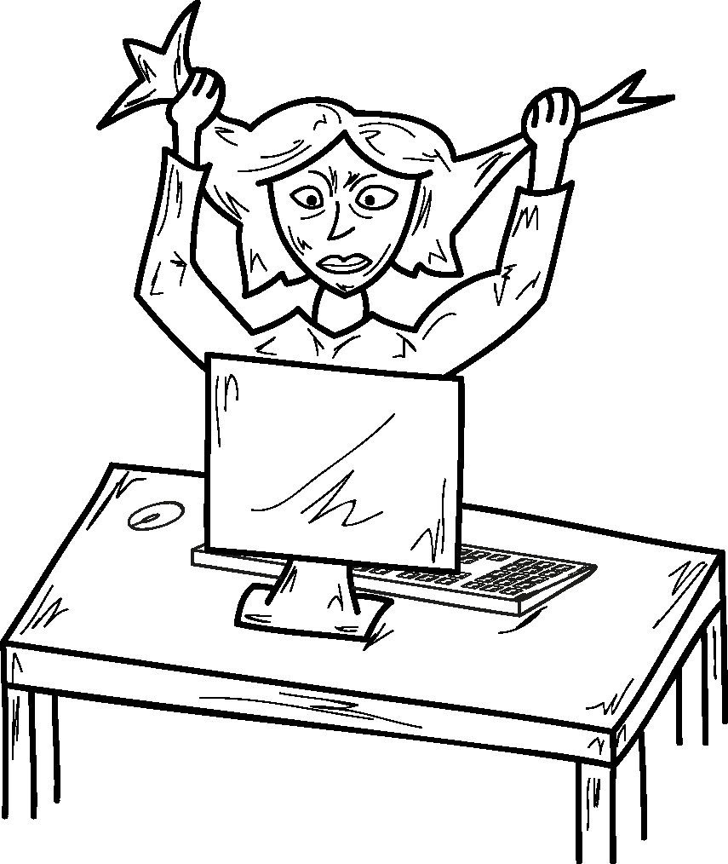
The Work is Never Done!

Slide 33


Grays Harbor County
Prioritizing the Most Vulnerable
Changing Ways of Work
2014 - 2015
Most housing assistance is eviction prevention 70% and 30% is for people who are homeless.
Recurring Myths:
‘People who are homeless like to live that way.’
‘If people don’t have an income, we are just setting them up for failure.’

Slide 34
Grays Harbor County
Before Prioritization
2014 - 2015
Most housing assistance is eviction prevention 70% and 30% is for people who are homeless.
Myths:
‘We will reduce homelessness if we focus on prevention’
‘If people don’t have an income, we are just setting them up for failure.’

Slide 35
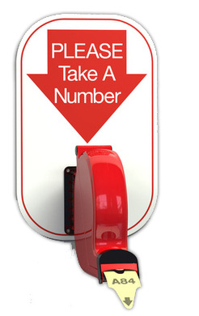
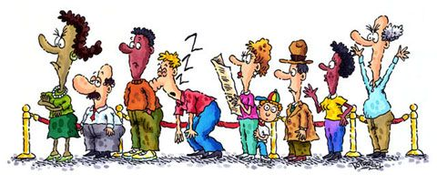
Before Coordinated Entry
First Come, First Serve
70% Targeted Prevention
Inconsistent Case Management
70%

Slide 36
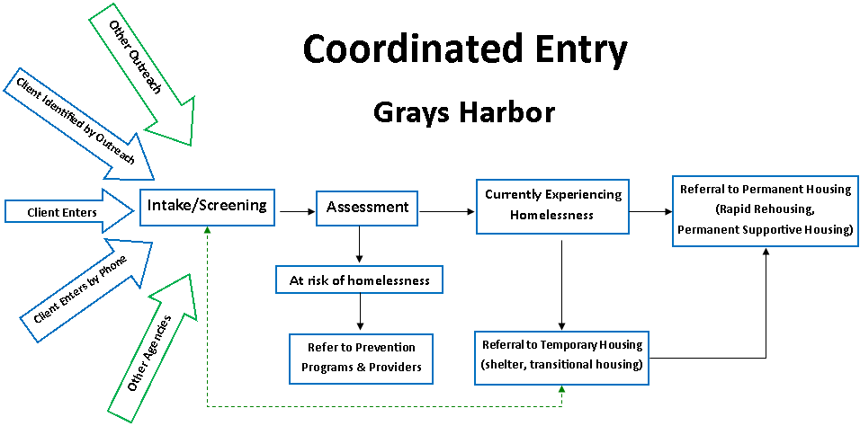
Grays Harbor County
Building a Coordinated Entry System

Slide 37


Coordinated Entry
The impact of Coordinated Entry was apparent immediately
Packed Lobby
Phones always ringing
Seeing 150 – 225
households a month
Notes:
Didn’t include case management

Slide 38
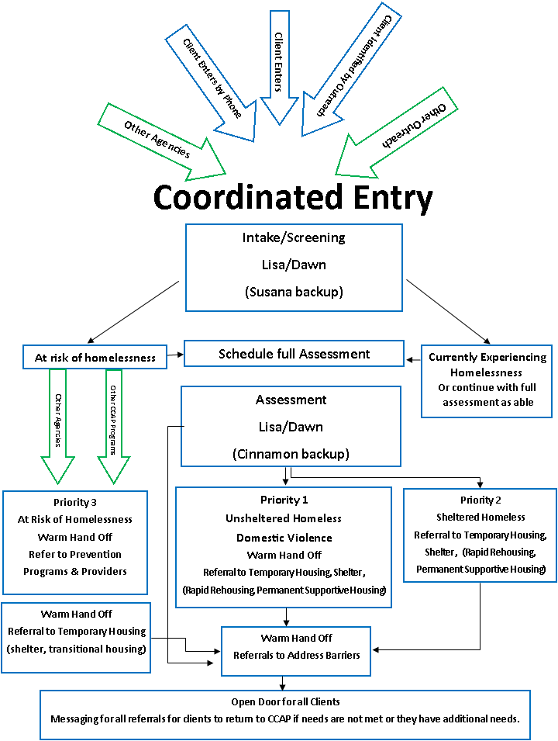
Next Steps
Articulating
Priority Groups
Unsheltered
Sheltered
At Risk

Slide 39

Learning
· Growing demand
· Data input was paralyzing
· People falling through the cracks
Changing the Model
Utilize a Tool
VI-SPDAT
Score 7+ Unsheltered
Domestic Violence
Score 4 – 7 Unsheltered
Score 7+ Sheltered
Score 4 – 7 Sheltered
At Risk of Homelessness

Slide 40

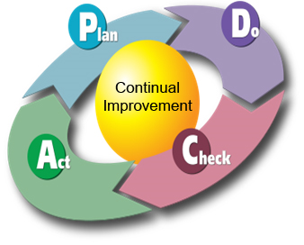
Changing the Model
More intensive case management
Results 51% - Unsheltered Homeless
Continuous improvement
    Change is the model

Slide 41
Contact Information
Cassie Lentz
Grays Harbor Public Health & Social Services
CLentz@co.grays-harbor.wa.us
360-500-4049
Shelley Kjos
Community Action of Skagit County
shelleyk@communityactionskagit.org
360-416-7585 x1195
Nora LeBlanc
Coastal Community Action Program
360-533-5100 x119
noral@coastalcap.org
Kathie Barkow
Aspire Consulting LLC kathiebarkow@earthlink.net
510.967.5161

