Slide 1
By Name Lists -More than Vets and Chronic Homelessness
Washington Low Income Housing Institute Annual Conference
May 10-11, 2017
Dusty Olson & Sara Hoffman

Slide 2
Introductions
Dusty Olson, Strategic Advisor
City of Seattle Human Services Department
Sara Hoffman, Coordinated Entry for All Program Manager
King County Department of Community and Human Services
Notes:
Dusty will kick off and both introduce

Slide 3
Audience Poll
By a show of hands, what is your community’s use of by name lists?
Not even sure what they are
We are talking about using one
We have started putting together a list
We have a by name list process for Vets and/or Chronic Adults
We use by name lists for multiple populations
Notes:
Sara

Slide 4
What is a By Name List
Understanding exactly who is experiencing homelessness and what their individual needs and barriers are to housing placement
Counts down to zero
Utilizes a real time, prioritized list generated by Coordinated Entry
Combines the list with a regular case coordination process
Creates accountability between community partners to ensure positive outcomes for people experiencing homelessness
Real time edits to waiting lists as new information is discussed
Valuable measurement tool towards system goals
Notes:
Dusty

Slide 5
How is this different than what we are doing now?
Static counts, such as Point in Time Counts are snapshots of homelessness in a community
Coordinated Entry Placement Lists are static waiting lists
Notes:
Sara

Slide 6
Potential Goals of By Name Lists
Housing Placements
Matching people off the list with available housing openings
Increases housing placement success
Housing Navigation
Making sure people nearing the top of the list have all necessary documents and services in place
Ensures timely housing placement
Service Coordination
Coordinating wrap-around services for people on the list or in housing
Notes:
Sara

Slide 7
System Benefits of By Name Lists
To identify and track systemic barriers and strategize solutions across multiple providers
Serves as a means to deepen understanding of homelessness at the local level
Supports communities’ planning efforts for reducing and ending homelessness
Provides communities with the ability to track exits from homelessness
Allows for measuring community goals and performance
Notes:
Dusty

Slide 8
More Benefits of By Name Lists
Project-Level
To ensure holistic, coordinated, and integrated assistance across providers for all persons experiencing homelessness in the community
To clarify roles and responsibilities and reduce duplication of services
Improves collaboration through case conferencing meetings among entities working to house individuals on the lists
Individual-Level
To review progress and barriers related to each persons’ housing goal
TO HELP PEOPLE BECOME PERMANENTLY HOUSED!
Notes:
Dusty

Slide 9
By Name Lists Around the Country
Region | Populations | Participants | Goal | # of People
Hennepin Co | Vets & LTSS Planning chronic & families | Supervisor and case workers from each agency, county screeners & data staff | Top 51 longest shelter stayers participants all get offered permanent housing placements | Touch on all top 51
Jacksonville | Vets & Chronic Planning YYA & families | Case manager, housing specialist , VA reps, Vash rep, GPD liaison, VA outreach & entire community outreach team | Highlight the barriers, issues and how to get them to the point of referral. Identify top priority clients to connect with | 40-50
Los Angeles | Youth & Single Adults | Supervisors from assessment, housing providers, mental health & child welfare representatives | Following up on housing placements that take place between the meetings. Connect youth high on the list to services and ensure readiness for referral | Varies
Connecticut | Families & Single Adults | Representatives from all service & housing providers | Housing placements and navigation activities in preparation of housing placements | Up to 75
Notes:
Dusty

Slide 10
Lessons Learned from Other Cities
Flexibility is key
Focus is on filling vacancies as fast a possible
Having the right people at the table is essential
Be willing to change the process as you learn
Most people will opt in for participation if it is presented effectively
Notes:
Dusty

Slide 11
Why use a Release of Information?
An appropriate ROI allows all relevant agencies to access and add to the community’s active list
Every ROI will look different depending on local community needs
A comprehensive ROI allows providers to coordinate services during case conferencing
Communities are encouraged to work with local partners to produce ROIs that satisfy their privacy regulations
Notes:
Sara

Slide 12
Consent Language
Seattle/King County: By signing this form, I authorize King County and Bitfocus to share HMIS information with Partner Agencies. The HMIS information shared will be used to help me get housing and services.
Jacksonville FL: If you sign the consent form, your information can be shared with other agencies that use HMIS with restrictions which you specifically indicate on the consent form. Sharing your information may help other agencies obtain information about you more quickly, help with case management and improve their services to you.
Connecticut: The Connecticut Homelessness Management Information System (CT HMIS) is a shared system. This means that authorized CT HMIS Participating Agencies will enter your information into the CT HMIS database. These participating agencies will have access to the information that is entered into HMIS. Sharing your data allows service providers to see if they have housing services that fit your needs. A list of participating agencies which will have access to your information is attached.
Notes:
Sara

Slide 13
What about people who opt out?
Each person is entered in HMIS using a unique identifier (ID number)
Agencies need to track the ID numbers for people they are working with
Information can be shared in a non-identifiable manner
There is potential for duplicate profiles
Notes:
Sara

Slide 14
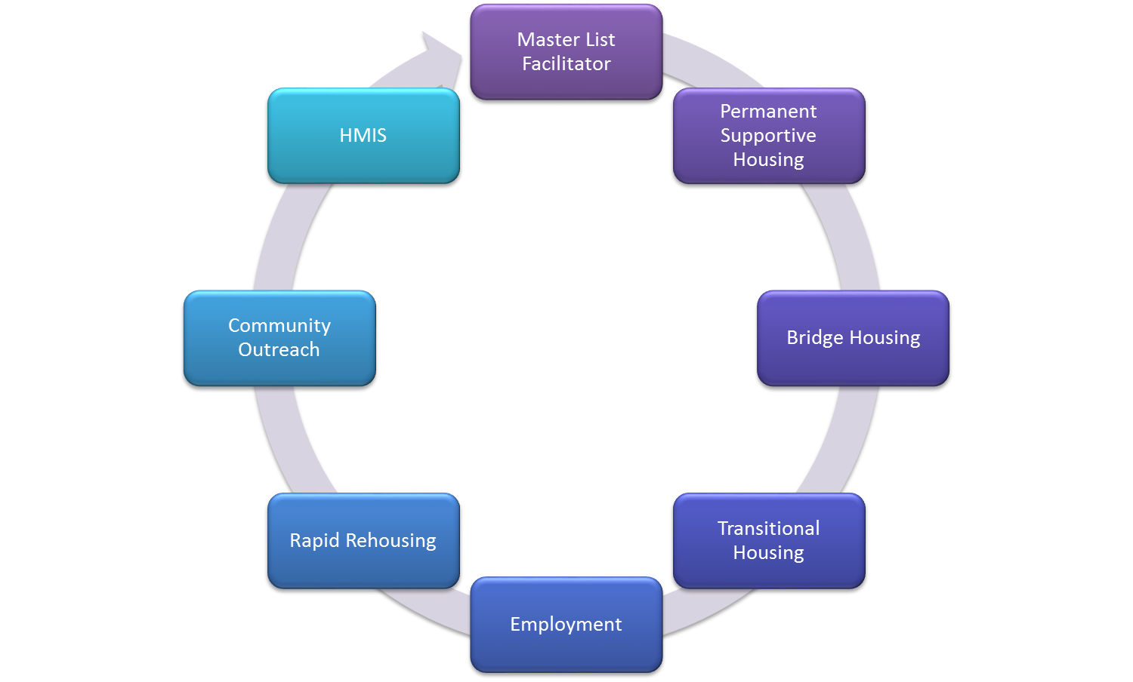
Potential By-Name List Members
changinghomelessness.org
Notes:
Dusty

Slide 15
Primary Goals of Case Conferencing
Update/maintain the BNL through case conferencing team updates.
Coordinate services and assign housing navigators based on the prioritization
Ensure people aren’t slipping through the cracks of the process.
Troubleshoot challenges that arise during the placement process and take steps to ensure housing retention.
Notes:
Dusty

Slide 16
Sample Agenda
Amount of Time | TOPIC
5 minutes | Review Dashboards (Inflow Rate, Active BNL Number, Permanent Housing Rate). Discuss trends/changes.
5-10 minutes | Review new people on BNL (inflow since last meeting). Who knows the person? Able to complete assessment? Need to be assigned to outreach worker to engage and complete assessment? Any concerns with score? Diversion attempted (multiple times)?
5-10 minutes | Review list of people within 1-2 weeks of becoming inactive. Anyone interacted with them or seen them around? (This may be less of a priority while establishing case conferencing norms and can be incorporated in the process down the road).
5-15 minutes | Review housing openings and make appropriate matches/referrals.
Remaining time (20-40 minutes) | Review prioritized BNL from top down, with goal of getting through 15% of the list at each meeting. Set time limit of 3-4 minutes per person and have timer in the group. Ensure people at the top of the list are connected to supports as needed (are engaged and can be located, have necessary documentation, are interested in housing) so they can quickly be connected to housing as soon as an opening becomes available.
Corporation for Supportive Housing
Notes:
Dusty

Slide 17
History of By Name Lists in King County
Veterans
Began in April 2015
Providers meet weekly to connect veterans who have completed a VI-SPDAT to Veteran Navigators, SSVF (Supportive Services for Veteran Families) programs and VASH Vouchers
Long Term Shelter Stayers
Initiative to address long term shelter stayers in 2015
Didn’t know to call it a by name list
Notes:
Sara

Slide 18
Long-Term Shelter Stayers
Participants: All single adult Emergency Shelter providers
Population: Those persons in shelter more than 2 years
Current list size: 200
Focus: Moving the 10 longest term clients in each shelter into permanent housing
Successes: 14 people have moved from the list since case conferencing began
Challenges: Must have the appropriate housing solutions in place in order to move quickly
Notes:
Dusty

Slide 19
Single Adult Impact Team
Participants: Outreach, Behavioral Health, Housing providers, drop-in centers, and shelters
Population: 100 Single Adults who have been assessed for CEA who have the highest vulnerability score and longest length of time homeless
Current list size: 100
Focus: Connecting with the most vulnerable and obtaining the documentation needed for housing
Successes: 29 people have moved off the list
Challenges: Clients are hard to find and do not have phones
Notes:
Sara

Slide 20
Family Impact Team
Participants: All family outreach, shelter and housing programs
Population: Families who have completed a CEA assessment and have the highest vulnerability and longest length of time homeless
Current list size: 1582 (focusing on top 100 from each band)
Focus: Working from the most vulnerable in each service band to confirm current status, ensure connection to resources, assess family status in advance of referral, and obtain documentation needed for housing
Successes: 25 people have moved off the list. Increased coordination across programs serving multiple clients
Challenges: List was static for so long that a lot of clean up is necessary to get to an active list. Agency participation is limited by HMIS Consent Form
Notes:
Sara

Slide 21
Young Adult Impact Team
Participants: Homeless Young Adult Navigators, drop- in centers, shelter and housing programs
Population: Young adults 18-24 who have completed a CEA assessment and have the highest vulnerability and longest length of time homeless
Current list size: 100 in each band
Focus: Connecting with the most vulnerable and obtaining the documentation needed for housing
Successes: 16 people have moved off the list
Challenges: Young Adults are hard to find and engage. Navigation staff is new, need to find their footing. List was static for so long that a lot of clean up is necessary to get to an active list
Notes:
Sara

Slide 22
Lessons Learned
Each new population group takes 4 or 5 calls to begin to get a good flow
Having the right people in the room really helps
Conference calls have benefits over meeting in person
Be willing to make changes when necessary
Letting your list sit static for a long time will result in inaccuracies
Notes:
Sara

Slide 23
Measures of Success
Number of people experiencing homelessness
Inflow (inflow + returned)
# of people becoming homeless for the first time
# of people returning to homelessness
Outflow (placements + inactive)
# of people being permanently housed
# of inactive after 90 days
Housing Process
Length of time from becoming homeless to identification
Length of time from identification to permanent housing
Notes:
Dusty

Slide 24
Questions & Answers

Slide 25
Thank you for attending today’s session
Dusty Olson, Strategic Advisor
City of Seattle Human Services Department
dusty.olson@seattle.gov
Sara Hoffman, Coordinated Entry for All Program Manager
King County Department of Community & Human Services
sara.hoffman@kingcounty.gov

