Slide 1

Youth & Young Adult Homelessness
Kim Justice
Executive Director
Office of Homeless Youth Prevention & Protection
May 10, 2017

Slide 2
Who are homeless youth?
Youth (under age 18) and young adults (age 18 through 24) who are living on their own, without a parent or guardian, and are without a safe, stable living arrangement.
Also referred to as “unaccompanied” youth

Slide 3
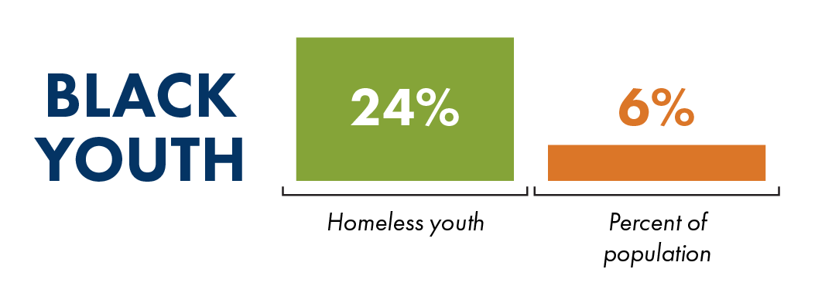
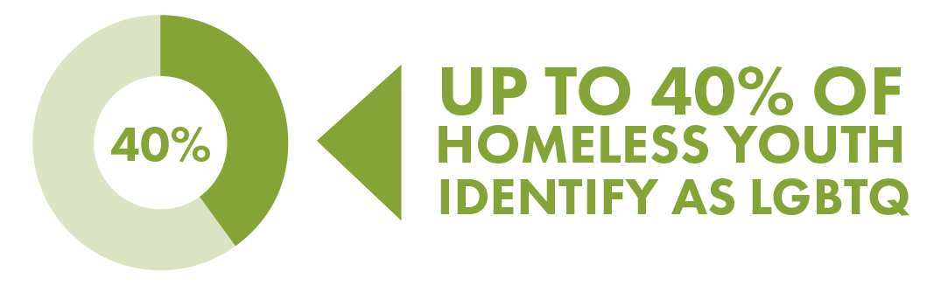
Who are homeless youth?

Slide 4
How do young people become homeless?
Family dysfunction, rejection, conflict
Economic instability
Exiting a system of care

Slide 5
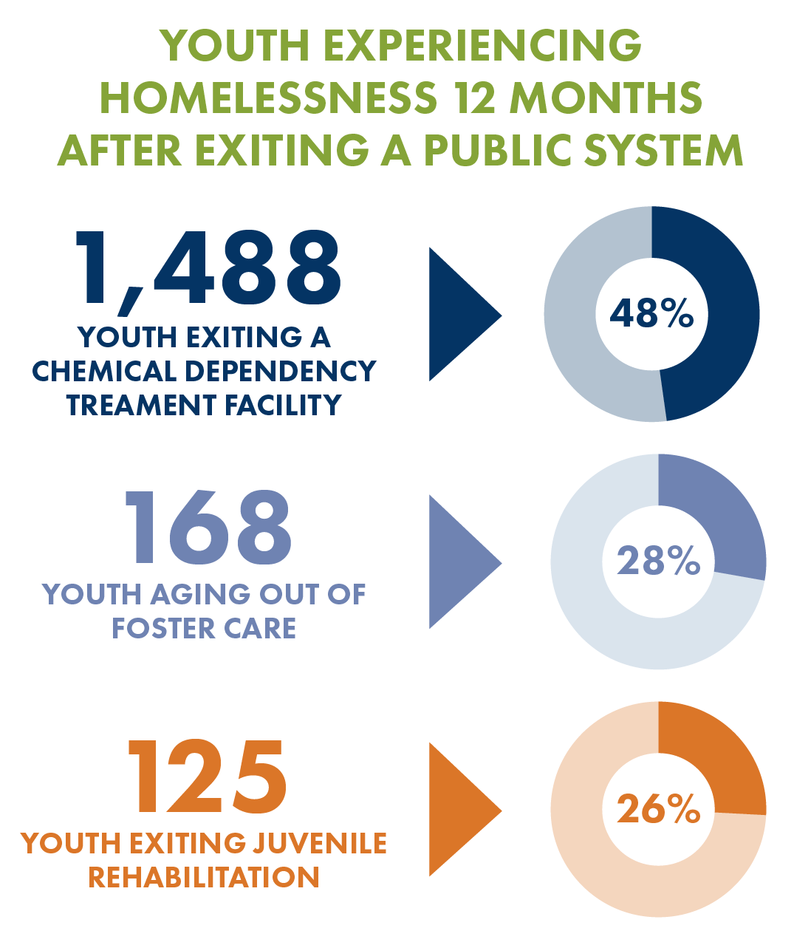
Exits from a system of care into homelessness

Slide 6
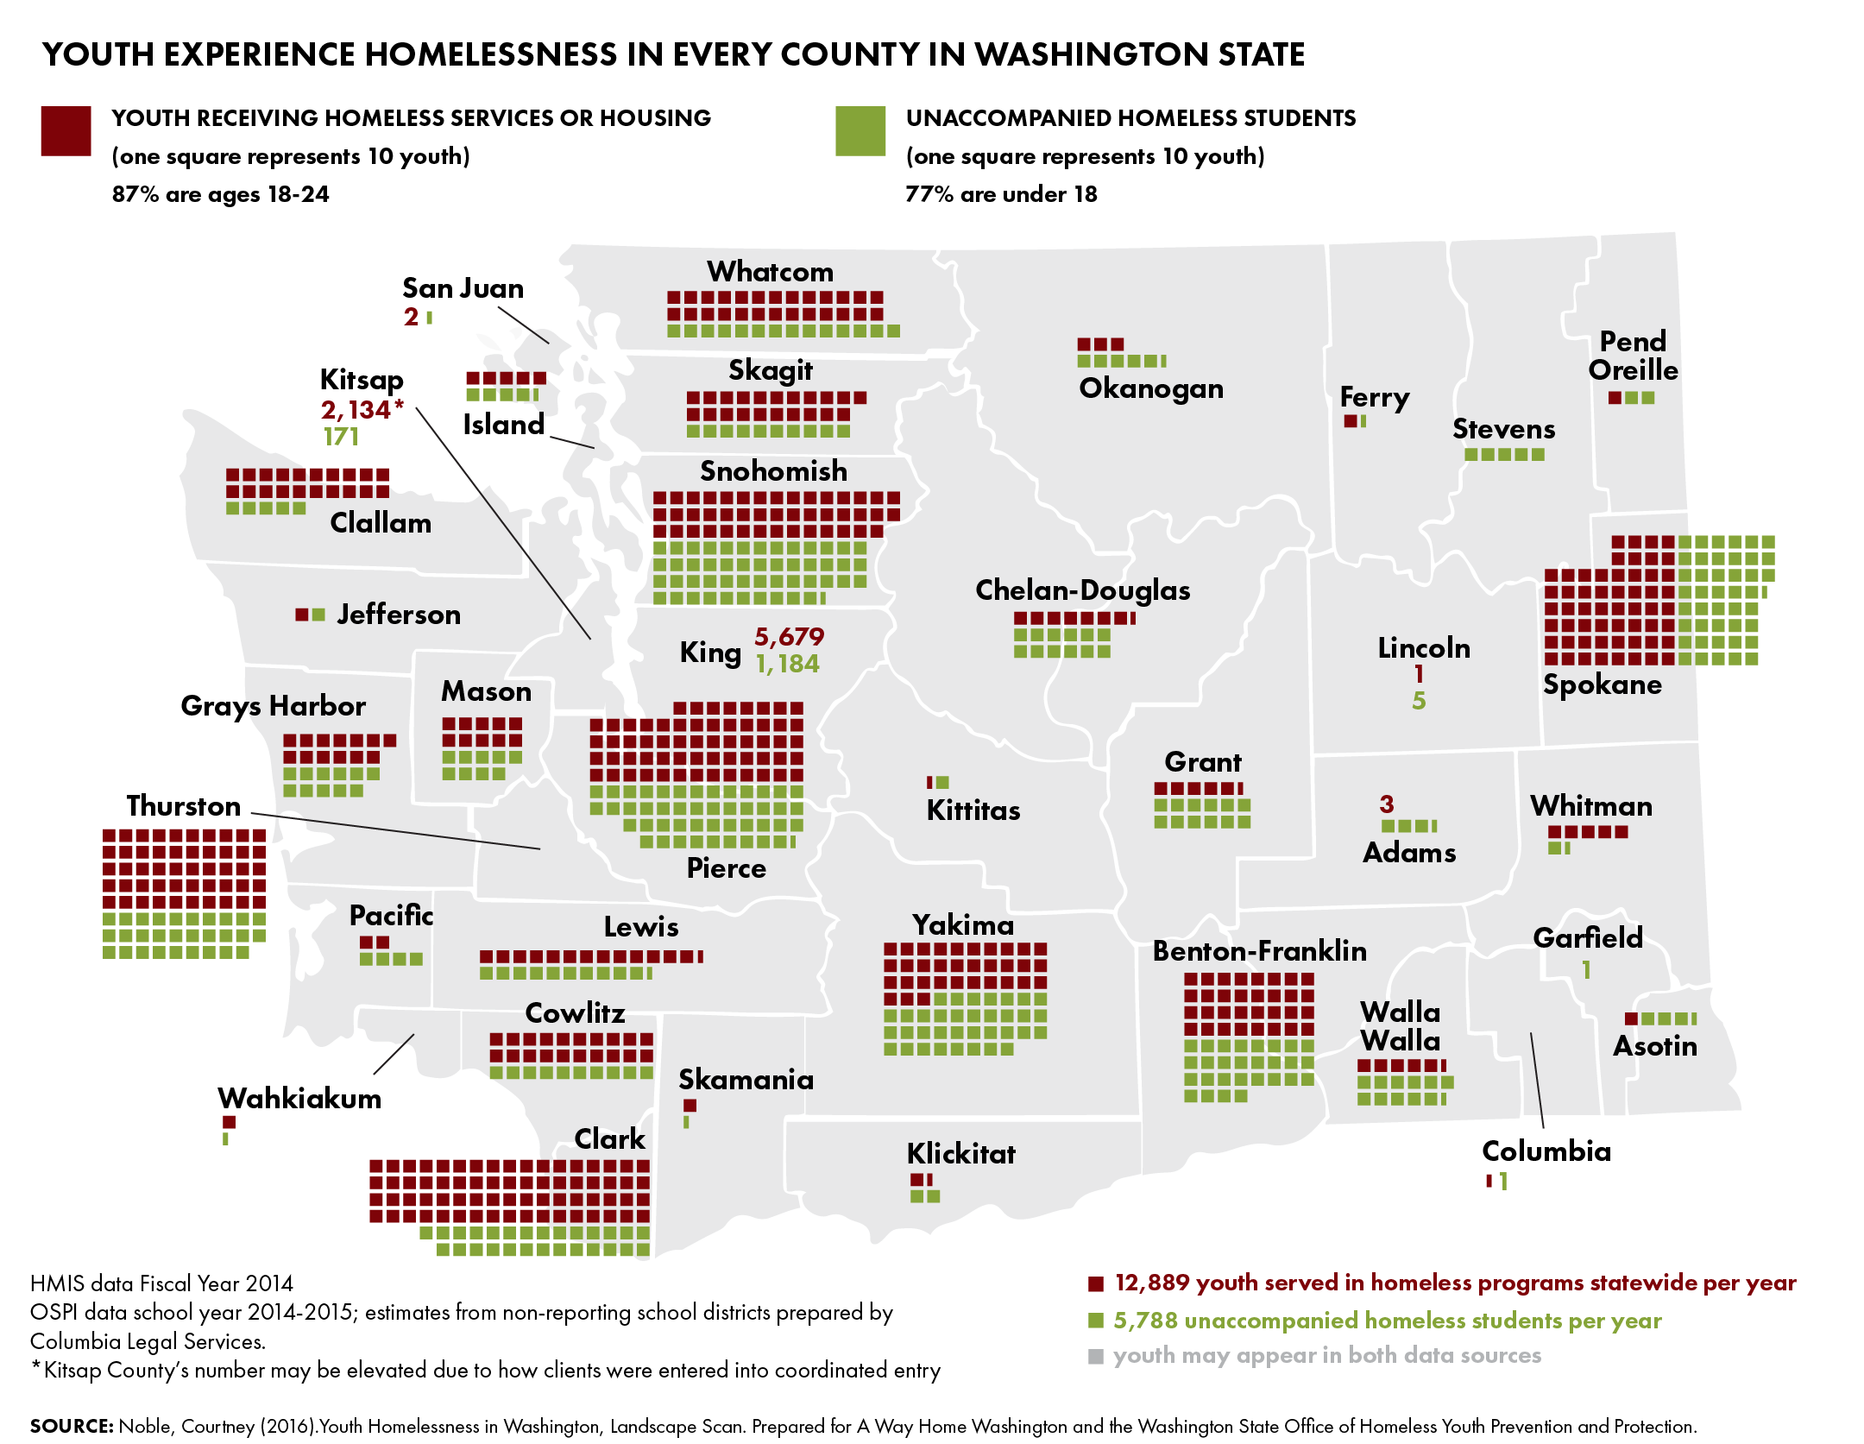

Slide 7
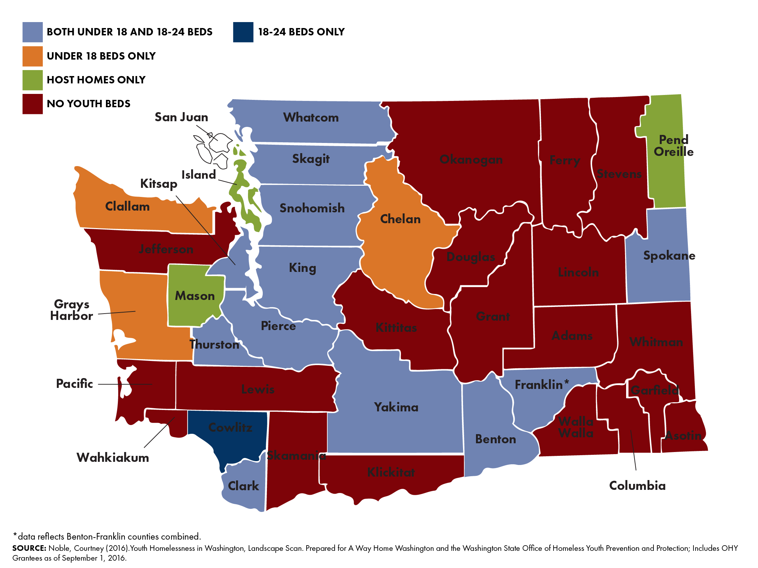
No Youth beds in half of WA’s counties

Slide 8
2015 Homeless Youth Act (2SSB 5404)
Established Office of Homeless Youth (OHY)
Set 5 priority areas:
  Stable Housing
  Family Reconciliation
  Permanent Connections
  Education & Employment
  Social & Emotional Well-Being

Slide 9
Guiding Vision
Every family and youth in Washington State has the individualized support they need so that no young person has to spend a single night without a safe and stable home. Every community has services that are equitable, accessible, effective, responsive, and coordinated.

Slide 10
How we serve homeless youth
Programs for youth under age 18
Crisis Residential Centers provide short-term, semi-secure, and secure facilities for runaway youth and adolescents in conflict with their families.
HOPE Centers provide temporary residence, referrals and permanency planning for street youth.
Street Youth Services connect youth to services and housing through street and community-based outreach.
Notes:
a youth to a secure CRC to serve a detention order.

Slide 11
How we serve homeless youth
Programs for young adults age 18 through 24
Independent Youth Housing Program provides rental assistance and case management for youth who have aged out of the foster care system.
Young Adult Housing Program provides rental assistance, transitional housing, and case management for homeless young adults.
Young Adult Shelter provides emergency shelter beds to young adults.

Slide 12
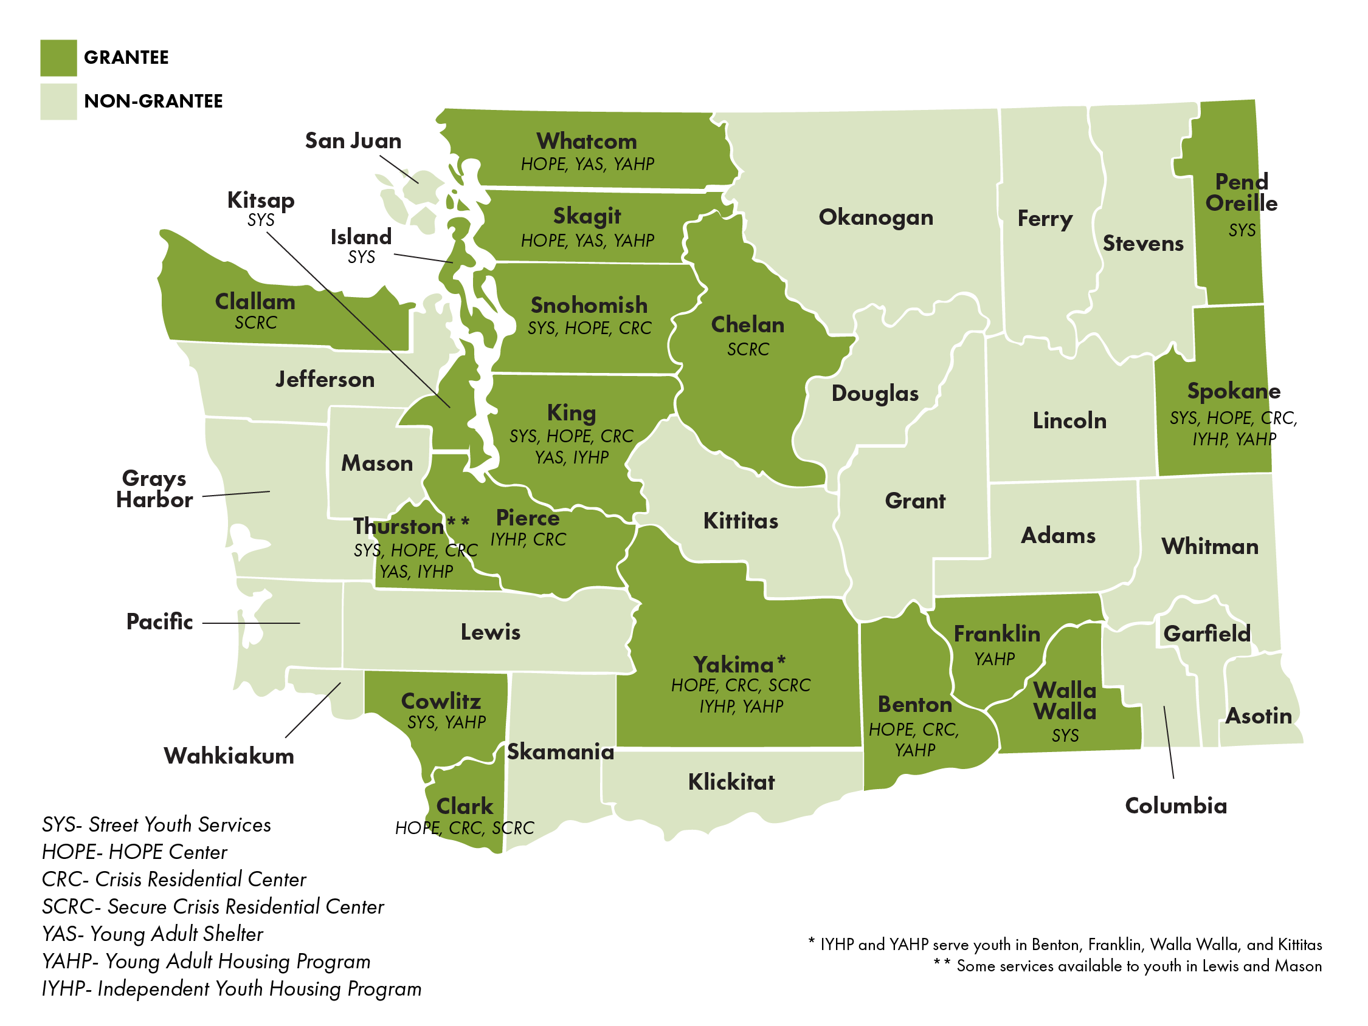
Office of Homeless Youth Programs

Slide 13
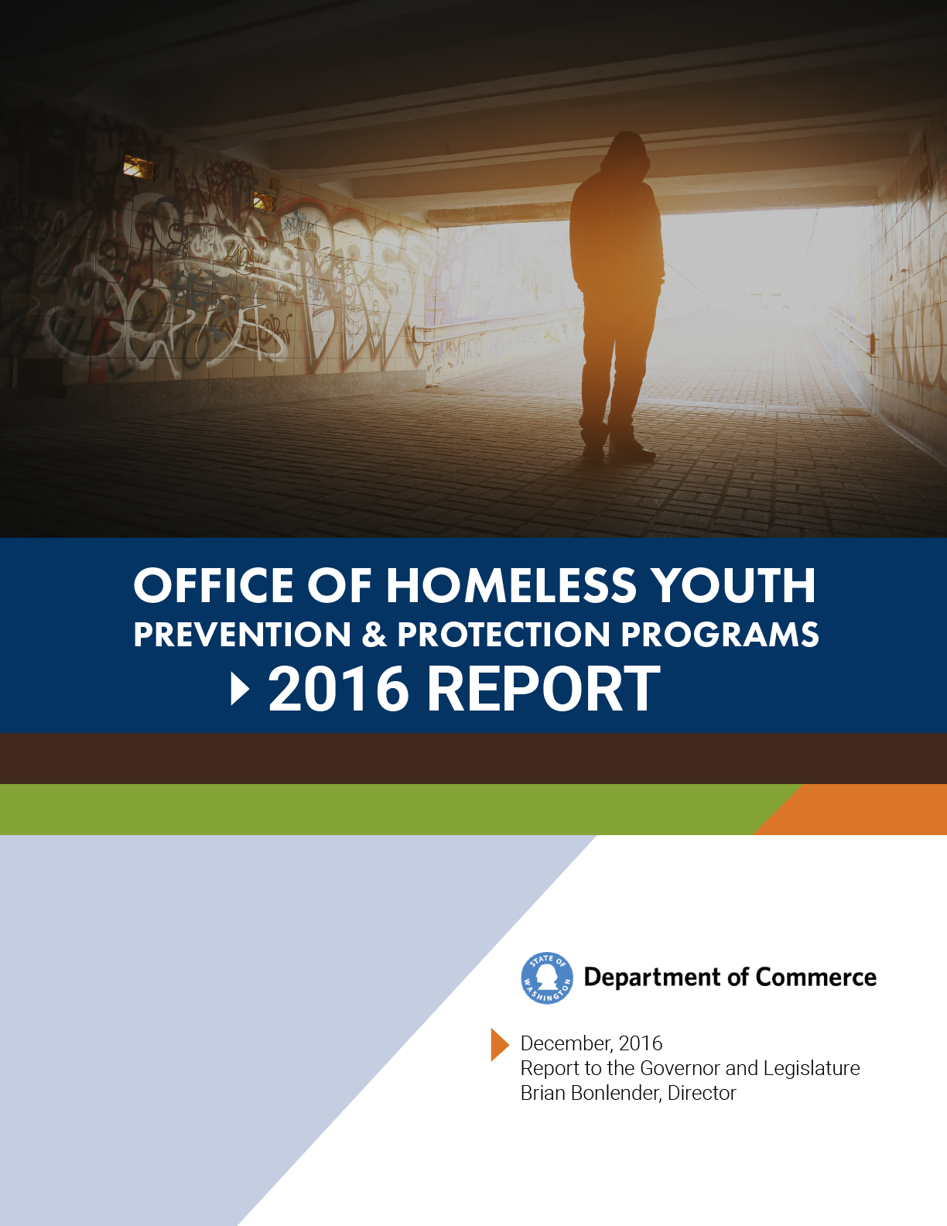
2016 Report to the Governor and Legislature

Slide 14
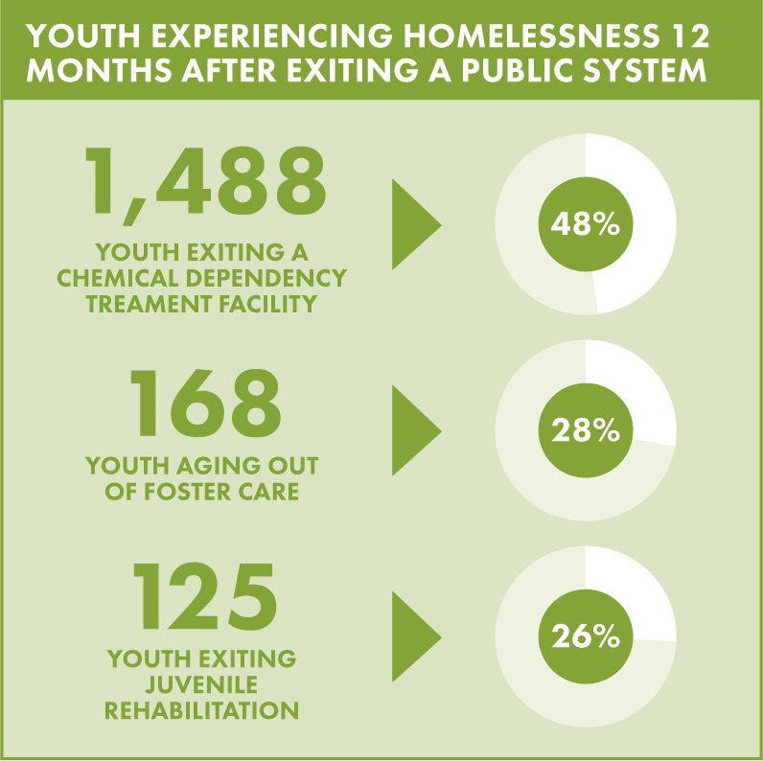
Near Term Actions
ENSURE THAT YOUTH EXITING PUBLIC SYSTEMS HAVE A SAFE, STABLE PLACE TO GO

Slide 15
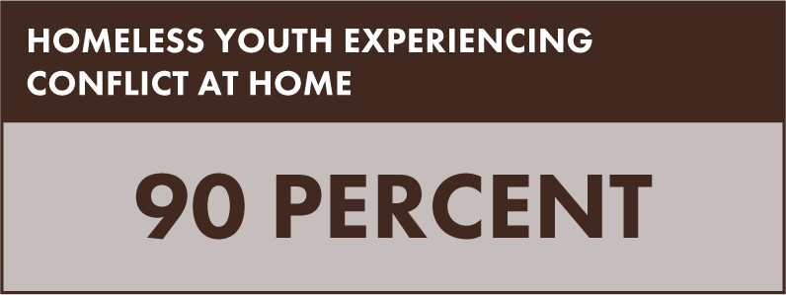
Near Term Actions
INVEST IN CRISIS INTERVENTION AND DIVERSION

Slide 16

Near Term Actions
IMPROVE EDUCATION AND EMPLOYMENT OUTCOMES

Slide 17

Partnership

Slide 18


Presented by:
Kim Justice
Executive Director, OHY
(360) 725-5055
kim.justice@commerce.wa.gov
www.commerce.wa.gov

Slide 19

Youth and Young Adult Homelessness
Jim Theofelis LMHC CDC, Executive Director, May 10th 2017

Slide 20

North Star:
Preventing and Ending Youth and Young Adult Homelessness in Washington State

Slide 21


Defining Success
What does ending youth and young adult homelessness mean to us? “Yes” to “Yes”
Building a statewide system that ensures local communities have the capacity they need to respond to youth and young adult homelessness in their area. So that: when a young person or a family says “Yes, I need support,” our systems, communities, and services can meet this request.

Slide 22

AWHWA Organizational Structure
Statewide movement focused on building Awareness, Connection, and Action
Time-limited campaign, linked to federal goal of ending youth and young adult homelessness by 2020
Not a 501(c)3 Sunset in 2020
Accept no government funding
Regional approach
Partnership with OHY

Slide 23
AWHWA Leadership Structure
Category | Roles and Responsibilities
Honorary Co-Chairs First Lady Trudi Inslee Youth Co-Chair Terry Jackson | Provide leadership in advocacy, communications and ambassadorship throughout the state Utilize the two unique voices to illustrate the urgency of the issue and the vision that we can end youth homelessness
Community Co-Chars Philanthropy Business Government Faith leaders Local leaders Tribes | A variety of community leaders throughout the state from different sectors to serve as ambassadors
Coordinating Partners | A diverse group of nonprofit leaders statewide to inform strategic direction of the campaign
Youth Advocacy Council | Youth and Young adult’s provide OHY & AWHWA with strategic advice and ambassadorship
Partners | Sign the pledge Share campaign information within their organization & share stories of work occurring in their community with AWHWA
Partner Organization Board Advocates | Deepen the knowledge of community board members empowering them to be ambassadors and advocates on local and state level

Slide 24

Who We Serve
Focused on nearly 13,000 unaccompanied youth and young adults who experience homelessness in Washington state
Youth = ages 12 through 17
Young adults = ages 18 through 24
Families = bio, adoptive, kin, foster, and chosen
Communities

Slide 25

AWHWA System-Improvement Strategies
Stopping discharge from public systems to homelessness
Supporting schools as the 1st point of contact
Strengthening local communities
Strengthening families

Slide 26
Unique Point in Time
YYA & Families
OHY:
Organizing agent that holds statewide standard of care
System-improvement strategies:
Preventing discharge, schools, local communities, families
Data-informed performance-driven solutions:
Landscape review, OHY report, dashboards, Oliver
Philanthropic partners:
Energized and engaged
Advocacy partners:
WACHYA
YAEH
ALUMNI
CLS
SHWA
Urgency:
100-Day Challenges, increased attention at state & local levels
Key conditions & stakeholders are in place & aligned toward the goal of preventing & ending youth and young adult homelessness
NATIONAL
MOVEMENT
INTERNATIONAL MOVEMENT

Slide 27
Prevention
Emergency Response
Housing & Supports
Current System Structure

Slide 28
Prevention
Emergency Response
Housing & Supports
Proposed System Structure

Slide 29
We Have a Plan

Slide 30
AWHWA Work Ahead
Activities
Awareness | 100-Day Challenges: communications, data, cheerleading, scheduled to end July 29th Video series: AWHWA & 100-Day Challenges Conference Presentations: WLIHA & AWC
Connection | Convenings: WACHYA, Host Homes, Developmentally Disabled Community network building Alumni Group: individuals aged 24+ who experienced homelessness as youth/young adults Organizational Peer Mentor Program: connecting providers Presentations & consultation with funders & administrators
Action | Legislative Advocacy: finish strong on 2017 session & interim work for 2018 Local readiness Data collection, analytics & performance metrics
Organizational Development | Regular AWHWA meetings: right-sizing capacity

Slide 31

100-Day Challenges
Teams from Spokane, Pierce, and King counties set ambitious goals for themselves to impact youth and young adult homelessness in their regions over 100 days
AWHWA amplifies progress and tracks data
Facilitation and coaching from Rapid Results Institute
Financial support provided by Raikes Foundation and Schultz Family Foundation
Part of growing national movement – similar challenges organized by A Way Home America in Austin, Cleveland, and Los Angeles helped house 413 young people in 100 days, exceeded original goals
#WaChallengeAccepted

Slide 32
100-Day Challenges
Community-Identified Goals
Spokane will house 100 youth and young adults in 100 days. At least 50 percent of the youth and young adults housed will be system-involved, with specific focus on youth and young adults that face substantial barriers, including at least 10 minors.
Pierce County will find successful housing options for 168 youth and young adults experiencing homelessness. Up to 30 percent will be 16-17 years old. Forty percent will be LGBTQ. Forty percent will be people of color. Pierce County will develop 100 new successful housing options, including foster home opportunities, host homes and landlords.
In 100 days, King County will place 450 young adults between the ages of 18 and 24 in safe and stable housing, of which 60 percent will be people of color and/or LGBTQ+ young adults, including all unsheltered young adults on the by-name list, as of 4/20/17.

Slide 33
2017 Legislative Actions

Slide 34
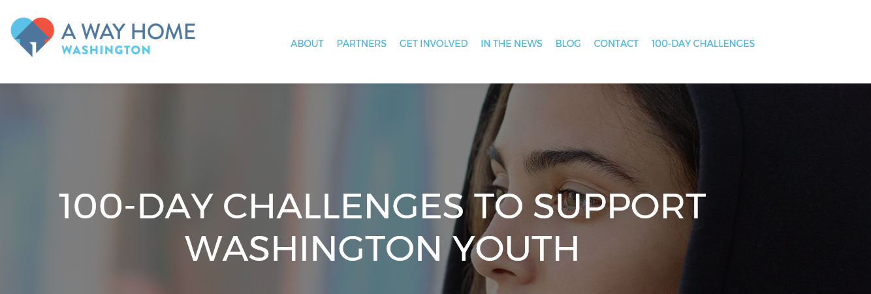
Partner With AWHWA
Visit our website: www.awayhomewa.org
Click on “Get Involved” and take our pledge!
Explore and learn more!
SEE | GIVE | COLLECT | SHARE | CONNECT | VOLUNTEER

Slide 35
Preventing and Ending Youth and Young Adult Homelessness in Washington State
Ensuring the resources, polices, and best practices are in place so that all of Washington’s young people find their way home.
Jim Theofelis
Executive Director
jim@awayhomewa.org
Erin Hatheway
Program Manager
ehatheway@awayhomewa.org

