Slide 1
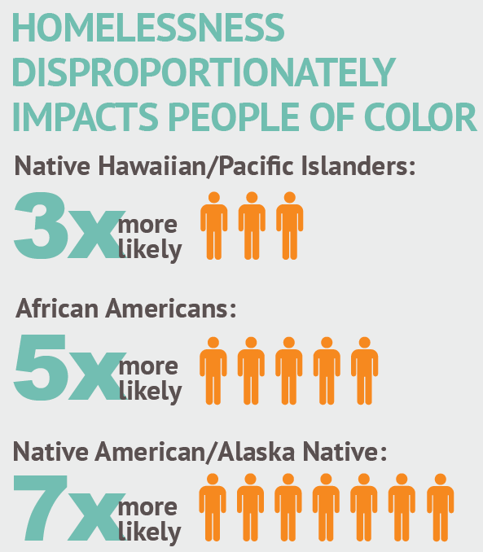
Notes:
Our goal – Get leaders to empathize with experience, and give you skill and confidence to discuss this topic in your community
Race isn’t the only important leadership factor – do you listen well, do you collaborate, etc.
Yet representation is a key democratic ideal. The Founding Fathers supposedly believed this…but they obviously didn’t.
In our sector of the community, we must do better.

Slide 2
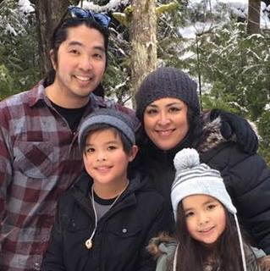
Who I am
System
Role
Person
Native Women
41 years old
Wife, Mother
Sister, daughter
Friend
Homeowner
Employee
Born and raised in rural Alaska

Slide 3
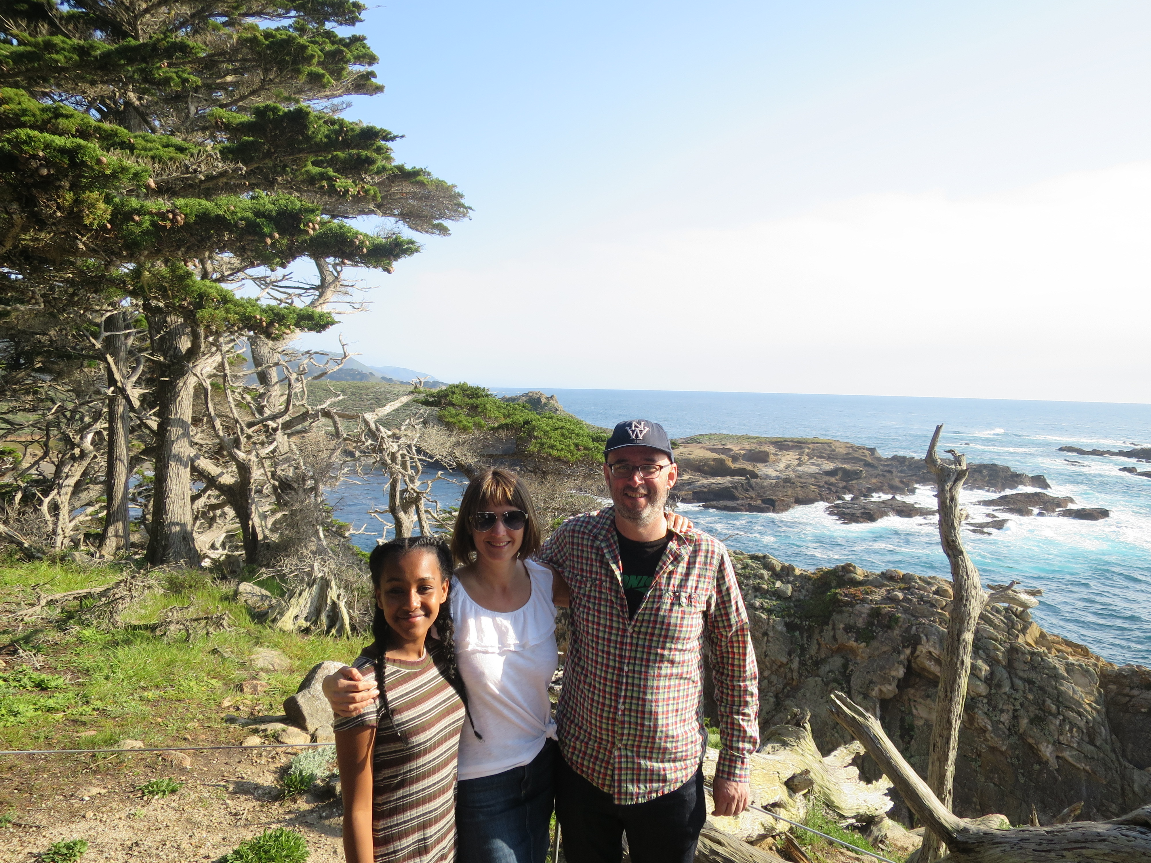
Who I am
System
Role
Person
Male
47 years old
Husband, father
Son, brother
Friend
Homeowner
Employee
Seattleite

Slide 4
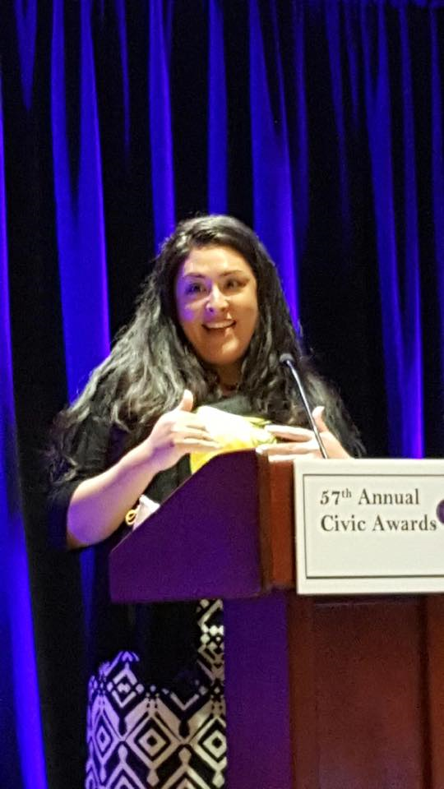
At work, I am
System
Role
Person
Spokesperson
Leader
Attempt to influence policy
Fundraiser
Attempt to influence
Decision-maker
Hirer
The boss
Often ask to represent ALL Native people

Slide 5
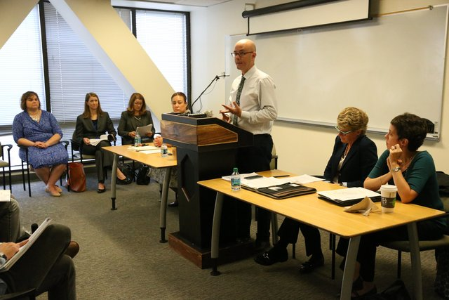
My role (and how I’m viewed by others)
System
Role
Person
Spokesperson
Leader
Policy setter
Funder
Influencer
Decision-maker
Hirer
The boss
White male

Slide 6
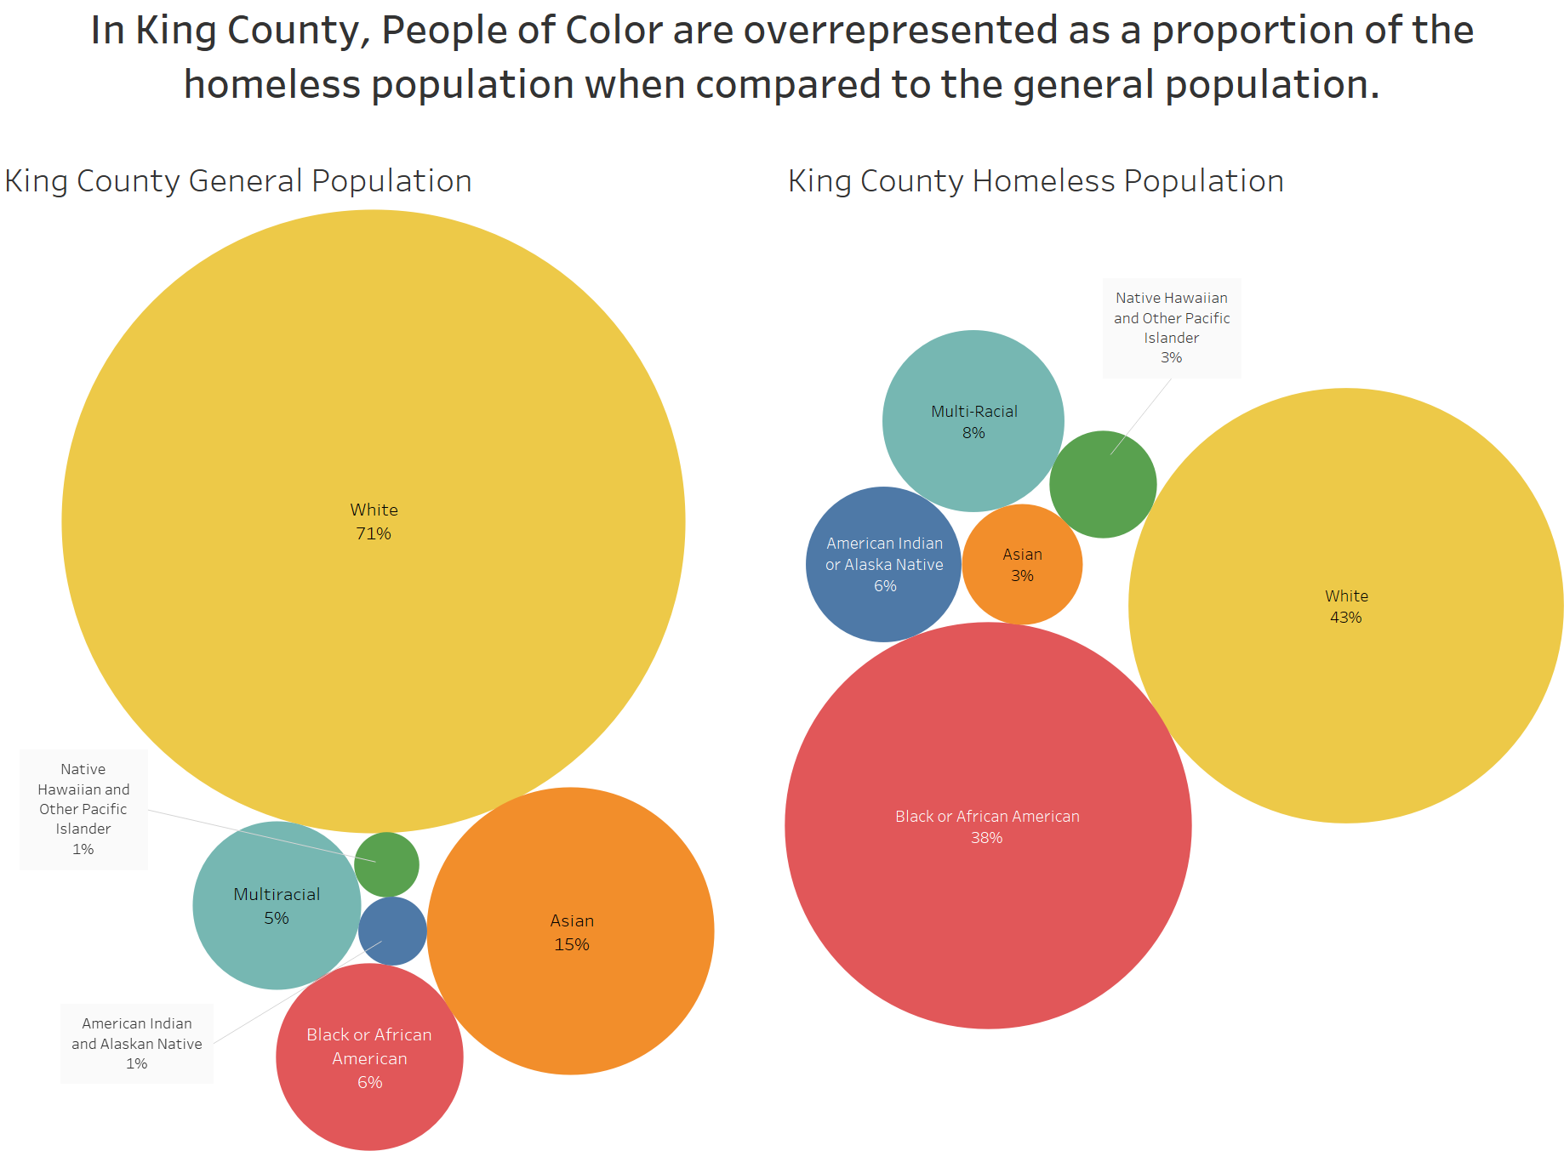
The work we do
System
Role
Person

Slide 7
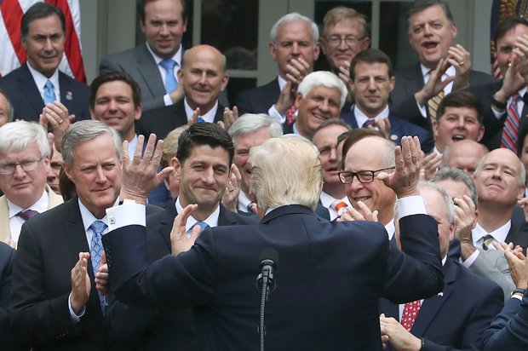
Nationally
Notes:
Decisions are being made by a white male majority, at all levels

Slide 8
And statewide:

Slide 9
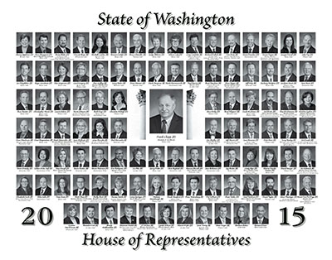
In 2017 as well:

Slide 10
Locally in King County as well:

Slide 12
I can build the bridge but I can’t get people to walk across

Slide 13
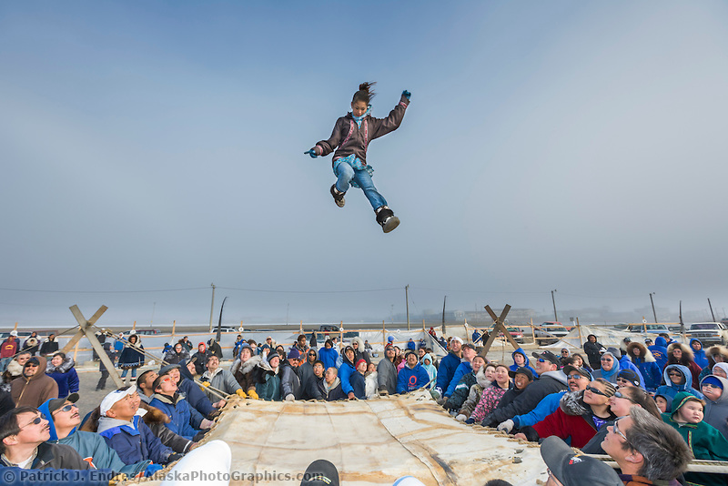
How are you supporting cultural expressions of leadership? How are you holding the blanket?
Notes:
Make relatives
CBPR is not ON, it is not just IN, it is WITH COMMUNITIES
There are several different definitions of CBPR, these definitions have many of the same components that encourage a collaborative method that involves reciprocal relationships between communities and researchers. Today we will be using the definition used by a WK Kellogg foundation CBPR program
“A collaborative approach to research that equitably involves all partners in the research process and recognizes the unique strengths that each brings. CBPR begins with a research topic of importance to the community and has the aim of combining knowledge with action and achieving social change...”
Examples - Kenny Smoker, Spokane Native, United Indians, American Indian Community House, Fairbanks Native Association
However, even CBPR assumes the ideas and science are generated by the academic partner, WHAT IF WE IMAGINE PAST THAT???

Slide 14
Is there a bridge that you need/want to walk over?

Slide 15
Do something about it
Act
Be creative and take action about inequity of leadership that is non-diverse
Be aware of your own biases and privilege
Understand the risk and vulnerability that is inherent for people of color who are staff
Be accessible, be vulnerable
Practice cultural humility
Name the elephant in the room
Embrace the struggle
LISTEN

Slide 16
What can we/you do?
Notice, observe, discuss, and act
Speak up about to the inequity of leadership that is non-diverse
Increase diversity of boards and staff through recruitment and development and sustenance
Foster culture that challenges status quo
Get out on the street and talk to people
Go into communities you don’t understand so that you can understand them better

Slide 17
Small steps of significance
Our board
and staff are
50% people
of color
Reducing
racial
disparities
(in access
and outcomes)
is one of our
4 primary goals

Slide 18
Taking action, including with funding Client engagement Advocacy focused on disparate impacts
Small steps of significance

