Slide 1
PROGRAM RULES:

Slide 2
Rules for this session
Participants must sign in and out at the check in sheet located at the entrance.
Participants may not leave the room after the session begins.
Cell phone or mobile device use during the session IS PROHIBITED. Use of a device will result in immediate expulsion from the session.
Restroom facilities will be available for use from 10:50 am to 11:10 am.
Participants may not speak while the presenter is speaking. NO EXCEPTIONS!
Participants are responsible for taking their own notes. WE WILL NOT TAKE NOTES FOR YOU.
Participants must sign the “Declaration of Understanding” in order to participate in this session.
Notes:
Cody

Slide 3
PROGRAM RULES:
Notes:
Schelli
Welcome and Schelli your self and introduce us:
Cody from Family Crisis Network in Pend Oreille County
Danielle from Cross Roads in Mason County
Emily from the Department of Commerce
Ask the group:
Did anyone attend the session last year?
Did anyone make changes to their program after the session last year?
Who works in a Shelter?
Transitional Housing?
PSH?
Rent Assistance Program?
Something else?

Slide 4
This workshop is based on and inspired by trainings provided by:
May 11, 2016
Notes:
Schelli
WSCADV acknowledgement
WSCADV has been talking about this and training on this issue among DV service providers for a LONG time
As domestic violence service providers (current and former) Schelli, Emily and Cody all received training from WSCADV regarding reducing program rules
There are links to WSCADV articles and other resources on the Resource Sheet

Slide 5
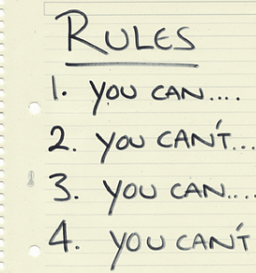
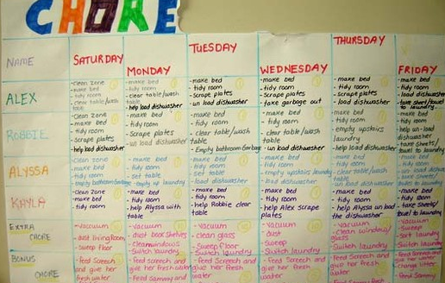
Program Rules
Rules about who gets in: Eligibility Criteria, Screening…
Rules about who stays in: Rules, Participation Agreements, Rights & Responsibilities, Grounds for Eviction/Termination…
Notes:
Emily
Rules about who get in = eligibility criteria, your screening process
Rules about who stays in =
Program participation requirements
Shelter rules
Grounds for Eviction
Client Rights and Responsibilities
Participation Agreements….
There are different kinds of rules
Some rules result in immediate eviction
Some rules are considered “strike rules” and multiple violations would result in eviction.
This all depends one the program re: how rules are applied

Slide 6
Program Rules: Why?
Funding
Safety
Control behavior
It’s easier than having a difficult conversation
Because of a one-time situation
For the convenience of program staff and administration
Um….because we have always had that rule
Notes:
Emily
Funder’s requirements: or what we believe to be the requirements of funders
Safety: Keep clients and staff physically safe
Control behavior of clients so that the program is functional and especially in the case of communal Living: rules to make peaceful communal living possible
These are not the main reasons rules get ugly. Rules get ugly because:
Making new rules is easier than a difficult conversation
Mike’s hard lemonade and Searches
Make new rules when one strange thing happens
No peeing in the closets
To make thing more convenient for staff or administration
Chores
And then there are those old rules…we don’t know where they come from or what purpose they serve but we keep holding on
No boys over 12

Slide 7
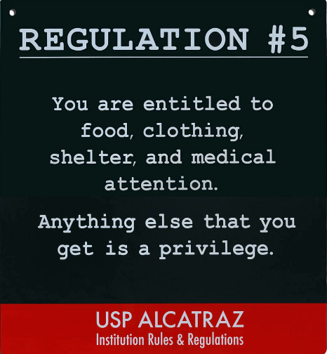
Rules & Consequences
How rules can effect the people you serve:
Keeps people out
Kicks people out
Re-Traumatizing
Can get in the way of the goal: HOUSING ASAP
Notes:
Emily
Rules that keep people experiencing homelessness from getting in or staying in your program contradicts the purpose of our programs- housing people.
This sign is supposedly from Alcatraz. It’s interesting because it says you are entitled to shelter. But in many shelter programs or housing programs you are not entitled to shelter. Shelter is a privilege. You have to keep your room clean right? If you don’t you can’t stay in the shelter.
To be effective, rules must have consequences. A homeless housing providers’ only real consequence is to deny or terminate services.
Rules can be traumatizing. And I think we can all agree that the overwhelming majority of people experiencing homelessness have had a lot of trauma in their lives. Homelessness itself is traumatizing.
These rules and how we apply them can be re-traumatizing:
Constant threats
Arbitrary application of rules
Surveillance
Searches and invasions of privacy
Questioning abilities and intelligence

Slide 8
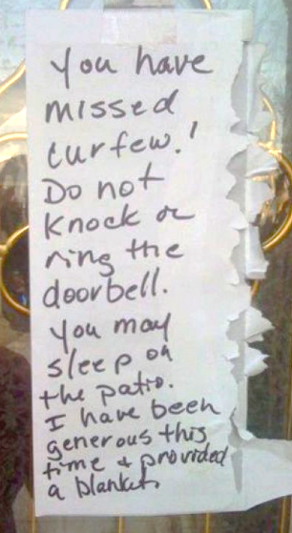
Rules & Consequences
How rules can effect program staff:
Time consuming
Confusing
Traumatic
Do you spend more time discussing rules than you do discussing housing?
Notes:
Emily
So many rules are confusing and time consuming for staff- they have to monitor all of them!
Writing letters and case notes explaining rule violations, strike notices
Staff as rule enforcer and ‘case manager’ or advocate?
Evicting people: My first eviction as a shelter manager

Slide 9
Rules & Consequences
How rules can effect the community:
Consequences contradict mission/purpose
The Question of Homelessness and Empty Beds
A project I worked on this year:
Catalog all known common shelter rules (77)
28 = shelter eligibility criteria
49 = shelter rules
Rules about personal schedules, required documentation, chores and parenting
Only 7 were required by a funder
Notes:
Emily
The consequence contradicts the purpose of our programs- housing people experiencing homelessness
Is homelessness a justifiable consequence for violating a program’s rules?
If you had to, could you defend these decisions to the community?
So that brings me to the question of homelessness and empty beds.
That doesn’t make sense to the community. “Those” people must choose to be homeless.
That is what people think right? It’s a choice.
The community at large is not aware of the eligibility criteria and rules that programs have.
They don’t know that the person sleeping outside may not be able to go to the shelter for a week because he missed curfew yesterday. The community doesn’t really know that you have to be sober for three days to get into the local program.
Are our own screening process and program rules keeping people on the streets? Maybe not in all cases but I think in a lot of cases all of these rules have made our services irrelevant to a large chunk of the population.

Slide 10
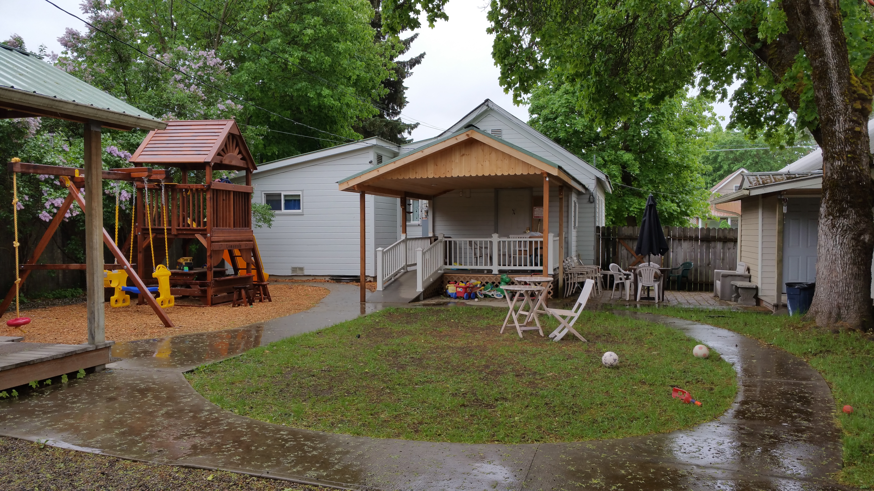
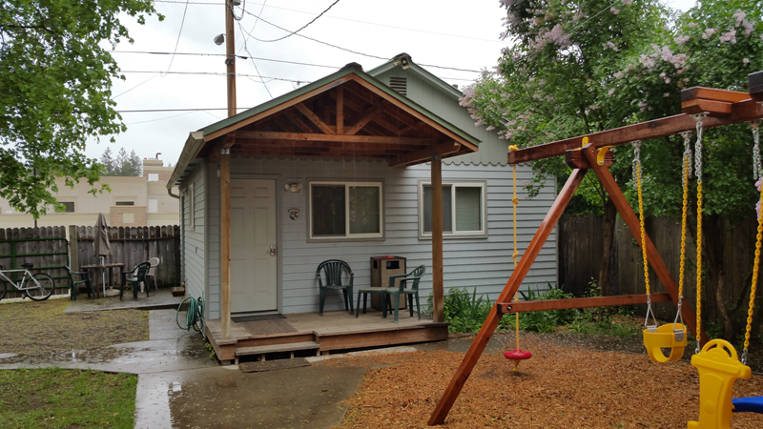
Cody’s Story
Shelter Stats:
10 bed emergency shelter for people experiencing homelessness and domestic violence survivors
1 unit individual apartment style, 1 unit communal living
Rural / Small sized town
No staff onsite after 5pm
Notes:
Cody

Slide 11
Cody’s Story
Old Rules:
Clients are not allowed to babysit another clients children
Inspection of the premises and facilities by shelter personnel is permitted without prior approval
All residents are to sign in and out when leaving the shelter to do errands, etc.. THERE ARE NO EXCEPTIONS.
No alterations of the facilities are permitted. Do NOT move the furniture or appliances.
Changes:
Please do not leave children unattended in the shelter. If you have childcare needs or issues please speak to an advocate
Inspection of the premises and facilities by shelter personnel is permitted without prior approval
All residents are to sign in and out when leaving the shelter to do errands, etc.. THERE ARE NO EXCEPTIONS.
No alterations of the facilities are permitted. Do NOT move the furniture or appliances.
Notes:
Cody

Slide 12
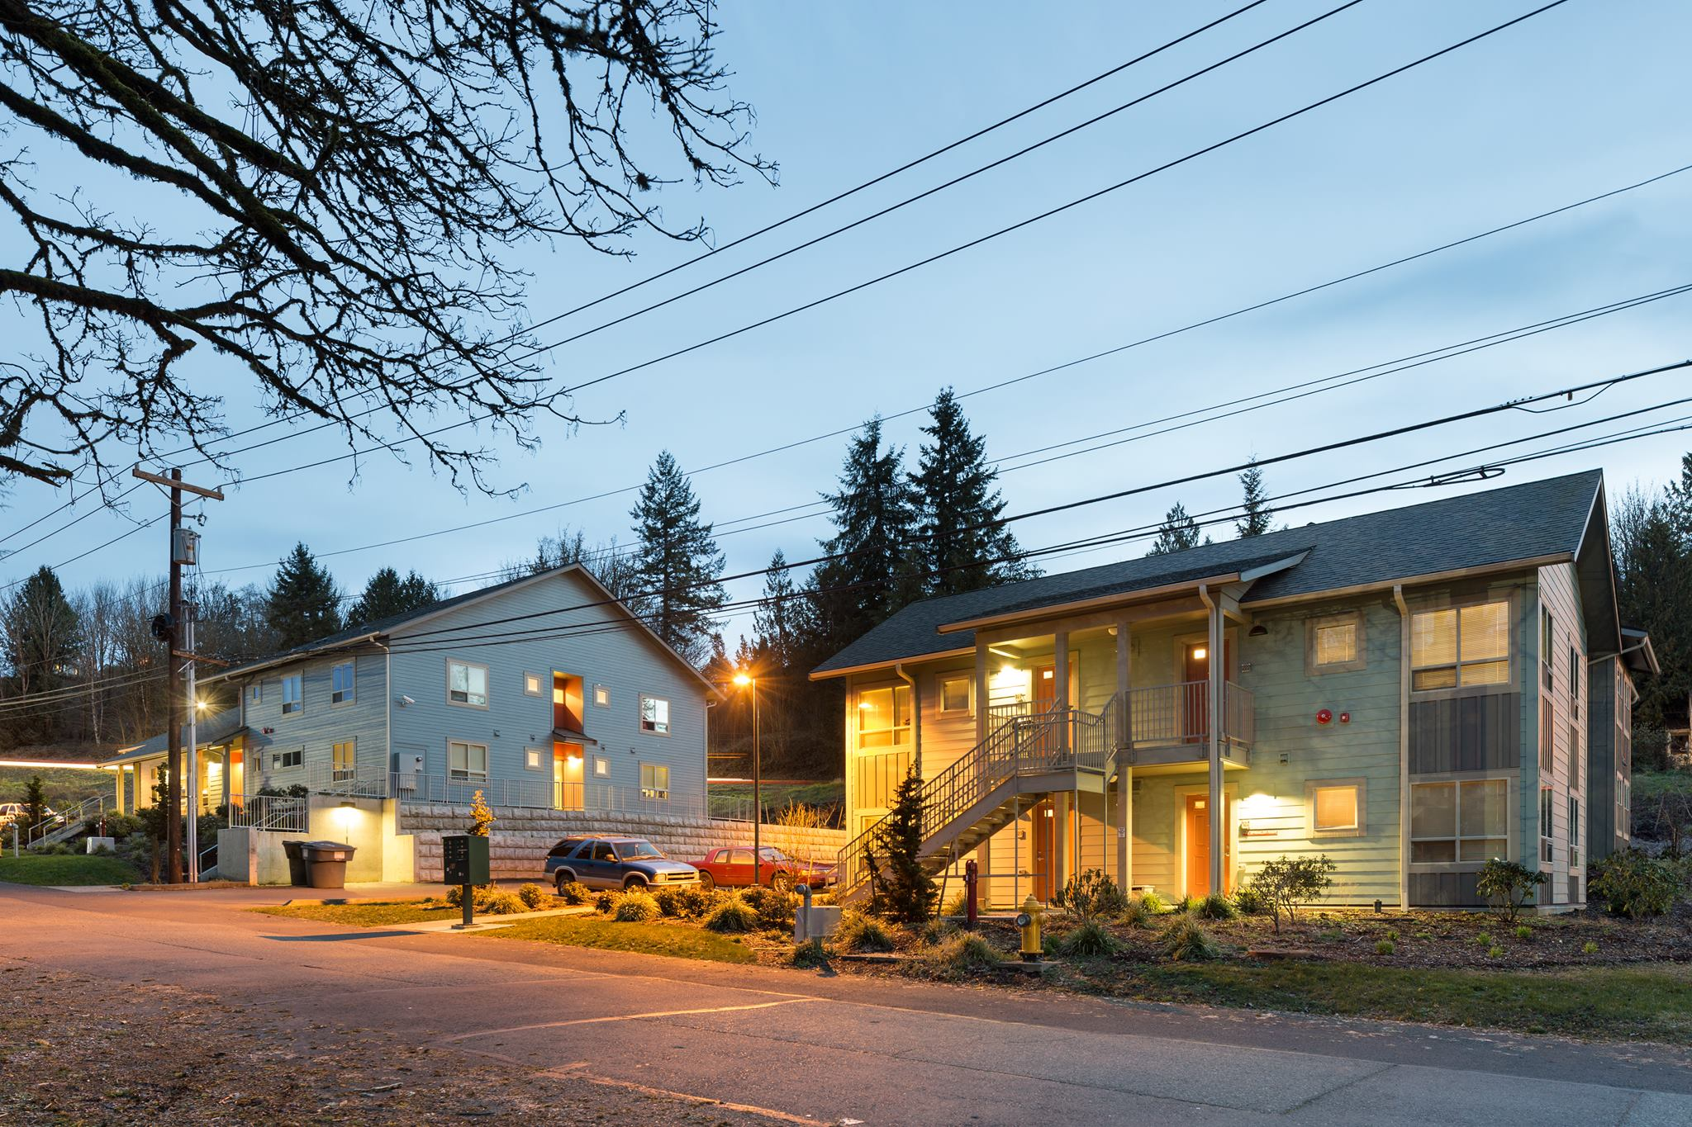
Danielle’s Story
Program Stats:
Emergency Shelter & Transitional Housing facilities
Apartment style
Rural / Medium sized town
Notes:
Danielle

Slide 13
Danielle’s Story
Where we came from
Education
Income
Housing
One Size Fits All
Notes:
Danielle

Slide 14
Danielle’s Story
New Model:
Low-barrier entry and stays
Client-led assessments and planning
Progressive engagement
Trauma-Informed environment
Rules
Policies
Environment
Transitions:
Notes:
Danielle

Slide 15
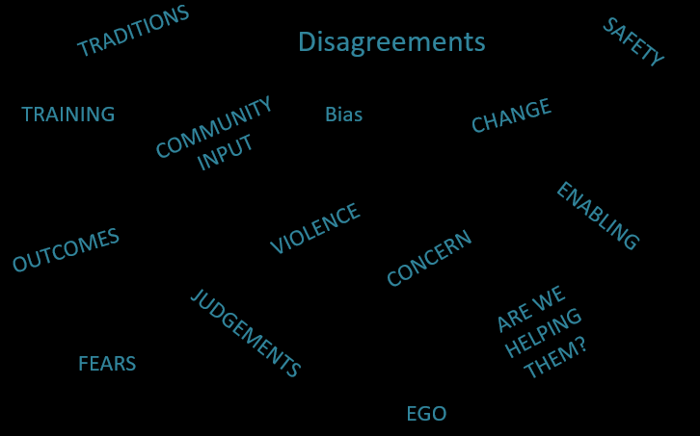
Danielle’s Story
Challenges:
Notes:
Danielle

Slide 16
Danielle’s Story
Results:
Clients | Staff | Housing Outcomes
Less trauma | Less stress | Fewer returns to shelter
More support | More trust | Increased exits to permanent housing
Faster, focused progress | More communication | Fewer dismissals from the program
More success | More inter-agency support | Length of stay
More access to supportive services
More autonomy
Notes:
Danielle

Slide 17
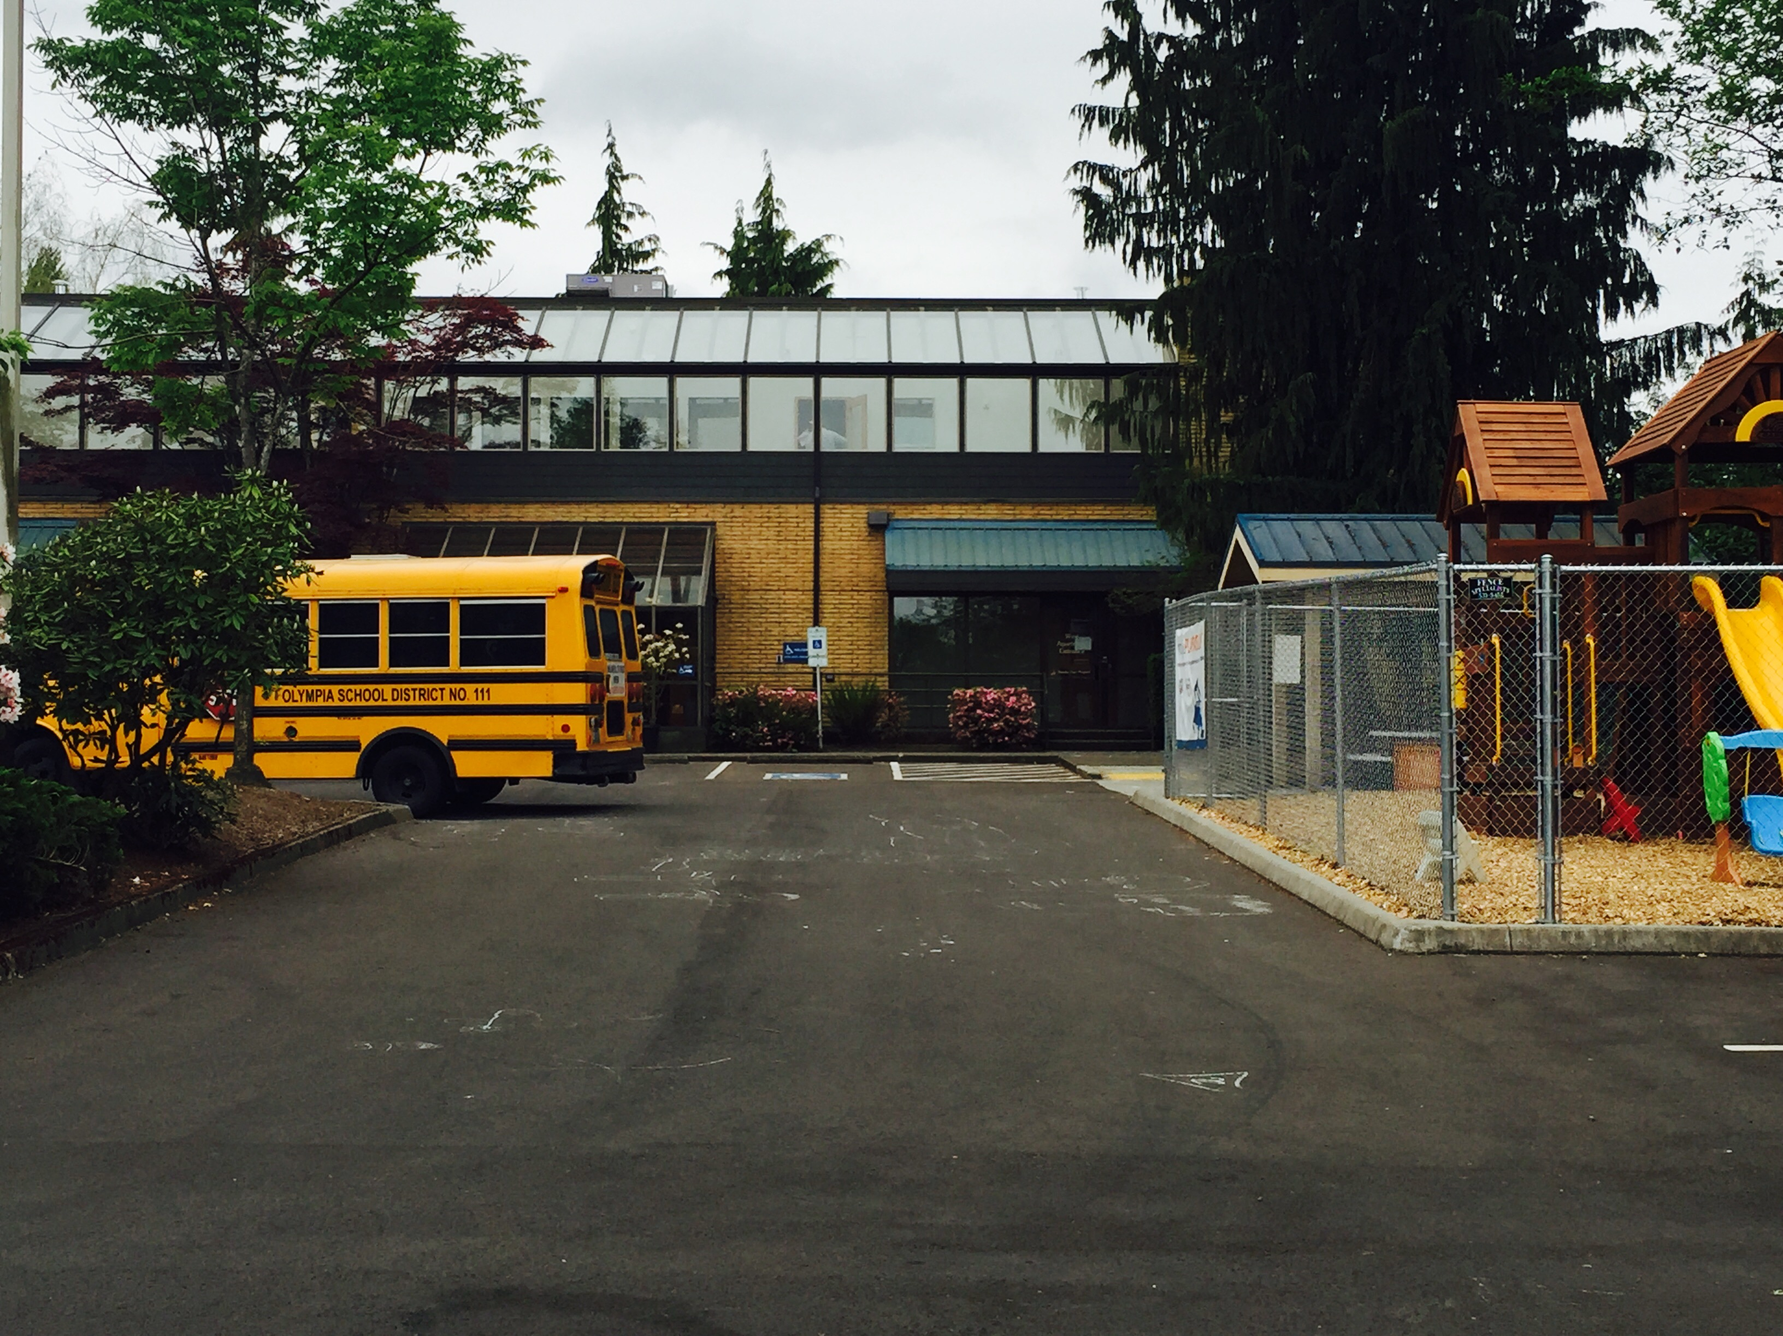
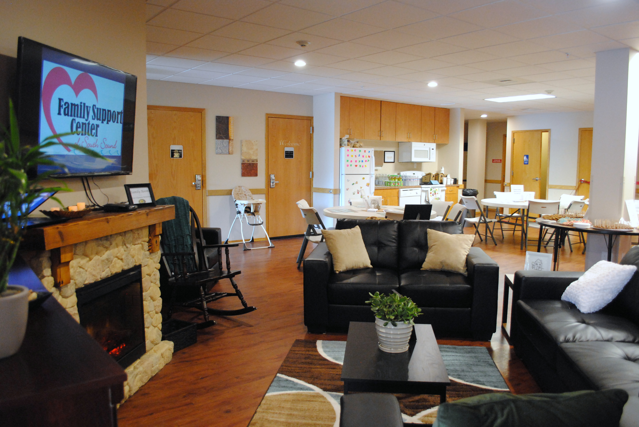
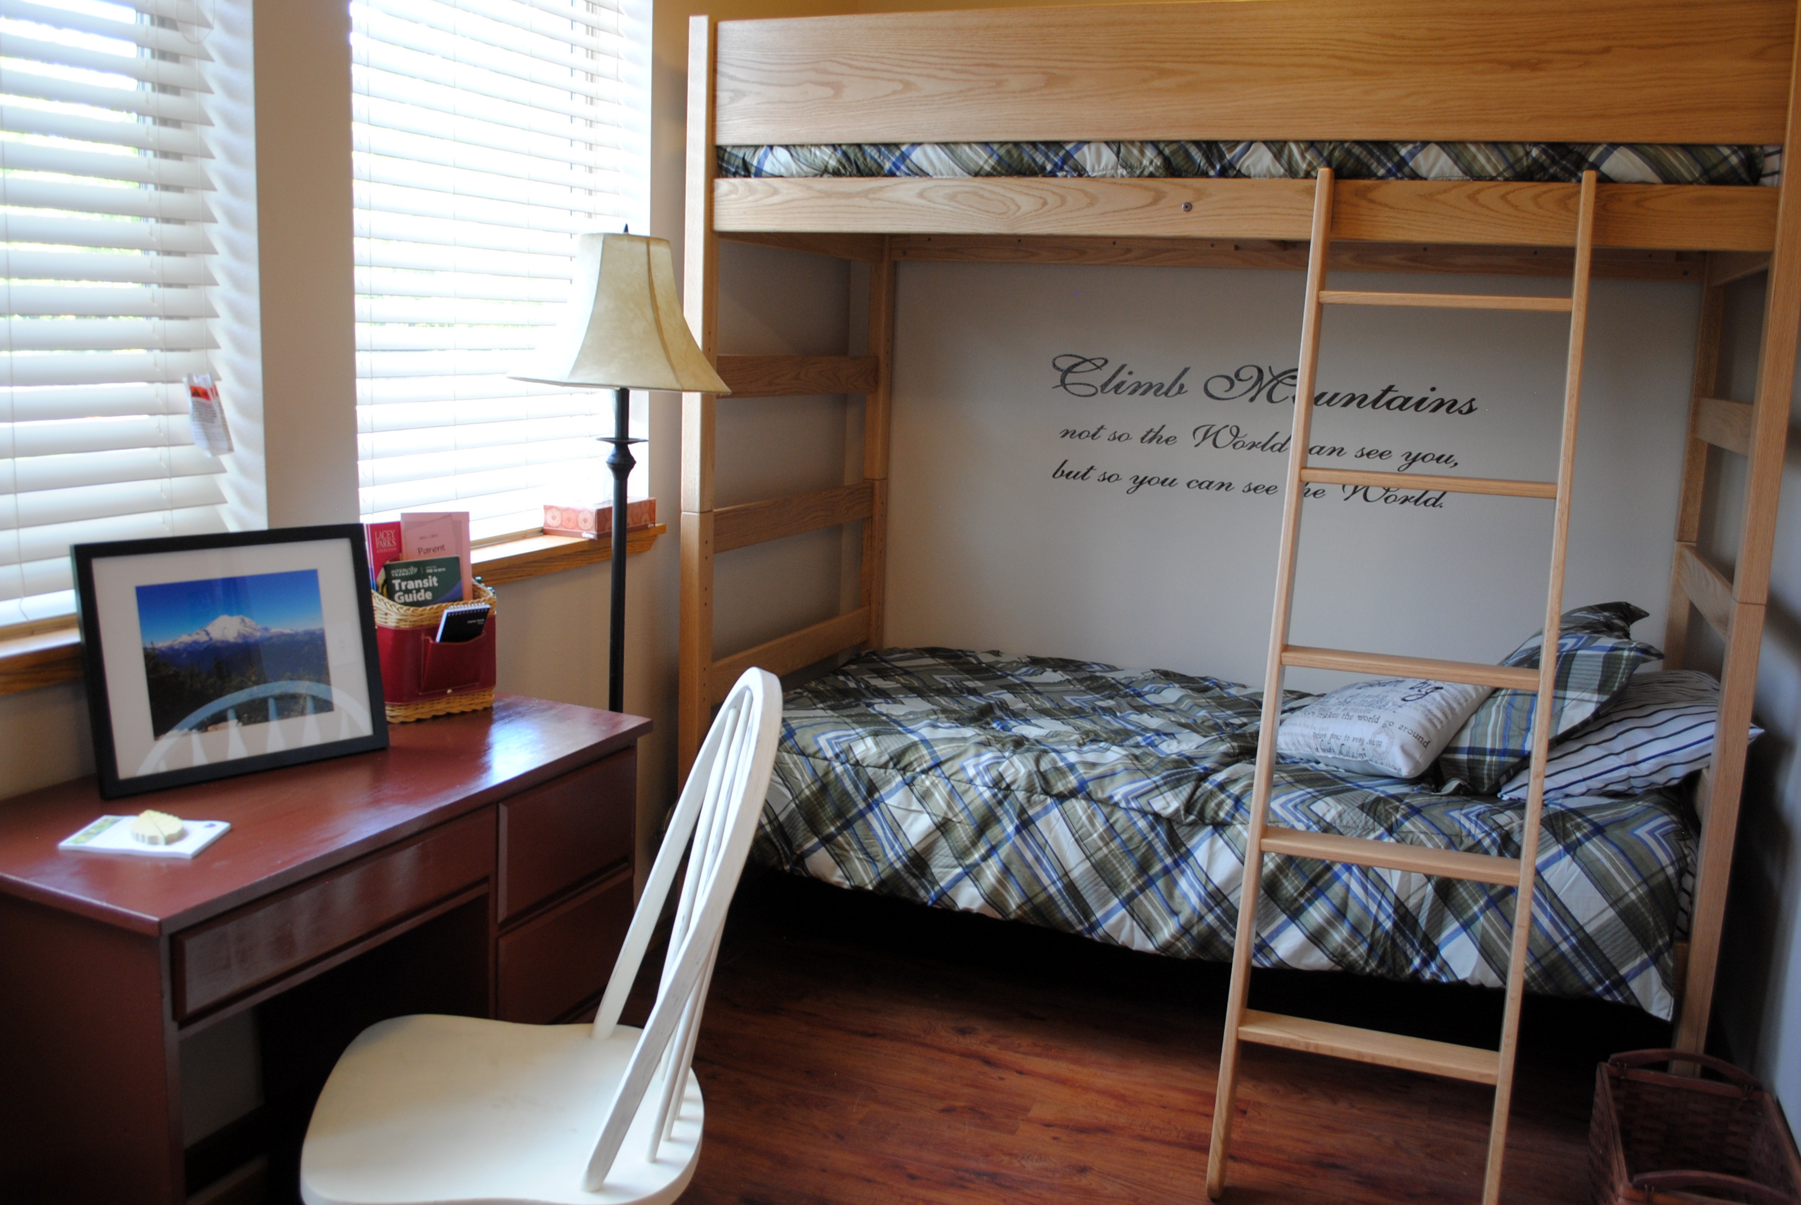
Schelli’s Story
Pear Blossom Place Stats:
36 bed emergency shelter for families with children experiencing homelessness
Placed by V.I.
6 units studio style, families share
All family members allowed
Urban / Medium sized city
Staff Onsite 7am-6pm 7 days week, volunteer and on call staff after hours
Notes:
Schelli

Slide 18
Schelli’s Story
RULES FIRST:
Room doors must be closed at all times, no propping doors
Spanking is strictly forbidden. Must use positive parenting strategies
Must communicate with respect at all times, no offensive language
Do not engage in sexual activity
Computer is for homework, job, housing search only.
Must be actively engaged in case management
No smoking, drugs, or weapons on premises
No entry or exit after 10pm;
No visitors or guests anywhere on property
Must supervise children of all ages at all times; do not leave children in another’s care
No eating in living room
Ensure the window screen is not removed or damaged
Only do laundry on your assigned day; Keep your room neat and tidy, participate in assigned chores
No pets (but service animals are ok, right?)
Notes:
Schelli

Slide 19
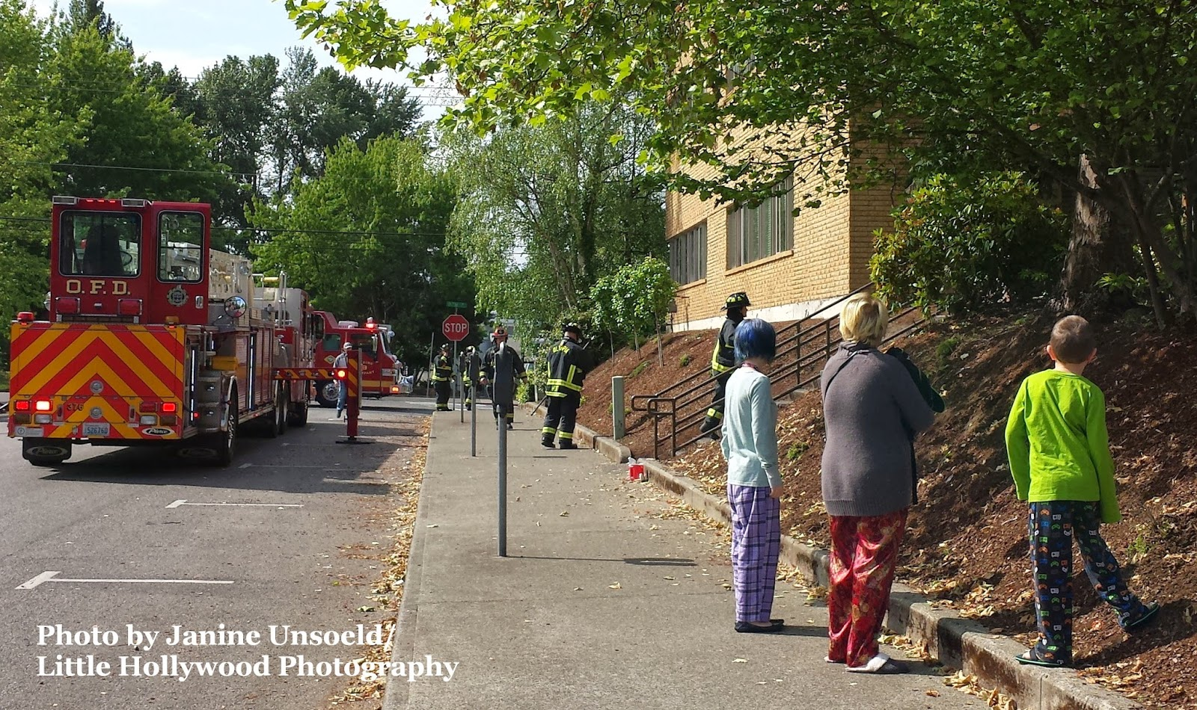
OMG! What if…
PEOPLE USE DRUGS!
THEY NEVER EVER LEAVE…
KIDS ARE IN DANGER?!
THERE’S A PREGNANCY OUTBREAK!
EVERYONE QUITS!
WE GET SUED??!
THIS HITS THE NEWSPAPERS?
THE SHELTER BURNS
DOWN?!!!

Slide 20
Schelli’s Story
Rules were in conflict with…
Mission, vision, values
“Housing is a Human Right”
Best practices:
Housing First
Trauma informed care
Harm reduction
Progressive Engagement
Protective factors
What we were all personally willing to live with
OUR JOBS
Notes:
Schelli

Slide 22
NEW RULES

Slide 23
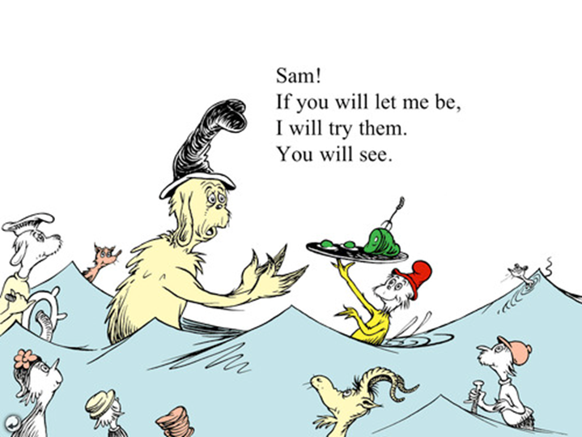
Lessons Learned
The GOOD, NOT SO BAD, & NOT SO UGLY RESULTS…..
PICK YOUR BATTLES….
Is it a dire public health and safety issue?
Are you making a moral judgement?

Slide 24
Small Groups: Critical Questions
In small groups: Pick a rule! Any rule!
A rule you all have in common or
A rule that someone really wants to work on
Use the hand out “Critical Questions to Ask About Program Rules”
to analyze the rule
Share with the group
Notes:
Small groups

Slide 25
Strategies to Reduce Rules
Examine all of your rules and their consequences
Ask the people you serve and your staff how the rules are working for them
Eliminate rules that are already law, unenforceable or inconsistent with your mission
Start with getting rid of one or two rules
Give it a trial run
If you cannot get rid of the rule can you change the consequence?
Plan ahead (instead of making a rule, make a plan)

Slide 26
Additional Resources
Levy-Peck Consulting, LLC “Resources on Trauma-Informed Services”
http://www.levy-peckconsulting.com/resources.html
How the Earth Did Not Fly Into The Sun: Missouri’s Project to Reduce Rules in Shelter
http://wscadv.org/resources/how-the-earth-did-not-fly-into-the-sun-missouris-project-to-reduce-rules-in-shelter/
Critical Questions to Ask About Shelter Rules
http://wscadv.org/resources/critical-questions-to-ask-about-shelter-rules/
How We Gave up Curfew
http://wscadv.org/resources/how-we-gave-up-curfew/
Making Minimal Rules Work
http://wscadv.org/resources/making-minimal-rules-work/
Rules: the Good the Bad and the Ugly
http://wscadv.org/resources/rules-the-good-the-bad-and-the-ugly/

Slide 27
Thank you for attending!
Please remember to complete your survey!

