Slide 1
Just Cause Eviction Ordinances
Increasing Housing Stability and
Building Renter Power with Local Legislation
Conference on Ending Homelessness 2017
Tenants Union of Washington
BEST – Being Empowered Thru Supported Transition

Slide 2
Workshop Goals:
1). Raise awareness of problems posed by current no-fault eviction laws; and of solutions offered by Just Cause Eviction Ordinances
2). Build skills and power around assessing community needs and passing local legislation to address them

Slide 3
Why Just Cause?

Slide 4
Problem: Current State law allows for no-fault evictions with only 20 days of written notice.
RCW 59.18.200: (1)(a) When premises are rented for an indefinite time, with monthly or other periodic rent reserved, such tenancy shall be construed to be a tenancy from month to month, or from period to period on which rent is payable, and shall be terminated by written notice of twenty days or more, preceding the end of any of the months or periods of tenancy, given by either party to the other.
Outside of Seattle, most rental agreements roll over to month-to-month tenancies even if initially a fixed-term lease.

Slide 5
Current law: Big power for landlords; big problems for renters!
Leads to unnecessary homelessness (short timeline, high moving costs, low vacancy rates)
Provides a legal screen to hide retaliatory and discriminatory actions
Renders other tenant protections (ie Source of Income Discrimination) less effective
Tenants are afraid to organize; make complaints to code enforcement; or even request repairs

Slide 6
Low-income tenants in Renton successfully organized to bring Source of Income Discrimination protections to their city… but without Just Cause protection, tenant organizers, voucher-holders, and others remain vulnerable to retaliation and discrimination (Photo credit: Leah Abraham | Renton Reporter)

Slide 7
Without Just Cause protections:
Local issues facing low-income renters are made worse
Tenants are afraid to organize to change their conditions

Slide 8
Case Study: Spokane

Slide 10
Case Study: Kent

Slide 11
How it Works:

Slide 12
Overview:
Just Cause legislation says a landlord must provide justification to terminate a tenancy; without proper justification an eviction based on the termination will not hold up in court. Limits “no-fault” evictions and often gives tenants more time to find housing and move in the case of a lawful termination.
Many cities and states have Just Cause eviction laws, including Seattle, San Francisco, Oakland, Berkely, Los Angeles, San Diego, New York City, the State of New Jersey and the State of New Hampshire
Federal housing programs often provide “good cause” protection which prohibit arbitrary termination of tenancy or refusal to renew a lease. Programs with good cause protection include: Project-Based Section 8 buildings and Low-Income Housing Tax Credit (LIHTC) properties.

Slide 13
Seattle Law:
Creates 18 good causes – the ONLY reasons for which a landlord can terminate a month-to-month tenancy. Without a clearly stated good cause, a termination notice is not valid
Includes tenant-based causes (failure to pay rent or to follow rental agreement) and landlord-based causes (wants to occupy unit or use for immediate family member)
Enforced by Code Compliance staff in the Department of Construction and Inspections
Passed by City Council in 1981 in response to displacement occasioned by Convention Center development

Slide 14
East Palo Alto Law:
Has both tenant-based and landlord based causes
Applies to term leases. A landlord can only regain possession of the unit if “Upon expiration of a prior rental agreement the tenant has refused to agree to a new rental agreement which contains provisions that are substantially identical to the prior rental agreement”
Doesn’t provide additional notice periods

Slide 15
Oregon Legislation:
A bill recently passed the Oregon House and is now before the Senate which limits no-cause evictions and requires to give 90-day notice and pay an amount equal to one month’s rent if they do evict without cause
The bill would also lift the statewide ban on rent control

Slide 16
Low Income Housing Tax Credit
Applies during the Compliance Period, usually the first 15 years of receiving the Tax Credit
In order to terminate a lease or not renew a lease the owners must demonstrate good cause
Good Cause is defined as “serious or repeated violation” of the lease by tenants or conditions that make the unit “uninhabitable”

Slide 17
Making it Happen!

Slide 18
Advantages of local legislation?
Avoids well-organized, well-funded landlord lobby at the State level (our friends who brought us statewide ban on rent control)
Local officials may be more responsive to community needs; more opportunities to held them accountable
Communities have opportunity to tailor solutions to their unique problems and conditions
Need to strengthen local power and responses given national climate

Slide 19
Opportunities and Challenges: Lessons from Spokane and Kent Just Cause Campaigns

Slide 20
Strategies for local organizing: Ask: Where could the city intervene? What changes do we need to fight for?
Build coalitions - Who else cares about this issue? How do our goals align?
Spread the word – media work; storytelling sessions; speak at city council, town halls and other forums; community presentations; workgroups or stakeholder processes
Cultivate relationships with sympathetic elected officials
Involve the legal community - work with legal aid and think about legal angles (ie fair housing law; habitability laws)

Slide 21
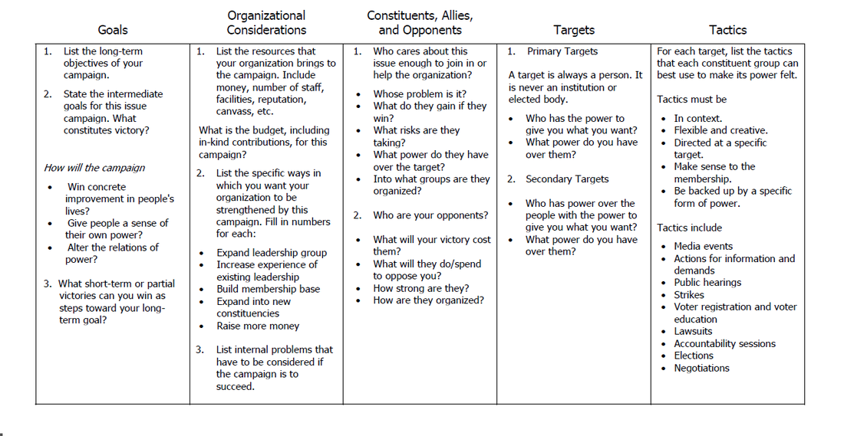
Strategy Chart (©Midwest Academy)

Slide 22
Workshop / Toolkit
Start your own campaign!

Slide 23
Materials in packet:
Sample Ordinance – prepared by the Center for Justice in Spokane
10 facts about Just Cause in Spokane
Why Kent needs a Just Cause Eviction Ordinance
Think about – what reasons stand out most for your community?

Slide 24
Questions for Small-Group Discussions:
What problems in your community could be addressed by local legislation?
What communities, groups, or organizations would get on board with your campaign?
Who has power in your community? What do they care about?
What would your first organizing steps be?

Slide 25
Call to Action – Set up an initial meeting in your community!

Slide 26
Thanks for your time – please get in touch!
Rev. Jimmie James: rev.jimmiejames@gmail.com - Terri Anderson: terria@tenantsunion.org
Dinah Braccio: dinahb@tenantsunion.org - Helena Benedict: helenab@tenantsunion.org

