Slide 1
Race, Class and Homelessness
Conference on Ending Homelessness
Tacoma, WA 5.10.2017
Presented by Anita Morales and Alan Preston

Slide 2
Two Sessions
Part 1: Structural Racism and Classism and its Impact on our Identities
Part 2: Race and Class in Our Work

Slide 3
Data from All Home reported in 2016, www.allhomekc.org

Slide 4
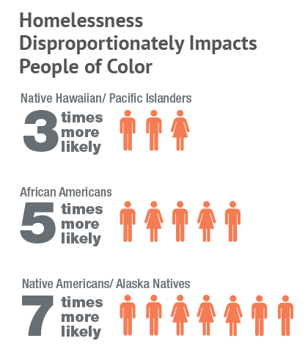
Data from All Home reported in 2016, www.allhomekc.org

Slide 5
Workshop Goals
Deepen understanding of structural connection between race, class and homelessness
Increase awareness of our own racial and class identities and biases
Identify ways that racism and classism impact and are reinforced by our institutions

Slide 6
The Intersection of Class & Race

Slide 7
What feelings did this clip bring up for you?
How does the historical relationship between class and race playing out today?

Slide 8
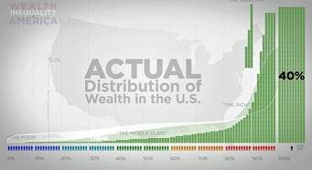
Wealth Inequality

Slide 9
Racial Wealth Gap

Slide 10
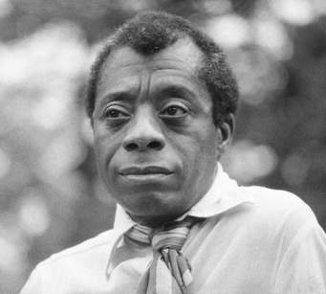
“History is not the past. It is the present. We carry our history with us. We ARE our history.”
~James Baldwin, quoted in
I am not Your Negro

Slide 11
Public Policy (From United for Fair Economy ‘s Racial Wealth Divide Workshop)
BOOSTS
Homestead Laws
Social Security
FHA Loans
Labor Laws
GI Bill
Home Mortgage Interest Deduction
Tax Breaks

Slide 12
Public Policy (From United for Fair Economy ‘s Racial Wealth Divide Workshop)
BOOSTS | BLOCKS
Homestead Laws | Loss of land
Social Security | Slavery
FHA Loans | Jim Crow
Labor Laws | Bracero Program
GI Bill | Immigration Quotas
Home Mortgage Interest Deduction | Redlining
Tax Breaks | Predatory Lending
 | Mass Incarceration

Slide 13
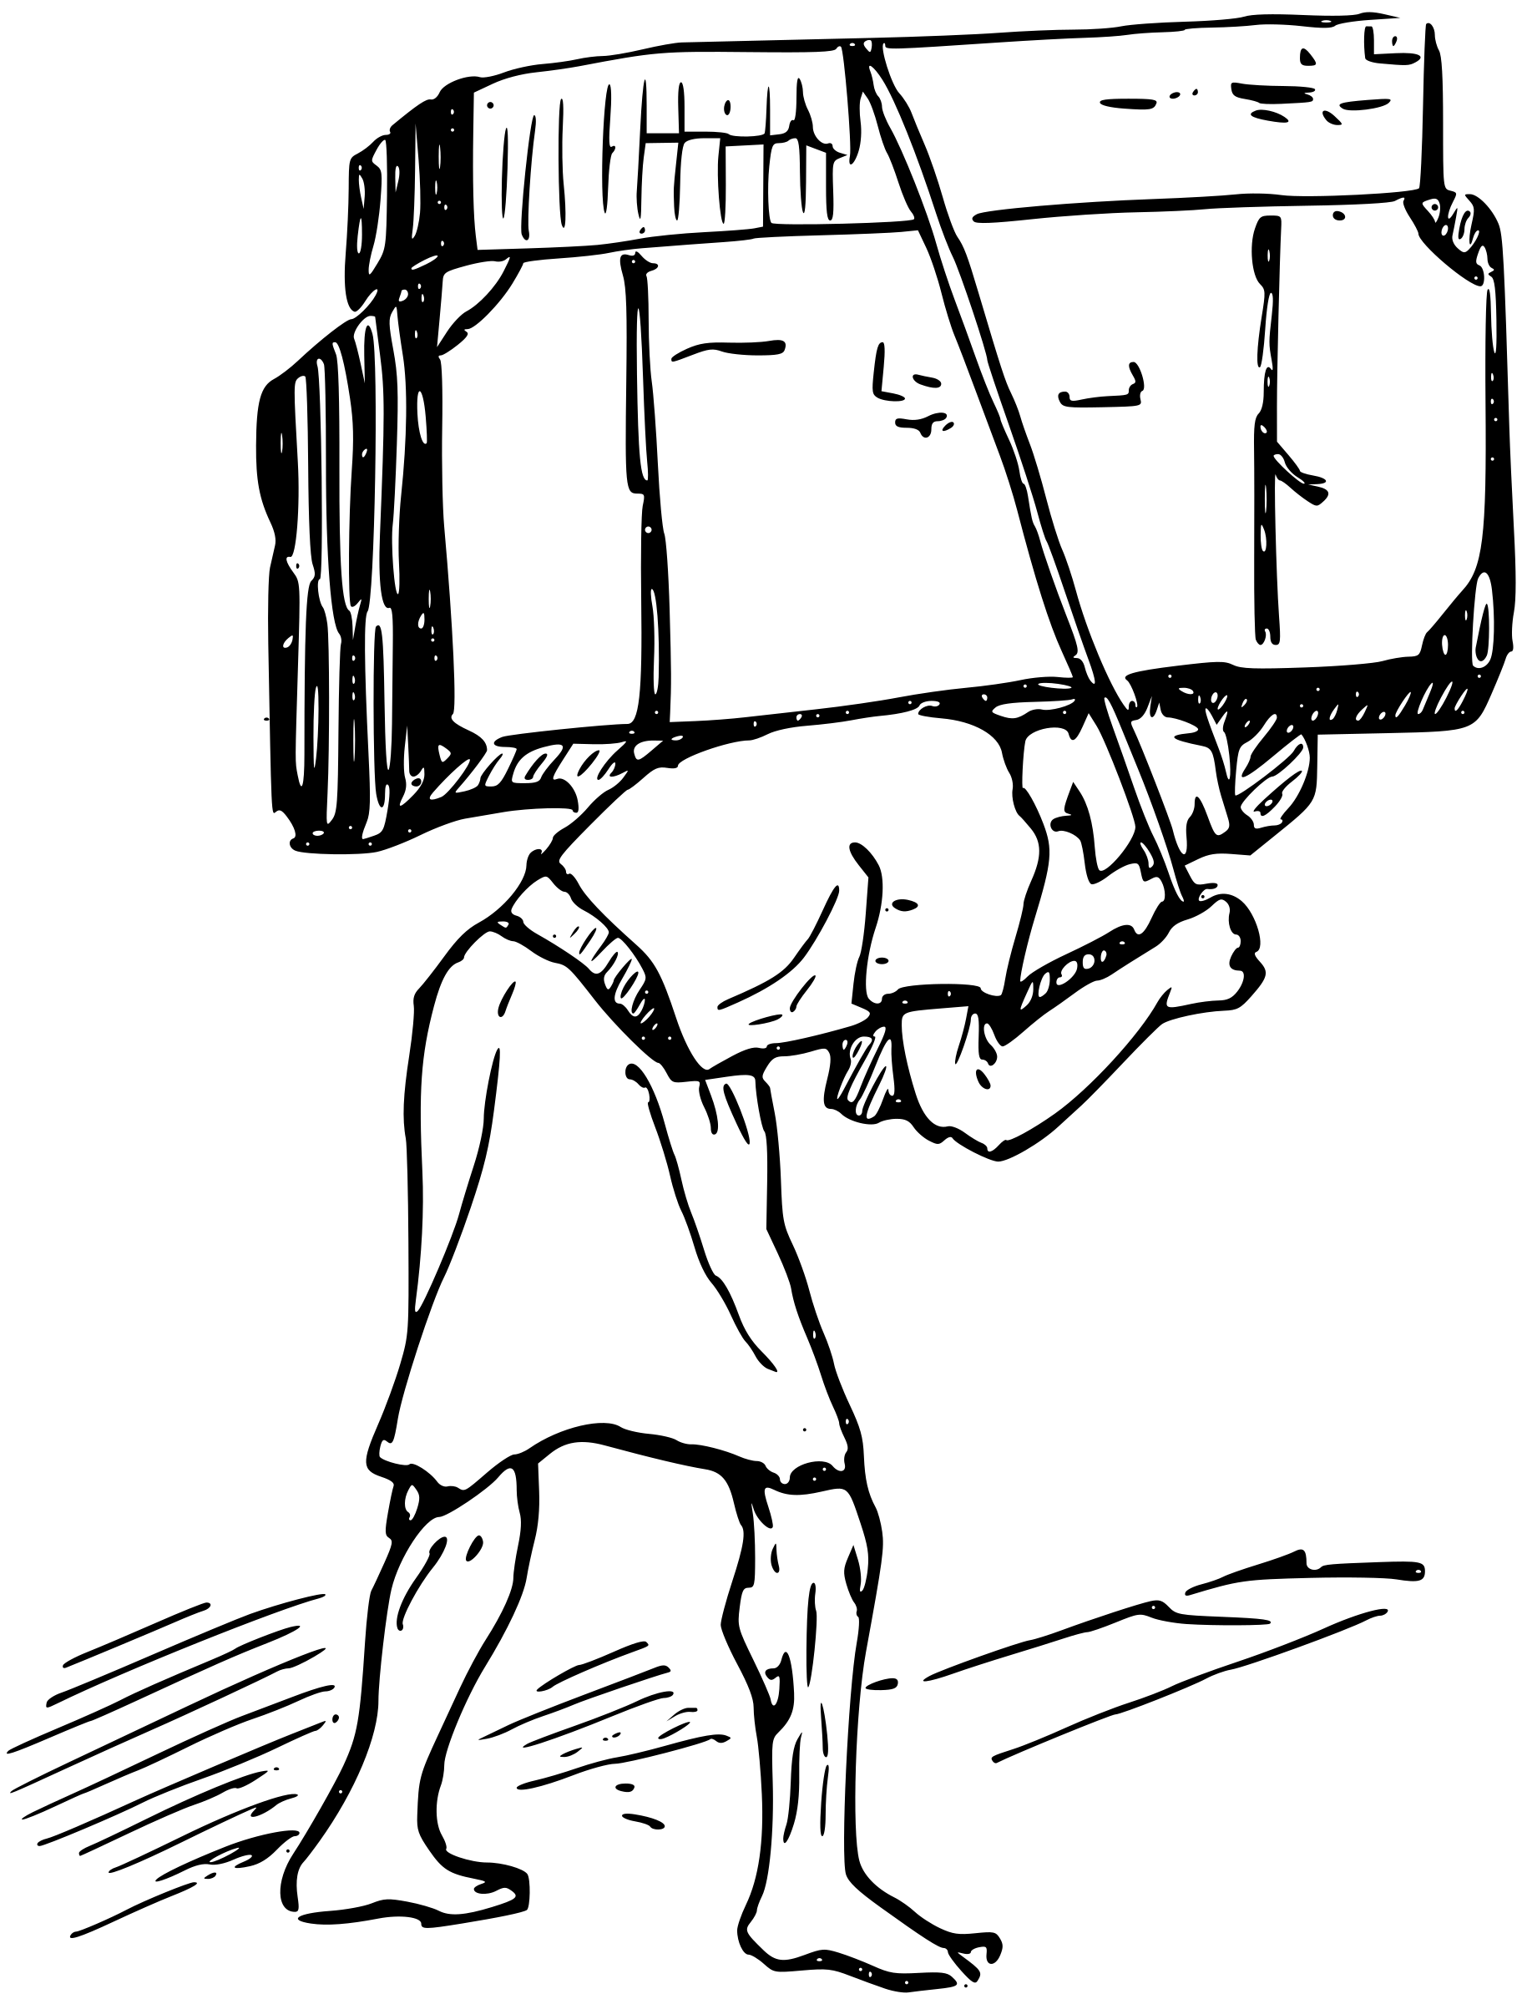
Who Benefits? Who is Burdened?

Slide 14
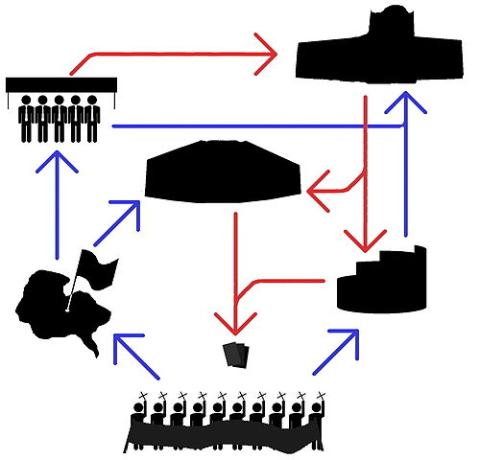
Beyond the laws
INSTITUTIONS

Slide 15
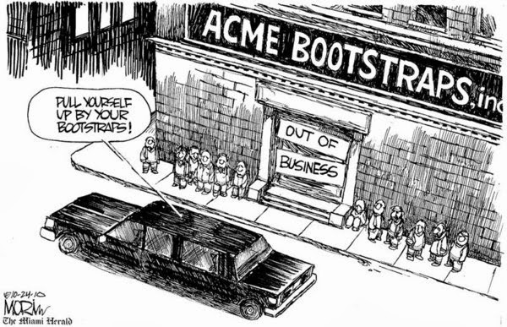
Beyond the laws
CULTURAL NARRATIVES

Slide 16
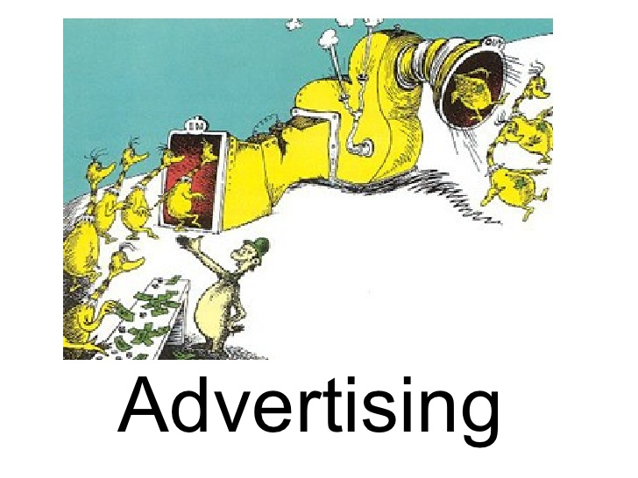
Beyond the laws

Slide 17
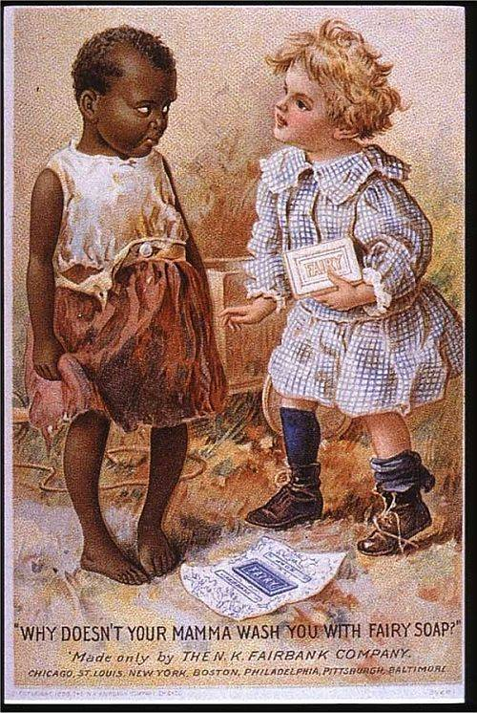

Slide 18
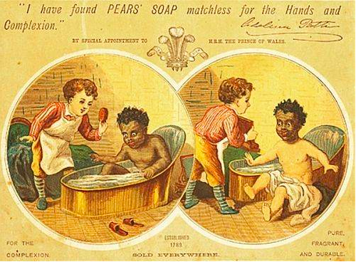

Slide 21
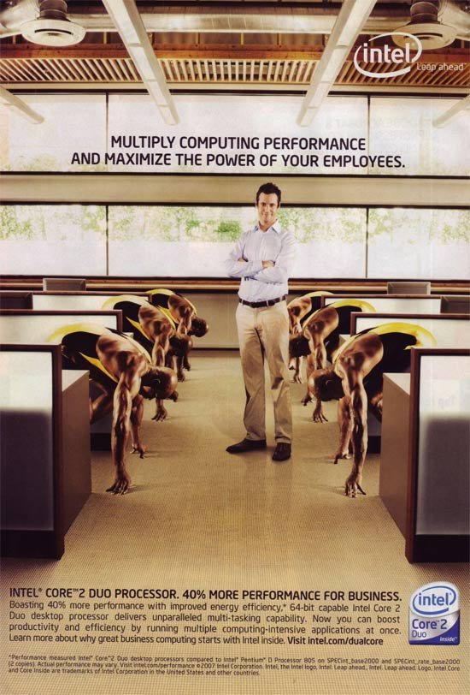

Slide 22
Implicit Bias
Lives in the unconscious mind
Occurs through the building of synapses image by image, message by message (over time)
Betrays values and intentions
Is default for policies and decisions
Notes:
10:12 - 10:20

Slide 23
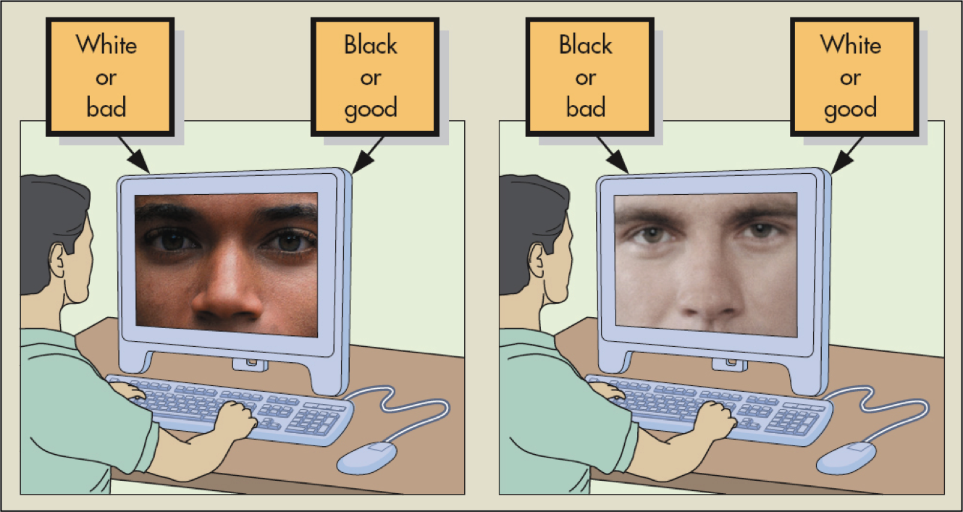
Harvard Implicit Bias Test (IAB)
https://implicit.harvard.edu/implicit/research/
Notes:
9:35 – 9:40
How many of you are familiar with the Harvard Implicit Association Bias Test? How many of you have taken it? There are several tests on this site, but I am referring to the race test.
I have been taking the test about twice a year for several years. When I am going to bring it up in a training, such as today, I make it a point to take it a couple of days before so the experience is fresh.
The IAB has been around a long time and is referenced by many folks who do this work or write about it – Claude Steel, Malcolm Gladwell
Sometimes people who take it discount its validity for one reason or another, and almost all the reasons they give have been factored in. Anthony , one of the designers of the test says that the proof of its validity is that no one has come up with something new or better.
If you have not taken the test, this is a great resource . Take the results from your first time and that becomes your baseline. As you continue to be involved in this work in and out of CCR and do reading, take other workshops, etc. You will see your preferences change over time.
My dream in SPS was to have everyone across the district take the Harvard Implicit Association Bias Test (IAB). Of course, this is best done in the privacy of their home and without having to do any reporting back about their “score”.

Slide 24
Early memories
What is one of your first memories of meeting someone of a different class than you?
What is your earliest memory of your racial identity?

Slide 25
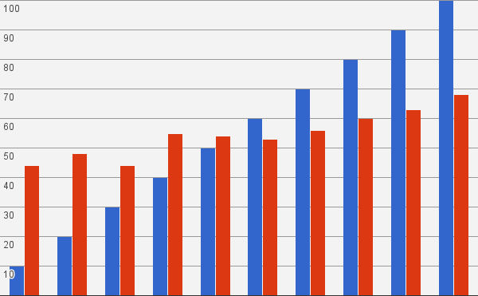
Distorted Perceptions
OBJECTIVE
PERCEIVED
Source: Guillermo Cruces et al., "Biased Perceptions of Income Distribution and Preferences for Redistribution: Evidence from a Survey Experiment." (2011).

Slide 26
Constructing Class
Financial
INCOME
WEALTH
STATUS
POWER
EDUCATION
Social
Cultural

Slide 27
Class: relative social rank based on Income, Wealth, Education, Status, and Power

Slide 28
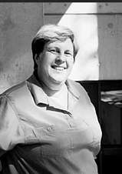
Class Cultures in Organizations
“Many of us grow up in complete class segregation, without being aware of it. We absorbed the cultural attributes of our class
of origin—the language, the worldview, the expectations, the communication norms,
and the work styles—and now we make assumptions or judgments about other that people reﬂect our class perspective…When we become activists, we bring our class cultures and conditioning into our organizations”
Felice Yeskel, late founder, Class Action

Slide 29
Professional Middle Class Institutions
Race
Class
PRIVILEGE
IMPLICIT BIAS
Cultural Norms
RACISM/CLASSISM
* From workshop by Regent Brown on “Anti-Oppressive Leadership”

Slide 30
White Middle Class Norms (drawn from Jones/Okun’s article White Supremacy Culture)
Power Hoarding
Defensiveness
Worship of the Written Word
Perfectionism
Fear of Open Conflict
Progress is Bigger, More
Quantity over Quality
Either/Or Thinking
Sense of Urgency
Paternalism
Objectivity
Right to Comfort
Individualism

Slide 31
Case Study Reflection
What were the issues of race and class that Bethany missed?
What strategies might have been more successful in achieving greater equity among New Leaf’s clients?

Slide 32
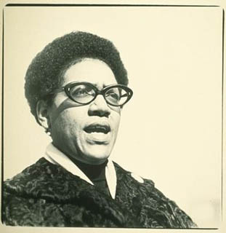
For the master’s tools will never dismantle the master’s house. They may allow us to temporarily beat him at his own game, but they will never enable us to bring about genuine change…I urge each one of us here to reach down into that deep place of knowledge inside herself and touch that terror and loathing of any difference that lives here. See whose face it wears. Then the personal as the political can begin to illuminate all our choices.” (Audré Lord)

Slide 33
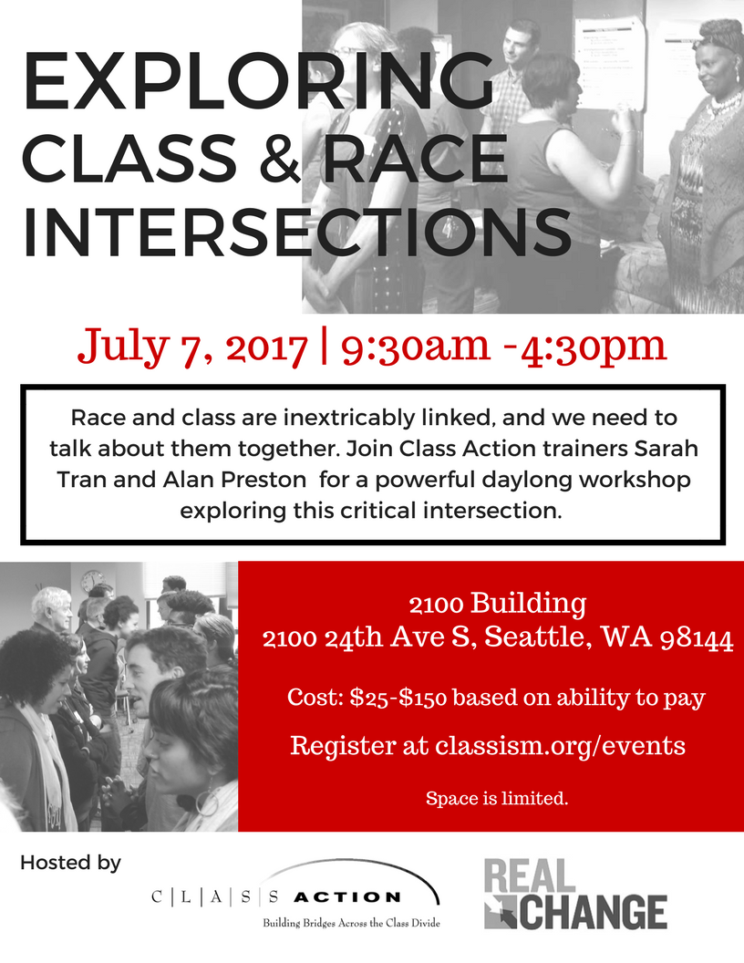

Slide 34
Want more information?
Class Action: www.classism.org
Contact us:
Anita: anitamorales1@gmail.com
Alan: alanp@realchangenews.org

Slide 35
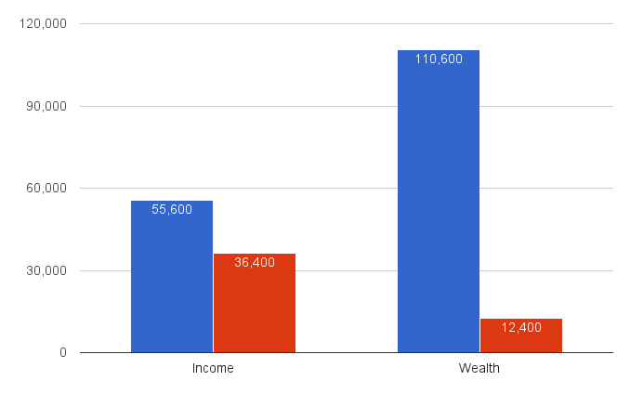
Racial Wealth Gap Far Exceeds Racial Income Gap
WHITE
NON-WHITE
Source: CFED’s “Treading Water In The Deep End,” (2014).

