Slide 1
Problem Statement:
There is a high prevalence of substance abuse and mental illness among the TANF population. Of the 73,921 TANF adults in the study population, 31 percent had an indication of need for alcohol/drug treatment, 55 percent had mental illness, and 21 percent had evidence of both conditions.
Early results in Calif. Increased from 16% to 47%

Slide 2
SIDE EFFECTS OF UNEMPLOYMENT IN THE GENERAL POPULATION
Increased substance abuse
Increased physical problems
Increased psychiatric disorders
Reduced self-esteem
Loss of social contacts
Alienation and apathy
Warr, P.B. (1987), Work, Unemployment and Mental Health, Clarendon Press, Oxford

Slide 3
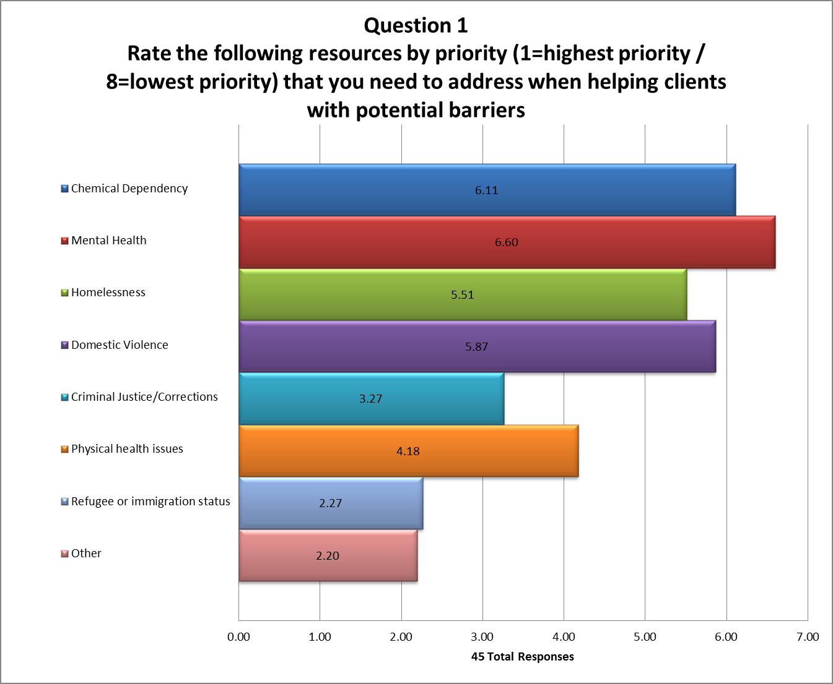

Slide 4
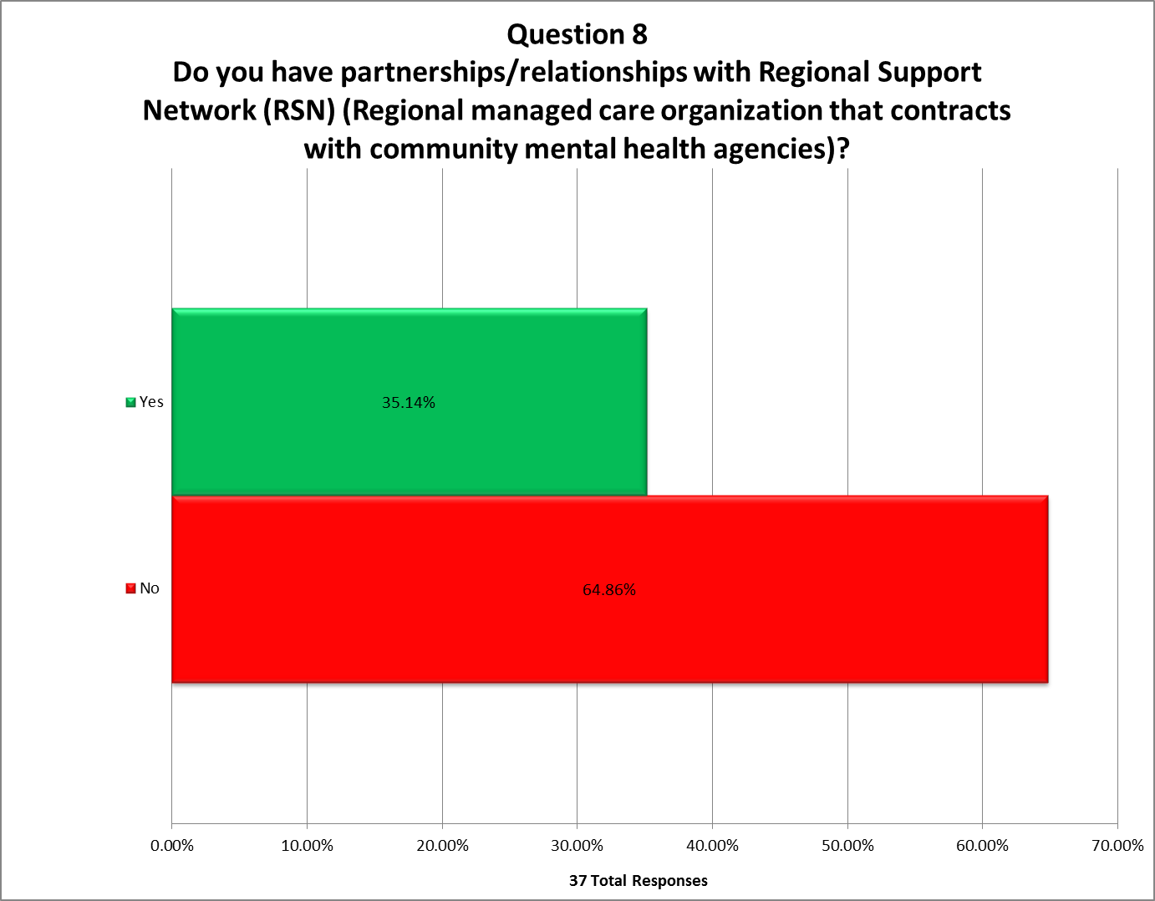

Slide 5
Overall Findings
All 22 studies showed a significant advantage for IPS
Mean competitive employment rates for the 22 studies:
56% for IPS
23% for controls

Slide 6
BEST and TANF SE Pilot Participating sites
Sunrise Community Mental Health
North Sound RSN
Snohomish and Skagit Counties
TANF
SE Site
Grant Mental Healthcare
Spokane County RSN
TANF
SE Site
BEST
Site
Columbia River Mental Health Services Southwest Washington Behavioral Health RSN
Clark County
BEST
Site

Slide 7
Systematic Job Development & Time-Unlimited Support
BEST (March 2015 to March 2017)
35 participants had 2nd job placement;
24 participants had 3rd job placement;
5 participant had 4th job placement

Slide 8
SAMHSA Grant Participants Enrolled as of September 2016
67
53

Slide 9
Systematic Job Development and Time-Unlimited Support
TANF Support Employment Pilot
April 2015 – March 2017
17 participants had 2nd job placement
Timely Job Development and Job Placement and Competitive Wages
TANF Support Employment Pilot
April 2015 – March 2016
Minimum
RANGE
Maximum
Average = 11
Average = 71
$6.25
Average = $11.69 Median = $10.00
SOURCE: Job data supplied via participant logs by Sunrise Mental Health Services. Job Development days calculated as the time from first contact to Job Development Start. Job Placement days calculated as the time from Job Development start to Job Placement.

Slide 10
Foundational Community Supports (FCS)
Notes:
The WHY – We know that for our beneficiaries with the most complex needs, the best route to health isn’t just through a Doctor’s office, nor can stability be maintained solely with a prescription pad. We must also address the foundational needs that prevent our most vulnerable individuals from maintaining healthy lives. We cannot expect someone to manage their chronic health condition if they are first worried about where they are going to sleep tonight, and we cannot expect someone to get off the path of long-term dependence on health and social services, without the supports necessary for them to reenter and remain in the workforce.
The Foundational Community Supports program, under Initiative 3 of the demonstration, seeks to address these needs through targeted Medicaid benefits for Supportive Housing and Supported Employment services in order to help individuals stabilize their basic needs so they can better address their health conditions. We believe this will improve health outcomes and reduce dependence on more intensive service settings, creating a strong business case for sustainability after the demonstration.

Slide 11
Medicaid funds flow Current Model
Medicaid
HCA – DBHR – ALTSA
SH/SE – Health care providers
SH/SE – Comm. BH Agencies
SH/SE – LTSS Providers
TPA
SH/SE – Tribal Providers
SH/SE - CBOs
Program oversight
Benefits administrator
Data
Provider
11
Notes:
This funds flow model represents the current approach. It remains a joint effort across HCA, DBHR and ALTSA, with a single TPA administering the benefits. HCA will hold the contract with the TPA, while DBHR and ALTSA will lead network development and provider support.

Slide 12
Supported employment target population
Aged, Blind, Disabled (ABD)/Housing and Essential Needs (HEN)
Individuals with severe and persistent mental illness, individuals with multiple episodes of inpatient substance use treatment and/or co-occurring
Working age youth with behavioral health conditions
Individuals receiving long-term services and supports

Slide 13
What is a third party administrator?
Contracted with the state
Provides administrative oversight of benefit programs
Provider network development and maintenance
Service authorization
Distribution of reimbursement payments
Data/encounter tracking

Slide 14
What does this mean for providers?
Single contracting entity for both benefits
HCA, BHA and ALTSA will continue to provide technical assistance and consultation
Licensed/certified CBHAs, LTSS providers will have the opportunity to provide FCS services
Notes:
Provider expectations are under development
Provide and receive payment for Medicaid services
Must demonstrate capacity/expertise
Community behavioral health agencies
Behavioral health licensure, certification
Long-term Services & Supports providers meet ALTSA requirements to provide comparable services

Slide 15
Fidelity to Evidence-based practices
Medicaid Requirements
1115 Medicaid Transformation Demonstration
Outcomes & Sustainability

Slide 16
Next Steps
Interested Agency List provided to TPA
Consider Licensing & Certification
Technical Assistance and Training on IPS model
Documentation Training – Guide available soon!
Partnerships with CSOs, DVR, WorkSource Centers etc.

Slide 17
Thank You!
Melodie Pazolt
Recovery Support Services Supervisor
DBHR
Department of Social and Health Services
Melodie.pazolt@dshs.wa.gov
(O) 360-725-0487

