Slide 1
Tiny houses: A Model for permanent supportive housing
Presented by Ginger Segel, May 2017

Slide 2
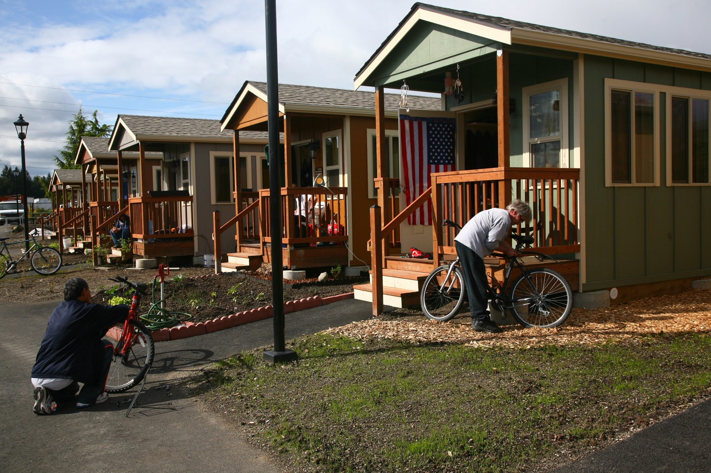

Slide 3
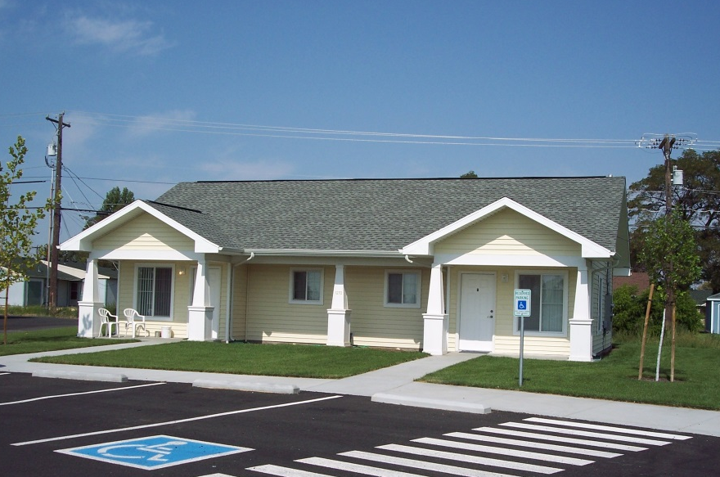
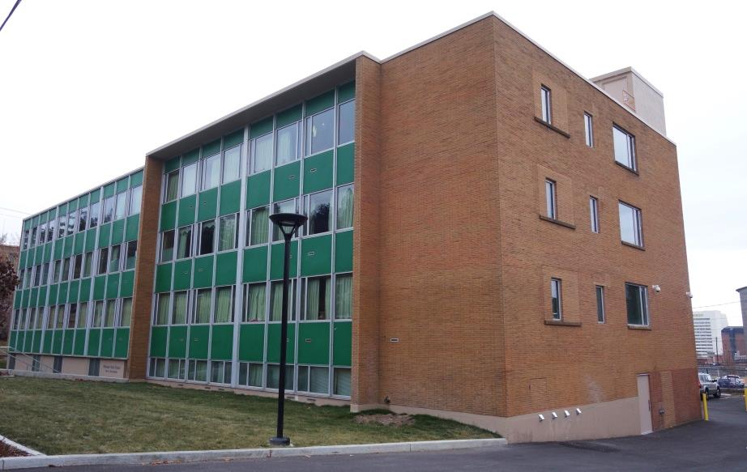
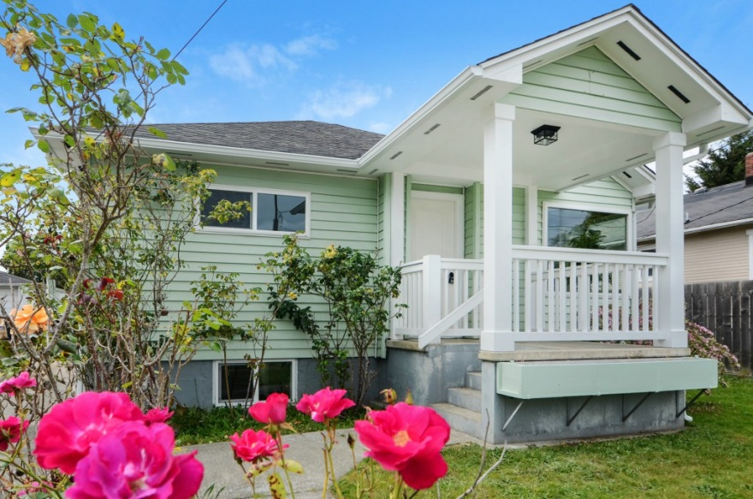
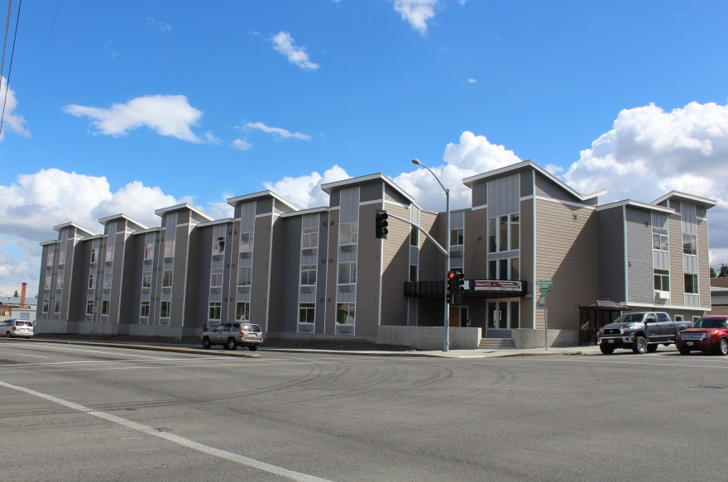
Northwest Estates 1
Pioneer Park Place
Remodeled House
West 315
Notes:
Community Frameworks has been developing affordable housing in Washington State for 30 years – single family homes, small scale projects, renovations, and new construction apartment buildings – for a variety of populations. These are all important components of the affordable housing continuum. But they are all expensive, and our resources are tight.

Slide 4
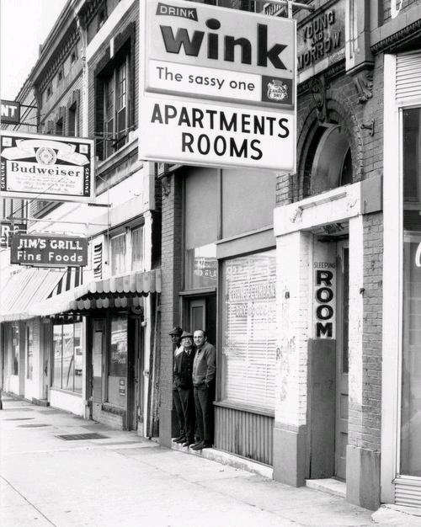
History
In the past many extremely low income individuals were housed in single room occupancy apartments, essentially bedrooms with shared kitchens and bathrooms, or rooming houses.
As these forms of housing have largely disappeared from American cities and towns, this demographic, which often has limited earning potential and high rates of disabilities, has few housing options, and virtually none that are unsubsidized.
Notes:
Many people in a demographic that is now largely homeless – single people with disabilities and limited earning potential - used to be housed in more modest accommodations – SROs and rooming houses, housing that some people today call substandard. Between 1970 and the mid-1980s 1 million SRO units were lost across the country, a very significant contributor to homelessness.
The challenge today is separating the American notion of ‘acceptable housing’ from a true definition of habitable housing – what people need to be safe and healthy.

Slide 5
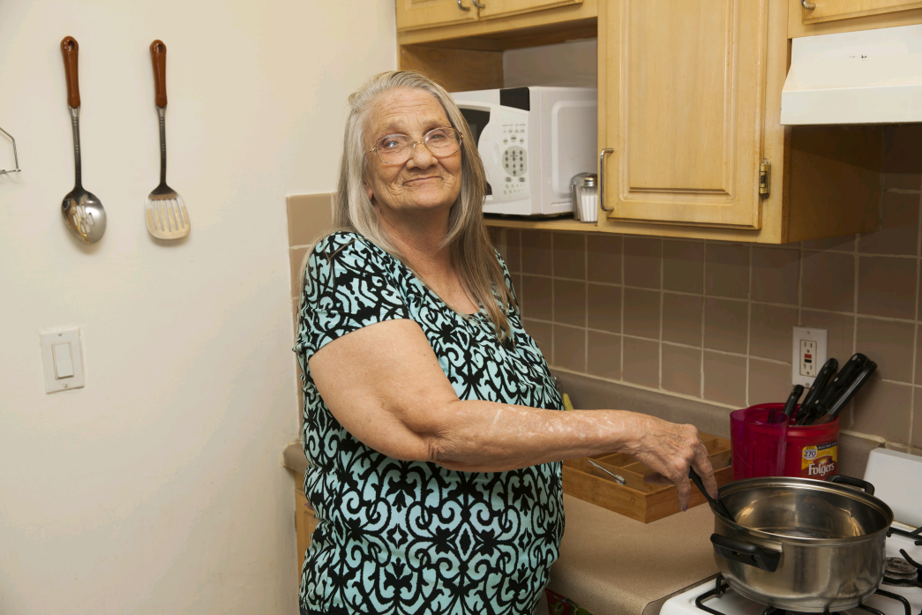
Permanent Supportive Housing (PSH)
Nationally accepted best practice.
Non time-limited housing with voluntary supportive services tailored to individual needs.
Can be a stepping stone to other housing options for some.
Others remain, needing community support and services to succeed over time.
Notes:
We have all accepted PSH as the best model, but there is nothing in the model that says that each person has to have a 400 SF apartment with a full kitchen and bath.

Slide 6
Why Tiny Houses for PSH?
Less Expensive – Quixote Village was $102,000 per unit, compared to $262,000 – the average cost of PSH units for singles built with HTF funds since 2013
Decent Housing Option
Foster Community and Healthy Engagement
Achievable for Communities
They are Super Cute

Slide 7
How Does the Cost Compare?
Tent | $70
Unconditioned Tiny House w/out plumbing or electricity | $2,000
Quixote Village Tiny House (Cost includes land, difficult site remediation and constructing the community building) | $102,000
Jail Cell | $114,986
Subsidized Small Apartment | $262,000
Hospital Bed | $352,992
Notes:
Tiny houses such as Quixote Village cost less than half the typical PSH apartment unit for single adults in Washington State. We could build twice as many units using this model. We don’t advocate against more traditional models, rather to add this model into the mix to increase the amount of housing produced with public funds.

Slide 8
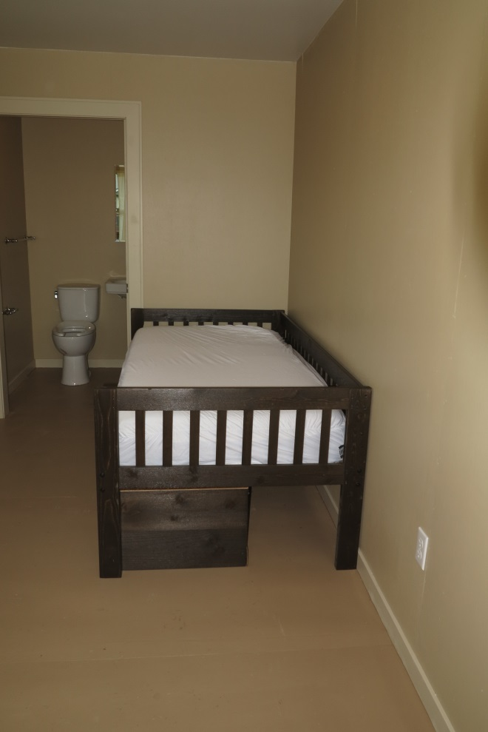
Decent Housing
To be more than a temporary solution, we submit that a tiny house must:
be large enough for a standard-size bed, chair, table, and some storage
be conditioned, meaning heated and insulated
have electricity
have standard ceiling height
have full bathrooms and cooking facilities nearby
be sustainably built for long term use whether the tenant stays for a short or long time.
PHOTO: Interior of Tiny House, Quixote Village
Notes:
These minimum requirements seem obvious, but in looking at the tiny house options around the country, some do not have full ceiling height – residents cannot stand up – and others do not provide access to running water or cooking facilities.

Slide 9
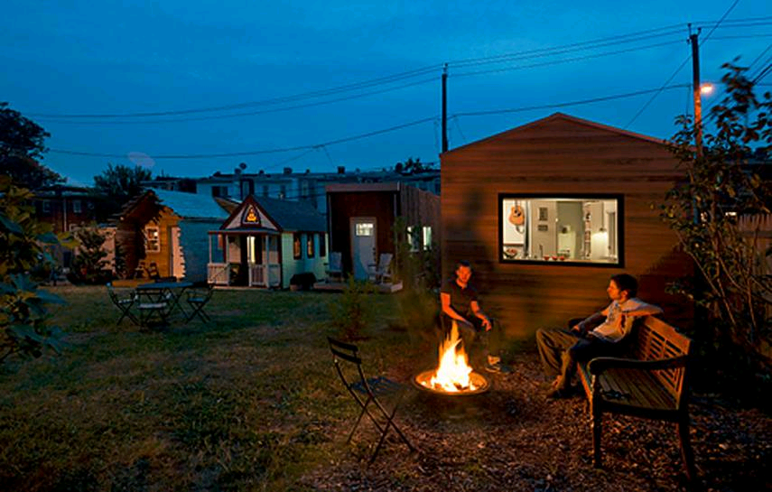
Tiny Homes Foster Community
Small, individual units with shared kitchen and/or bathing facilities balance individual private space with shared community space, thereby fostering positive community engagement and encouraging residents to interact with peers, volunteers and staff.

Slide 10
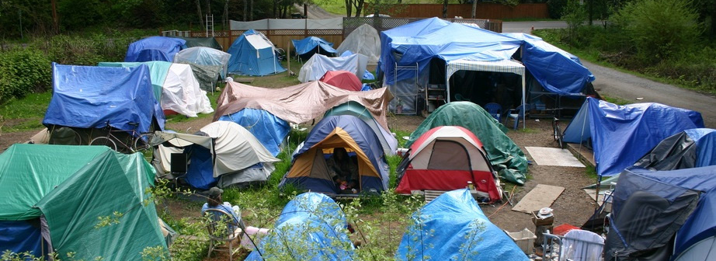
Community Success: Quixote Village
Quixote Village grew out of Camp Quixote, a homeless tent city in Olympia, WA that was hosted by several area churches.
30 – 144 SF cottages with living space and ½ baths & a community building with kitchen, bathing facilities, recreational and program space.
QV is the only publically subsidized permanent supportive housing tiny house project in the country. It was completed in December 2013.
PHOTO: Camp Quixote

Slide 11
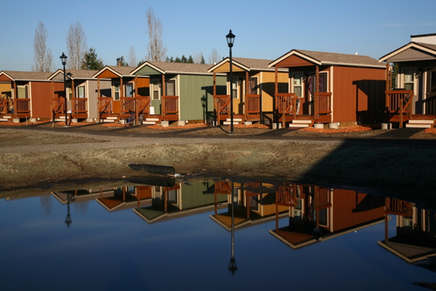
PHOTO: Tiny Houses, Quixote Village
Notes:
30 homes, 2 are ADA compliant. A lesson we have learned that there are higher rates of people with disabilities than expected and we are planning for 6 ADA units out of 30 at the new tiny house villages under development.

Slide 12
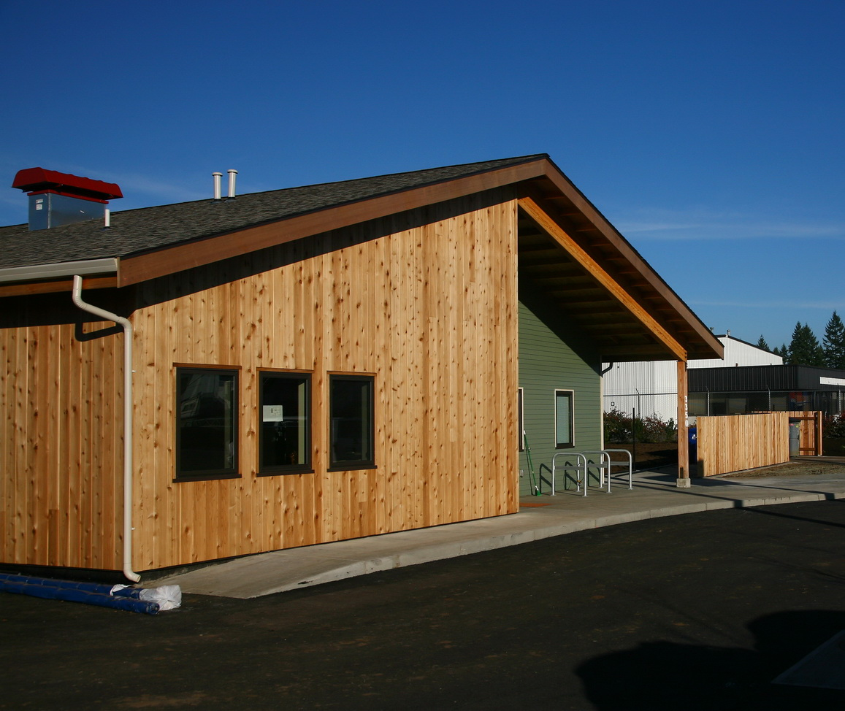
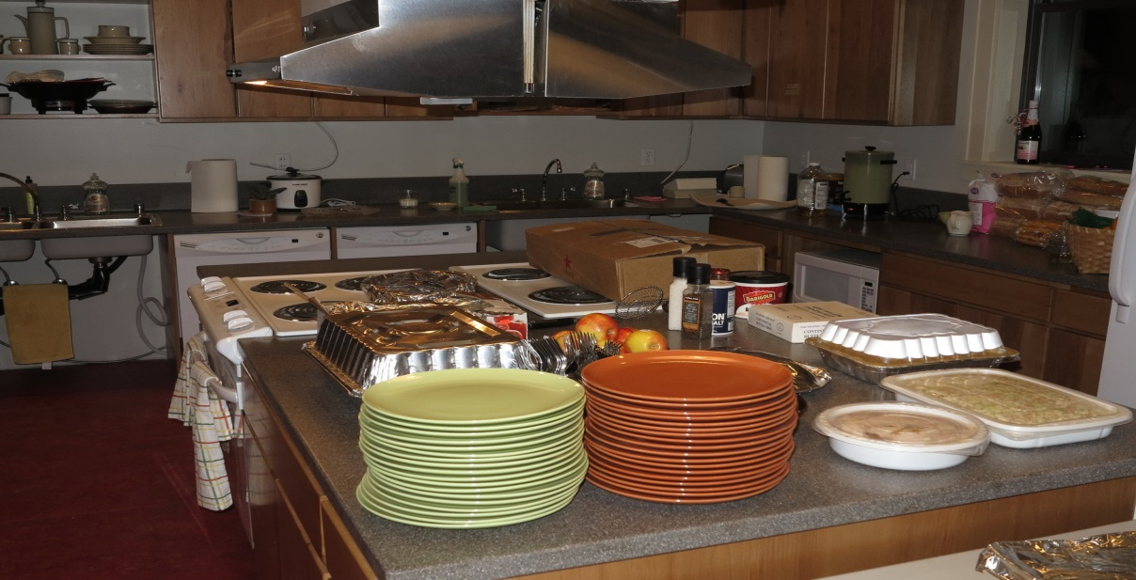
What does Quixote Village offer?
Community Building
Community Kitchen
Living Area
Notes:
The 30 cottages at Quixote Village are 144 square feet which includes a 1/2 bath and closet.
Each cottage has a front porch and garden area.
The community building has a large kitchen with two sets of appliances and four refrigerators; locking cold and dry storage for each resident; four bathing rooms with tubs or showers; restrooms; a large dining/living area with a wood stove; a conference room for classes, meetings or recreational use; a laundry room; and two offices.
In addition there is a large community vegetable garden.

Slide 13
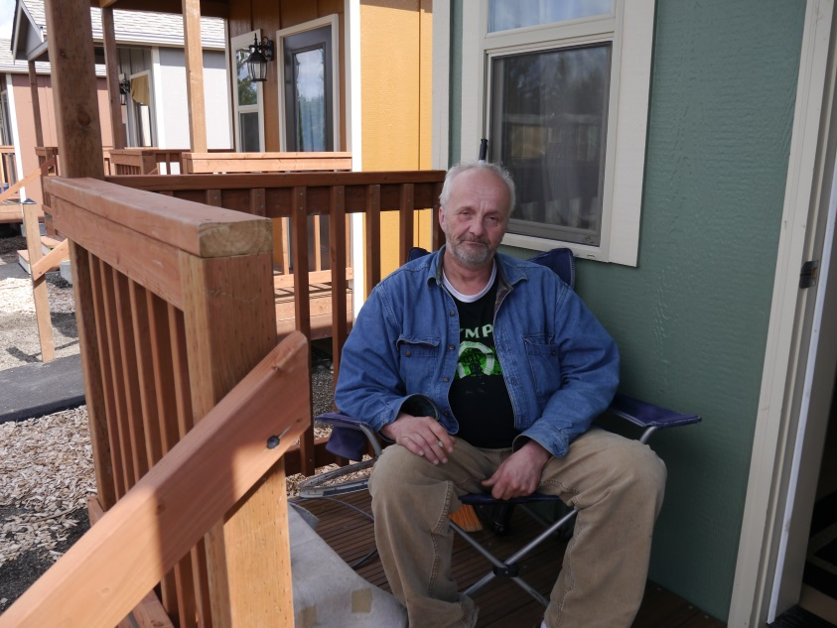
Quixote Village Successes
“It’s been a year full of blessings at the Village. We’ve had one college graduation and two other residents are now enrolled in college. Two people have been hired for full-time jobs and others are working as day laborers. One is operating a freelance graphic design business.”
(Excerpt from Panza’s Annual Fundraising Letter, 2014)
PHOTO: Resident, Quixote Village
Notes:
Jill Severn from Panza is here and can speak to the successes of QV – there a many heart warming stories of people getting clean and sober, increasing their education, and even re-uniting with children.

Slide 14
Possible Public Funding Sources
State Housing Trust Fund
Local Government (Document Recording Fees, Etc.)
HUD HOME Funding
HUD CDBG Funding
HUD McKinney Funding
HUD Section 8 & VASH Vouchers
Notes:
QV uses most of these sources – all but HOME & McKinney. It is possible, but challenging to get public funder regulations to work with tiny houses.

Slide 15
Recommendations: Public Jurisdictions
Publically Owned Land.
Review Land Use and Building Codes.
Review Available Public Funding Sources.
Permit, Hook-Up and Impact Fees.
Notes:
Publically Owned Land. Cities, counties and states own unused land that can be appropriate for affordable housing development. Jurisdictions can inventory available land and ensure that public policies are in place to allow public land to be used for low income housing. However, it is important that the land be suitable for residential use and does not have expensive underlying issues. Much unused land is unused for a reason.
Review Land Use and Building Codes. Jurisdictions should review their land use and building codes and make modification, if necessary, to allow tiny house and SRO apartment development.
Review Available Public Funding Sources. Local jurisdictions may control federal or state funding such as CDBG, HOME, or, as in Washington State, the Consolidated Homeless Grants from the State. Local jurisdictions can also play a key role in advocating for state or federal funds for tiny houses by asking larger jurisdictions to align their funding priorities or allocation processes. Local jurisdictions may have lobbying efforts that could advocate for additional resources for homeless demonstration programs.
Permit, Hook-Up and Impact Fees. These fees can be quite substantial. They totaled over $94,000, or over $3,000 per unit, for Quixote Village. Local jurisdictions may be able to grant variances, waive, or otherwise modify the fees so that they are not an obstacle to tiny house development.

Slide 16
Recommendations: Funders
Remove Administrative or Regulatory Barriers to Tiny Houses.
Encourage Cheaper Development.
Work Cooperatively with Other Funding Sources.
Work with All Providers.
Notes:
Although there has been a spotlight on the cost of affordable housing for several years, there has not been real efforts to encourage cheaper development models. For example the State’s new scoring criteria gives extra points to projects that leverage a lot of other funds, but does not reward projects that have a reduced per unit development cost.

Slide 17
Recommendations: Owners/Sponsors
Stick With It!
Build Relationships
Seek Advice and Help
Create Partnerships
Educate Yourselves
Notes:
Tiny houses tend to be championed by homeless people living in encampments, or church-based or community organizations providing support to encampments. These groups have limited capacity and are seen by funders as high risk sponsors who may not be able to successfully build or operate the housing. Our recommendations for these groups are:
Stick With It! New concepts take persistence and dedication, and you are blazing a trail that will benefit many others.
Build relationships with your jurisdictions, neighbors, and the broader community.
Seek Advice and Help from experienced non-profit developers, housing providers, and social service providers.
Create Partnerships to develop, own and/or manage the housing to establish the level of credibility and capacity that may be essential to successfully secure public or philanthropic funding.
Educate Yourselves on housing for chronically homeless people. Tiny houses are new, but modern homelessness has been with us since the 1980’s. There is lots of information on successful models. The Corporation for Supportive Housing and the National Coalition for the Homeless are good starting points.

