Slide 1
Tiny House Villages and Encampments
Presented by Sharon Lee
Executive Director Low Income Housing Institute
www.LIHI.org

Slide 2
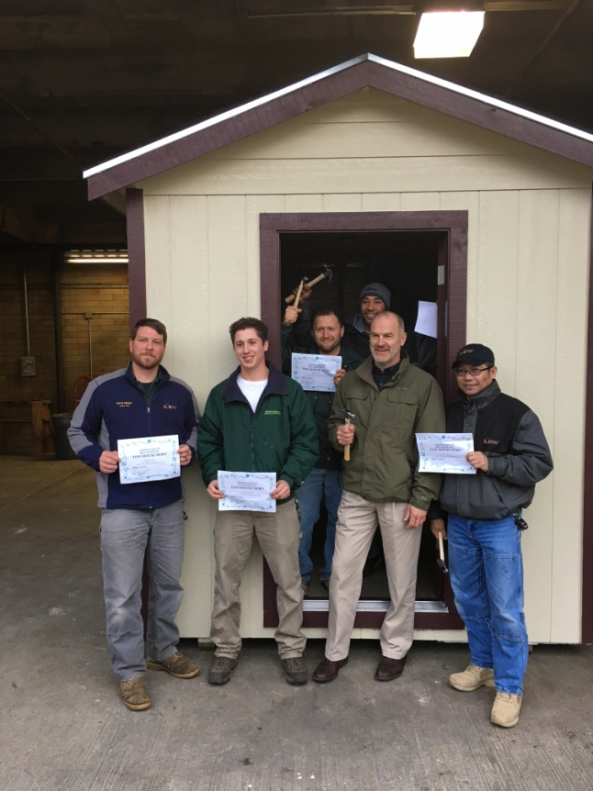
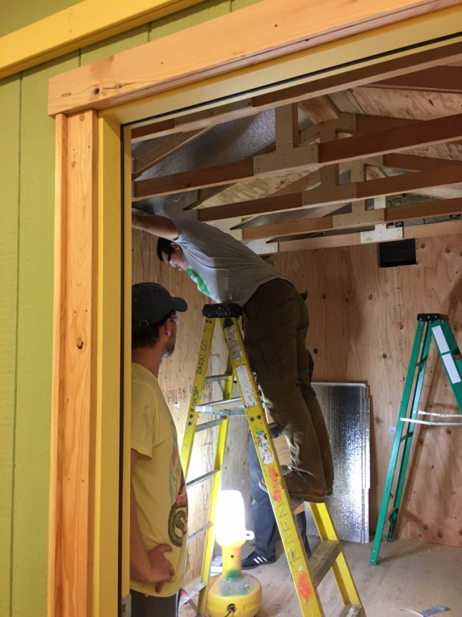
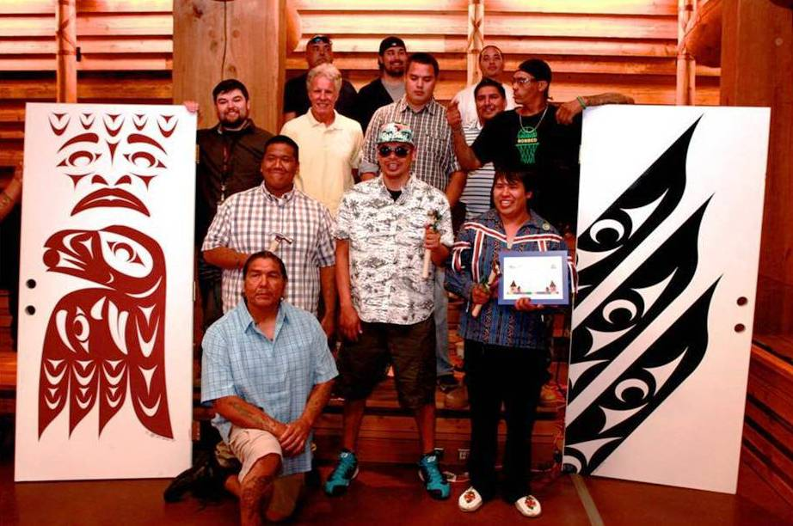
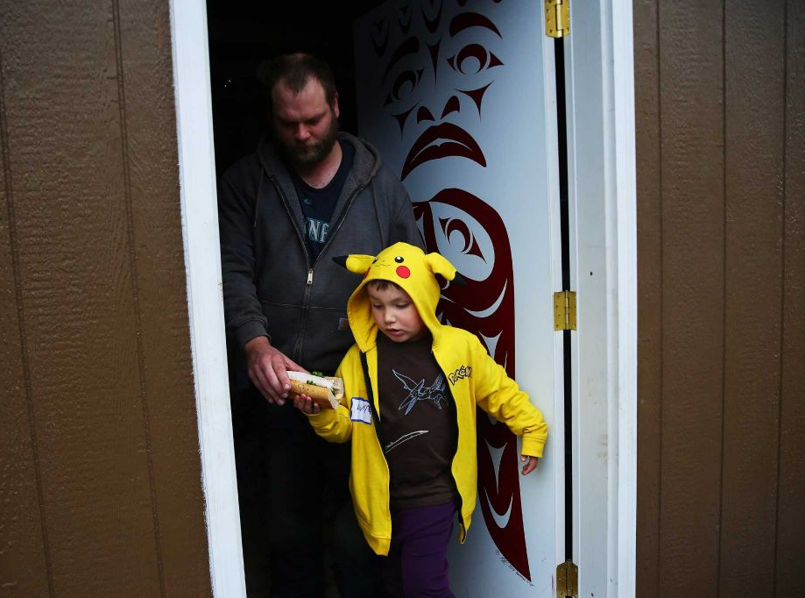
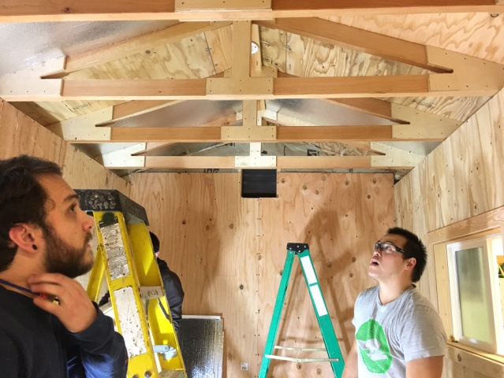
Tiny House Construction
We have worked with numerous schools, colleges and training programs, which have used the project as an education opportunity and provided volunteer the labor to build inexpensive, but quality, durable Tiny Houses, complete with electricity, insulation and heat.
Tulalip Tribes TERO program built two tiny houses with beautiful doors.

Slide 3
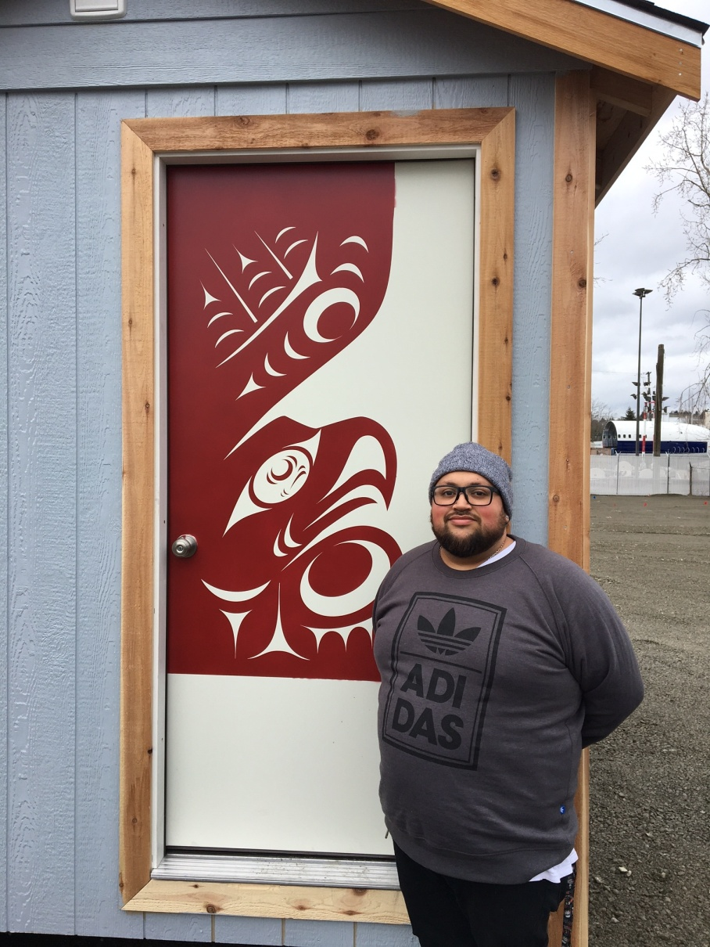
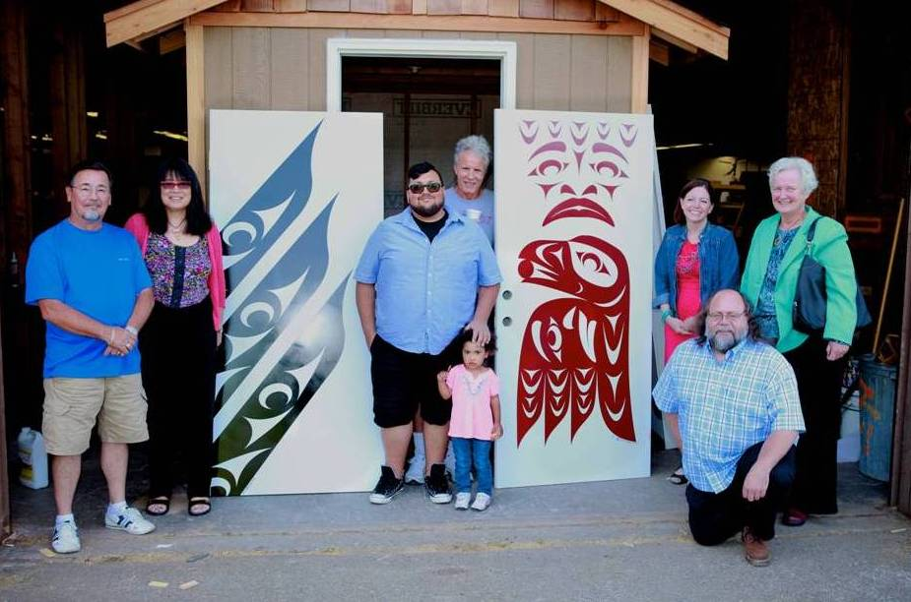
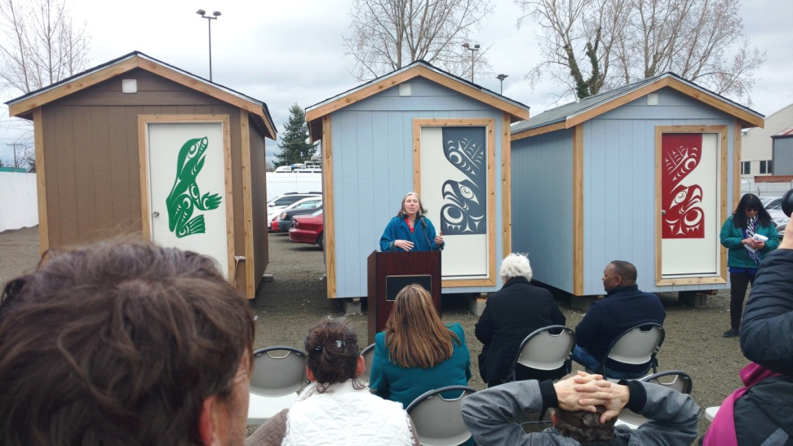
Tulalip Tribe TERO

Slide 4
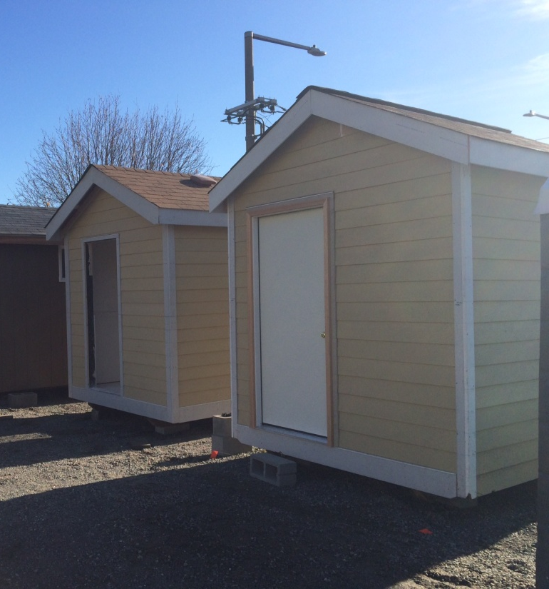
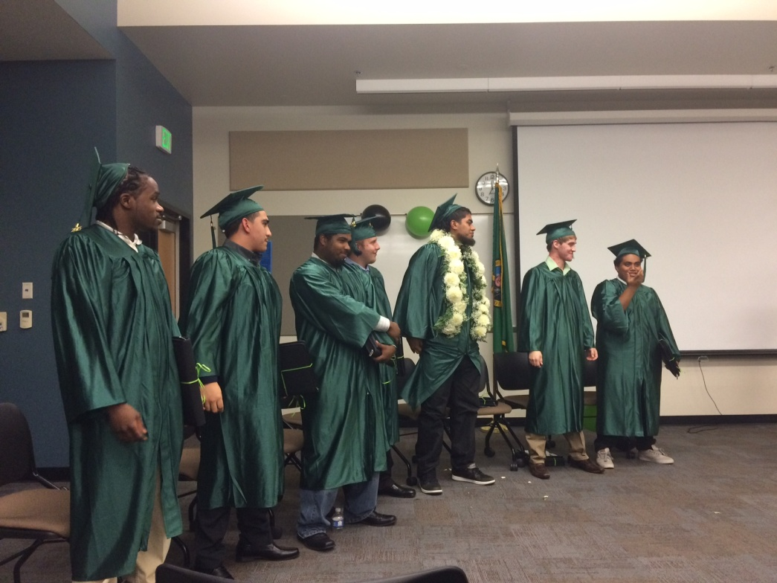
YouthBuild, a Program of YouthCare

Slide 5
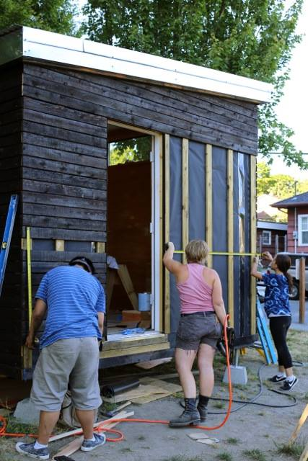
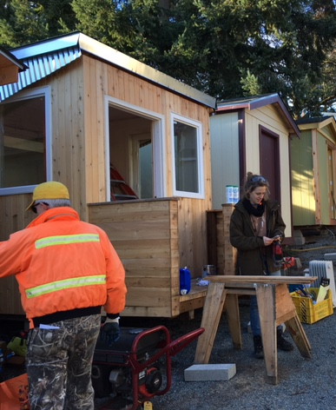
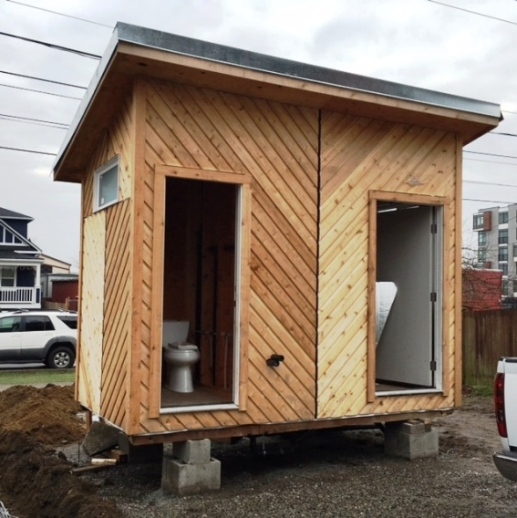
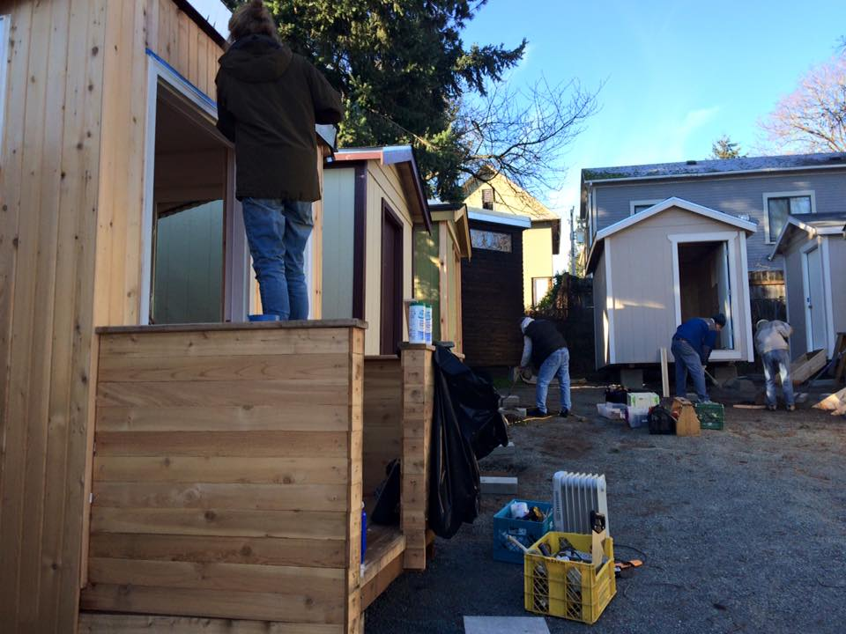
Sawhorse Revolution

Slide 6
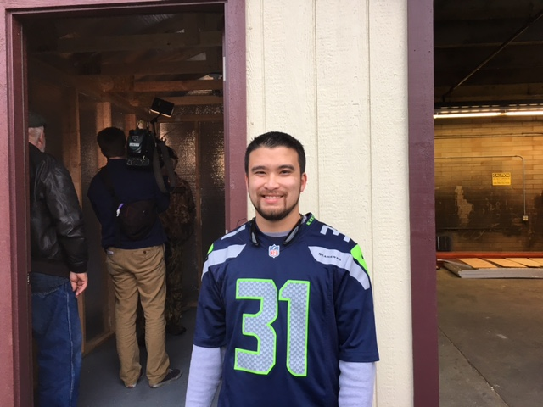
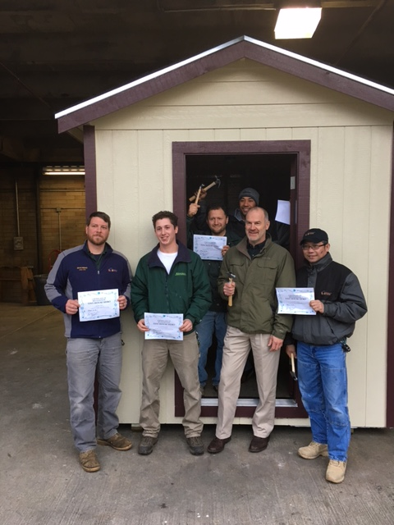
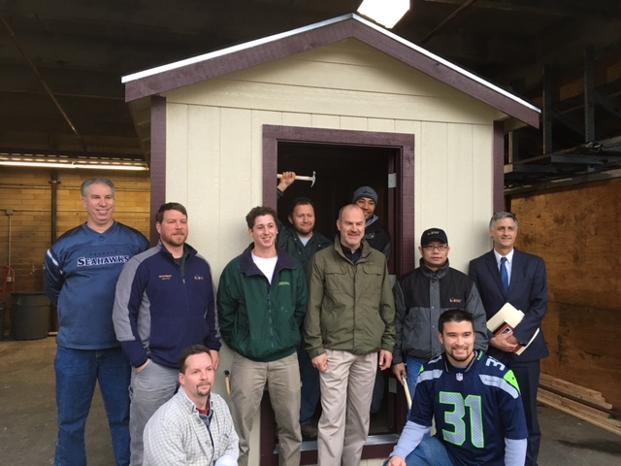
Renton Technical College

Slide 7
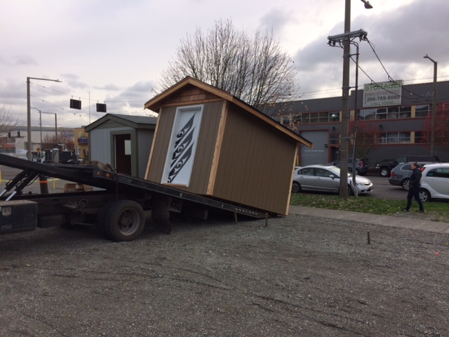
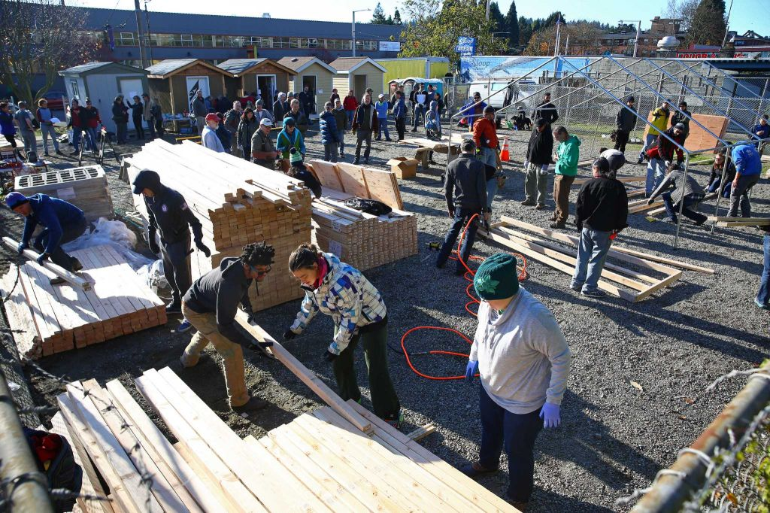
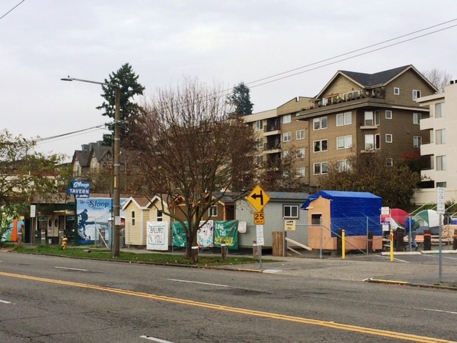
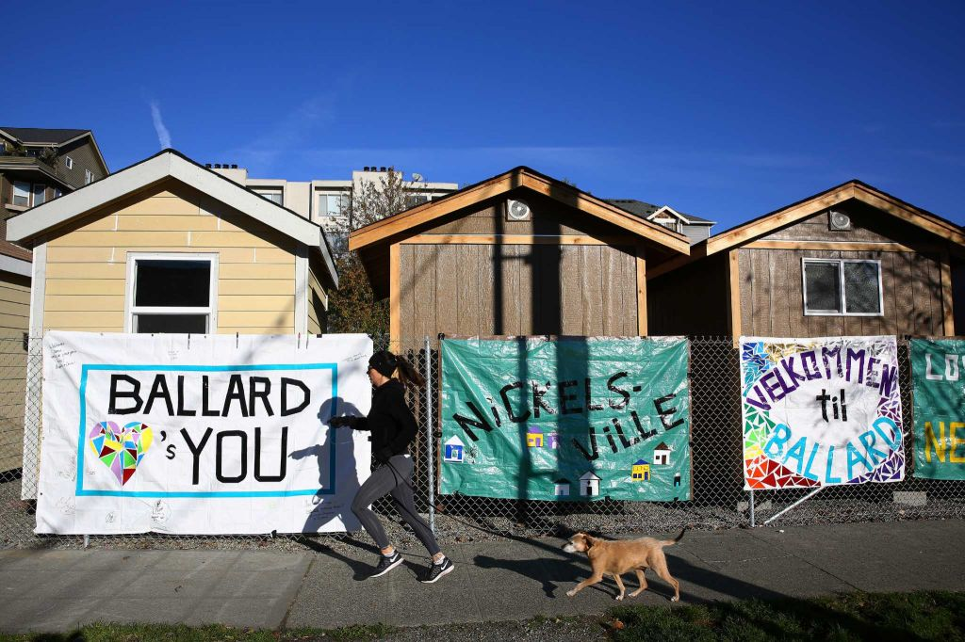
Nickelsville Ballard Encampment November, 2015 - 5 Tiny Houses
“Barn raising” day

Slide 8
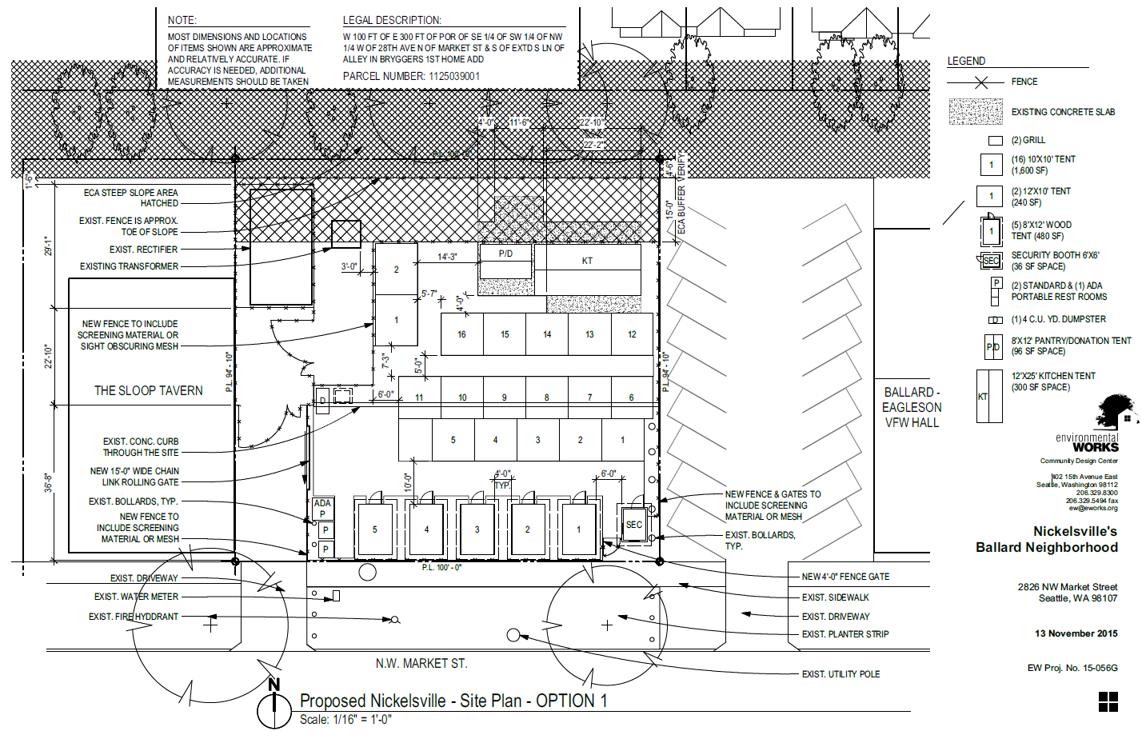
Ballard Encampment

Slide 9
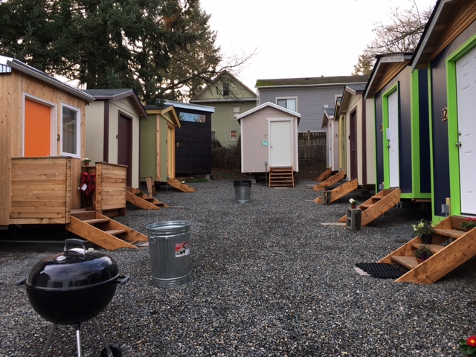
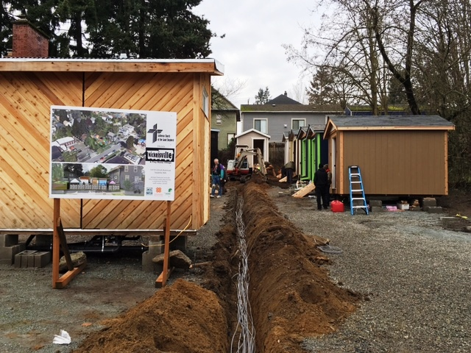
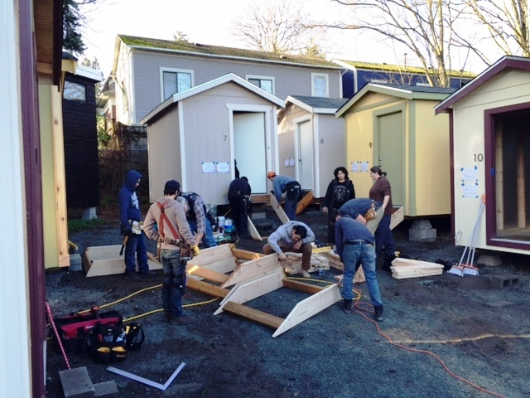
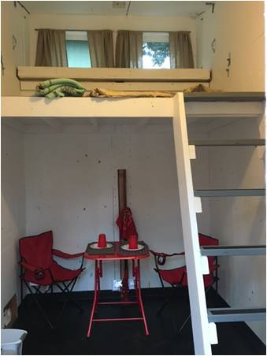
Good Shepherd Tiny House Village January, 2016 - 14 Tiny Houses
Electrical
Cable Trench
Loft &
Dining Room

Slide 10
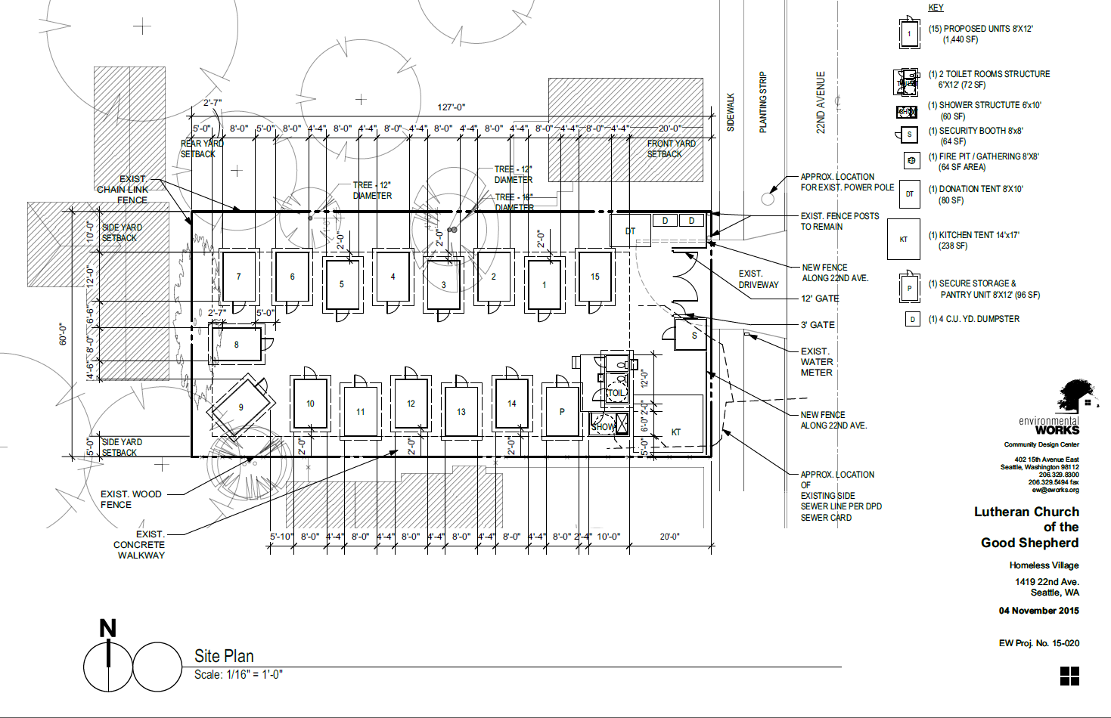
Tiny House Village

Slide 11
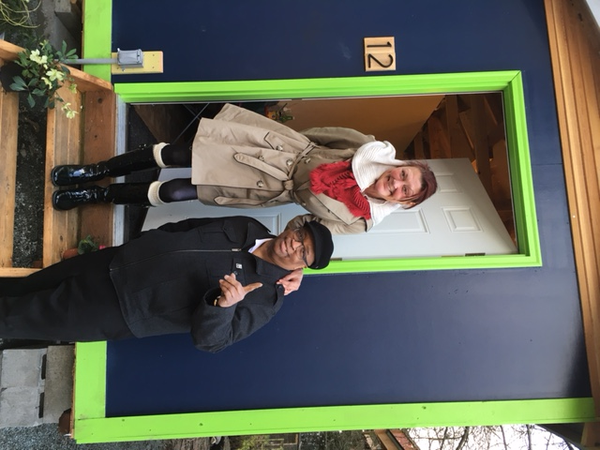
King County Councilmember Larry Gossett visiting the site w/Sharon Lee
Tiny House #12 is, of course, Seahawk themed

Slide 12
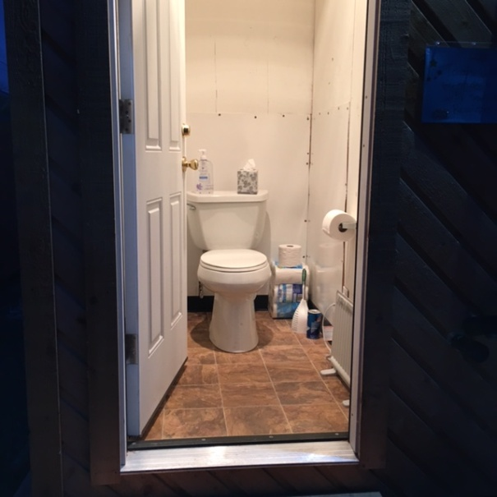
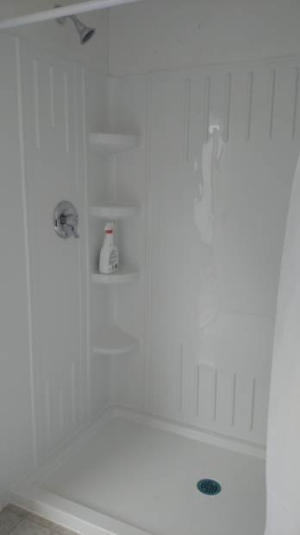
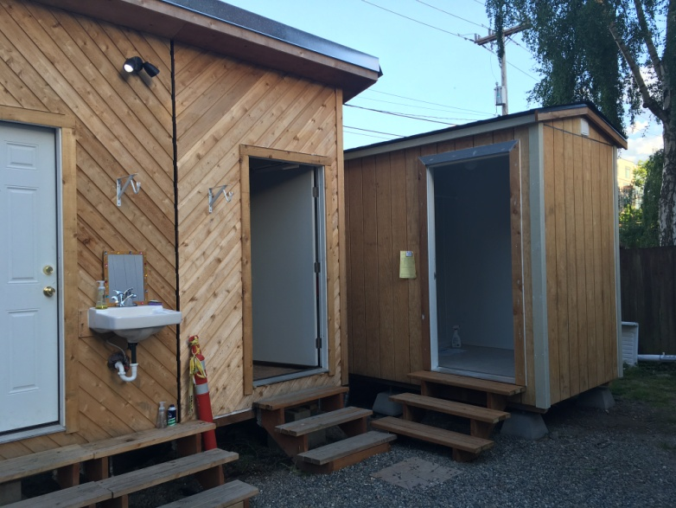
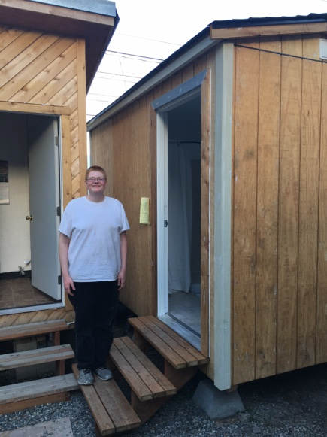
Toilet and Shower Houses (Plumbed)

Slide 13
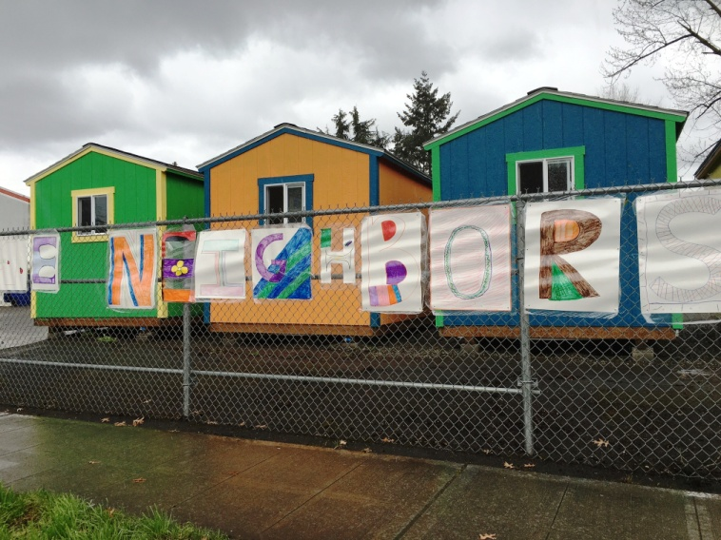
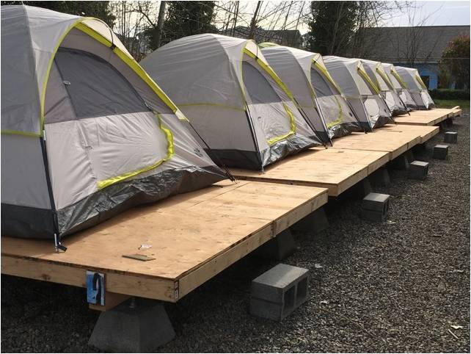
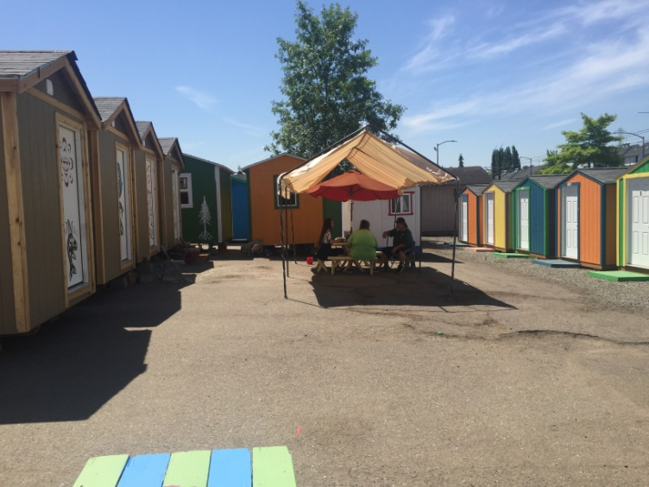
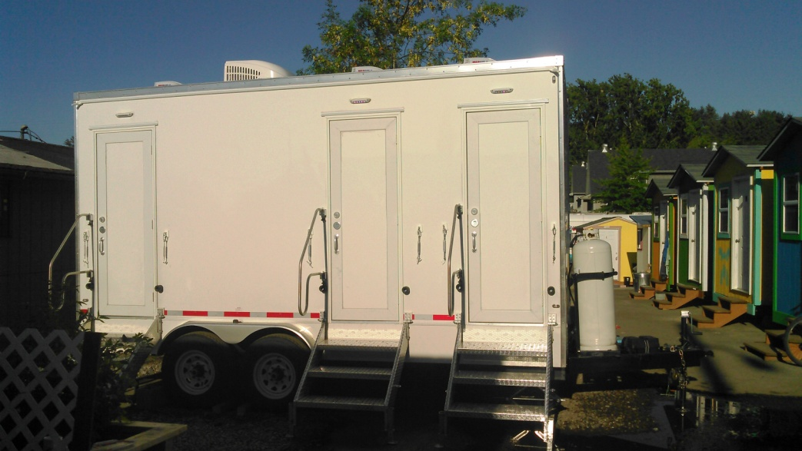
Othello Village March 2016, 28 Tiny Houses & 14 Tents
Platforms improve
tent livability
Shower Trailer

Slide 14
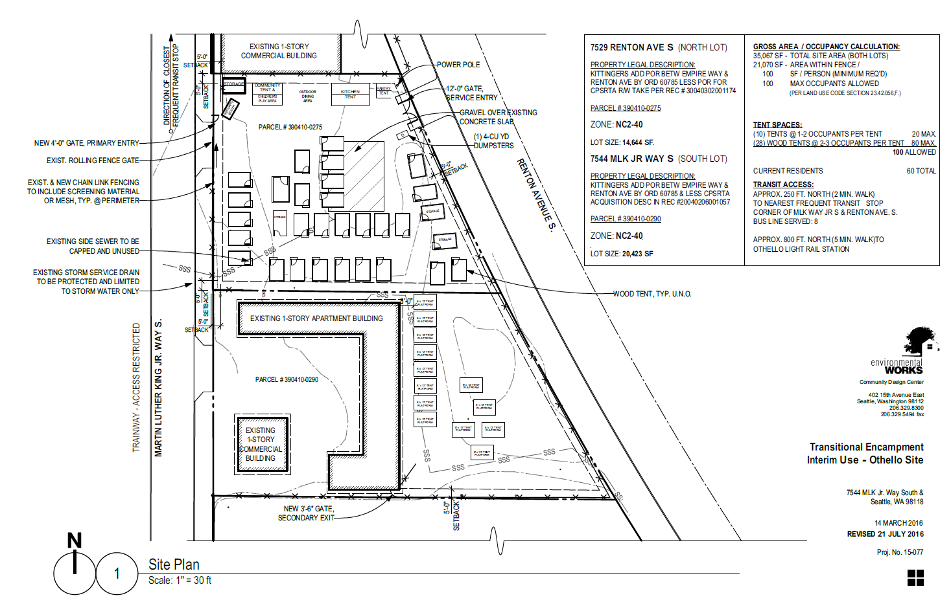
Othello Village
…

Slide 15
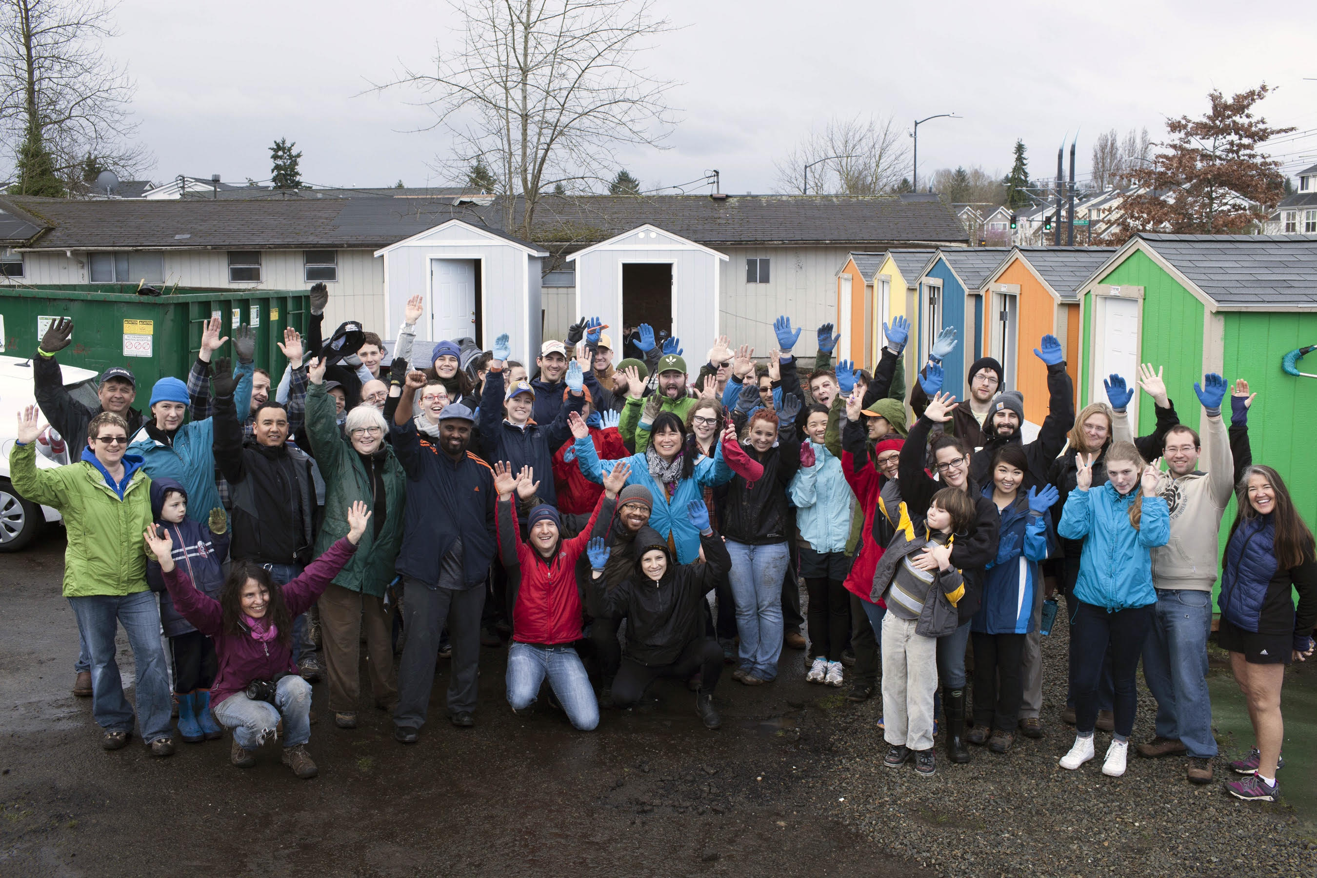

Slide 16
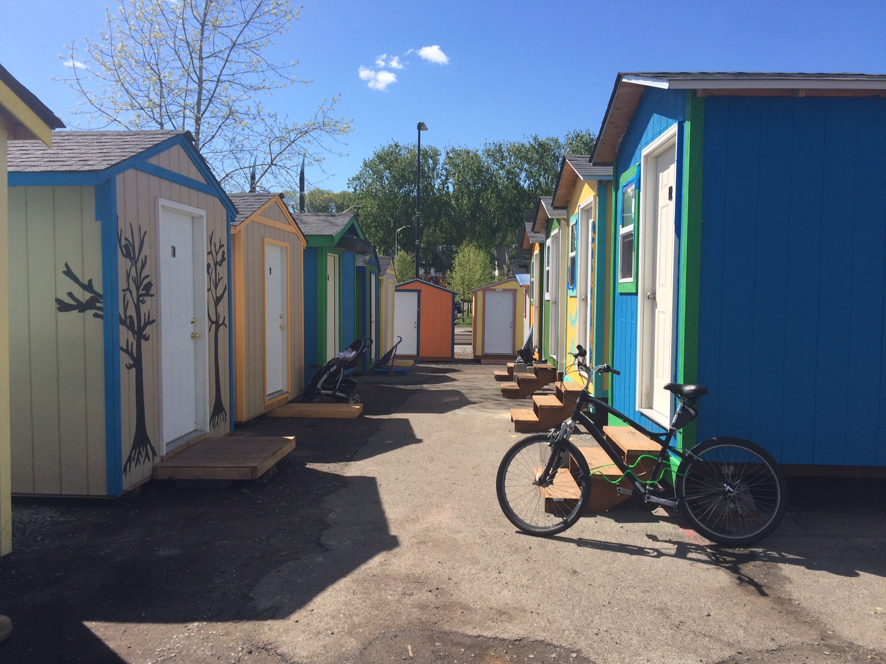

Slide 17
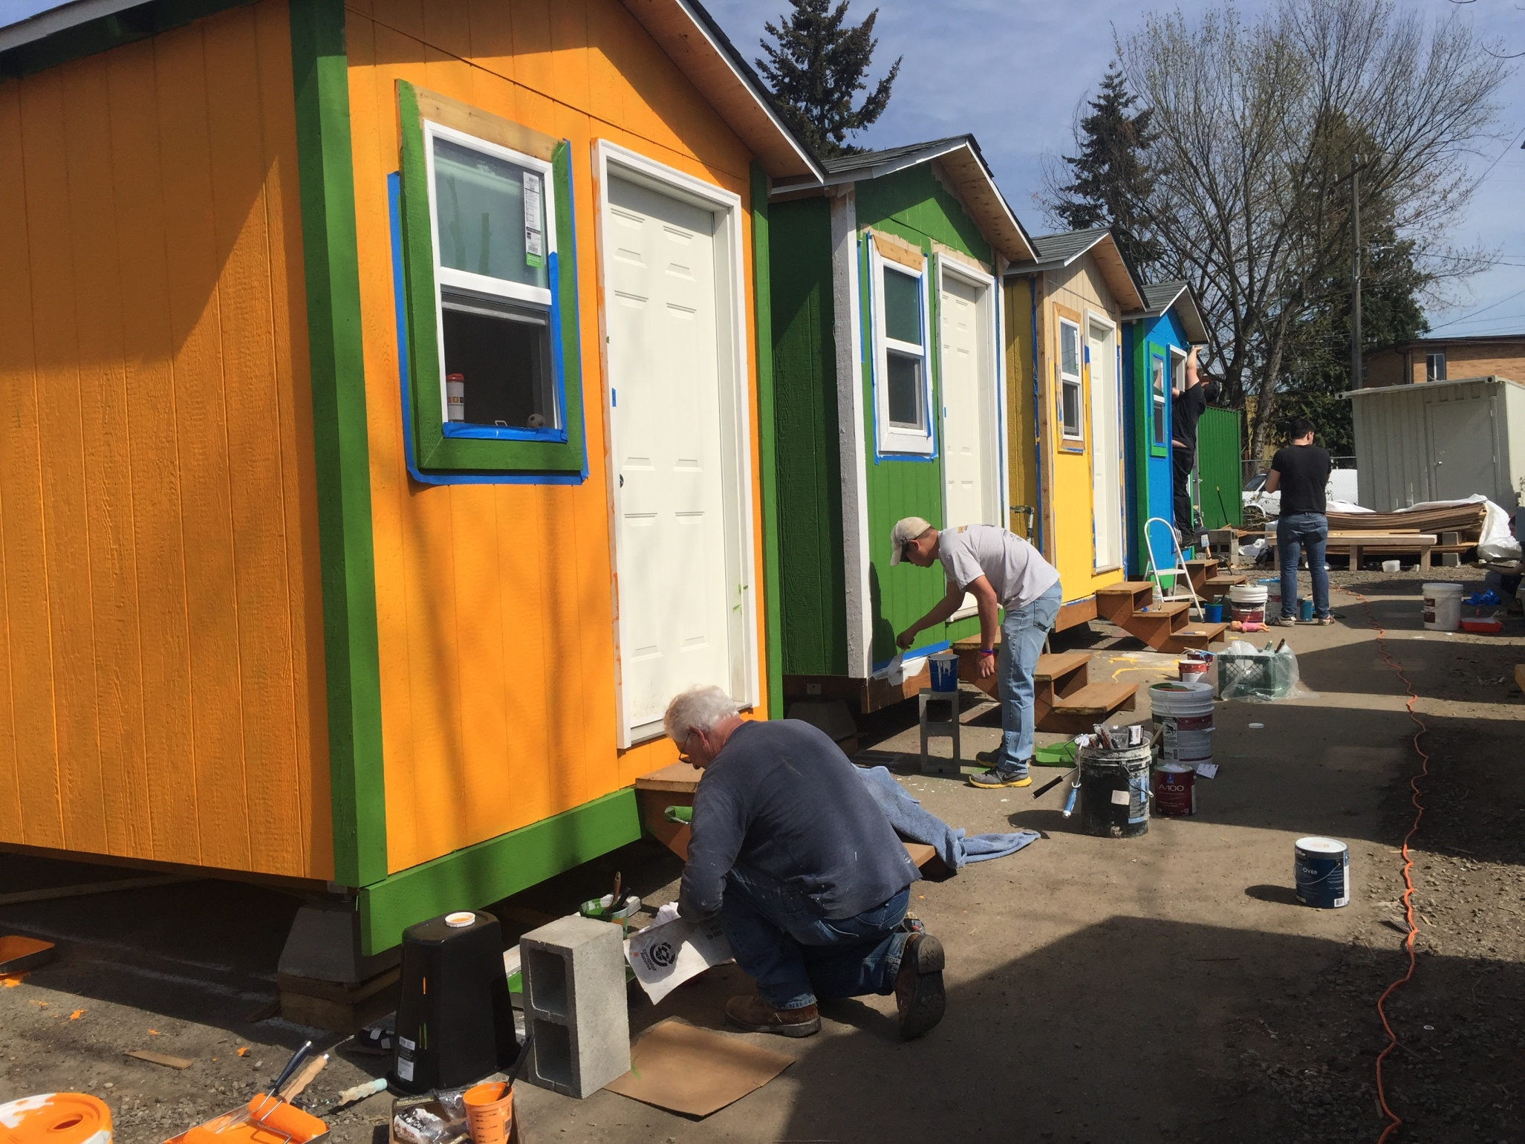

Slide 18
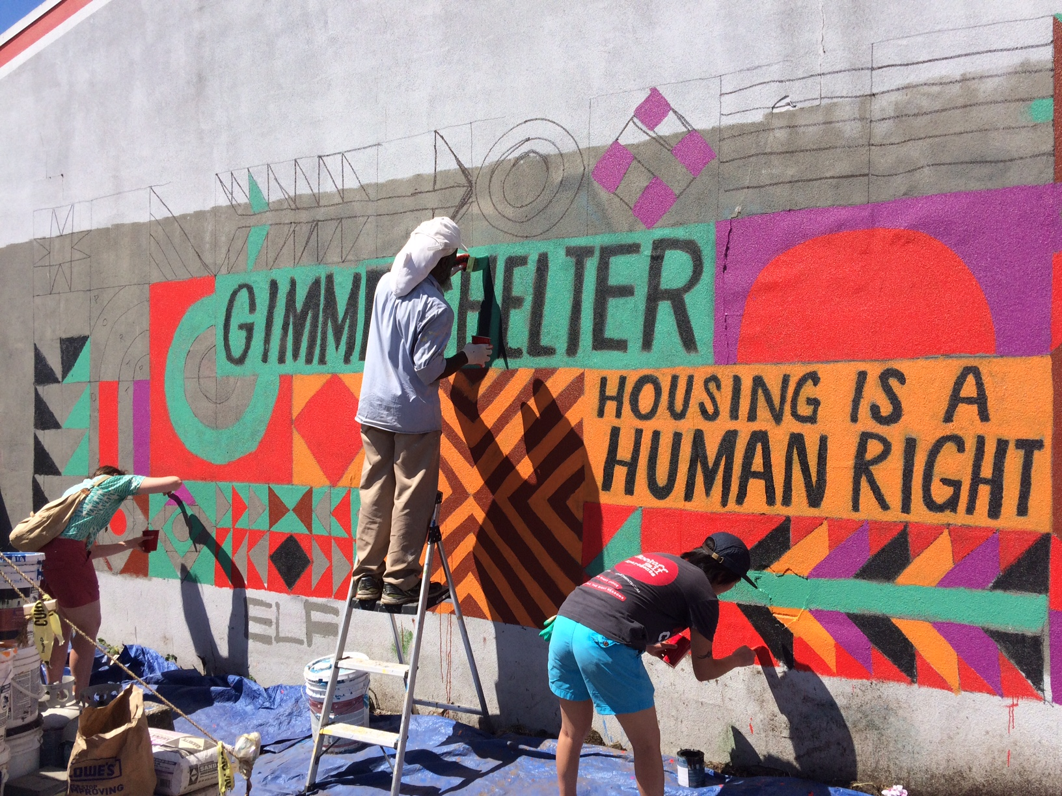
NeighborWorks Community Celebration at Othello Village

Slide 19
2016 Outcomes
LIHI case managers have successfully moved 161 people from tiny houses into more permanent housing, helped 106 people obtain employment and reunited 34 individuals with family or friends.
At any one time more than 320 individuals are served by LIHI’s tiny house and encampment program, with thousands of others in permanent low-income housing at other LIHI buildings.
Two recent success stories:
An older homeless veteran lived in a tiny house at Othello Village and was able to move into permanent housing at LIHI's Frye Apartments with the help of a LIHI case manager. He lived at Othello Village for about 8 months, and now lives at the Frye and is able to pay 30% of his income for a permanent place to live in downtown Seattle.
A homeless mother with a twelve year old daughter lived in a tiny house at Othello Village for six months. A LIHI case manager moved them into permanent affordable housing at LIHI's Denny Park Apartments in South Lake Union.

Slide 20
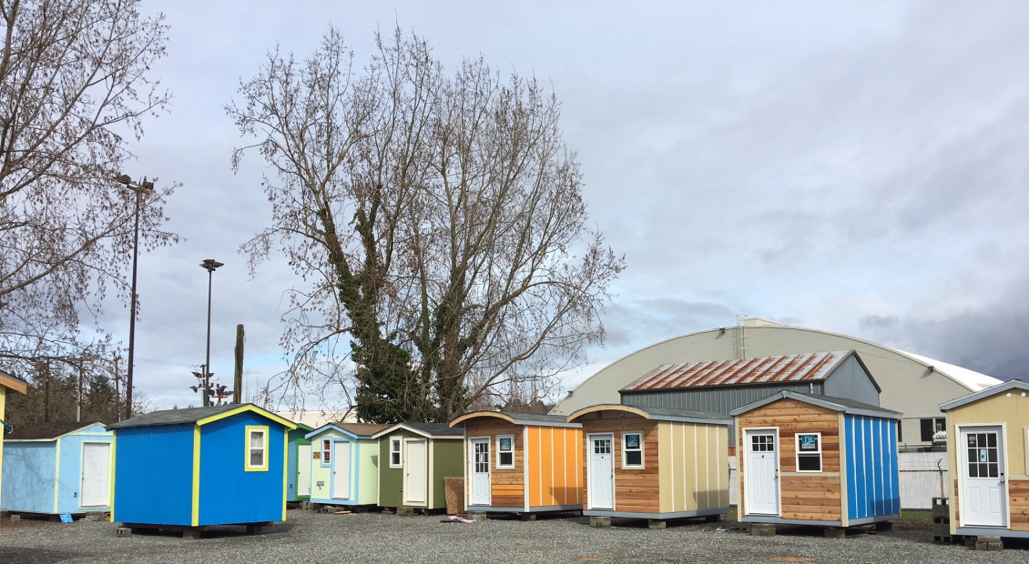
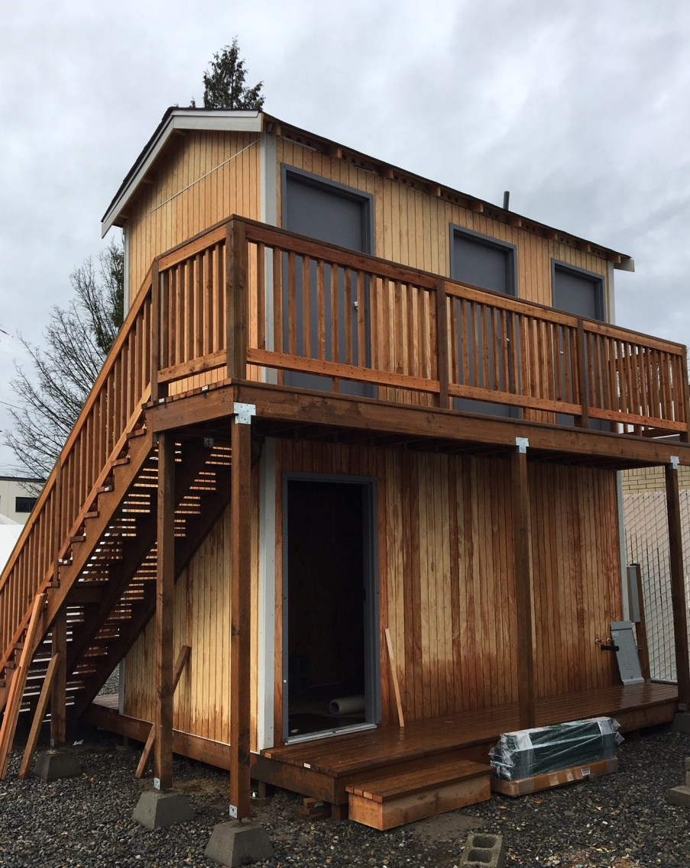
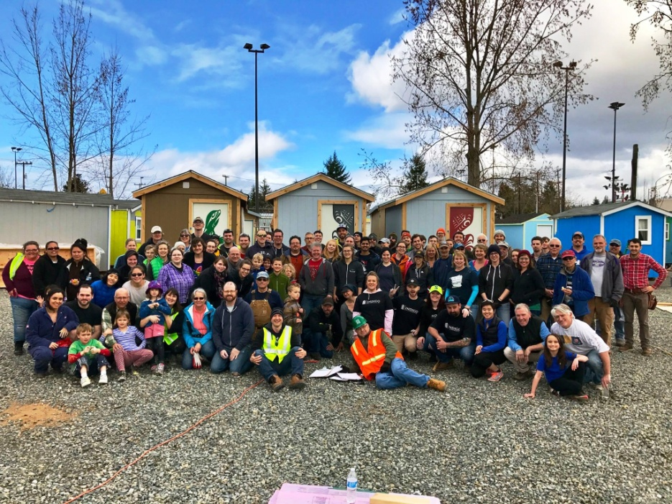
Georgetown Village March 2017, 37 Tiny Houses & Overflow Tents
Shower Tower

Slide 21
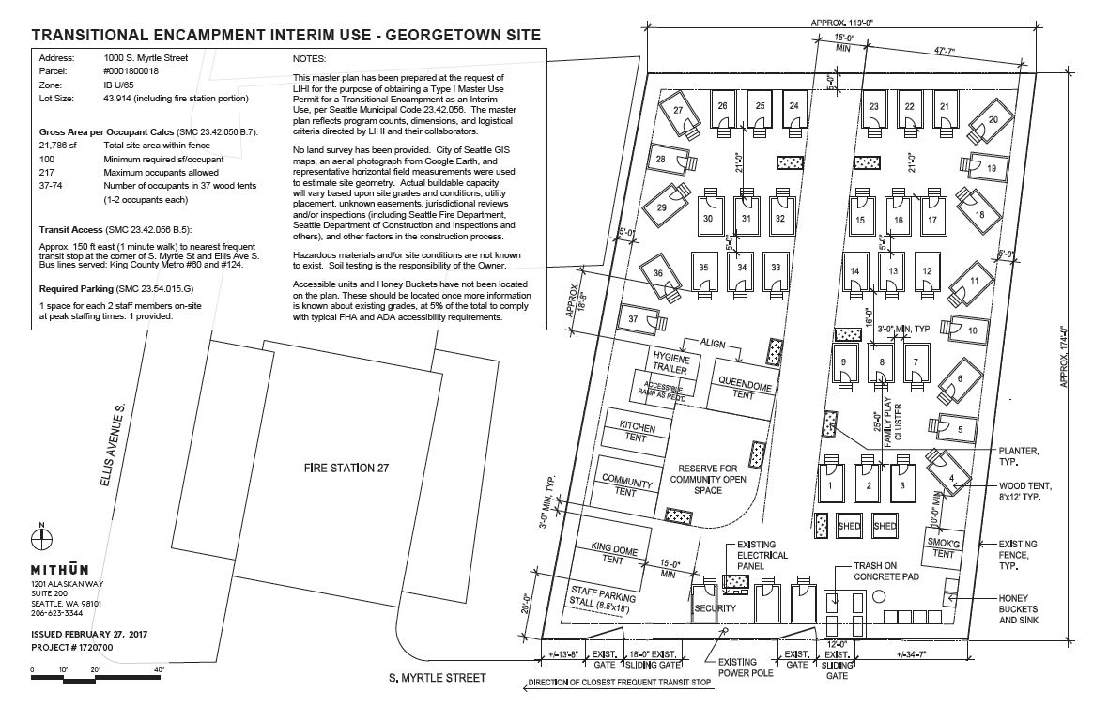
Georgetown Village

Slide 22
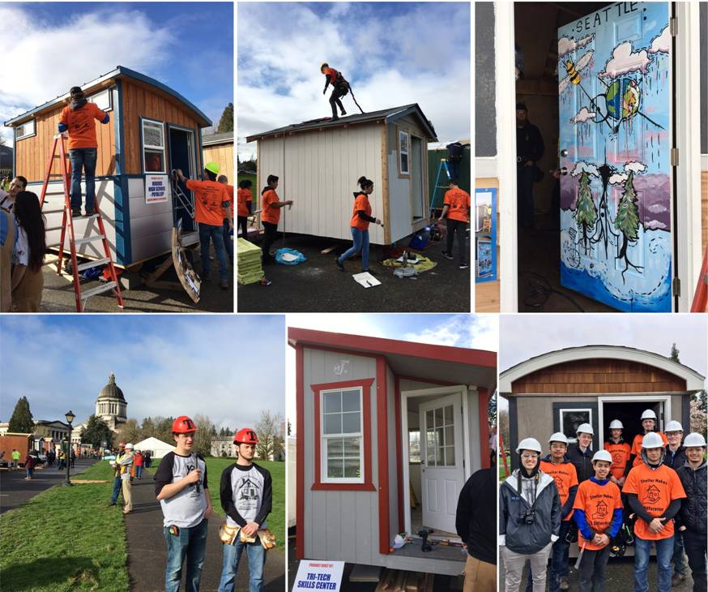
CTE Showplace of Skills Tiny House Competition on Capitol Grounds, March 2016 After Competition houses were moved to Licton Springs Village

Slide 23
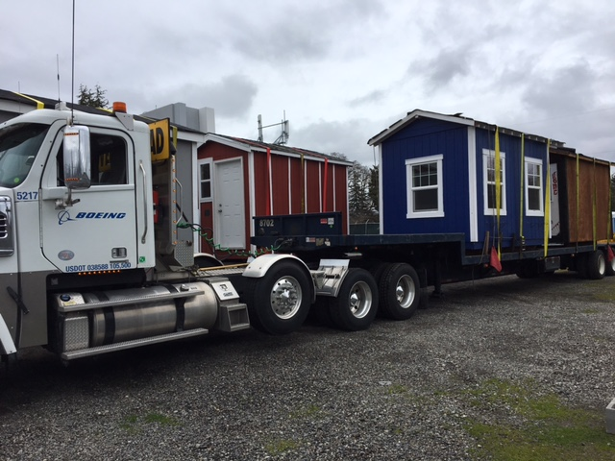
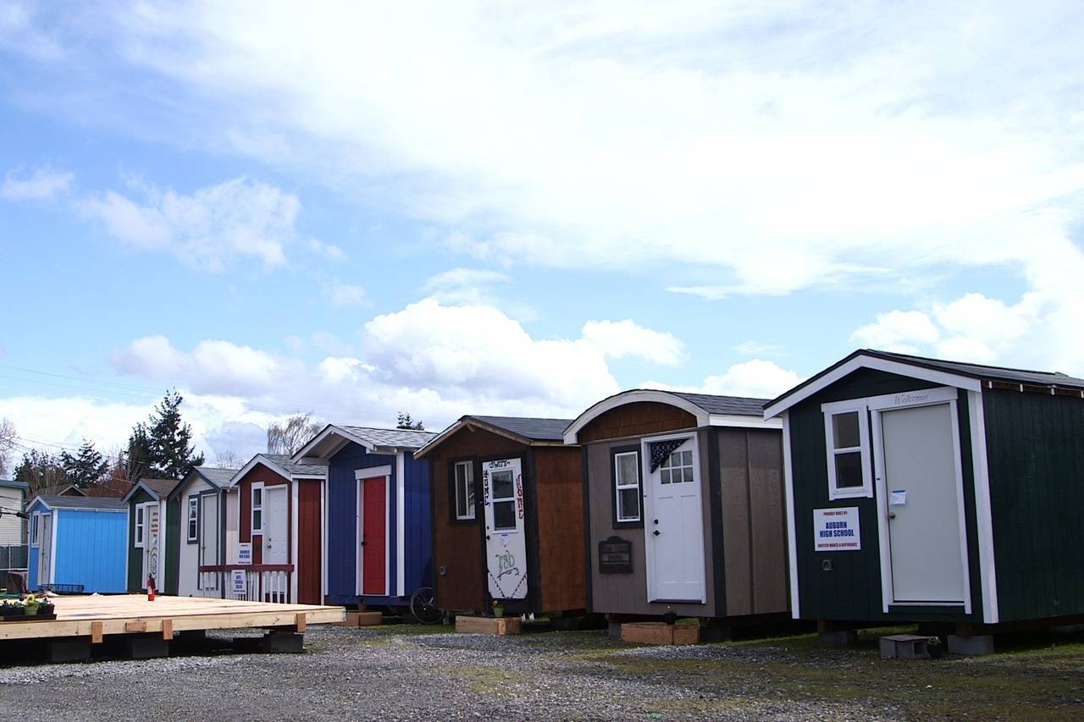
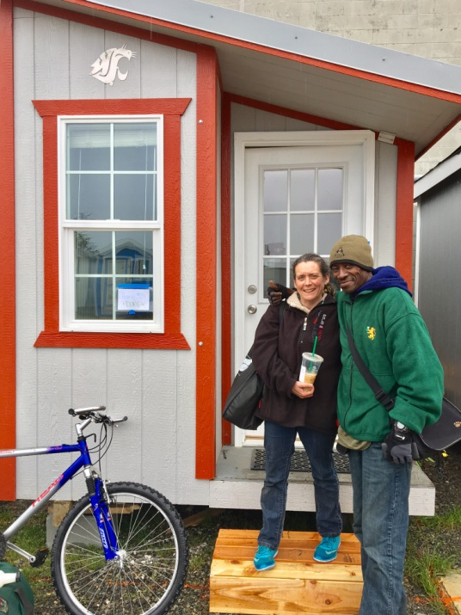
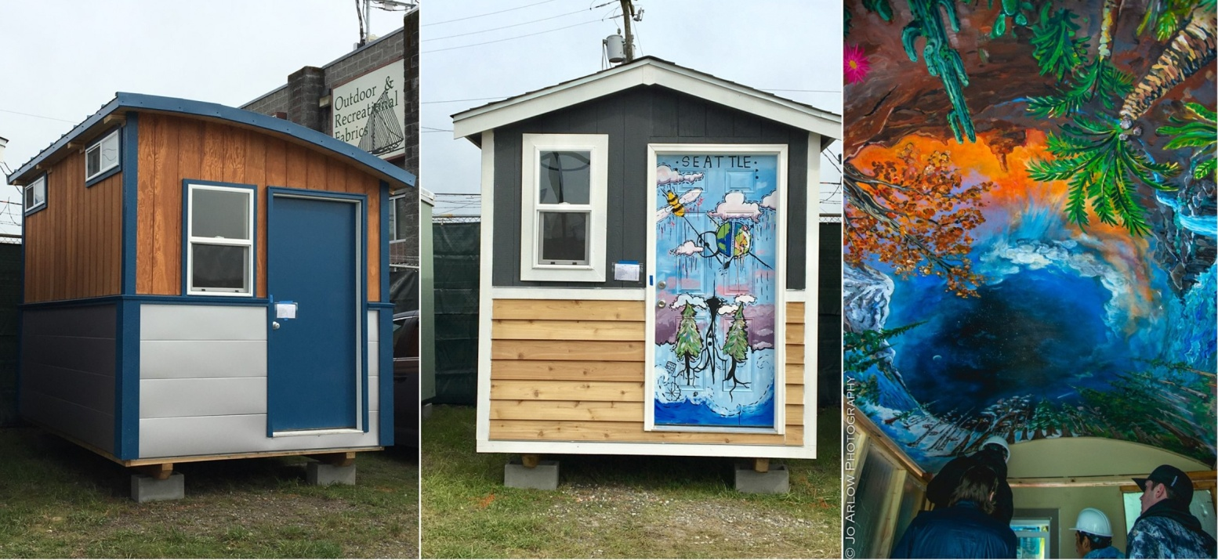
Licton Springs Village April 2017, 27 Tiny Houses & Overflow Tents

Slide 24
Licton Springs Village

