Slide 1
Shame and Resilience in Child Welfare

Slide 2
Who are we
Heather Cantamessa-Parents for Parents Program Coordinator
Ambrosia Eberhardt-Parents for Parents Ally Lead
Vanessa Matthews-Division of Children and Families Services
Tarena Coleman-Office of Public Defense

Slide 3
Presentation outline:
Identify shame
Reflection
What shame looks like
“I'm not good enough” reaction
What not to do(how to avoid shame and shaming interactions)
When I am not doing well
What you need to build shame resilience
I can stop self-defeating (shaming) thoughts/actions and do better, what we need to hear
Questions

Slide 4
Some of the things to identify shame
We all have it.
Shame is universal and one of the most primitive human emotions that we experience.
The only people who don’t experience shame lack the capacity for empathy and human connection.
We’re all afraid to talk about shame.
The less we talk about shame, the more control it has over our lives.

Slide 5
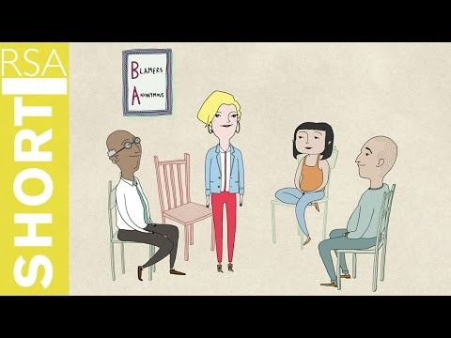
Video…..

Slide 6
What shame looks like
Shame loses power when it is spoken
How your shameful thoughts turn to action/inaction (aggressive/disappearing/power and control, etc.)
Shame is the intensely painful feeling or experience of believing that we are flawed and therefore unworthy of love and belonging
The “I’m not good enough” reaction – what does it look like in you? In others?
Shame is all about fear

Slide 7
Shame needs three things to grow out of control in our lives
Silence
Shame loses power when its spoken
Secrecy
Don’t talk, don’t tell.
Judgement
We live in a blame culture we want to know whose fault it is and how they are going to pay

Slide 8
avoiding shame
We live in a blame culture – we want to know whose fault it is and how they’re going to pay.
-When I’m not (past or present) doing well, this is what it looks/ed like (who I am, who I was, who others were being that did not help, etc.)
The key is to separate people from their behaviors – to address what they’re doing, not who they are
-I realized I wouldn’t do my part well if I continued with this behavior/thoughts, etc…

Slide 9
Building Shame Resilience
If we want to fully experience love and belonging, we must believe that we are worthy of love and belonging
I began to do well when I began to think/feel/act with these thought processes
Others helped me feel like I could do it by…
The greatest challenge for most of us is believing that we are worthy now, right this minute
How you/I can stop self-defeating (shaming) thoughts/actions and do better, what we need to hear.

Slide 10
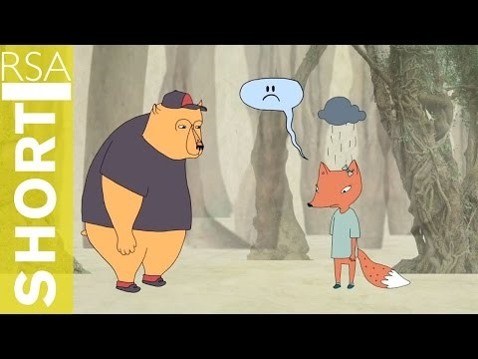
One of the ways to build shame resilience video

Slide 11
Why building Shame Resilience is key to our work:
Relatively new research into shame shows us that there are ways to identify, name and reduce the impact shame has on families and parents that CPS comes into contact with. Working on building shame resilience allows families to talk about what gets in their way of getting the real work done to put their families back together again.
The “How-to” will not work without talking about what gets in the way and this panel sums up the real (research-based) things that get in the way of progress and success from both families and the child protection/welfare workers. Learn how to help families be more successful, engage families in real dialog and work toward common goals that protect children and preserve families.

Slide 12
“Only when we are brave enough to explore the darkness will we discover the infinite power of our light.” Brene Brown
Questions?????

