Slide 1
Housing Immigrants and Refugees Muslim Housing Services Housing the Homeless Since 1999
Mr. Rizwan Rizwi
Executive Director
&
Mr. Roble Abdinoor
Senior Case Manager

Slide 2
Why MHS was Founded
Founded in 1999 to help alleviate hardships faced by homeless and needy families in the greater Seattle area, King/Pierce County homeless families who are primarily refugees and second migration immigrants from East Africa, Eastern Europe, the Middle East and other parts of Africa.
Large number of homeless families:
Many refugees
Single parents from war torn countries with young children
Many with very limited English language skills
Many with little applicable skills for working in the US
Large families and families with disabilities
Notes:
Story of pregnant women about to get discharged from her program

Slide 3
Why MHS was Founded cont.
At the time most of the Existing Transitional Housing Programs were inadequate
Many had 2-4 week duration caps
Had trouble meeting needs of refugees, single parents with young children, large families, those without language and vocational skills
Focus on Housing
Most important need in the US: protection from the elements
No way to raise a family on the streets
Enables much greater efficiency for other critical needs (like food)

Slide 4
Goals
All families become self-sufficient and achieve permanent housing
Removed hard timelines, we wanted to get our families self-sufficient and have flexible timelines to customize help to particular families situation.
Provide orientation for refugee families
ESL and vocational training along with help in finding employment
Accommodate large families (some with 11 family members)
Leniency in dealing with families with very young children, disabilities, or other issues preventing them from working or become self-sufficient

Slide 5
MHS and Our Services
6 Fulltime Staff that speak 8 different languages in addition to English.
Provide housing for approximately One hundred families every month.
Provide many other services for the families.
All families below federal poverty line to enter program.

Slide 6
Programs we Operate
Homelessness Prevention
Transitional Housing
Case Management
Rental Assistance
Youth Program

Slide 7
Youth Program:
After school program (benefits)
Supportive environment
Interpersonal skills
Staying Active (Soccer Program)
Mentoring
The program aims to install/maintain a positive outlook in our participants and those learned skills can be applied in their daily lives.

Slide 8
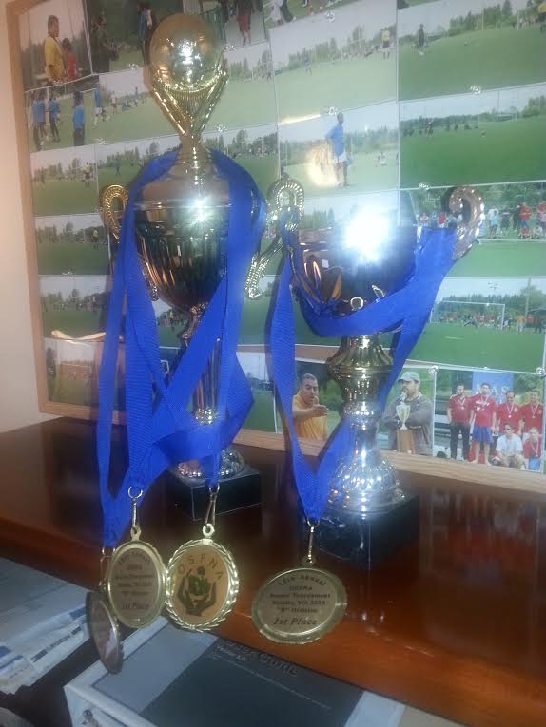
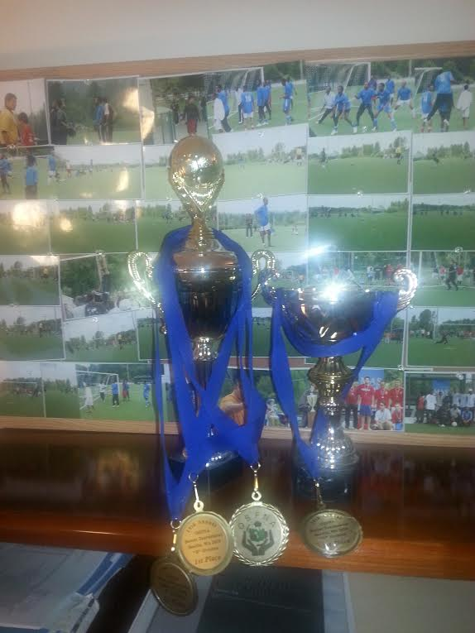
Youth Soccer Team Keeping them Active:

Slide 9
Youth Outreach – Seattle Police Department: Officer Jojo
Reaching out to the community:
Giving the youth the Opportunities to interact:

Slide 10
Our Clients
Large number of our clients are either from war-torn or poverty stricken countries.

Slide 11
Refugees & Immigrants
We are the first place where many refugees/immigrant families come to for assistance
Some families come from as far away as the Snohomish & Pierce County by public transportation just to get help and meet with our Case Managers

Slide 12
Integrating into their adopted country:
Learning the language of the land
Becoming contributors (Taxpayers)
Knowing your civic duties
Balancing between two cultures
Always working towards bettering their future (education, career and overall quality of life)

Slide 13
As an Agency we make sure our clients get help with:
Job readiness; employment, education and training; limited English proficiency; life skills, health/mental health needs, legal issues, family unification, childcare and domestic violence intervention and immigration
How to successfully to adjust into their newly adopted country

Slide 14
Hurdles Faced by Immigrant & Refugee Families
Not understanding the system (not knowing how to seek the right resources)
Cultural shock (cultural challenges)
Attaining employment
Language Barriers
Housing Issues

Slide 15
Housing Issues
Mistreatment by Landlords
Financial struggles
Relief agencies only pay first three months
No job and no other means of paying
Eviction and families become homeless
Unhealthy environment
Large families (seven to ten family members): One or two bedroom units
Relief agencies who brings them places the new arrivals in unbearable living situations

Slide 16
TANF Recipients by family size:
Family Size: | Amount (TANF):
1 | $332
2 | $420
3 | $521
4 | $613
5 | $706
6 | $802
7 | $927
8 | $1,026

Slide 17
Eligible for Assistances
Washington State residents
Taking care of children
Pregnant
Citizenship/ alien status requirements
Participate in the work first program
Complete all requested reviews
Participate in all required job search and work preparation activates

Slide 18
Refugees and Immigrants
Refugee
Immigrants
Temporary Assistance for Needy Families (TANF) provides temporary cash for families with children.
Medicaid (Apple Health)
Supplemental Nutrition Assistance Program (SNAP)
Women, Infants and Children (WIC) Supplemental nutrition program
Refugee Cash Assistance for refugees without children for first 8 months
Refugee Medical Assistance (RMA) provides medical services for up to eight months
State Food Assistance Program (FAP)
Women, Infants and Children (WIC) Supplemental nutrition program

Slide 19
Case Study
Before MHS
During their time with MHS:
Current situation
Relief agency only paid 3 months of the rent
Two bedroom unit for SEVEN people
Limited income (DSHS)
Received a notice of eviction (were not able to pay rent)
Language barrier and struggling to attain a job
Learned of MHS through the community and decided to come and applied for assistance
Our Arabic speaking Case Managers were able to assist the family
MHS was able to clear their outstanding rent, help them get a larger unit.
Assist the family with applying low-income housing, job search and started taking ESL classes
The family are now living permanent housing
Own a successful small business

Slide 20
Muslim Housing Services
6727 Rainier Ave S
Seattle, WA 98118
Tel# 206-723-1712
info@Muslim-Housing.org
www.facebook.com/MuslimHousing
www.muslim-housing.org

