Slide 1

Dispatch from Under the Dome
Dispatch from Under the Dome
May 11th, 2:00 – 3:30
Washington Low Income Housing Alliance
Michele Thomas, Director of Policy & Advocacy
Kate Baber, Homelessness Policy & Advocacy Specialist
Notes:
Opening Slide

Slide 2
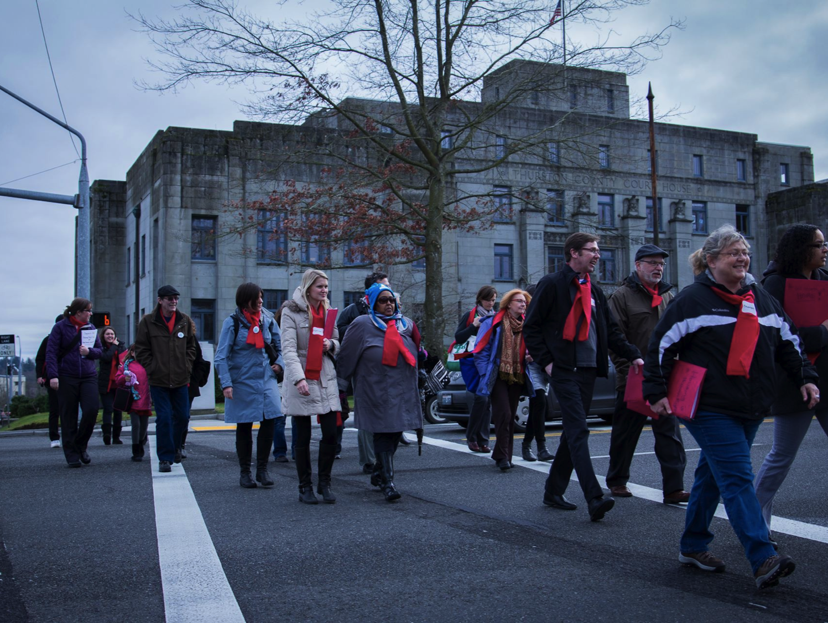
The Housing Alliance
Everyone should have the opportunity to live in a safe, healthy and affordable home.
Notes:
MT, 2 min, 2:02 – 2:04
*Factored in a 2 min late start time

Slide 3
Dispatch from Under the Dome
Workshop Overview
2:00 – 3:30
2017 State Legislative Session Debrief
- Update on Special Session
- Overview of Key Policy and Budget Issues
Questions and Answers
How Can You Impact the Outcome?
- A Review of Best Advocacy Practices and Commonly Asked Questions
Advocacy Resources and Tools
Questions and Answers
Notes:
MT, 3 min, 2:04 – 2:09

Slide 4
Dispatch from Under the Dome
Special Session
The Governor called a 30-day Special Session that started on April 24th.
What is a “special session”?
What can be considered during this session?
What happens if they are not done by May 23rd?
Notes:
MT, 2 Min 2:09 – 2:11

Slide 5
Dispatch from Under the Dome
State Policy & Advocacy Update
Eliminate the sunset on the Housing & Homelessness Assistance Surcharge and increase homelessness resources (SHB 1570/Macri)
Outlaw Discrimination Based on a Renter’s Source of Income (HB 1633/Riccelli & SB 5407/Frockt)
$200 million Investment in the Housing Trust Fund (Capital Budget)
Protect Housing & Essential Needs; the Aged, Blind and Disabled Program; Medical Care Services and SSI Facilitation Services. (HB 1831/Pettigrew; HB 1239/Sullivan; and the Operating Budget)
Ensure State Authorization for the Medicaid Transformation Demonstration (Operating Budget)
Notes:
MT, 2 min 2:11- 2:13

Slide 6
Dispatch from Under the Dome
State Policy & Advocacy Update

Slide 7

Dispatch from Under the Dome
State Policy & Advocacy Update
Prevent the cliff in state
homelessness funding
Eliminate the sunset of the document recording fees,
Increase resources to prevent and end homelessness,
Eliminate the 45% mandate,
Streamline and improve reporting and planning requirements,
Streamline audits required of the state and local governments.
Notes:
KB, 4 min, 2:13 – 2:17

Slide 8
Dispatch from Under the Dome
State Policy & Advocacy Update
Document recording fees are the major fund source for all state and local homelessness services including:
Domestic violence shelters,
Youth and young adult shelters and outreach services,
Short-term and longer-term rental assistance (Rapid Rehousing),
Move-in assistance (deposits, tenant screening fees),
Permanent Supportive Housing Services,
And more.
Notes:
KB, 1 min 2:17 – 2:18

Slide 9
Dispatch from Under the Dome
State Policy & Advocacy Update
State investments are making a difference
Source: Washington State Department of Commerce
Notes:
KB 2:18 – 2:20

Slide 10
Dispatch from Under the Dome
State Policy & Advocacy Update
County | Loss of Funds
Whatcom County | -$2,257,046
Spokane County | -$4,642,674
King County | -$21,986,392
Clark County | -$5,503,819
Yakima County | -$1,654,086
Snohomish County | -$8,513,313
Walla Walla County | -$508,600
Grays Harbor County | -$750,443
Skagit County | -$1,440,805
Pierce County | -$8,986,609
State Total | -$74,862,116
Notes:
KB, 1 min 2:20 – 2:21(for this slide and for slide 11)

Slide 11
Dispatch from Under the Dome
State Policy & Advocacy Update
Homelessness will increase and people will suffer.
H
County | People impacted each year by loss of funds | 2016 Point in Time, people unsheltered
Spokane County | 2,334 | 981
King County | 11,053 | 4,505
Clark County | 2,767 | 231
Snohomish County | 4,280 | 481
Pierce County | 4,518 | 1,762
Notes:
KB 1 min, 2:20 – 2:21 (this 1 min is shared with the prior slide)

Slide 12
Dispatch from Under the Dome
2017 State Legislative Session Debrief
Outlaw Discrimination
Everyone Should Have Equal Opportunity
to Apply for Housing
HB 1633/Riccelli & SB 5407/Frockt
Notes:
MT, 5 min total for all SOID slides 12- 16, 2:21 – 2:26

Slide 13
Dispatch from Under the Dome
2017 State Legislative Session Debrief
House Judiciary Committee hearing on HB 1633/Riccelli February 7th, 2017
Notes:
MT, 5 min total for all SOID slides 12- 16, 2:21 – 2:26

Slide 14
Dispatch from Under the Dome
2017 State Legislative Session Debrief
Key Points
An otherwise eligible tenant cannot be denied tenancy based on their source of income.
This bill addresses the disparate impact that source of income discrimination has on communities known to be at high risk of housing discrimination.
The 2017 bill covered all legal sources of income and included a “Housing Access Income Calculator” to ensure landlords don’t use an income multiplier in a way that disqualifies eligible tenants who can afford the rent.
Next steps.
Notes:
MT, 5 min total for all SOID slides 12- 16, 2:21 – 2:26

Slide 15
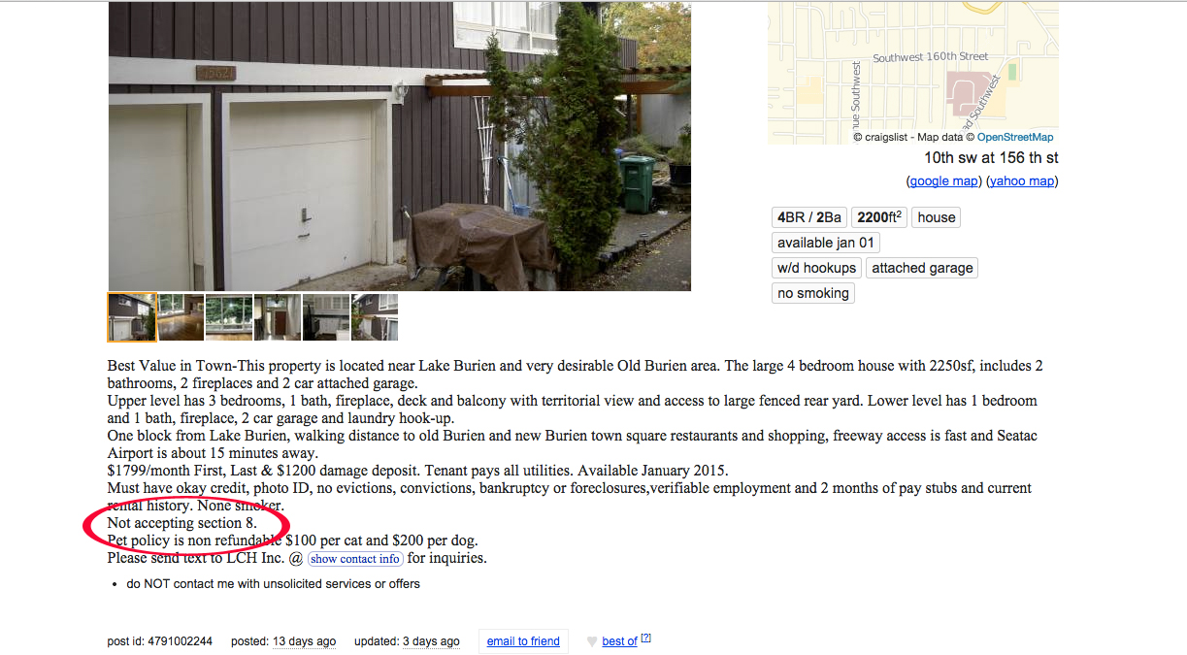
Dispatch from Under the Dome
2017 State Legislative Session Debrief
Notes:
MT, 5 min total for all SOID slides 12- 16, 2:21 – 2:26

Slide 16
Dispatch from Under the Dome
2017 State Legislative Session Debrief
"All I kept thinking was, 'You're gonna be out there in the freezing air [homeless] with these kids.'" Thomas began searching frantically for a new place to live, a search that "became like an addiction" keeping her up at night. She says she made a portfolio with photos of her kids in their church clothes to show to potential landlords. She was constantly making calls and scanning Craigslist, only to be told by multiple landlords they didn't take Section 8.
"That's what you're going through all day," Thomas says. "You're selling yourself... and you're still being turned down. There are no words to express or articulate that feeling."
Notes:
MT, 5 min total for all SOID slides 12- 16, 2:21 – 2:26

Slide 17
Dispatch from Under the Dome
2017 State Legislative Session Debrief
Housing Alliance Budget Priorities
Housing Trust Fund
HEN/ABD, Medical Care Services and SSI Facilitation Services
Medicaid Benefit for Permanent Supportive Housing
Notes:
MT – transition slide to Housing Alliance Budget priorities

Slide 18
Dispatch from Under the Dome
2017 State Legislative Session Debrief
2017 ask = $200 Million investment over this biennium.
$200 million will build over 5,700 permanently affordable homes.
The Housing Trust Fund invests state funds on a competitive basis to build affordable homes to people earning zero – 80% of the local area median income.
There is a significant gap of affordable and available housing. For every 100 very low-income households, there are only 28 affordable and available homes.
x
Notes:
MT, 3 min total for HTF 2:26 – 2:29

Slide 19
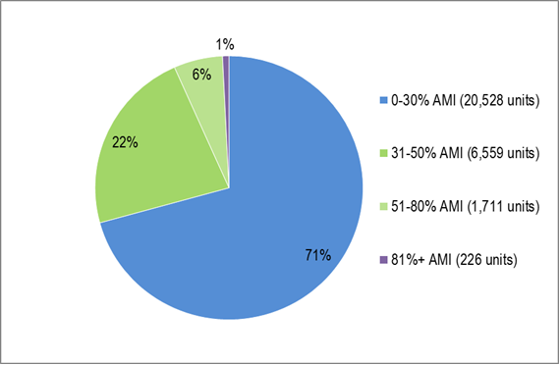
Dispatch from Under the Dome
2017 State Legislative Session Debrief
The overwhelming bulk of Housing Trust Fund dollars support homes for those with the lowest incomes, with over 70% for extremely low income households.
Notes:
MT, 3 min total for HTF
2:26 – 2:29

Slide 20
Dispatch from Under the Dome
2017 State Legislative Session Debrief
1989- 2015
Whatcom
1,229 Units + 9 Beds
$32 M
Pend
Oreille
152 Units
$2.3 M
San Juan
236 Units
$9.9M
Okanogan
361 Units + 47 beds
$9.3 M
Ferry
177 Units
$2.6 M
Skagit
715 Units + 6 Beds
$19.8 M
Island
163 Units +
17 Beds
$6.4 M
Stevens
183 Units
$5.7 M
Clallam
666 Units
$21.7 M
Snohomish
2,569 Units +
55 Beds
$57.5 M
Kitsap
960 Units +
80 Beds
$28.2 M
Chelan
926 Units +
6 Beds
$30 M
Jefferson
109 Units + 4 Beds
$5 M
Douglas
150 Units +
18 Beds
$9.6 M
King
15,320 Units +
2,098 Beds
$370.3 M
Lincoln
39 Units +
16 Beds
$2.5 M
Spokane
2,907 Units +
177 Beds
$81 M
Grays
Harbor
231 Units +
25 Beds
$5.3 M
Mason
279 Units +
$8.5 M
Grant
1,390 Units +
$31.4 M
Pierce
2,738 Units +
224 Beds
$76.6 M
Kittitas
183 Units
$3.7 M
Adams
438 Units +
$12.6 M
Whitman
239 Units
$9.3 M
Thurston
926 Units +
88 Beds
$32.4 M
Pacific
68 Units +
8 Beds
$6.2 M
Franklin
388 Units
$11.4 M
Lewis
386 Units + 6 Beds
$13.1 M
Garfield
10 Units
$94.1 K
Yakima
1,421 Units +
108 Beds
$47.6 M
Wahkiakum
19 Units
$1.1 M
Cowlitz
474 Units +
41 Beds
$16 M
Skamania
142 Units
$4.6 M
Benton
515 Units +
8 Beds
$12.3 M
Walla Walla
603 Units +
151 Beds
$28.3 M
Columbia
8 Units
$42.3 K
Asotin
56 Units
$1.1 M
Klickitat
63 Units + 6 Beds
$2.3 M
Multiple Counties (scattered-site projects)
358 Units
$6.7 M
Clark
2,036 Units +
95 Beds
$42.8 M
Notes:
MT, 3 min total for HTF
2:26 – 2:29

Slide 21
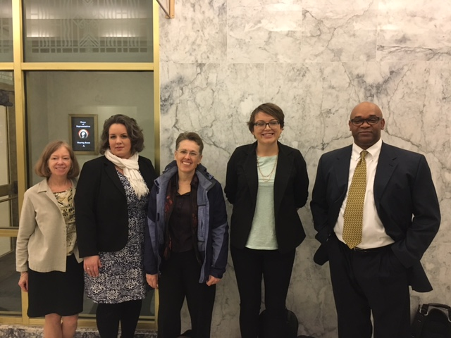
Dispatch from Under the Dome
2017 State Legislative Session Debrief
Housing Trust Fund Testifiers, House Capital Budget Hearing on April 6th 2017
Notes:
MT, 3 min total for HTF
2:26 – 2:29

Slide 22
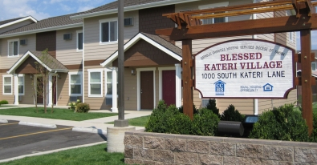
Dispatch from Under the Dome
2017 State Legislative Session Debrief
Blessed Kateri Village in Wapato by Catholic Charities Housing Services of Yakima
Notes:
This project was funded with HTF dollars

Slide 23
Dispatch from Under the Dome
2017 State Legislative Session Debrief
HEN/ABD, Medical Care Services and SSI Facilitation Services
The Housing and Essential Needs (HEN) and Aged Blind and Disabled (ABD) programs are critical components of our state’s homelessness, disability, and mental health safety net.
76% of HEN and ABD recipients have been diagnosed with a mental illness.
Housing and basic survival resources are critical in supporting people with mental health illness in their recovery, and they help prevent a mental illness from decompensating to a crisis.
Notes:
KB 6 min total for slides 23 – 27, 2:29 – 2:35

Slide 24
Dispatch from Under the Dome
2017 State Legislative Session Debrief
Governor’s Budget Proposal
Aged, Blind, and Disabled Program (ABD)
- Increases ABD grant from $197 to $400 per month ($29.617 million)
Housing and Essential Needs (HEN)
- Preserves HEN assistance
- Creates a $20 per month HEN transportation stipend ($1.893 million)
Medical Care Services
- Preserves the Medical Care Services program
Notes:
KB 6 min total for slides 23 – 27, 2:29 – 2:35

Slide 25
Dispatch from Under the Dome
2017 State Legislative Session Debrief
Senate’s Budget Proposal
Aged, Blind, and Disabled Program (ABD)
- Creates a 36-month time limit for ABD presumptive SSI recipients
- This would cause 2,395 ABD recipients to be terminated during the first month the time limit is implemented
- State would lose access to federal ABD recovery payments for the population that reaches time limit
- People who reach time limit would also lose access to SSI Facilitation Services. The loss of ABD assistance and SSI Facilitation Services would put people at high risk of experiencing chronic, unsheltered homelessness.
Housing and Essential Needs (HEN)
- Initially eliminated all HEN funding ($59 million)
- Sen Miloscia amendment restored $10 million of HEN funding
- HEN recipients who receive Medical Care Services would lose their health coverage
Notes:
KB 6 min total for slides 23 – 27, 2:29 – 2:35

Slide 26
Dispatch from Under the Dome
2017 State Legislative Session Debrief
House Budget Proposal
Housing and Essential Needs (HEN)
- Full funding for HEN ($59 million)
- Adds a new $10/month transportation stipend for HEN recipients starting in 2019
Aged, Blind, and Disabled Program (ABD)
- Fully funds the program,
- Beginning in FY 2019, the maximum grant for the Aged, Blind, or Disabled (ABD) program is increased from $197 per month to $227 per month.
Notes:
KB 6 min total for slides 23 – 27, 2:29 – 2:35

Slide 27
Dispatch from Under the Dome
2017 State Legislative Session Debrief
Related Bills
PRO: ESHB 1239/Sullivan would help ABD recipients (and others) access federal SSI and SSDI benefits by requiring health facilities to share one free copy of an individual's medical records if the individual is appealing the denial of SSI or SSDI benefits.
Died in Senate Health Care Committee
PRO: ESHB 1831/Pettigrew would improve economic security for people struggling to meet their basic needs, including HEN and ABD recipients, by increasing public benefit programs' cash asset limit from $1,000 to $6,000, and the vehicle asset limit from $5,000 to $10,000.
Died in Senate Ways and Means
CON: SB 5898/Braun would implement a 36 month time limit on ABD recipients, require that TANF applicants prove that recent job searches have been conducted prior to applying for benefits, and makes other changes to Working Connections Childcare and WorkFirst.
Notes:
KB 6 min total for slides 23 – 27, 2:29 – 2:35

Slide 28
Dispatch from Under the Dome
2017 State Legislative Session Debrief
Creating a Medicaid Benefit for Tenancy Support Services in Permanent Supportive Housing
What is Permanent Supportive Housing?
What is Chronic Homelessness?
What is Medicaid and why should it pay for tenancy support services?
Notes:
KB, 5 min total for slides 28 – 30, 2:35 – 2:40

Slide 29
Dispatch from Under the Dome
2017 State Legislative Session Debrief
Creating a Medicaid Benefit for Tenancy Support Services in Permanent Supportive Housing
Notes:
KB, 5 min total for slides 28 – 30, 2:35 – 2:40

Slide 30
Dispatch from Under the Dome
2017 State Legislative Session Debrief
Creating a Medicaid Benefit for Tenancy Support Services in Permanent Supportive Housing
Reminder: Medicaid is a health insurance program serving people living on incomes at or below 138% of the federal poverty level. It is jointly funded and operated by the federal and state governments.
Washington State is working to create a new Medicaid benefit that would pay for the housing services delivered in permanent supportive housing.
This new Medicaid benefit would help people experiencing chronic, long-term homelessness, people with physical and behavioral health disabilities, and people with long-term care needs access and retain housing.
Notes:
KB, 5 min total for slides 28 – 30, 2:35 – 2:40

Slide 31
Dispatch from Under the Dome
2017 State Legislative Session Debrief
Housing Alliance Budget Priorities
Notes:
KB, 1 min, 2:40 – 2:41

Slide 32
Dispatch from Under the Dome
State Policy & Advocacy Update
HB 2186/Lytton, The House Revenue Package, key components:
Capital Gain Tax on profits from sales of stocks, bonds and other financial assets above $25,000
Reforming the Real Estate Excise Tax :
- Charge more for properties valued at over $1 million
- Reducing tax rate for properties valued under $250,000
Eliminating Unfair Tax Breaks:
- REET tax break for banks purchasing foreclosed properties,
- Tax break on bottled water,
- Sales tax breaks for out of state shoppers,
- Tax breaks for oil refineries,
- Tax breaks for prescription drug wholesalers,
- Tax breaks for international investment management companies.
Reform State Business & Occupation (B&O) Taxes:
- Eliminate B&O taxes for small businesses earning less than $250,000,
- Reduce B&O rate for those earning $250,000 - $500,000
Notes:
MT 3 min, 2:41 – 2:44

Slide 33
Dispatch from Under the Dome
2017 State Legislative Session Debrief
Housing Alliance Budget Support Items
Notes:
MT 1 min, 2:44 - 2:45

Slide 34
Dispatch from Under the Dome
State Policy & Advocacy Update
Housing Alliance 2017 Support Agenda – Key issues
Protect and Improve TANF Benefits (SB 5347/Walsh; HB 1831/Pettigrew; SB 5609/Darneille; and the Operating Budget)
Pass progressive revenue (HB 2186/Lytton)
Homeless Youth and Young Adults (SB 5625/Zeiger & HB 1630/Slatter; and the Operating Budget)
Protect and expand the Rights of Washington’s Tenants (SB 5408/Cleveland & HB 2040/Frame)
Mental Health and Chemical Dependency Services (Capital and Operating Budget investments)
Notes:
MT, 2 min, for slides 34 and 35, 2:45 – 2:47

Slide 35
Dispatch from Under the Dome
State Policy & Advocacy Update
Housing Alliance 2017 Support Agenda (Additional Issue Areas)
Advance Social Justice Immigrant rights, Fair Housing, Criminalization of Homelessness, Criminal Records, Racial Justice.
Democracy and Voting Rights Protect and expand voting rights & do more to encourage voter engagement.
Build & Preserve Affordable Homes Implement local funding options, preserve affordable homes, support homeownership & manufactured housing protections, address needs in rural Washington.
Prevent Homelessness and Meet the Needs of Vulnerable Populations Domestic violence survivors, seniors, people with disabilities, people living with mental illness.
Notes:
MT, 2 min, for slides 34 and 35, 2:45 – 2:47

Slide 36
Dispatch from Under the Dome
Q & A
Any questions before we proceed?
Notes:
MT & KB, 3 min 2:47 - 2:50

Slide 37
Dispatch from Under the Dome
In-district Advocacy
Record advocacy this session!
Number of advocates | 2038
Advocates who testified | 89
Advocacy Day attendees | 637
Actions taken | 3008
Emails/phone calls made | 8382
Lawmakers who heard from advocates | 147+1
Notes:
KB, 2 min, 2:50 – 2:52
What is advocacy? Point out that it can be a meeting, a tour, inviting a lawmaker to an opening, use example of Mercy Housing summer reading with lawmakers.
It is critical: Our ability to advance policies and budgets issues that impact affordable housing and homelessness are dependent on stakeholders being engaged.

Slide 38
Dispatch from Under the Dome
In-district Advocacy
Housing & Homeless Advocacy Day 2017
Notes:
KB 2 min, 2:52 – 2:54

Slide 39
Dispatch from Under the Dome
In-district Advocacy
How can advocates utilize Special Session & the time between sessions to educate your lawmakers?
Why develop a relationship with your state lawmakers?
Examples of successful in-district advocacy: tours, openings, and engaging lawmakers in creative ways.
Notes:
MT 2 min, 2:54 – 2:56

Slide 40
Dispatch from Under the Dome
In-district Advocacy
Reminder of 501c3 lobbying allowances
Advocacy: Educating on an issue.
No limits.
Lobbying: Advocating for a specific piece of legislation or budget.
Some (generous) limits.
Two IRS options: “Substantial Part” test and 501(h) election.
Free lawyers: Alliance For Justice - Bolder Advocacy at www.afj.org.
Campaigning: Helping get someone elected.
Never allowed!
Notes:
KB, 2 min, 2:56 – 2:58

Slide 41
Dispatch from Under the Dome
In-district Advocacy
Helpful Information to Know Before Meeting With a Lawmaker:
What’s the lawmaker’s position on homelessness and affordable housing issues?
Does the lawmaker serve on any key policy committees? Do they hold a leadership position within their caucus?
What’s the lawmaker’s voting record on the legislation you care about?
What policy issues does the lawmaker have a history of supporting and opposing?
Notes:
KB, 4 min, 2:58 – 3:02
Use this slide to transition to the next one, the next one has a screenshot of www.leg.wa.gov

Slide 42
Dispatch from Under the Dome
In-district Advocacy
A valuable resource: www.leg.wa.gov
Notes:
KB, 2 min, 3:02 – 3:04 (MT will probably chime in here too)

Slide 43
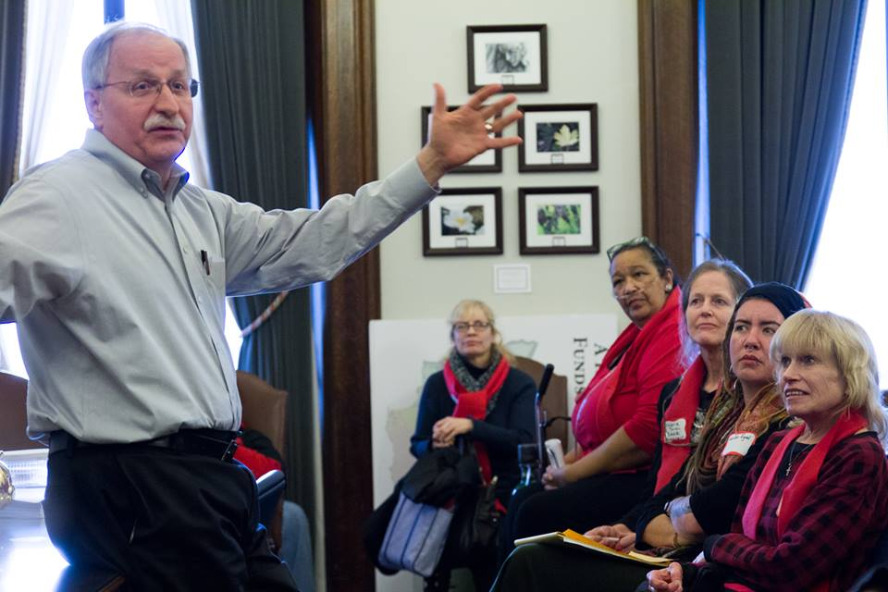
Dispatch from Under the Dome
In-district Advocacy
One of the keys to having a successful meeting is knowing what you want to accomplish:
Broad Goals:
Introduce yourself and your organization
Develop a relationship
Introduce an issue to the lawmaker
Specific Goals:
Request lawmaker to take action to address a specific issue
Increase lawmaker’s understanding of a complex or specific problem
Ask lawmaker to sponsor legislation
Notes:
KB, 3 min, 3:04 – 3:09

Slide 44
Dispatch from Under the Dome
In-district Advocacy
Who Should Attend Your Advocacy Meeting?
People directly impacted by the issue, such as people who have experienced homelessness and housing instability, have unique expertise to share with lawmakers.
Non-profit board members and staff at all levels of an organization have valuable perspectives about emerging needs & policy implementation.
Community leaders and local elected officials representing city and county governments can be effective messengers and increase the visibility of an issue.
Unexpected messengers representing sectors outside of homelessness and affordable housing can illustrate nexus between housing and other issues.
Notes:
KB, 3 min total, 3:09 – 3:11

Slide 45
Dispatch from Under the Dome
In-district Advocacy
Advocacy Material Tips
Keep materials brief and easy to read; main points and should be easily identifiable.
Writing should be clear and concise; avoid jargon and technical language.
Frame issue using values-based messages: “all people deserve a safe, healthy & affordable home.”
Include information about local homelessness and poverty indicators, such as your PIT count number, local poverty rate, OSPI homeless student numbers.
Include success information, such as outcome data, client stories, and cost savings information.
Include an ask!
Notes:
MT, 3 min total 3:11 – 3:14

Slide 46
Dispatch from Under the Dome
Advocacy Tools
Housing Alliance is a resource!
www.wliha.org has advocacy resources & tools
Follow our blog and follow us Facebook for timely updates
Notes:
MT, 2 min total 3:14 – 3:16

Slide 47
Dispatch from Under the Dome
Advocacy Tools
Take Action Today!
Urge lawmakers to:
Make a deep investment in the Housing Trust Fund,
Protect & expand homelessness services and,
Strengthen our social safety-net by supporting the House budget and revenue package!
bit.ly/conferenceaction
Notes:
MT, 2 min total 3:16 – 3:18

Slide 48
Dispatch from Under the Dome
Q & A
Any questions?
Notes:
MT & KB 10 min to end 3:18 – 3:30

Slide 49
Dispatch from Under the Dome
Thank you!
Please contact the Housing Alliance
with any questions:
Michele@wliha.org
Kateb@wliha.org
Please fill out an evaluation of this workshop!
Notes:
Thank you!

