Slide 1
John Freeburg
Living with schizophrenia

Slide 2
Early Days
John with his younger brother in Tokyo with their nanny, Terry.

Slide 3
Early days
John and playmates in Tokyo

Slide 4
family
John with his children
Holidays 1999

Slide 5
family
John and his son in Port Orchard, WA

Slide 6
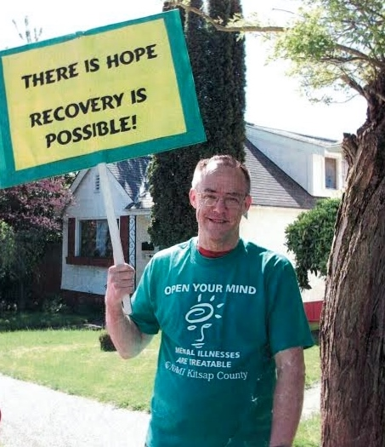
recovery
Fighting stigma by being visible
Armed Forces Day Parade
Bremerton, WA

Slide 7
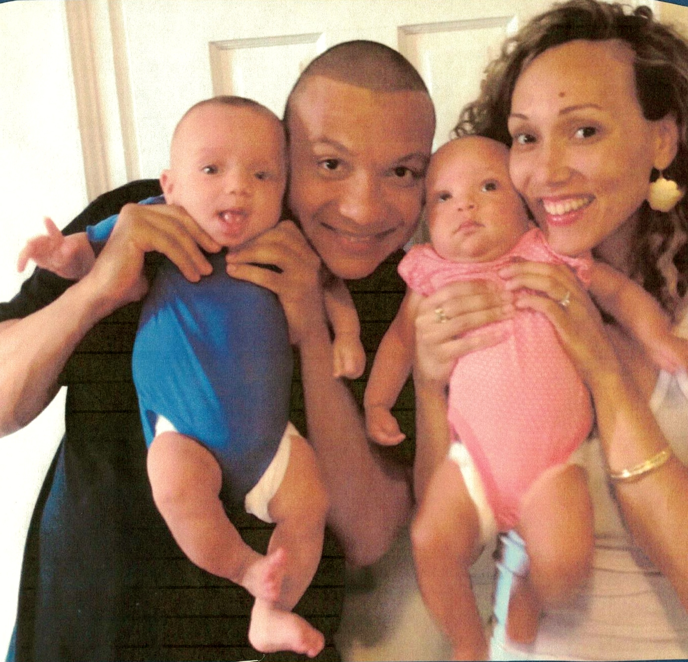
Growing family
John’s daughter and son-in-law, and his new grandbabies!

Slide 8
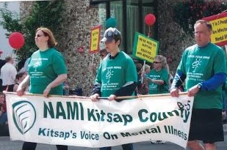
visibility
Armed Forces Day Parade
Bremerton, WA
John was president of the NAMI Kitsap County Affiliate and marched in the parade with NAMI Kitsap and PEERS

Slide 9
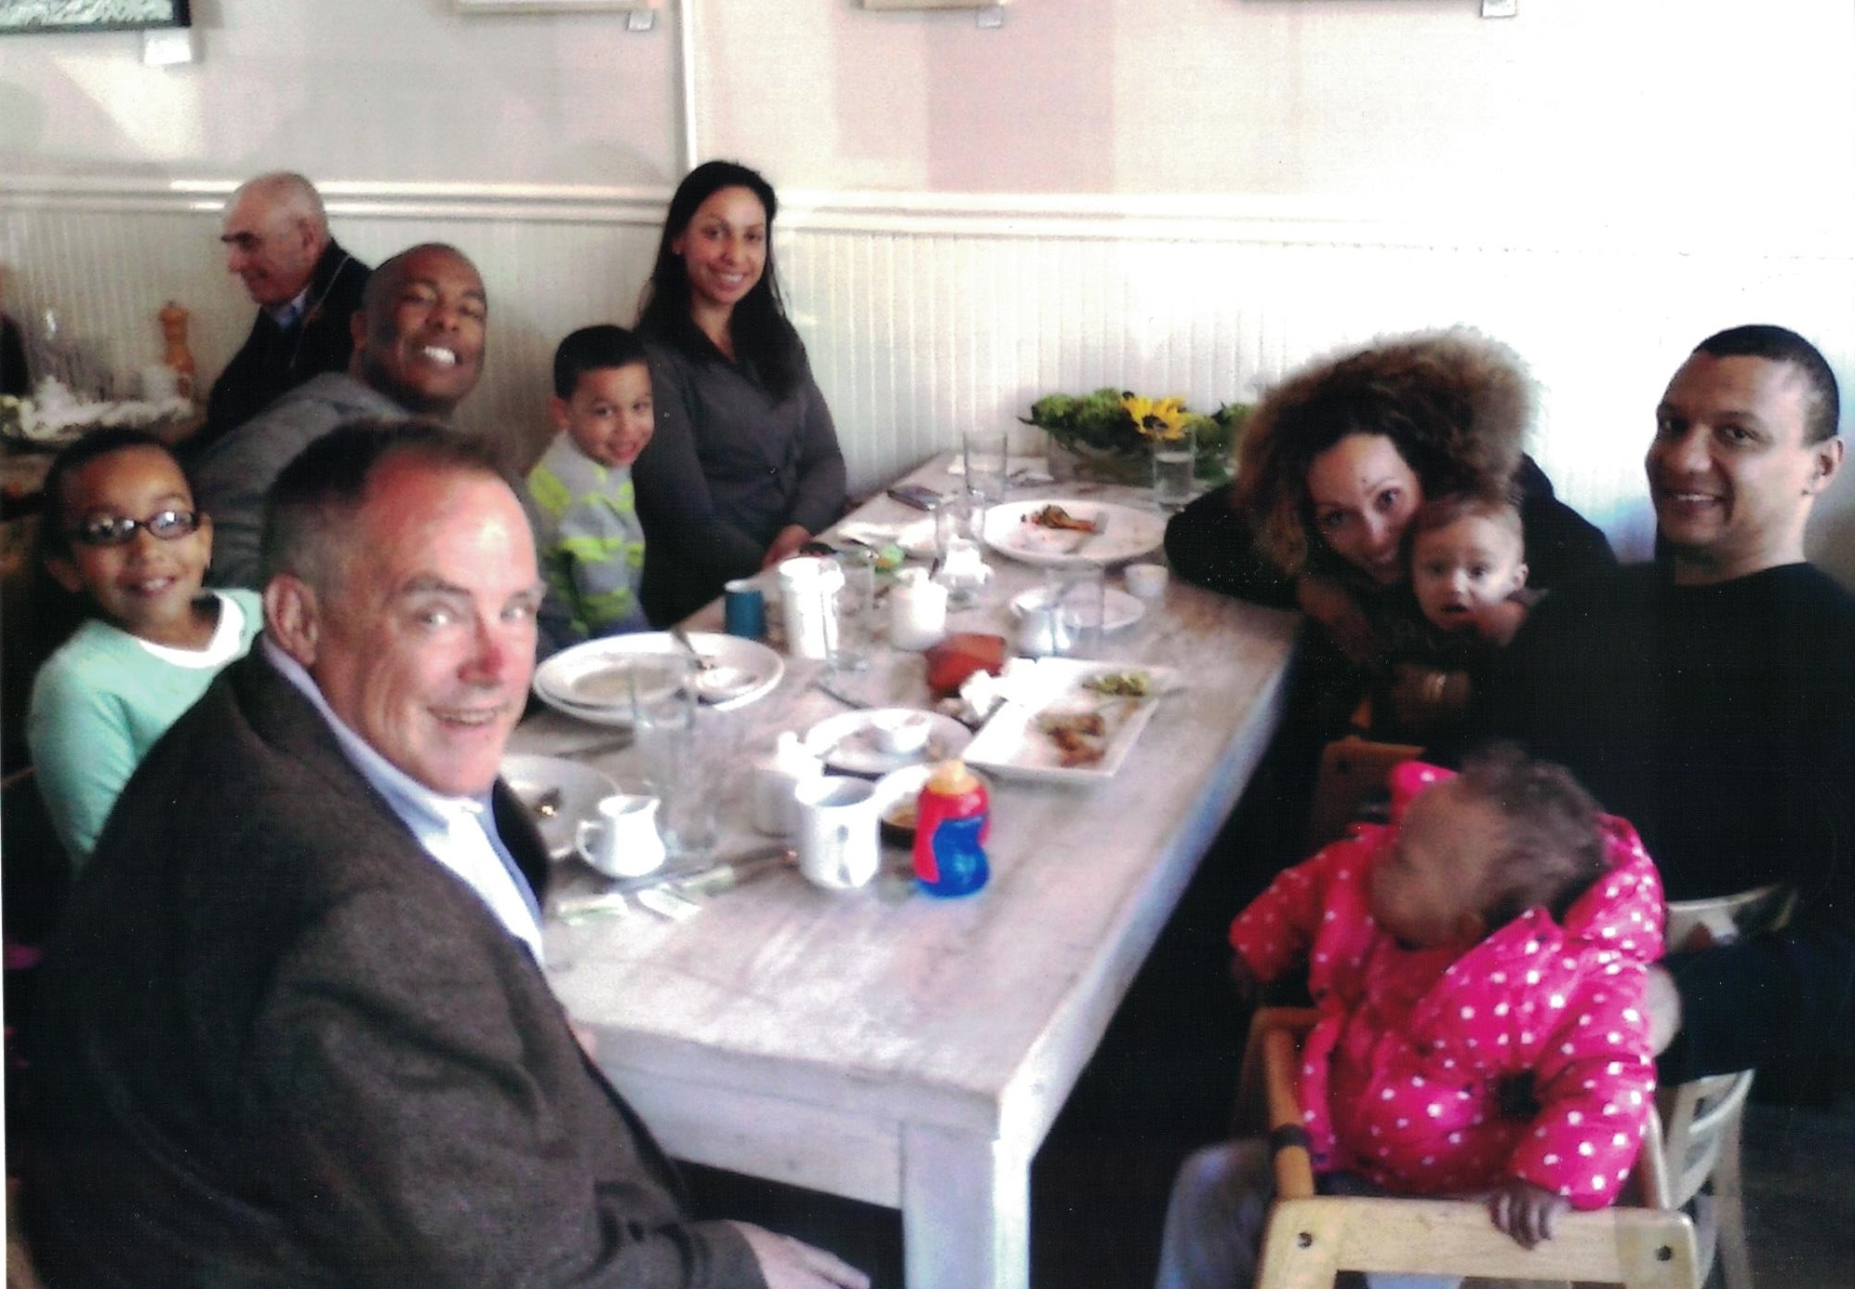
Living life
John with his family celebrating Easter in Brooklyn, NY

