Slide 1
PEER Led Services:
An Introduction to NAMI
Washington Low Income Housing Alliance
May 11, 20167
Lauren B. Simonds, M.S.W.
John Freeburg
Francesca Martin
Daryn Nelsen-Soze, M.S.W.

Slide 2
MILLIONS
OF AMERICANS,
1 in 5 or nearly 60 million people, face the day-to-day reality of living with a mental illness. We get it. We’ve been there. We offer help and hope; we improve lives and take a stand.
NAMI
MEANS MORE
than simply hope—we educate families and those living with mental illness and advocate night and day to ensure better lives for everyone.

Slide 5
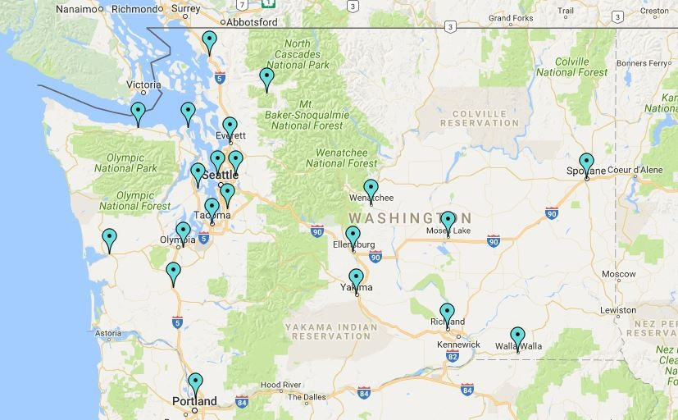
Affiliate Map

Slide 6
THE WORLD IS LOOKING
at mental health in a new way. Stepping up to shine the light and embrace the cause.

Slide 8
We are peers reaching out and responding to peers in need.
SUPPORT
NAMI HelpLine

Slide 9
EDUCATION
We get it. We’ve been there.
With the understanding unique to those with lived experience, we provide an array of no-cost education programs.
CLASSES

Slide 10
EDUCATION
We get it. We’ve been there.
With the understanding unique to those with lived experience, we provide an array of no-cost education programs.
Support groups

Slide 11
EDUCATION
We get it. We’ve been there.
With the understanding unique to those with lived experience, we provide an array of no-cost education programs.
Presentations

Slide 12
AWARENESS
We promote a unified voice on mental health, aiming to replace ignorance with understanding through media relations, public presentations, and outreach initiatives.

Slide 13
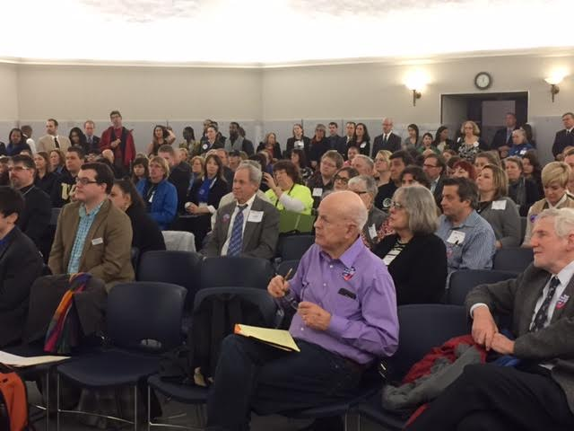
Through NAMI’s Stigmafree pledge and campaign and #Act4MentalHealth,
ADVOCACY
we are engaging our communities to promote acceptance and understanding for those who are affected by mental health challenges and to work for change!
Through powerful words and actions, we will shift the barriers for those living with mental health conditions and encourage acceptance and understanding.
#IAmStigmaFree

Slide 14
RAISING AWARENESS TO REACH A NEW GENERATION:
A new NAMI.org, mobile app, infographs, videos and more—
NAMI is launching new
tools to meet the needs of a changing demographic.

Slide 15
It’s time to stand up, take a stand and
make a difference.
TOGETHER,
we can make mental
health a priority and be part of the solution to solving one of the biggest problems we face as a nation and a world.

Slide 17
Lauren Simonds – Lsimonds@namiwa.org
John Freeburg – johnfreeburgwaja@gmail.com
Francesca Martin – fmartins4c@gmail.com
Daryn Nelsen-Soza – dnelsensoza@gmail.com
7500 Greenwood Ave N
Seattle, WA 98103
206.783.4288
www.namiwa.org

