Slide 1
Living Paycheck To Paycheck: Examining The Impact Of Current Wages For Direct Service Workers
Washington Low Income Housing Alliance 2017 Conference on Ending Homelessness

Slide 2
Panelists
Peter KurtZ-Glovas, Program Coordinator, Compass Housing Alliance
Elizabeth (Liz) Rapuzzi, Housing Case Manager, Plymouth Housing Group

Slide 3
Washington’s Direct Service Workforce Jennie Romich University of Washington romich@uw.edu

Slide 4
Wages in direct service jobs
 | Washington employment | Mean annual wage
Childcare workers | 8,430 | $25,610
Personal care aides | 26,820 | $25,910
Social and human service assistants | 6,100 | $37,370
Community health workers | 1,050 | $39,980
Mental health counselors | 4,050 | $46,050
Social workers | 12,210 | $54,060
WA Source: State Occupational Employment and Wage Estimates Washington. May 2016. Bureau of Labor Statistics. https://www.bls.gov/oes/current/oes_wa.htm

Slide 5
2017 HUD Income Limits

Slide 6
Metro King County

Slide 8
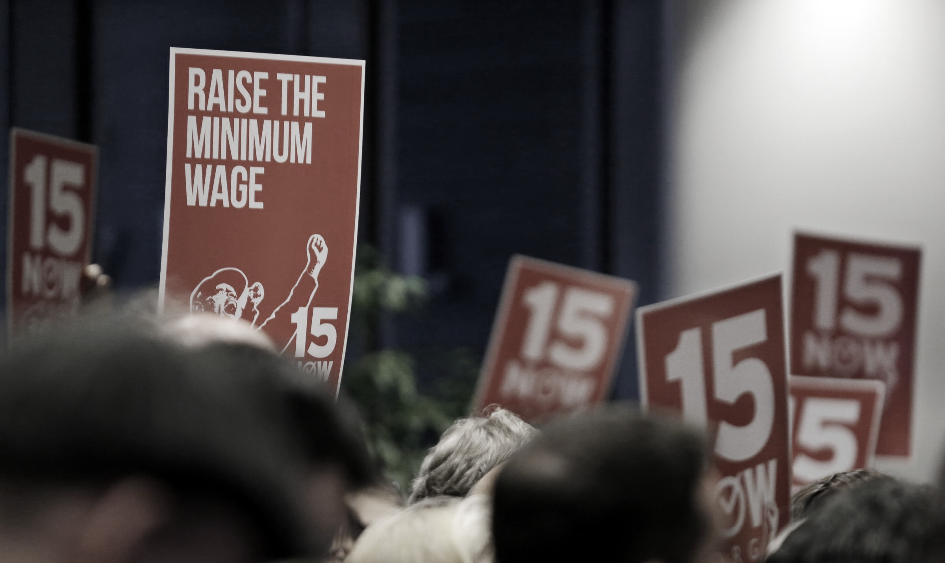

Slide 9
Living Paycheck To Paycheck: Examining The Impact Of Current Wages For Direct Service Workers
Washington Low Income Housing Alliance 2017 Conference on Ending Homelessness

