Slide 1
De-escalation Strategies for Care Providers Behavioral Health Symptoms and Crisis Situations
Jessica Shook, LMHC
Division of Behavioral Health and Recovery
shookjm@dshs.wa.gov

Slide 2
Learning Objectives
Self awareness and self control
How do we influence behavior?
Understanding and responding to behaviors and symptoms
Supportive interventions

Slide 3
Behavioral Health In Our Community
1 in 4 adults in the United States experiences mental illness in a given year
1 in 17 adults has a serious, chronic mental health disorder such as Schizophrenia, Bipolar Disorder, or Major Depressive Disorder (National Alliance on Mental Illness, March 2013)
In 2009, 23.5 million people (9.3% of population 12 years of age and older) needed treatment for a substance use disorder (SAMHSA National Survey on Drug Use and Health)

Slide 4
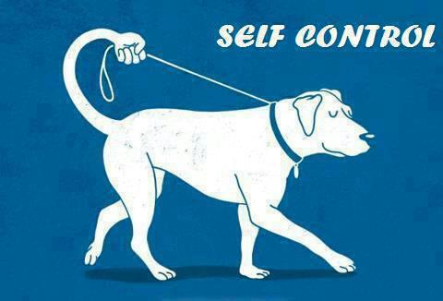
Self Awareness
In any situation, the only
thing you have complete
control over is yourself
We work in a profession that provides care for individuals who will experience crisis
Successful de-escalation begins with us – our attitudes, beliefs, and actions

Slide 5
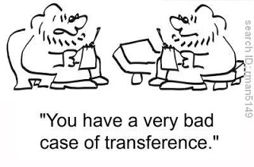
Personal Feelings Impact Care and Communication
Transference and
Counter-transference
An individual’s positive or negative feelings associated with another person or a past experience may be transferred onto us
We may project our own positive or negative feelings from past experiences onto the individual

Slide 6
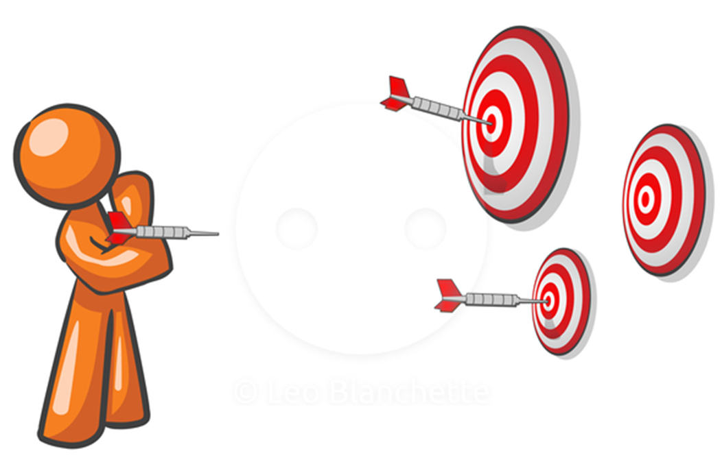
Self Awareness
What are my triggers and buttons?
This person is challenging what I love or hate
This person is violating my sense of morality

Slide 7
Under and Over Reaction
Failure to protect the safety of an individual through inaction
Failure to set verbal, physical limits due to fear, avoidance, or other reasons
Destructive attitudes or actions
Withdrawal of a caring manner toward an individual
A physical intervention that hurts an individual
A punitive reaction

Slide 8
Self Control
I don’t have to get into a power struggle
I don’t have to give back what I get
It’s not personal
I know what my triggers are

Slide 9
How Can I be Proactive?
Be aware of your Internal Self
Biases, beliefs, moods
Reaction to stress
Be aware of your Environment
Location, proximity, potential weapons
Be aware of the Other Person
Notice and respond to cues about emotion and behavior

Slide 10
Understanding Behaviors
Everyone has thoughts, feelings, and needs
We are more impulsive when we are in crisis
People may not realize they are out of control
Behaviors are a way to get needs met
We need to match our interventions to the needs behind the behaviors

Slide 11
Identifying and Responding to Behaviors
What is the need behind the behavior?
FEAR
MANIPULATION
FRUSTRATION
INTIMIDATION

Slide 12
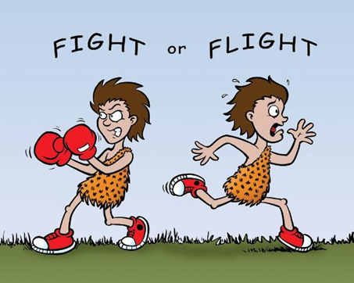
FEAR
How do they look?
Freeze, cower, hide
Tense posture
Fight or flight mode

Slide 13
Reducing Fear
Helping the person feel safe
Stay relaxed with your hands in full view
Stand slightly off to the side and far enough away that you do not appear to pose a physical threat to the person
Keep your voice soft and low
Use short phrases, 5 words or less
Explain your actions before you take them

Slide 14
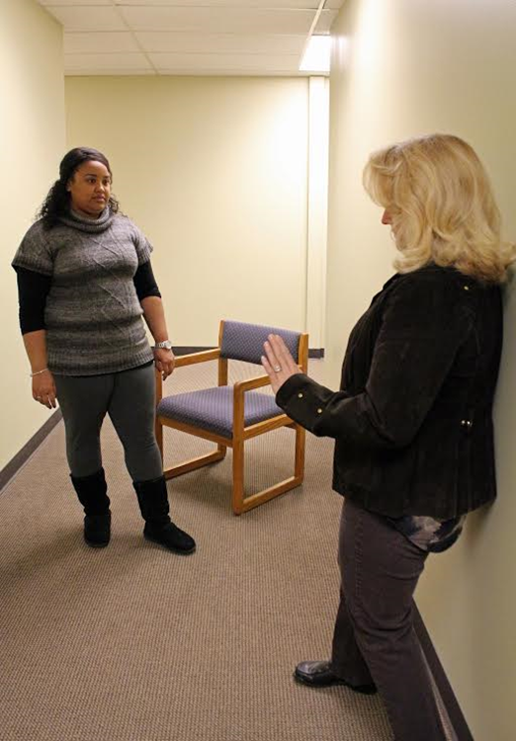
Not this Try this

Slide 15
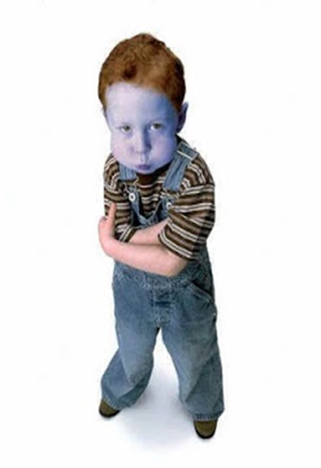
MANIPULATION
Person may make an initially calm request that cannot be granted
Statements and behaviors designed to provoke a response
Promote confusion

Slide 16
Working Through Manipulation
Stay relaxed and assume a closed posture
Turn slightly away, but do not turn your back
Display subtle gestures of disinterest or disapproval
Avoid direct eye contact, instead look at their shoulders, hairline, or chin
Keep your voice low
Respond like a broken record, or minimize response

Slide 17
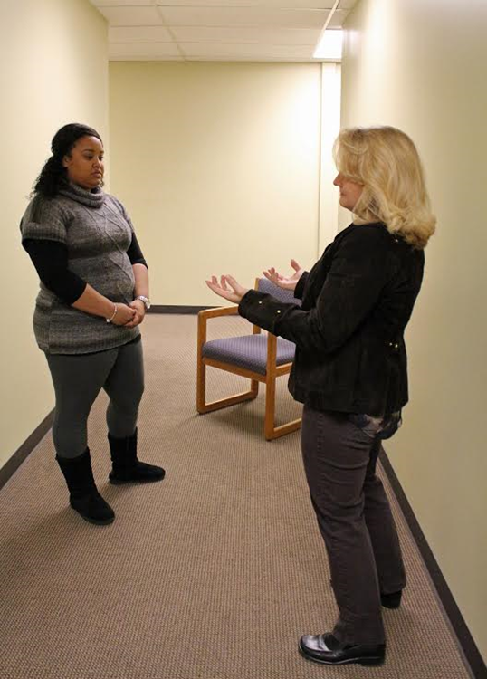
No Yes

Slide 18
FRUSTRATION
Tense posture
Fixed, focus glare
Large, clenched gestures

Slide 19
Reducing Frustration
Helping the person regain control
Square your shoulders, keep your back straight and your chin up
Keep hands visible, with palms out
Stay out of striking range
Maintain eye contact and focus on the person when you speak
Keep your words clear and voice low
Stick to repetitive directives of 5 words or less

Slide 20
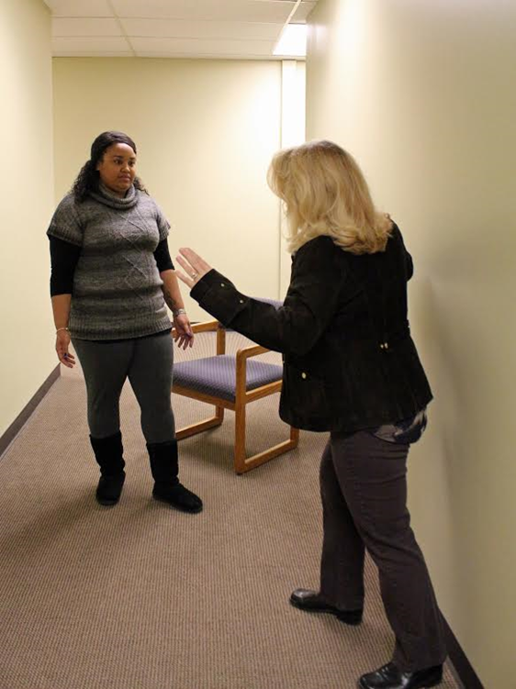
Not this Do this

Slide 21
INTIMIDATION
Presents as physically menacing
Clear demands that cannot be granted
Threats of physical assault

Slide 22
Defusing Intimidation
Maintain safety
Be relaxed but ready, do not appear fearful
Have an escape route
Do not use large gestures
Keep your voice emotionless and matter-of-fact
Your speech should be clear with direct statements
Make eye contact sparingly, do not stare

Slide 23
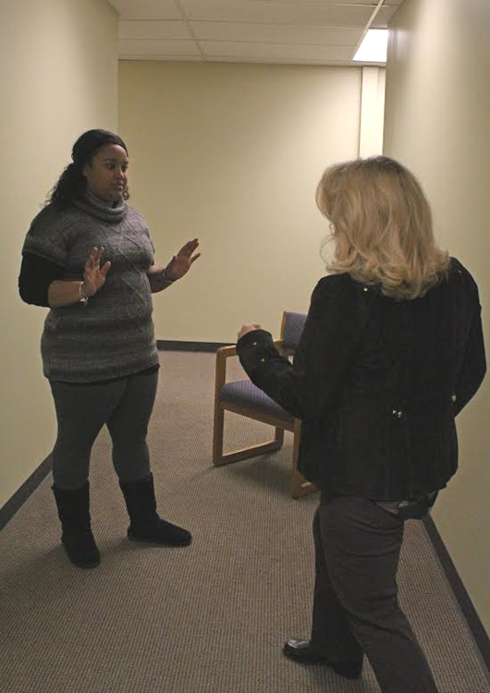
Not this Do this instead

Slide 24
Identifying and Responding to Symptoms
Personality Disorders
Mania/Hypomania
Psychosis
Depression
Anxiety
Post-Traumatic Stress
Dementia
Traumatic Brain Injury

Slide 25
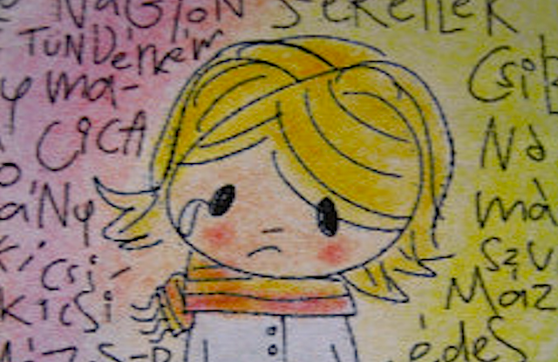
Personality Disorders
Anger, depression, anxiety, mood swings
Sensitivity to rejection, criticism, abandonment
Easily overwhelmed, frustrated, and agitated
Difficulty tolerating distress
Behaviors to elicit care,
attention, validation from
others

Slide 26
Response Plan: Personality Disorders
Avoid power struggles
Limit emotionally charged responses
Avoid threats, ultimatums, or excessive restrictions
Remain matter-of-fact and neutral
Give realistically available choices as often as possible
Check back in with the person often

Slide 27
Mania/Hypomania
Extreme mood swings and behaviors
Euphoric, energized, expansive, overconfident
Feeling ‘invincible’ to harm and superior to others
Labile, anxious, guarded
Impatient, easily frustrated
Confusion as to why others are concerned

Slide 28
Response Plan: Mania/Hypomania
Plan for unpredictability
Low stimulus level
Keep directions short and simple
Don’t argue
Say “you’re right” as much as possible

Slide 29
Psychosis
Hallucinations and delusions
May respond to auditory hallucinations
Hyper-vigilant, fearful, self protective
Religious preoccupation
Withdrawn, inward focus
Self-harm or suicidality in response to command hallucinations

Slide 30
Response Plan: Psychosis
Approach slowly with non-threatening body language
Ask them what they need
Don’t contradict or argue about their beliefs
Keep stimulus low in the environment

Slide 31
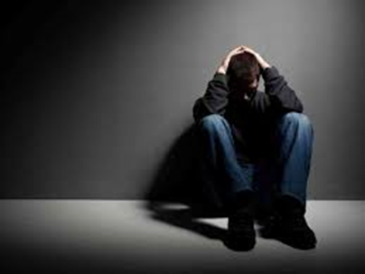
Depression
Feeling overwhelmed, hopeless, helpless
Change/loss of perspective
Multiple life stressors
Suicidal ideation
May or may not have identifiable emotions but feel “empty” or “blank”

Slide 32
Response Plan: Depression
Ask what they need, explain what you can do for them
Avoid excessive restrictions
Be kind and reassuring
Explain what is happening
Connect with family, friends, social resources for acute support and additional resource

Slide 33
Anxiety
Irritability, distractibility
Feelings of dread
Overwhelmed with thoughts and emotions
Difficulty making decisions and processing information
Panic attacks
Self medication with alcohol or drugs

Slide 34
Response Plan: Anxiety
Treat physical symptoms as real
Be reassuring, provide information about what will happen next
Ask what would be most helpful to them
Ask what has worked in the past
Discuss recent and current situation in brief, neutral way

Slide 35
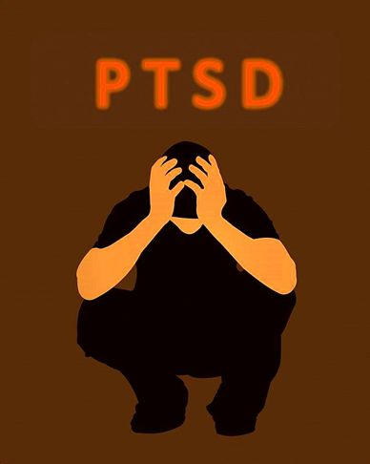
Post-Traumatic Stress
Depression, hopelessness, helplessness
Anxiety
Irritability, outbursts of anger
Difficulty sleeping, concentrating
Suicidal thoughts and actions
Hypervigilance
Flashbacks
Self medication with alcohol or drugs

Slide 36
Response Plan: Post-Traumatic Stress
Give space
Reduce external stimuli
Anticipate and ask about triggers
Ask what would be most helpful to them
Ask what has worked for them in the past
Involve family, friends, support network

Slide 37
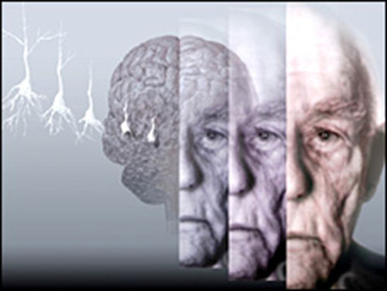
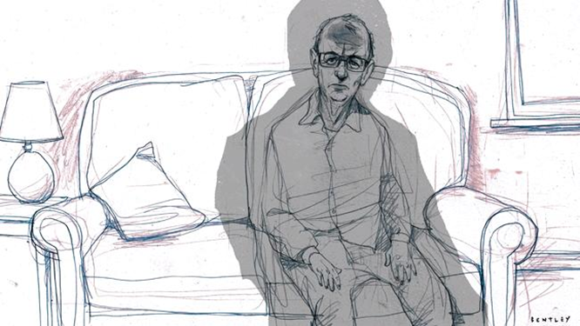
Dementia
Confusion, disorientation
Poor memory
Irritability, rapid mood changes
Anxiety
Aggression resulting from confusion or fear
Vulnerability to medical complications

Slide 38
Response Plan: Dementia
Create a calm environment
Speak slowly, take your time
Be reassuring and provide comfort
Ask permission
Ask what would be most helpful to them

Slide 39
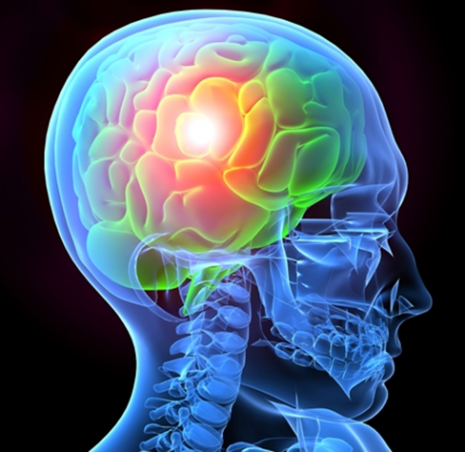
Traumatic Brain Injury
Headache
Difficulty concentrating
Memory impairments
Attention deficits
Mood swings and emotional disturbance
Easily frustrated
Impaired cognitive functions
Difficulty with speech or communication
Impulsivity
Agitation and restlessness
Hallucinations

Slide 40
Response Plan: Traumatic Brain Injury
Anticipate confusion and reactivity
Speak briefly and clearly
Direct attention away from confusion rather than attempting to argue or convince
Explain what will happen and what you will do next
Minimize stimuli

Slide 41
Responding to Behaviors and Symptoms
Everyone has needs
Behaviors are an attempt to get those needs met
Acknowledge and attempt to meet the need behind the behavior
In a crisis situation, we are not our best selves
Respond to the person, not the crisis

