Slide 1
Please sit around other folks who are in your community.
Look for a sign with your area. If there isn’t one yet, make one!
Notes:
As people are entering… please sit together with other folks from your community!
Have signs available for people to make!

Slide 2
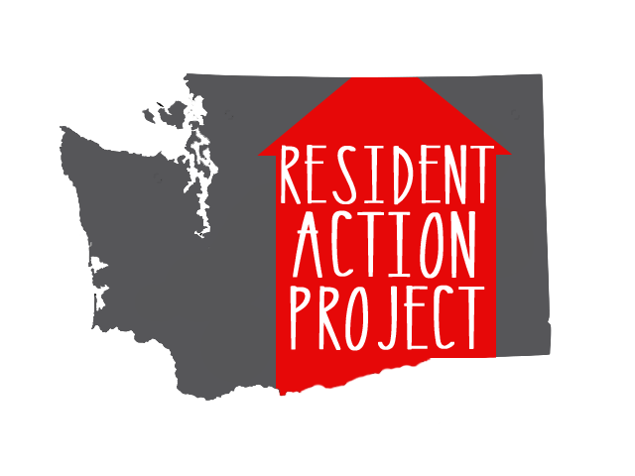
Building Power Through Organizing in Your Community
Hill Cummings, Mr. B (Bretrand Harrell), Kristina Nielander, Mindy Woods
Notes:
Welcome everybody!! Brief introductions with our names and pronouns. (For example, do you prefer she/her/hers, he/him/his, they/them/theirs, etc.)
Mindy First, we want to get a sense of who is in the room:
People who have experienced homelessness before or are experiencing homelessness currently?
People who have had a hard time paying rent?
People who have had a hard time finding an apartment?
People who work at nonprofits?
People who are concerned community members?
Members of the statewide steering committee for RAP? (There are several in here that are not presenting today - thanks for being here!)
Hill
Today, we are hoping to create a space that is courageous and allows people to be safely vulnerable. As we can see, people in this room are coming from many walks of life, with many different experiences and identities.
To create a courageous space where people are willing to be vulnerable and think outside the box, we want to be intentional about the space that we’re creating.
First, we’re going to be courageous and vulnerable ourselves as presenter’s and let you know a little bit more about where we’re coming from. And then we are going to go through some group agreements.
Story of Self (briefly) from each presenter (2-3 mins apiece)
Hill
Mindy
Kristina
Mr. B

Slide 3
Group Agreements
“Why am I talking?” & “Why am I not talking?”
Don’t Yuck my Yum.
Call each other in.
Speak from your own experience and listen with empathy.
What’s said here stays here. What’s learned here leaves.
Expect and accept non-closure.
Respect the land that we are on.
Take care of yourself.
Use the Parking Lot.
Notes:
Kristina will facilitate this discussion.
Why am I talking? vs. Why am I not talking?
If you tend to be a person that talks a lot, be mindful of how much you’re contributing to make sure that others have a chance to contribute. If you are a person who generally does not contribute as much during meetings, challenge yourself to contribute a bit more.
Don’t Yuck my Yum
All ideas are welcome here. Please be respectful of ideas as they come up.
Call each other in.
We know that there are many systems of oppression and that everyone is coming to the space with different oppressed and privileged identities. Sometimes people say things and don’t understand the impact that they’re having on others. If something comes up, we will call each other in to have a conversation about the impact, whether that be here in this room or after the session.
What’s said here stays. What’s learned here leaves.
We want to respect the confidentiality of experiences people share. Please don’t share others’ personal stories outside of the group unless you ask permission first. Do take the larger concepts and themes of the conversation outside of the room to share with others.
Speak from your own experience and listen with empathy.
You can’t know what another person is experiencing. Speak from what you have experienced, and listen to the experiences of others empathetically. Listen to learn, and do not be defensive if that experience doesn’t line up with your current worldview.
Expect and accept non-closure.
All of the things that we’re working on are really hard, and we’re coming together to make a change. But we’re not going to have all of the answers today. So we just want to name that right now.
Take care of yourself. Get up, stretch, use the bathroom, take a break if you need to. Whatever you need to do to take care of yourself physically, emotionally, or in any way, we encourage you to do that. This can be hard at a conference where there is a huge amount of information and opportunities. ** flag the chill room **
Use the Parking Lot. There are a lot of important conversations that we can have here that are absolutely related to the work that we’re doing! But we also want to get through our presentation today. We’ll put any conversations that are important, but that we can’t have right now, in the parking lot. If people want to join together afterward to continue those conversations, this is a tool that will help us do that.
Briefly introduce rest of agenda

Slide 4
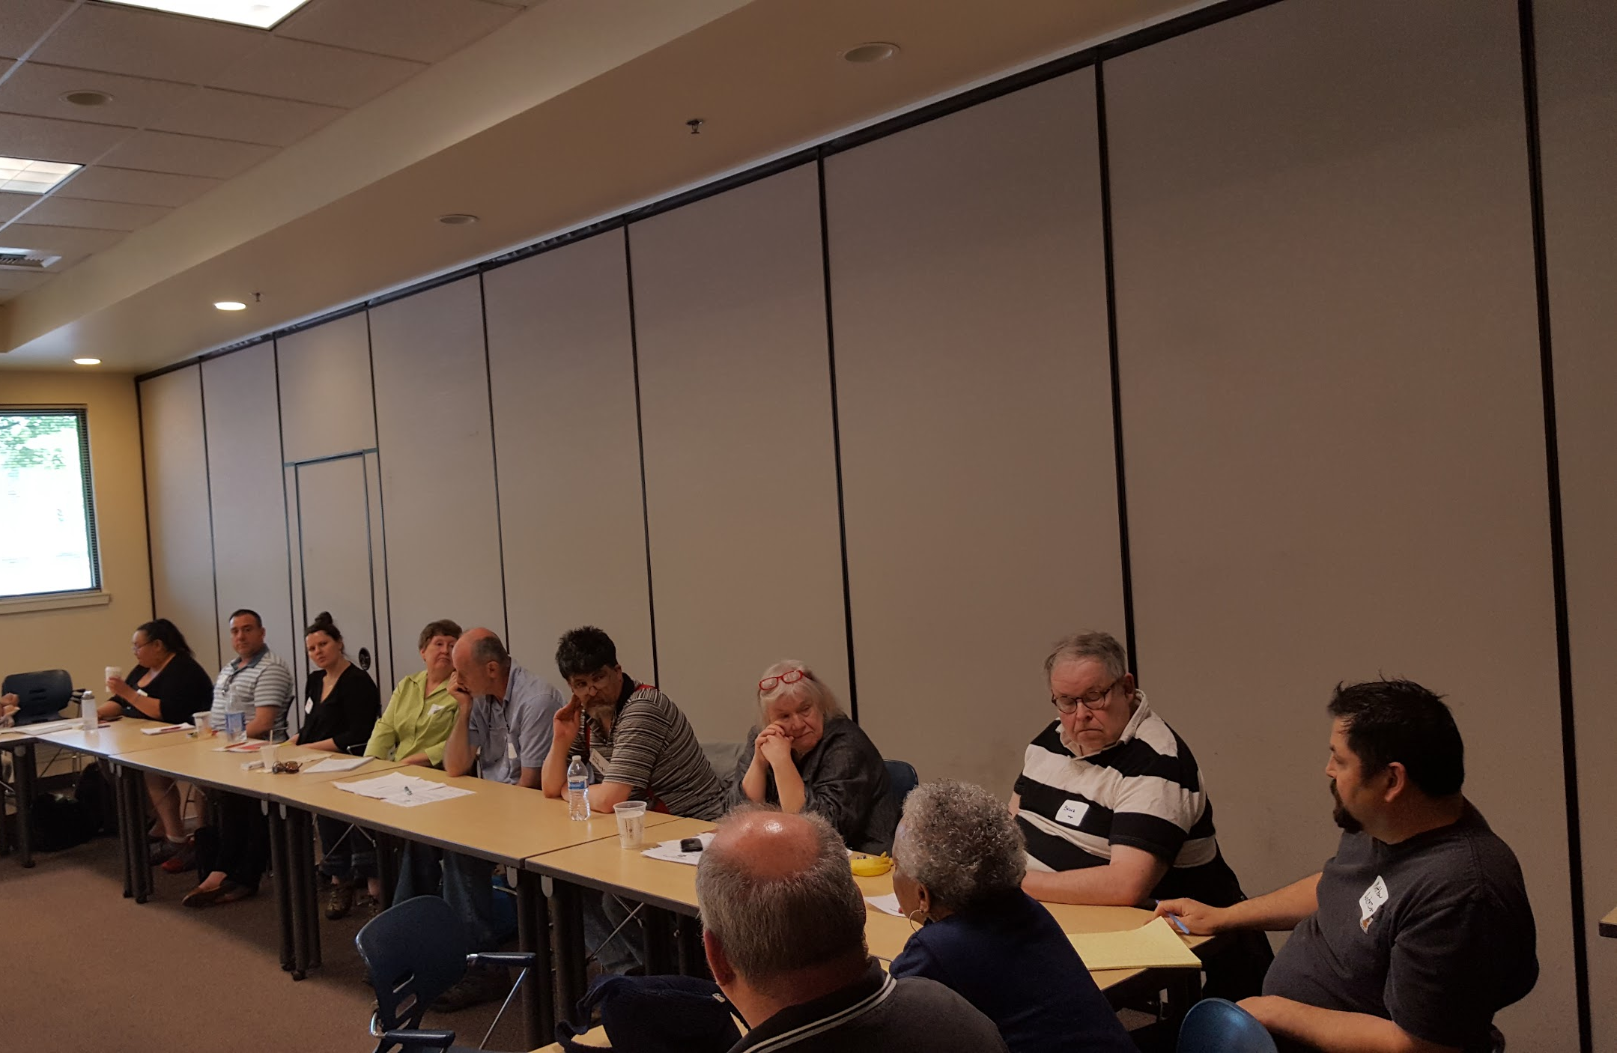
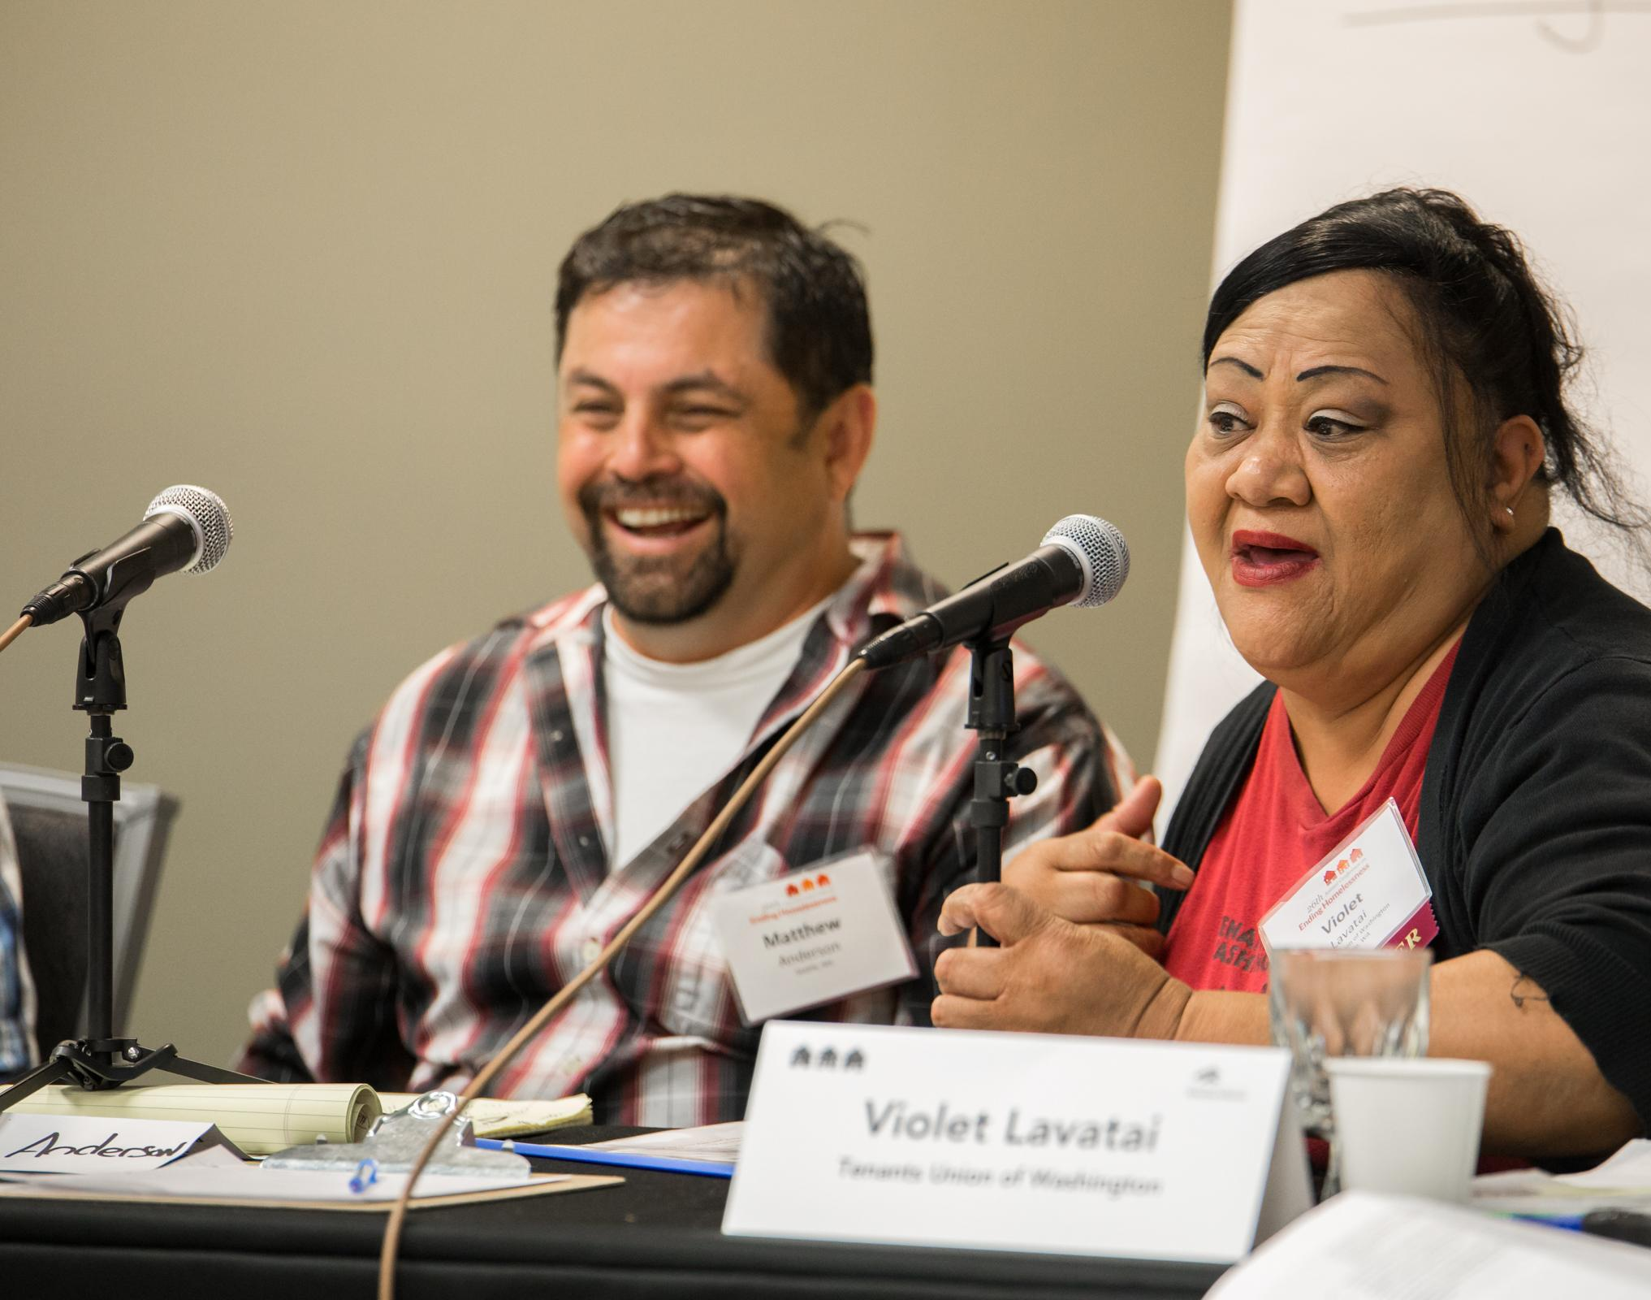
Introducing the Resident Action Project
Who are we?
What do we do?
Notes:
Mr. B will facilitate this discussion.
Who are we and what do we do
Aiming to organize a statewide network of people who have personal experience with homelessness and with being low-income. We want to build power with people so they can be a force for change.
We are going to be working on statewide policy to impact housing and homelessness issues from from the perspective of those who are most impacted and the community.
The theory behind our work:
We are in a crisis, and we need to build power and community to push for change. If we have a network of people with personal experience all across the state who are organized, that represents a lot of power.
It is important to follow the lead of people who are most directly impacted by issues in large-scale social change. That’s the only way to have an authentic movement.
We are partnering with nonprofits because people who work in nonprofits also have a unique perspective on the issues and they serve as gatekeepers to contacting others to get involved.
They’re on the frontlines and see the daily effects of these issues.

Slide 5
What We’re Up To
Statewide Steering Committee
Forming Relationships with Nonprofit Partners
Listening Sessions
RAP Summit!!!
SAVE THE DATE!
Saturday, September 30th
11:00 - 3:00
Southside Commons in Seattle
Lunch Provided
Some Transportation Assistance Available
RSVP
Notes:
Mindy will give this overview of what we’ve been up to.
We formed a statewide steering committee that is made up predominantly of people who have personal experience with the current housing and homelessness crisis. Shout out to all the steering committee members in the room! The steering committee will guide the work and growth of RAP.
We are working on forming relationships with nonprofit partners because we know that they represent access to a lot of people who are directly impacted and also have a unique perspective on why we need solutions to the current crisis.
This summer, we are going to organize listening sessions around the state. We are going to sit down with people to hear about what issues they think are most important.
The listening sessions will lead to the RAP Statewide Summit. During this time, we will gather folks from all over the state and talk about what we heard during the listening sessions, what’s currently on the table policy-wise, and make decisions about what policies we want to prioritize moving forward. We will also form some work groups to get ready for the 2018 legislative session. We invite you to join us!

Slide 6
Our Assumptions
We know our world is built on relationships between people, organizations, and institutions.
The relationships in our world too often reflect a massive difference in power, where many are oppressed for the benefit of a few.
The power differential reflected in these relationships is created and reinforced by laws and policies.
Social change movements aim to disrupt those relationships and change laws for justice.
True justice can only be achieved if people who are most directly impacted are “at the table.”
Tip
A question to consider: what does “at the table” really mean?
Notes:
Hill will go over our assumptions.
This is the way that we frame our thinking around change and power in our organizing.

Slide 7
So before we get started talking about the organizing toolkit…. We’d like to ask you to join us!
https://residentactionproject.org/signup/
TEXT “RAP” with your name and email (if you have one) to: (206) 651-4491
(but we’re not too fancy, so you won’t get a text back for a few days)
Notes:
Mr. B will make the ask to join us here, and will let folks know that we’ll be asking them again! But we wanted to ask them twice because we’re so excited to get them involved.
Send around a sign in sheet for the first time.
Direct people to residentactionproject.org -- they can fill out the sign up form right now!
Text Google Voice Account
We are following the lead with people who have personal experience with housing instability and homelessness. We welcome you to join us! But there is also a role for nonprofit staff and community members. Get in touch with us, and we’d love to have more conversations about how to get involved!

Slide 8
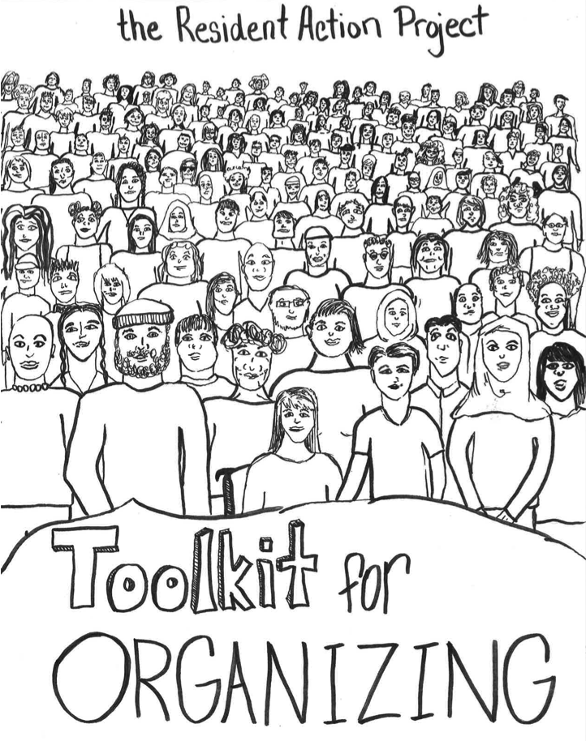
Toolkit for Organizing in Your Community
((HOLD -- front cover of toolkit))
Download at:
residentactionproject.org/toolkit
Notes:
Kristina will introduce the rest of the presentation.
Today, we’ll be providing an overview of how we are organizing in RAP. This will include: an overview of what organizing is, why we organize, the organizing space that we want to create, and how we organize and do outreach. This will include the different kinds of tools that you can use to begin building out the Resident Action Project in your community, depending on the capacity that you have to advance this effort. We’re trying to build a statewide organization. On our end, we want to provide the tools and be the center for information and communication. We need folks in the community to help do some of the organizing leg work to build the statewide network.

Slide 9
First, what is organizing?
It includes:
Working together in community to fight for social change
Thinking about all of the people we’re connected to, all of the resources we have access to, and what talents people have in their community
Building relationships and leadership with people in our communities
Sitting down together and thinking about what the issues in our society look like for each person and working to find a common narrative or story
Brainstorming and researching solutions
Coming up with a plan of action to implement change!
Toolkit: pg 18-23
Definition adapted from scott winn’s definition of organizing
Notes:
Mr. B will cover this slide.
Ask what people in the audience see what organizing is to them? To add to the definition!
There are a lot of fancy words that people use in organizing. Target, policy wonk, strategy, tactic, etc to name a few. All of those details are important, but here are some of the key elements involved.
Scott winn is from the Seattle Office of Civil Rights, and we adapted this definition from his.

Slide 10
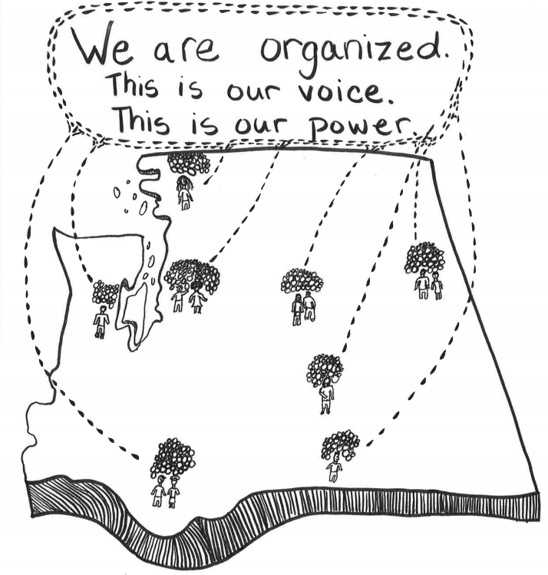
Why We Organize
Notes:
Kristina will facilitate this section.
The Resident Action Project is organizing a powerful network of people who live in or need affordable homes. We are building a force that demands that our state invest in communities that have been historically pushed aside and silenced for too long. To us, this means that the state must invest in affordable homes and in a housing system that won’t leave anyone out. It also means that we will fight for the state to pass policies that are equitable and protect people from systemic injustice in housing and beyond.

Slide 11
Why We Organize
The current housing crisis has not happened by accident, and it cannot be explained by individual fault. Our struggle is created by a system rooted in oppression - racism, classism, sexism, homophobia, ableism, and others - and reinforced by years of policy decisions that favor the wealth, health, and happiness of a few at the cost of the livelihood, health, and happiness of the majority.
Our government has left access to housing, which we assert is a human right - up to a volatile and unregulated market within a system that has a history of structural racism and other structural oppressions that have not yet been undone.
To push for change - for housing and for all issues that intersect with it - we need to build power by following the leadership of people who are directly impacted by this history and the current crisis.
Toolkit: About Us pg 4-7; Housing History pg 8-17
Notes:
Mindy
We are in a crisis.
Rents are too high and wages are too low
Thousands of kids don’t have a home to go back to after school.
Many of our cities allow gentrification that pushes people of color and people who have low incomes out of their neighborhoods.
Many people are struck with criminal records or eviction records that make it very hard to access housing.
Transportation, healthy food, healthcare, and other necessities are expensive and often inaccessible.
The criminal justice system targets primarily African Americans and the lack of opportunties are no mistake in our current system.
Mr. B
The crisis we see has not happened by accident, and it cannot be explained by individual fault. Our struggle is created by a system rooted in oppression - racism, classism, sexism, homophobia, ableism, and others - and reinforced by years of policy decisions that favor the wealth, health, and happiness of a few at the cost of the livelihood, health, and happiness of the majority.
We know that many people who are directly impacted are: people of color, people who identify as LGBTQIA, single parent families, people with disabilities.
Hill
Mostly, the people benefiting from our current system are those who make or influence policy decisions. Many of them rarely reach out to people directly impacted by systemic oppression - to hear about our lives, and the implications of the votes they cast. So we have to go to them to demand a change.

Slide 12
The Space We Want to Create
Culture of Appreciation and Accountability
Anti-Oppression and Antiracism
Self-care and Group Care
Notes:
Kristina
We want to live our values in Resident Action Project spaces, and that means that we want to build community, fight for justice and fairness, undo oppressions in our organizing spaces, and form a culture of appreciation and accountability. Coming into an organizing space is not like coming into a “regular meeting space” in the professional nonprofit world. We value personal stories that people are showing up with, which means that we must be vulnerable with each other and break down professional norms and expectations.
Mindy Culture of Appreciation and Accountability:
We value relationships, and so we are going to appreciate and recognize each other and all of our “wins,” which includes the small ones!
We are also going to be accountable - by saying what we do, following through, and seeking support when we need it. We are not going to be perfect.
We are going to have to remind ourselves and each other of our values, and we are going to have to have hard conversations sometimes, and that’s okay. That means that we’re committed to doing justice for ourselves and each other in this work.
Mr. B Anti-Oppression and Anti-Racism:
Whenever we come into an organizing spaces, everybody holds different identities and experiences that impact the way that they move through the world.
There are oppressive systems in our society. It is important that we are intentional about working to undo this in our organizing spaces.
So what does this look like? Here are some examples: we will educate ourselves on anti-oppression, listen with empathy to each other’s experiences, hold each other accountable for our actions and words, and work to dismantle professionalized culture that upholds white supremacy and patriarchy. We will hold each other accountable with compassion (call each other in, instead of calling each other out).
Hill Self-Care and Group-Care:
Organizing is incredibly important work, and it can be exhausting.
Most of the people in RAP have personal experience with housing and homelessness issues, and it can be challenging to talk about these issues constantly.
That’s why self-care and group-care are so important, as well as making space for everybody’s stories, experiences, and the impact that those have.
We will respect each other’s boundaries as we care for each other in the group. (Ask the presenter’s to give some examples of self-care)

Slide 13
How We Do Outreach
Notes:
Kristina will introduce this section.
During this section, we are going to do a quick overview of all of the organizing tools that are in the RAP toolkit. These all predominantly focus on outreach, and we’d be happy to point you to more resources around strategy if you’re interested.

Slide 14
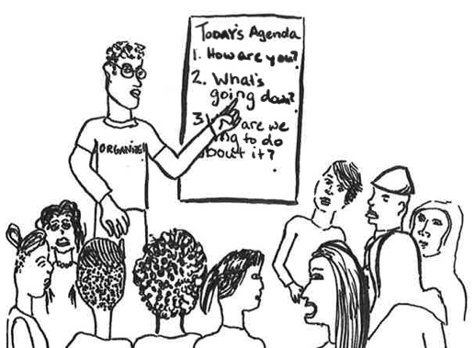
Community Meetings
A community meeting is a small gathering of people discussing issues in their community. These meetings can be used to learn collectively, to recruit new members, or to ask people to take a specific action. This is an ideal place to get to know people, share information, and listen and learn together.
Toolkit: pg 24-24
Notes:
Hill to introduce this tool.
Hill to talk about his experience organizing a couple of community meetings.

Slide 15
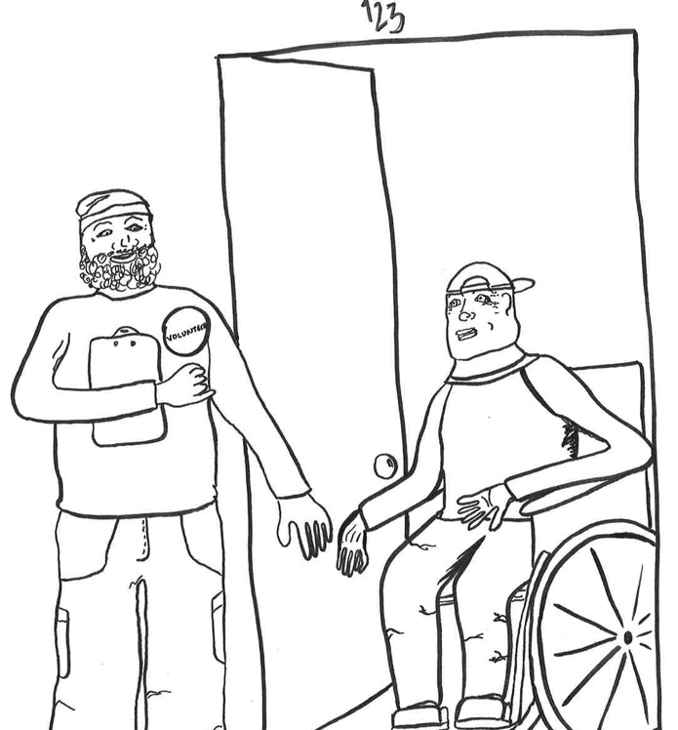
Canvassing
Canvassing is knocking on doors in a community to have conversations with people. You can canvass to ask people to come to a meeting, to do a community survey of an issue, to ask people to register to vote, and more. It’s a great way to meet folks face-to-face where they are at and to show that you’re invested in hearing what they have to say.
Toolkit: pg 41-51
Notes:
Mr. B to introduce this tool and talk about his experience.

Slide 16
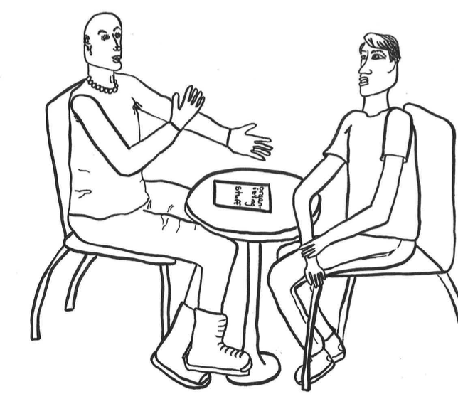
One-on-One Meetings
Building meaningful relationships is key to building power for a successful grassroots movement. One-on-one meetings are a great way to build your base, to get commitments from people, and to strengthen relationships. It is an opportunity to learn about the person’s experiences, networks, and skills to open up a conversation about what role might be the best fit for them in your organization.
Toolkit: pg 35-40
Notes:
Mindy to introduce this tool and talk about her experience doing one-on-one meetings.

Slide 17
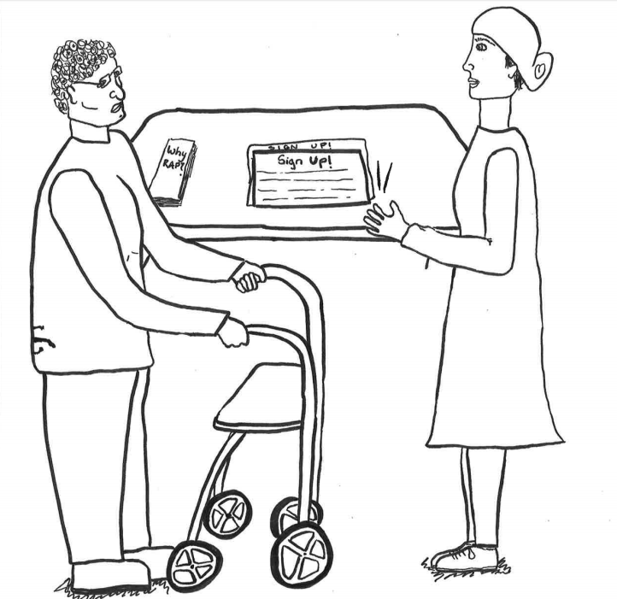
Tabling
Tabling is an organizing tool that lets you meet people where they’re at. Whether you’re tabling at a community event, on a street corner, in the lobby of your building, or in another public space, you have the opportunity to have conversations with folks about the work that you’re doing to see if they’re interested in getting involved. It’s also a great way to build leadership.
Toolkit: pg 52-55
Notes:
Mr. B to introduce this tool and talk about his experience tabling.

Slide 18
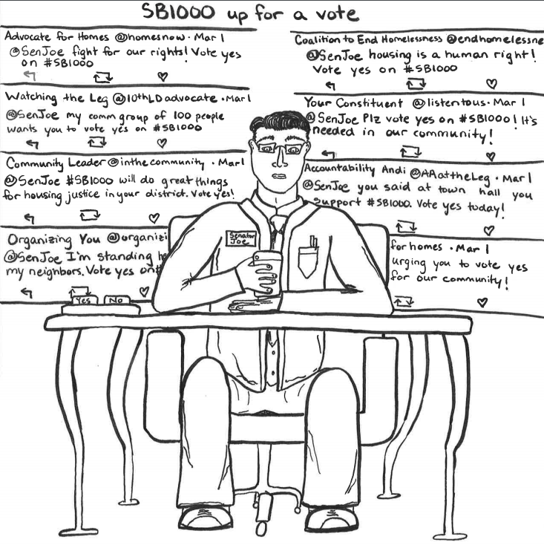
Social Media
Lots of people are connected to social media, and it’s proven to be an effective organizing tool in the past decade. You can do outreach, organize events, contribute to an ongoing conversations, and take action online, like participating in a Twitter storm.
Toolkit: pg 56-59
Notes:
Mindy to introduce this tool and talk about her experience organizing over social media.

Slide 19
Questions so far?
Reflections?
Notes:
Hill to make the call for questions.
Give a few minutes to do this, but be sure to leave a half hour for community discussion.

Slide 20
Community Discussion Time!
How could you see the Resident Action Project playing out in your community?
What do you need from Resident Action Project staff to be supported in this work?
Who are some folks who you might invite to get involved?
Refer to your worksheet to guide your discussion.
Notes:
Kristina to give instructions for what people are supposed to do next!
Ask people to sit together geographically, or find their group if they haven’t already.
Have presenter’s float around to different groups to answer questions.

Slide 21
Let’s come back!
Please report one potential strength for doing this in your community and one challenge that you might face if you try to do this in your community.
Notes:
Be sure to ask folks to keep this brief. We don’t have a ton of time!
Mindy and Mr. B are going to lead the debrief.

Slide 22
Seriously… get in touch with us!
And save the date for the RAP Summit!
Kristina Nielander
kristinan@housingactionfund.org
Mr. B
bretrandharrell@live.com
Mindy Woods
melindawoods19@hotmail.com
Hill Cummings
hillcummings@live.com
residentactionproject.org
206-442-9455 x211
Saturday, September 30th
11:00 - 3:00
Southside Commons in Seattle
Lunch Provided
Some Transportation Assistance Available
RSVP: bit.ly/rapsummit
Notes:
Hill to do the final wrap up!! (Could be everyone -- how do we want to do it?)
Each presenter gives an appreciation to close!!

