Slide 1
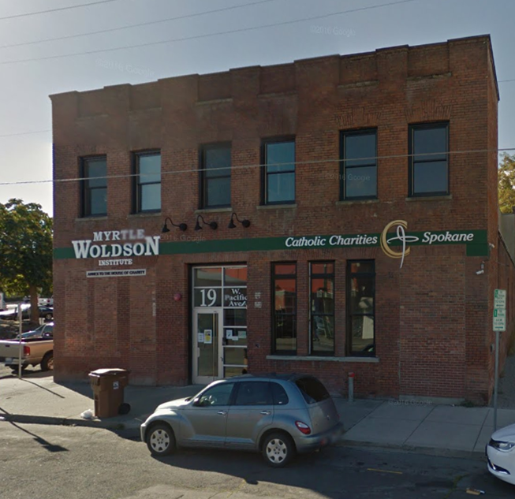
Diversion Services In Spokane By: Sharon Stadelman and Jackie Thomson
A Front Door Approach to Reducing Homelessness in our Community.

Slide 2
Our Service Philosophy for Diversion
Our overarching goals are to reduce the number of households entering the homeless area by 50% and re-direct those experiencing homelessness for the first time to alternative options for housing stability.
We also want to avoid the trauma of shelter stays—especially for households with vulnerable children, and to conserve our limited homeless housing resources.
We provide intense, comprehensive and skilled intervention through a Diversion-First model.
We encourage our households to be pro-active and return to Diversion if they need further assistance.

Slide 3
What is Diversion?
Diversion in Spokane: simply enhancing the conversation you already have with households!
This can be done over the phone, in person at your CA portal, or as a front door shelter intake conversation.
Diversion provides resource-sharing and innovative solutions to fill gaps between housing instability and homelessness.
It’s a critical component in our Coordinated Assessment systems.
It’s teaching us all to be a comprehensive “Resource Coordinators.”
Locally, we provide Diversion Services for both Singles and Families in our community.

Slide 4
Essential Link: CA and Diversion
How we provide a “Diversion-First” Model—
ALL CA staff are cross-trained in Diversion and CA assessments.
“Diversion First:”
All HH coming into our walk-in hours qualify for Diversion and meet with a case manager right away.
We are able to provide services to any household due to having diverse and flexible funding stream supporting Diversion in our community.
Initial conversation with all households=Diversion. CA acts as a separate intervention only after the initial Diversion conversation.
If households are still in need of homeless housing resources, households proceed with the CA enrollment process—otherwise Diversion case managers will continue working with the household to overcome their housing crisis.

Slide 5
Our Process
We DO NOT have funding for rental assistance
We are not a money program!
Length of Diversion services:
Average length of enrollment-- 1month of services with extensions given for up to two months.
Services Provided:
Education and advocacy, landlord mitigation, conflict resolution, housing search and stabilization, community resource triaging, connection to mainstream employment and income resources, collaborative problem-solving, and VERY limited financial assistance for approved costs (no rental assistance dollars) that will lead to housing stability.

Slide 6
Diversion-First Model in Action:
(3) Referrals to Homeless Housing programs
(2) CA Assessment
(1) Diversion conversation:
*Proceed to Diversion case load OR CA Assessment based upon client choice.
Service Delivery at our CA (HFCA) Portal:
Households either call or visit us during walk-in hours: M-TH from 12:30-5pm.

Slide 7
What’s worked well?
Helping households identify their own intrinsic strengths and resources as a solution to their housing crisis.
Having pre-existing landlord relationships and understanding the ins and outs of landlord tenant laws.
Becoming ‘community resource experts’ and creating new collaborative community partnerships
We cannot emphasize this enough—know what your community has to offer and partner with these agencies. Strategically connect households to resources that are already in existence that can meet their need. You do not have to do everything!

Slide 8
Diversion in Practice
When in doubt--summarize!
Powerful Questions:
What would you like to see happen today?
How do you see that happening?
What could you do to make that happen? What could I help you with to make that happen?
What does_________(self-identified goal from client) look like to you?
How can I help you to work towards your goal of ____________ and blank______?

Slide 9
Let’s Practice!
Listen, Summarize and use Powerful Questions…
Pick a partner:
One is the client and one is the diversion case manager.
5 minutes then switch roles
How did it feel being the client/case manager?

Slide 10
What have been the biggest challenges?
Reshaping the community “message”
Erasing the “prevention $$” concept and instilling a new philosophy of providing service, mediation and access to community resources as possible solutions for housing crisis.
Money is not the only or sometimes best intervention.
Really high case loads
Solution:
Commitment: HH’s sign program agreement/ commit to the program.
We remind households that are always able to re-assess when/if their circumstances change, and we are still able to connect with CA portal for homeless housing resources if the Diversion intervention does not work.

Slide 11
Outcomes: Jan2016-March 2017
Of the 564 households enrolled in Diversion, only 102 of them became enrolled in another homeless program within this time frame.
ES Shelters to all RRH programs in our community
Looking currently at an 82% success rate
Best practice looks at 90 days

Slide 12
Outcomes: Jan 2016- March 2017
564 HH with 377 exiting to positive destinations=67% success rate

Slide 13
Questions?
Thank you!
Additional Resources: http://www.endhomelessness.org/page/-/files/3.08%20Diversion-%20Best%20Practice%20for%20Preventing%20Homelessness%20Katherine%20Gale%20Tricia%20Bradly%20Marlyn%20Benker.pdf

Slide 14
Contact Information
Sharon Stadelman
Director, St. Margaret’s Shelter
101 E. Hartson, Spokane, WA 99202
509.624.9788
sstadelman@ccspokane.org
Jackie Thomson
Assistant Director of Community Housing
19 W. Pacific Spokane, 99201
(509) 325-5005 ext. 102
jthomson@ccspokane.org

