Slide 1
YOUTH AND YOUNG ADULT RAPID REHOUSING IN PIERCE COUNTY

Slide 2


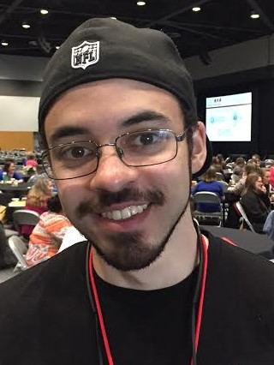
Introduction of Speakers
Nick Bayard
Director
The REACH Center
Shameka Williamson
Lead Housing Case Manager Housing 4 Success
The REACH Center
Jamie Thoburn
YAEH Representative & Youth Advocate

Slide 3
WHAT WE WILL DISCUSS
Recent history
Innovations for success
Jamie’s journey
Evolution of the system
Numbers & statistics
Community call to action

Slide 4
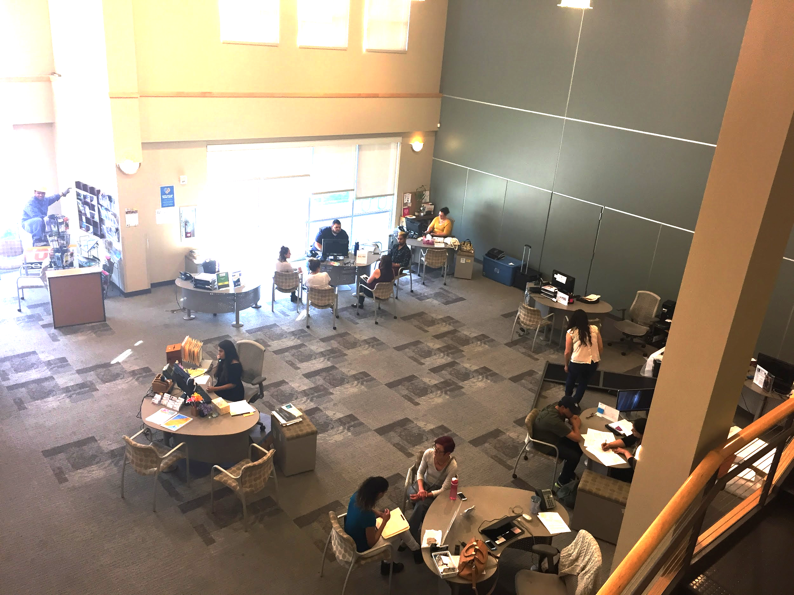
The REACH Center: A “One-Stop” for Youth and Young Adults

Slide 5
Timeline & History
September 2009: REACH Center launched
October 2013: Plan to End Youth and Young Adult Homelessness released
November 2013: Housing 4 Success (H4S) launched as Transitional Housing project
July 2015: H4S converts to Rapid Rehousing Project
December 2015: Community Youth Services (CYS) opens temporary shelter for 18-24-year-olds
2016: CYS opens youth drop-in center
November 2016: Hold is placed on unemancipated minors entering Coordinated Entry system
April 2017: 100-Day Challenge launch
June 2017: Projected date for 15 young adult PSH units opening

Slide 6
Housing 4 Success Collaborative
The REACH Center: Case management, housing navigation, support services, lead agency
Shared Housing Services: Host home recruitment, training, and support, case management, supportive services
Vadis: Life Skills training, Ready 2 Rent classes, employment readiness training
Oasis Youth Center: Peer mentoring and support for LGBTQ participants

Slide 7
Key Learnings
Rapid rehousing can work for young people—but only with the right resources and design
  Is ideally accompanied by
    Incorporation of youth voice/leadership
    Highly functioning CE system
    PSH and transitional housing options
    Robust family reunification services
    Mental health and chemical dependency services
Importance of host homes
Importance of community-wide equity lens
Importance of coordinated funding
Importance of legal clarity and administrative flexibility

Slide 8
Jamie’s Journey

Slide 9
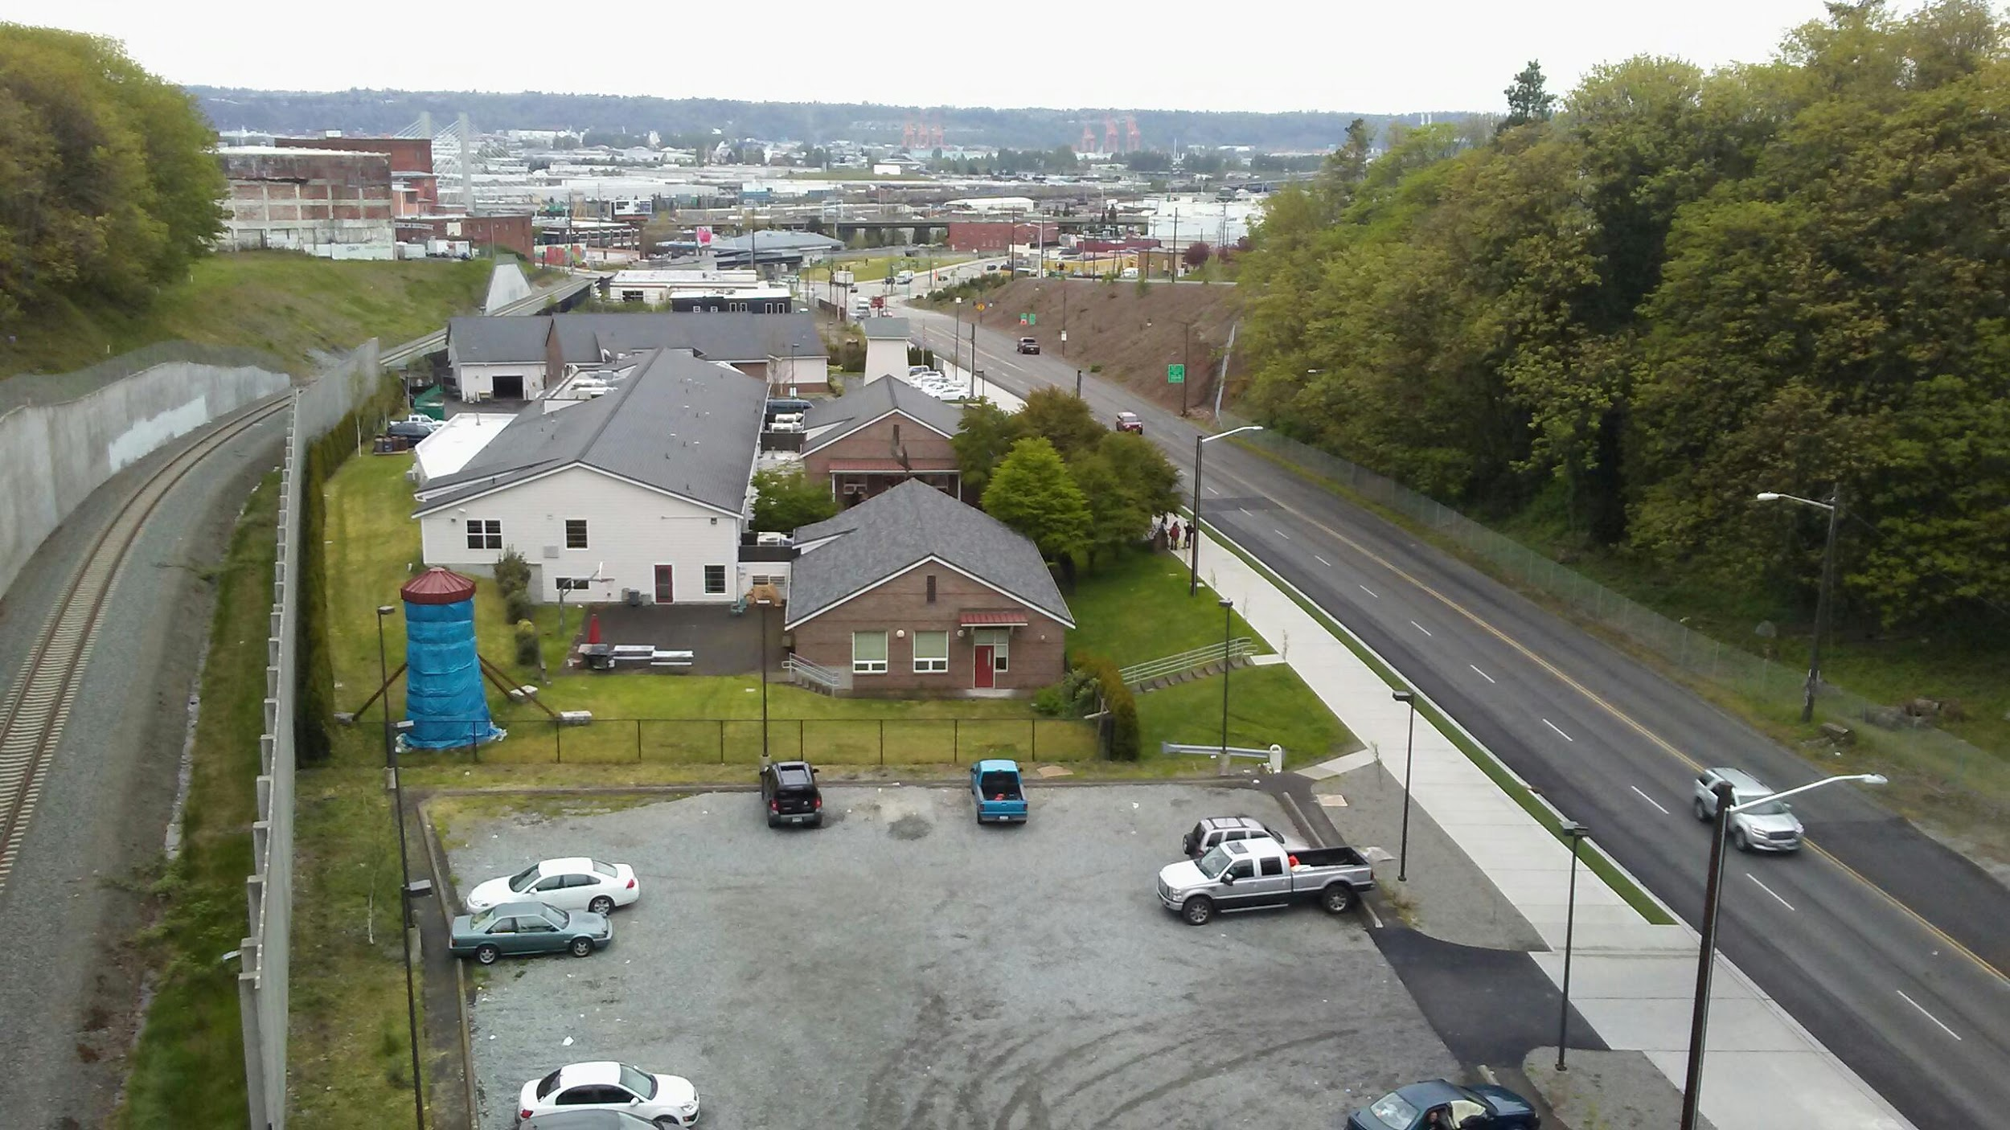
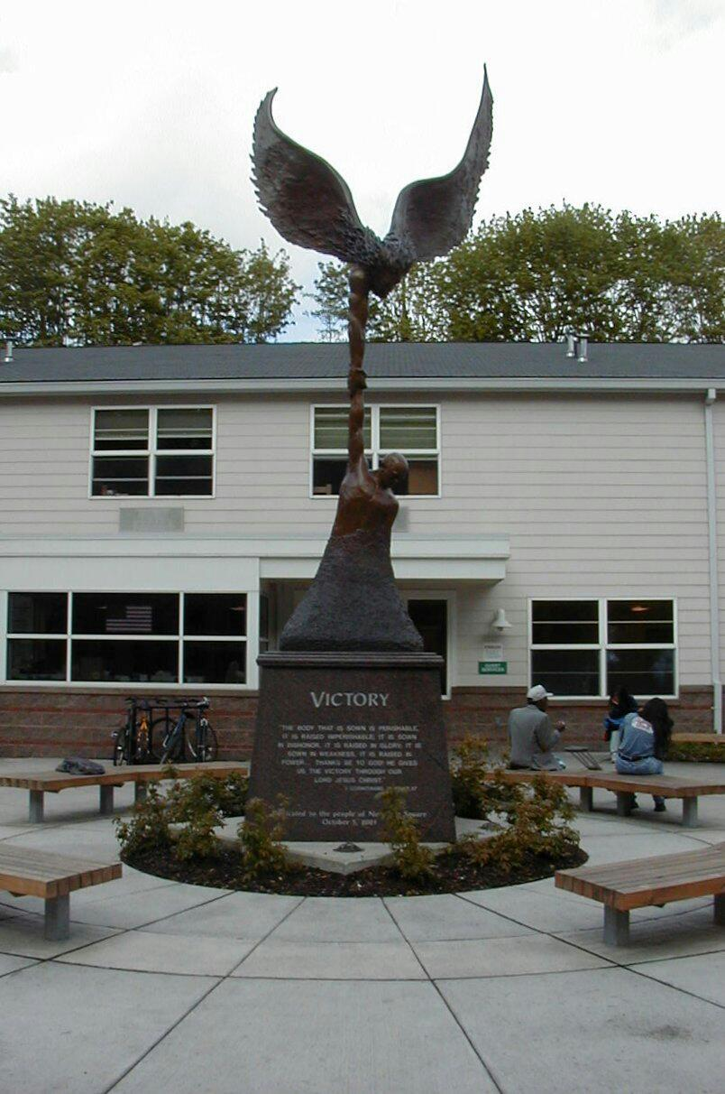

Rescue Mission
New Life Program
Shelter Stay
Tacoma Homeless
Community
Warehouse Job

Slide 10
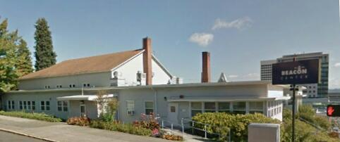

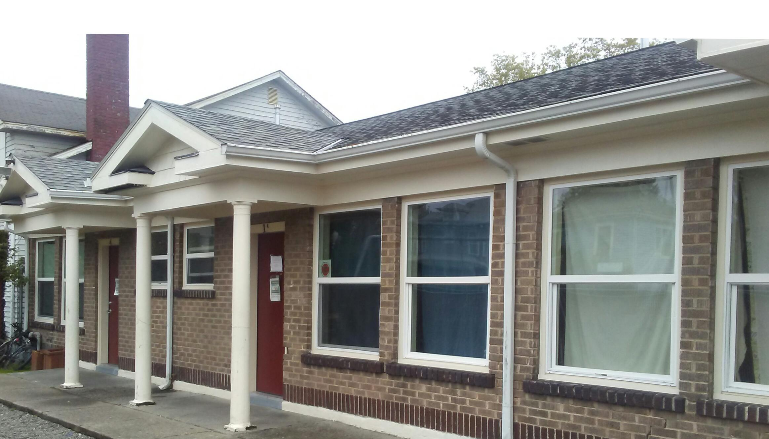
CYS Young Adult Shelter
Beacon Center
Drop-In Center

Slide 11
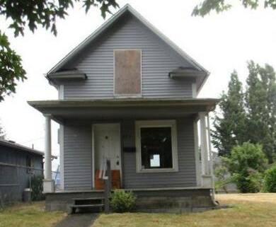
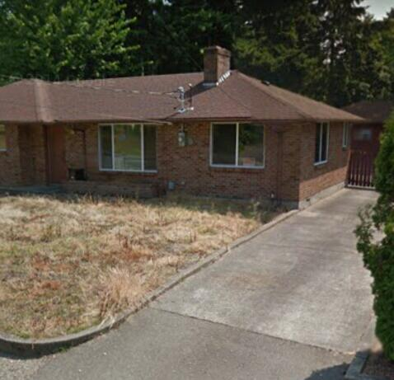
Abandoned Houses
Central Tacoma
University Place

Slide 12
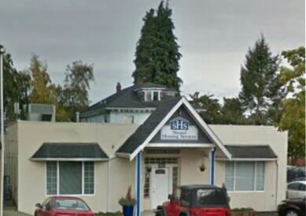
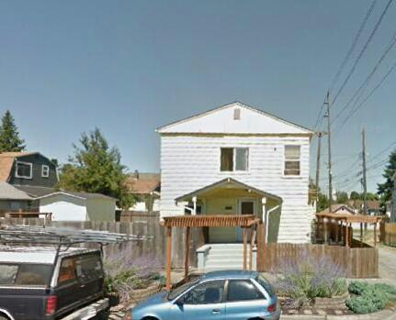
Shared Housing
Community Partner
Housing 4 Success
REACH Center Case Management

Slide 13
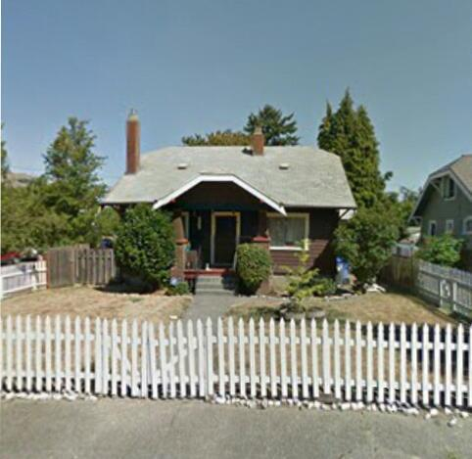
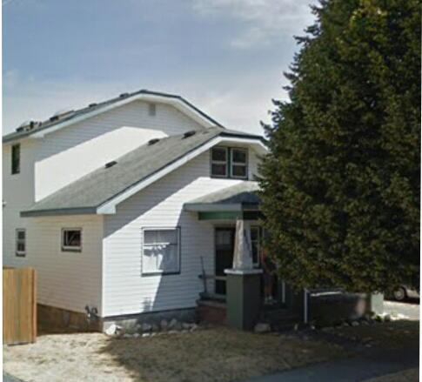
Natural Supports
12 step programs
Addiction & homelessness
Financial rehabilitation, budget coaching

Slide 14
EARLY INTAKE PROCESS
Coordinated Entry Intake
Referred to Housing 4 Success
Schedule Intake
Team Meeting
Schedule a team meeting
Initial intake paperwork & policy review
Schedule housing navigation meeting
Start housing search
Participant gets housed
Individual starts rental contributions takes over rental subsidy.
We focus on employment and education
Individual graduates from program.
Notes:
Thank you Jamie for sharing your journey and testimony. So this is my portion of the presentation. I’ll discuss some of the challenges and improvements of Housing 4 Success as well as what we need from you and the community. So first, I will show where we started with Housing 4 Success and what a participant’s time should look like while in our program. {Goes over intake} Seems Pretty Simple Right?

Slide 15
Challenges & Program Evolution
Lack of coordination with Coordinated Entry
Partnership with Coordinated Entry
to schedule and conduct intakes at REACH.
Unable to Contact Referrals
Partnered with Path & CYS shelter to be able to reach out to referrals
Opportunities to house multiple participants in 4 to 5 bedroom houses to provide more realistic and affordable housing options for participants. Hired a full time Housing Navigator for landlord engagement
Lack of Available/ Affordable Housing and unrealistic housing placements
Revamped the Housing 4 Success policies and created Housing Tier Tracks and Tier assessment to provide better tailored service to youth and young adults and reduce the returns to homelessness.
Returns to Homelessness after Program Graduation
Notes:
Here is a list of some other challenges Housing 4 Success has faced as an organization.
{Challenge 1} We have had youth coming to us needing services and unable to get in contact with Coordinated Entry or they have been waiting for an extended period of time to get referred.
{Challenge 2} This year alone, we had 42 referrals between January through April. Of those 42, we had to send 22 back because of no contact. That’s 52% of our referrals.
{Challenge 3} We have a small landlord pool, who’s apartment’s can only hold so many participants. We have individuals who do not meet the income criteria due to lack of income and rental history, and/or criminal background. It is also unrealistic to expect an 18-24 year old to pay $1332 in rent, utilities, and other responsibilities per month on a minimum wage salary.
{Challenge 4} This challenge is the result of unrealistic housing options, which case our participants to return to homelessness and/or get referred back to us with an eviction on their record making it difficult to house.
Housing 4 Success has evolved this year to strategize and confront the past challenges we have faced as an organization.
{Improvement 1}Housing 4 Success along with the collaboration of our partner organizations have worked together to have more participants receive services by having Coordinated Entry conduct intakes at REACH.
{Improvement 2}We also reach out to the Path Team and Community Youth Services youth shelter if we are unable to contact a referral.
{Improvement 3}To address the lack of affordable and available housing options we have partnered with landlords willing to rent our multiple room homes so were are able to house multiple participants in a community environment. This year, we are partnering with two landlords and were able to house 8 participants in two 4 bedroom houses. We’ve also hired a full time housing navigator to increase landlord engagement.
{Improvement 4} Because we want our participants to be successful outside of the program, we have revamped our program policies, and created realistic housing tiered housing tracks along with an assessment to understand their needs outside of just housing to create a successful tailored housing stability plan. We have realistic and visual discussions about budgeting and what that looks like,( I will give an example this on the next slide) and we have conversations about their goals in life.

Slide 16
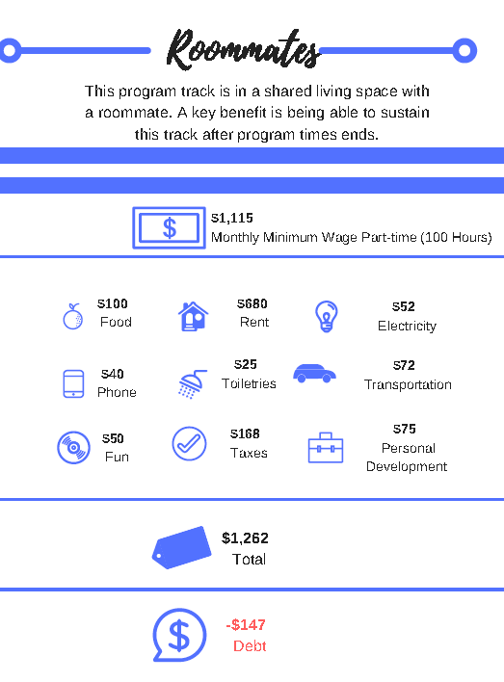
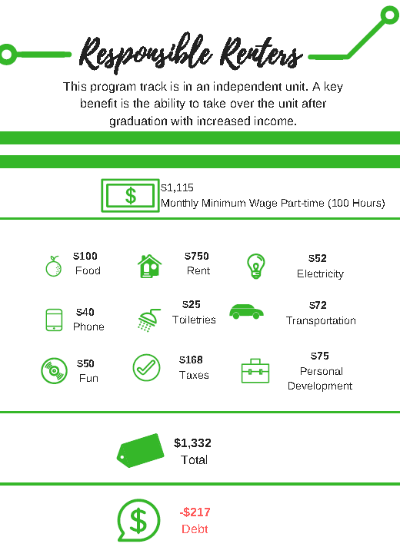

Slide 17
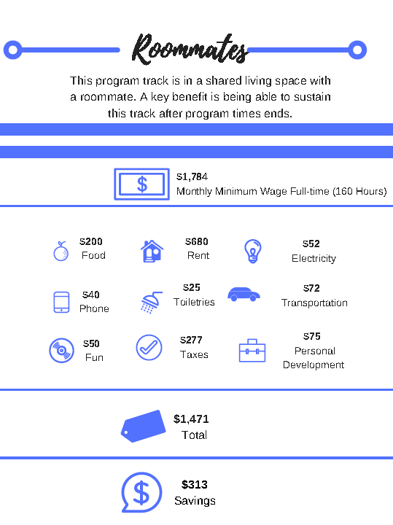
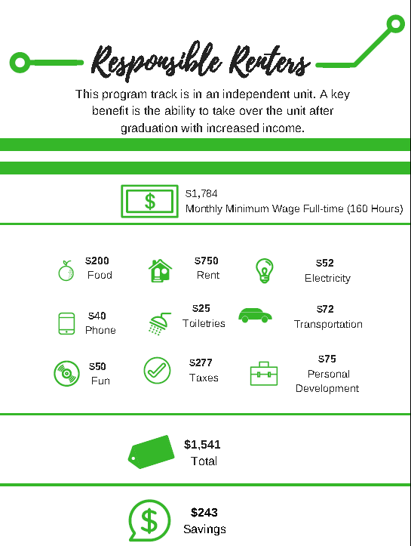
Notes:
These are the realistic conversations we have with our participants. We let them know that their first stop isn’t their final destination.

Slide 18
SINCE HOUSING 4 SUCCESS LAUNCHED IN 2013:
We have housed over 200 youth and young adults
Since January of this year, we have housed 10 new youth and young adults in Independent Living and 6 new participants in Shared Housing
We estimate we will house a total of 56 participants as a part of the 100 Day Challenge
      Goal to house 168
      Up to 30% 16-17YO
      At least 40% LGBTQ+
      At least 40% People of Color
Notes:
The 100 Day Challenge was created by A Way Home Washington as a way to address the urgency to end youth and young adult homelessness. Pierce County organizations such as Housing 4 Success, Team Child, Associated Ministries, Community Youth Services, and Oasis Center any many more have risen to the challenge with the goal to house 168 youth and young adults from July 29th 2017.

Slide 19
ONGOING CHALLENGES
Small landlord pool, lack of host homes, and limited affordable housing options
Housing that is not felon friendly
Lack of community education regarding people who experience homelessness
Battling stigmas and stereotypes of individuals experiencing homelessness
Notes:
While we had made great strides to overcome many of the challenges with Housing 4 Success, we still have some hurdles to cross. These are a few that we are still facing. Many times in communication we have heard things such as, “I want to help the homeless, but not here.” “ Not in my neighborhood” “I don’t want that type of element in my backyard.” “We can get rid of homelessness if we got rid of all the tents” Many people have preconceived ideals on why some is experiencing homelessness and what homeless people look like and because of this it is difficult for a larger push for community support. This video that I am about to show highlights some of the stereotypes and ideas that people have about people experiencing homelessness. It is a video about people experiencing homelessness reading tweets about what a portion of society feels about people experiencing homelessness.

Slide 20
Call to Action
Positive community support
Better education to unpack and dispel myths about people experiencing homelessness
Affordable housing
Tiny houses as more affordable options
Private landlords willing to work with individuals with criminal backgrounds
Housing options for individuals who struggle with substance use and sobriety
More Transitional Housing options for young people
Permanent Supportive Housing for young people
A national conversation about a housing model that is better suited to youth and young adults—taking elements of RRH, TH, and PSH
Notes:
Wow, I know that was difficult to watch but I am certain it is twice as difficult for the people who have to hear this in person on a regular basis. So with everything we discussed with this presentation, you’re probably wondering( I’m hoping) what can I do to help, or what is needed? I’m so glad you mentally asked. Here is a call to action of what we need. Many of these things aren’t overnight changes, but there are small daily changes that can be made. We can first start with educating people when we hear untrue stereotypes of people experiencing homelessness. Like let’s first change the language from “homeless people” because we stop looking at the person and at the end of the day they are still human and they deserve to be treated as humans. We’re only a small group of housing organizations, but how many of you in this room knows someone looking to rent a room, looking to rent a house, knows of a vacancy in an apartment. How many of you drive past houses with for sale signs on them? As of 2016 Tacoma Washington has a vacancy rate of 3.4%. We’re seeing a boom of apartments but how are actually affordable and equitable to our population when the quote for affordable rent is $850, $929, and up to $1000 per month. Let’s not forget you have to make 3x the amount of rent to even qualify for most of these apartments. Youth Homelessness and in general homelessness will not end overnight, but with help and support from you, your friends, peers, family, network, it can end sooner if we work together as a community.

Slide 21
The End
Questions?
Notes:
And thus that concludes our presentation. Thank you for you time and consideration. We’ll now open the floor for questioning.

