Slide 1




Passing an Affordable Housing Levy in Your Community
Conference on Ending Homelessness
May 11, 2017
Tacoma, WA

Slide 2
Agenda
Welcome and introductions
Statewide landscape
Case studies from successful campaigns
Q&A
Small group discussions
Ongoing support and resources
Networking

Slide 3
Small group discussions
Your name and what community you’re from
What are some of the opportunities and challenges to passing an affordable housing levy in your community?
What do you hope will be addressed in this afternoon’s session?

Slide 4
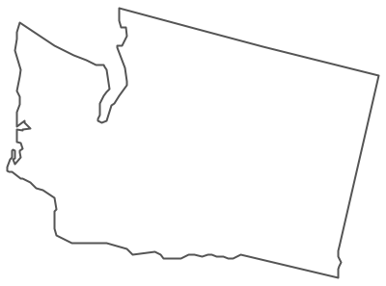
Statewide landscape

Slide 5


Case studies from successful campaigns

Slide 6
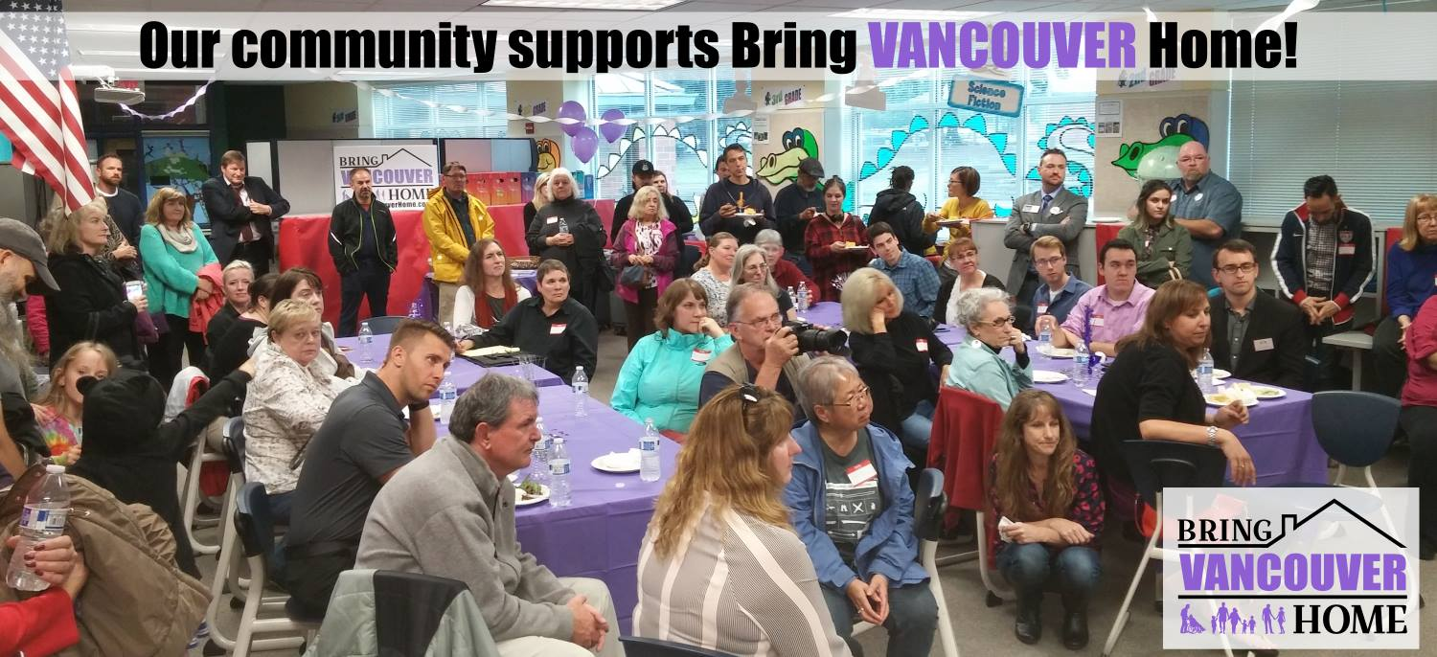
Campaign kickoff June 23rd

Slide 7

Cross-sector partnerships

Slide 8

Community Education

Slide 9
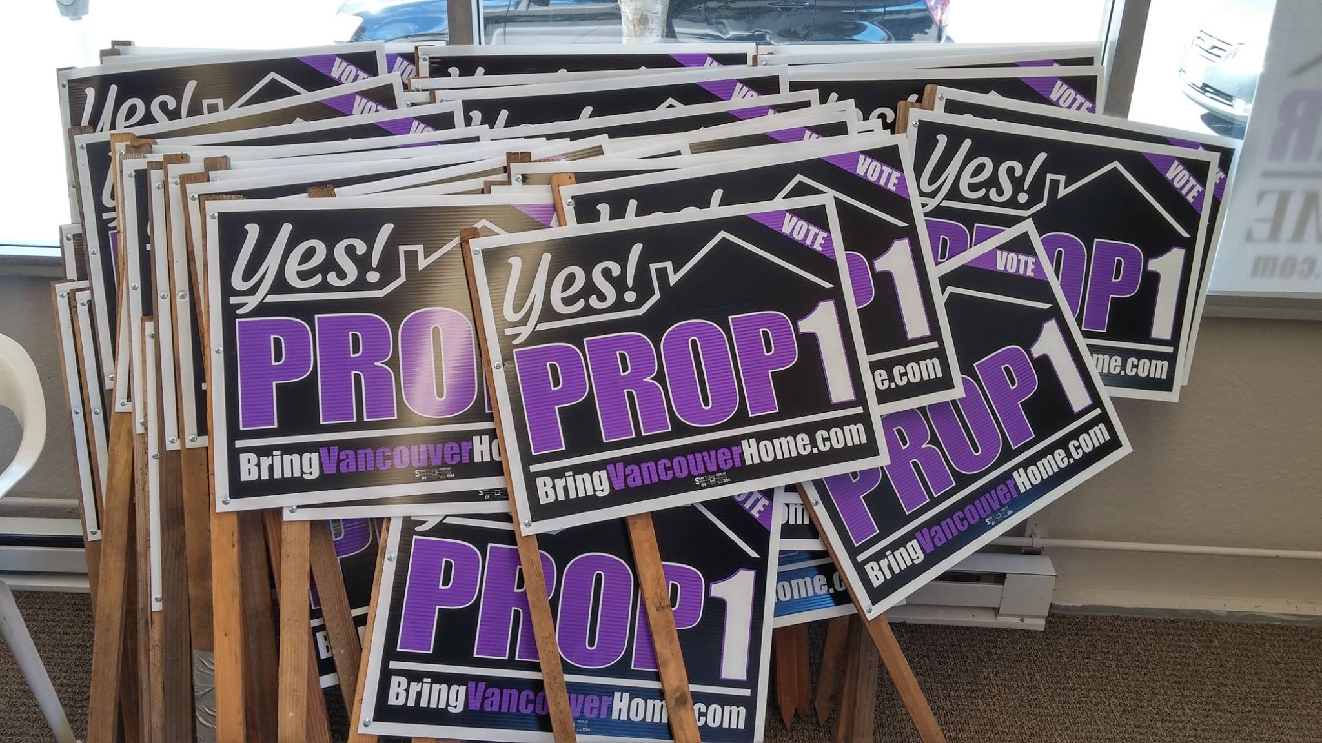
Over 15,500 doors!

Slide 10
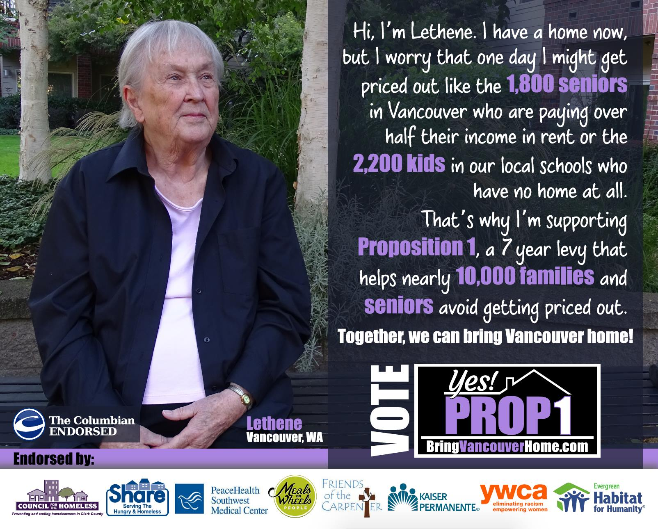
About $115,000 raised and spent

Slide 11
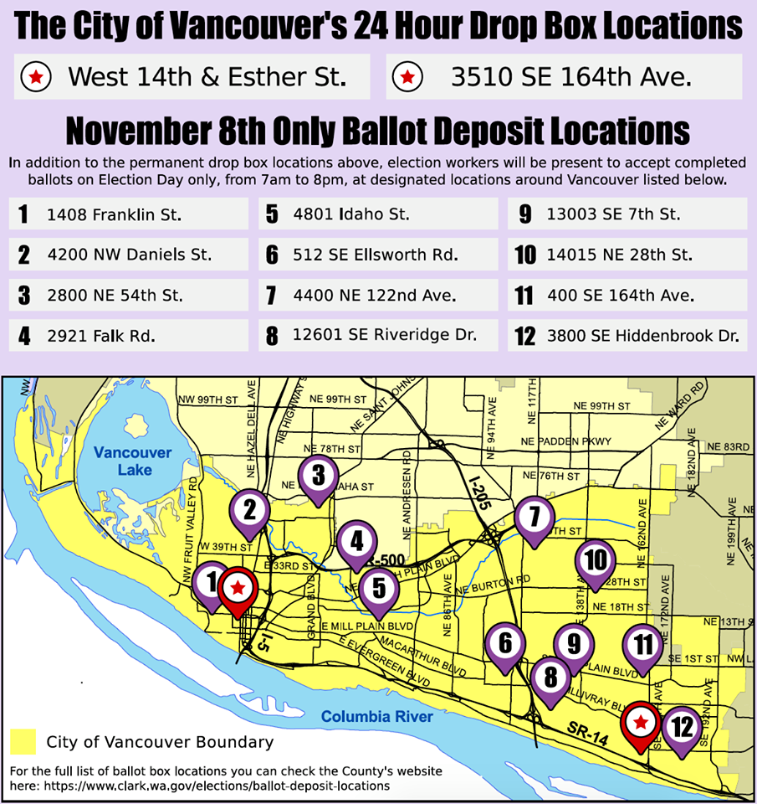
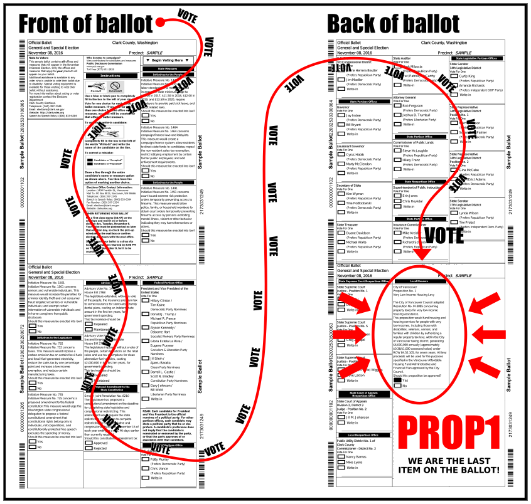
GOTV! Over 10,000 calls

Slide 12
57.64% Yes!!!!!

Slide 13
Resources to support development and preservation of affordable housing: Bellingham Home Fund
WLIHA Conference on Ending Homelessness
May 11, 2017
Greg Winter, Opportunity Council

Slide 14
The Main Ingredients of a Housing Affordability Strategy
Policies and leadership
Funding – local and nonlocal
Capacity to implement policies and put the funding to work

Slide 15
Recruit campaign team
Develop message
Execute winning strategy
Lay ground work
Build coalition

Slide 16

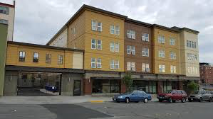
Francis Place
42 studio and 1-BR apartments for chronically homeless young adults (18-24), older adults and veterans
Housing-first
24/7 Services staffing funded by Bellingham and Whatcom CountyCommunity room for social activities/events

Slide 17

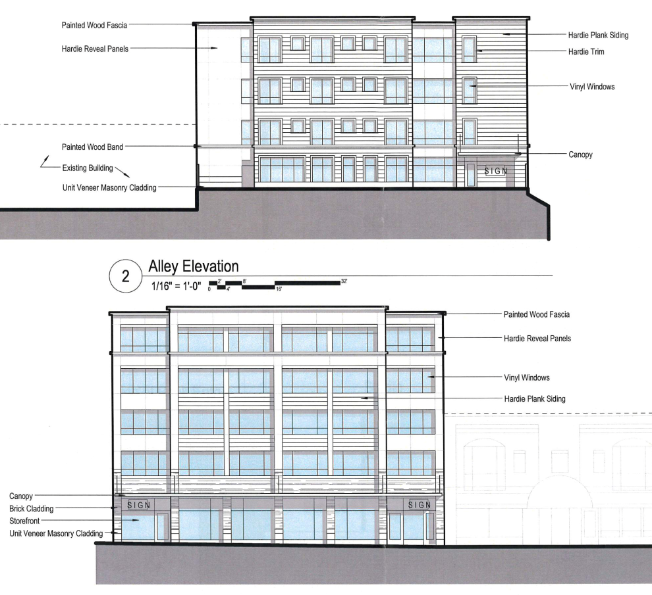
22 North
**in development**
40 studios for chronically homeless young adults (18-24) and older adults.
Housing-first
24/7 on-site services
Community room for social activities/events
Client meeting space/exam room

Slide 18
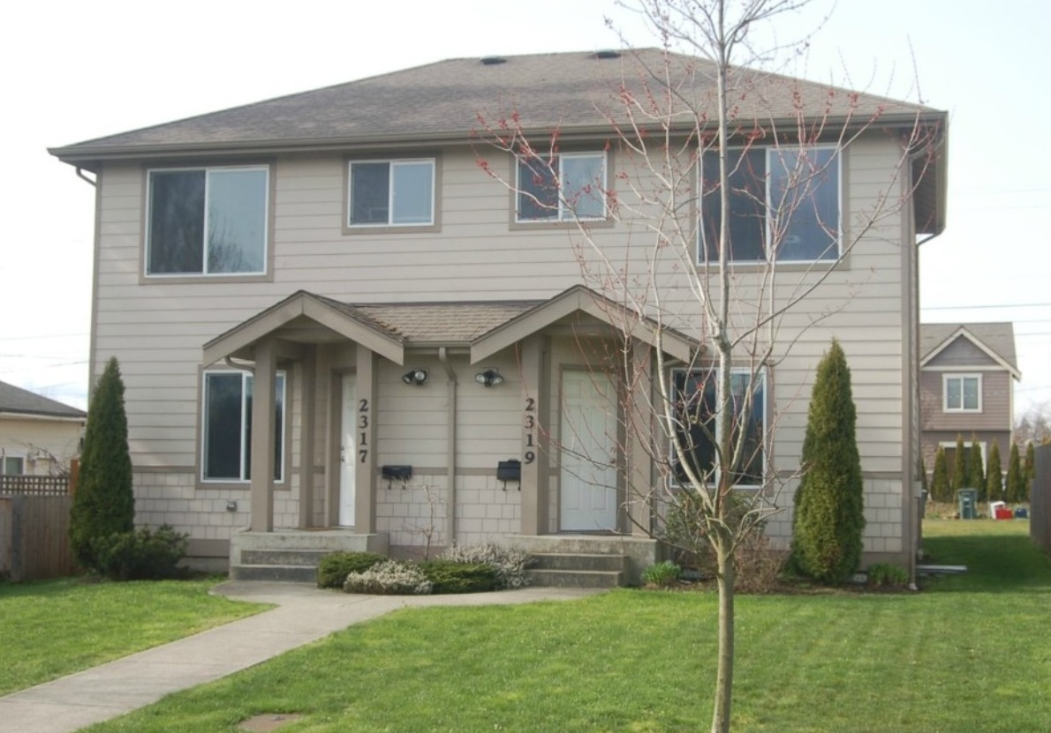
Other projects serving people who were homeless
Greggie’s House
6 units of permanent supportive housing (PSH) for single adults with mental illness who have not succeeded in other housing
Birchwood Court Apartments
7 units for single homeless women
Bell Tower Apartments
5 units serving single homeless persons
Greggie’s House

Slide 19

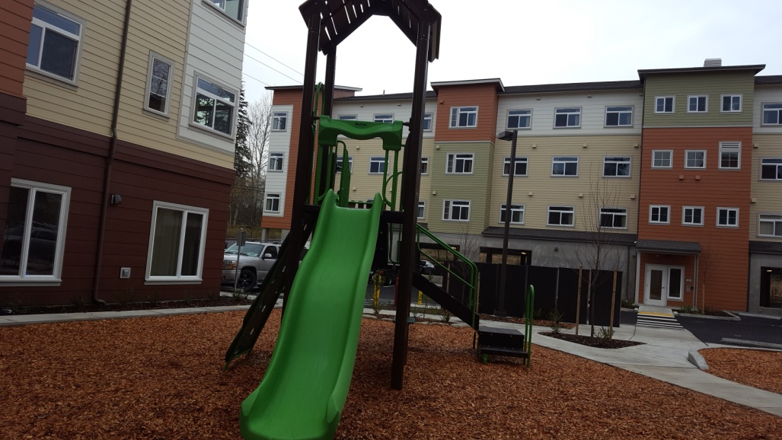
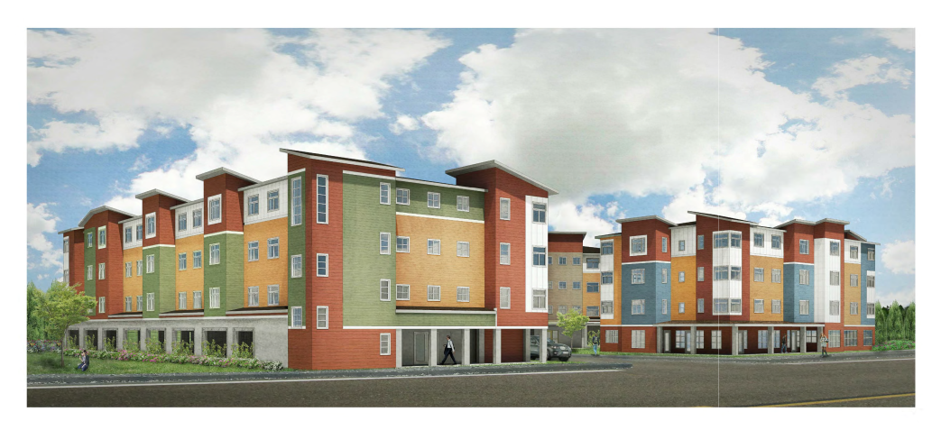
Villa Santa Fe
Farmworker Family Housing
50 – 2 & 3-bedroom units.
Covered parking
On-site Head Start classroom (proposed)

Slide 20

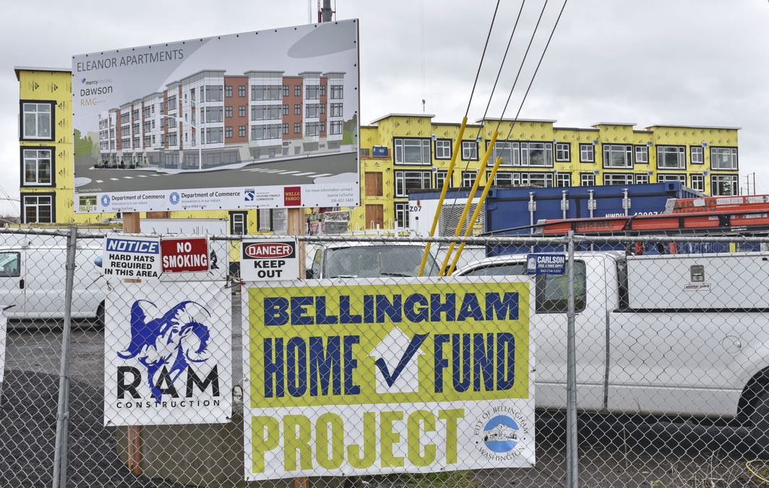
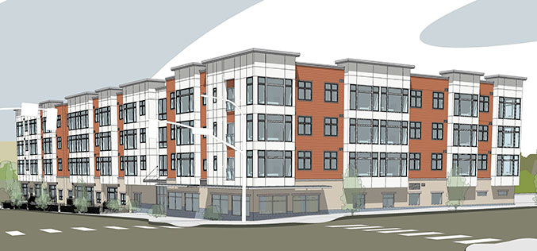
Eleanor Apartments
Senior housing
80 one-bedroom units.
On-site health and wellness services by PeaceHealth.
Large on-site community center.
Located in downtown Bellingham

Slide 21

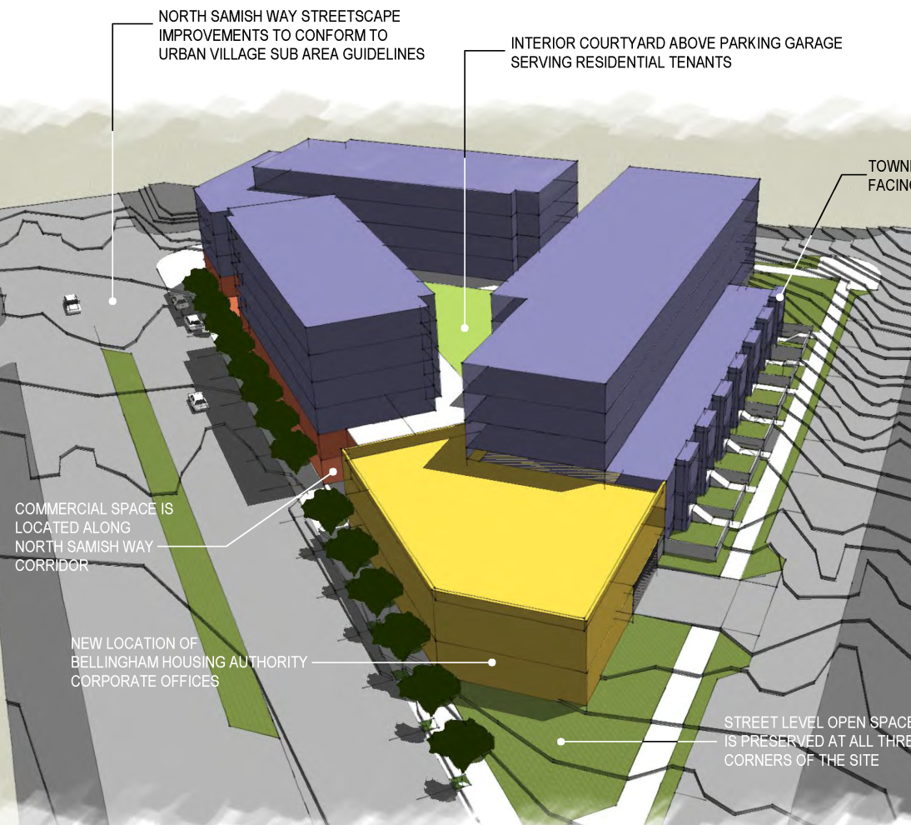
Aloha Motel Redevelopment
Workforce housing
Replaces a blighted property
Used opportunity fund for land acquisition
150 housing units, including townhouses
Large commercial space

Slide 22


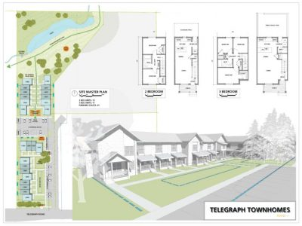
Telegraph Road Townhomes
Homeownership housing
24 - 2 & 3 bedroom homes selling for $100-150K
Passive house energy efficiency
Long-term affordability under shared equity model
On-site amenities: community garden, trail connectors

Slide 23

Bellingham Home Fund – Washington State’s Second Housing Levy
Voter approved ballot measure
36¢ per $1,000 assessed value
$21 million over 7 years
  Housing production
  Preservation
  Rent assistance and services
  Homeownership
  Opportunity fund

Slide 24
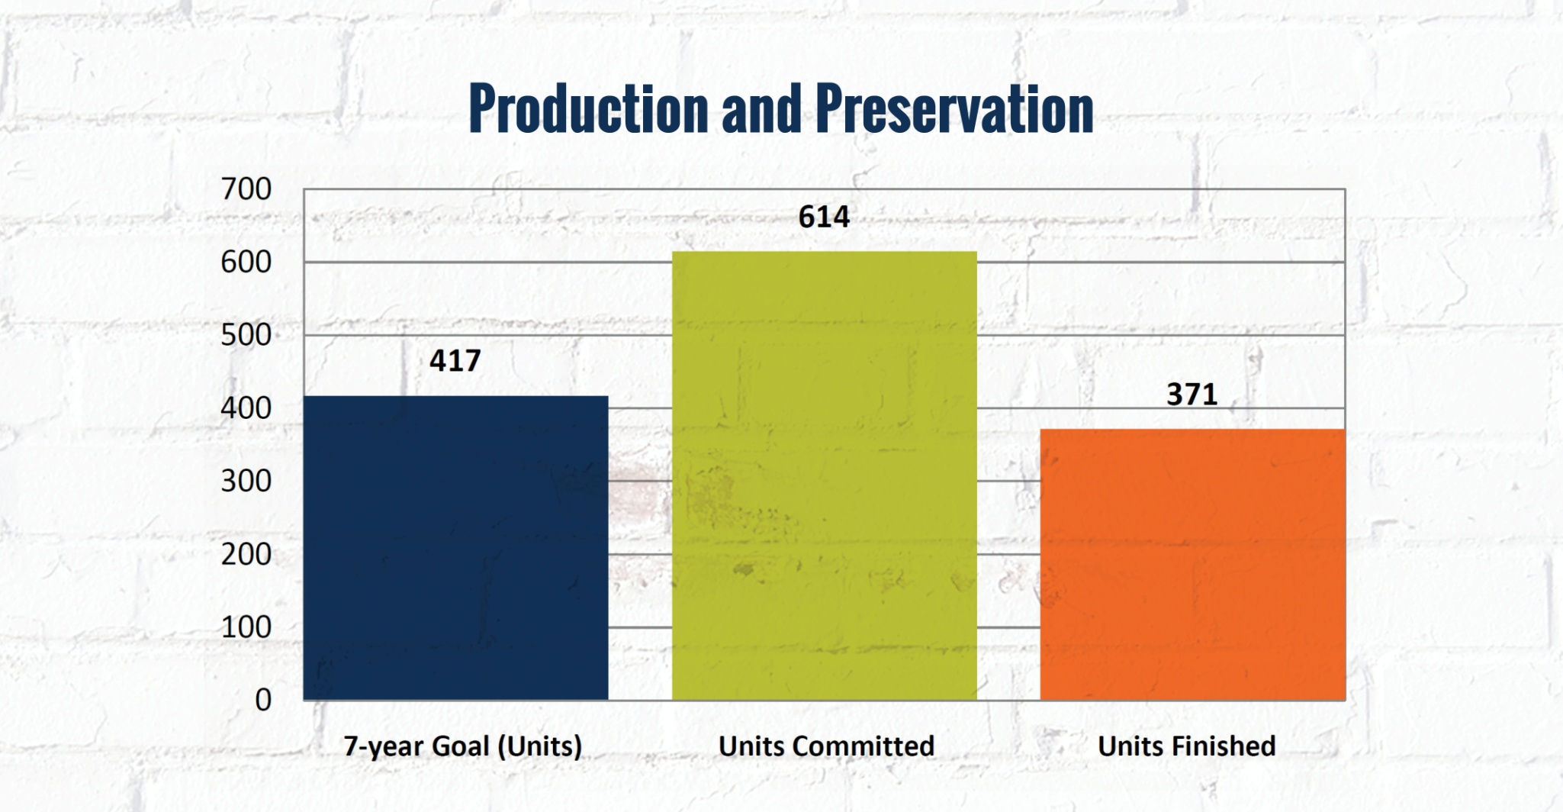

Slide 25
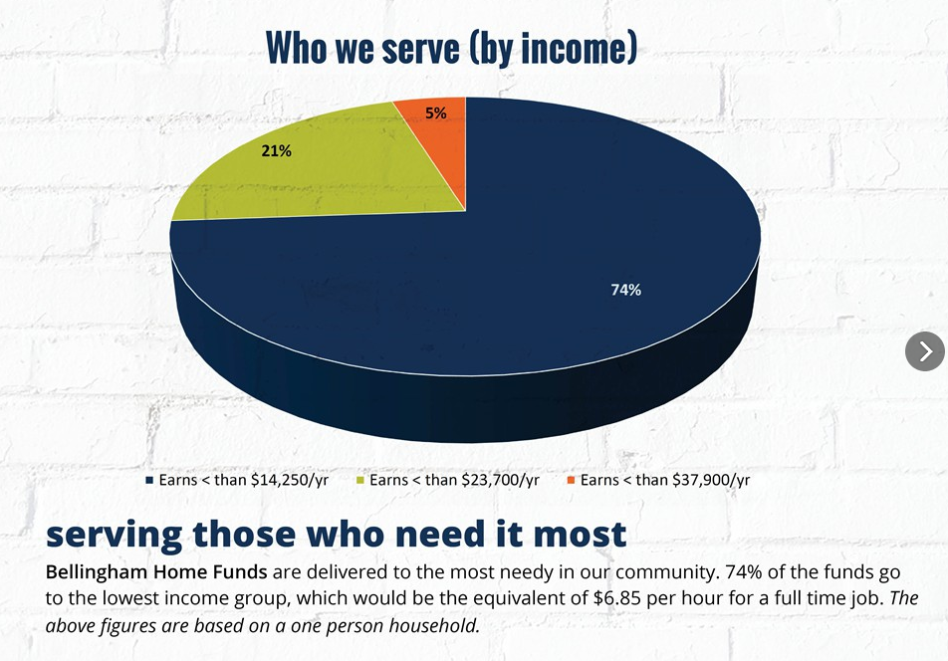

Slide 26
How Leveraging is Working
 | City Funds | Match
Production | $5,108,053 | $49,073,308
Preservation | 1,446,426 | 4,222,546
Rental Assistance & Supportive Services | 1,648,518 | 5,972,328
Homebuyer | 615,000 | 4,076,787
TOTAL | $ 8,817,997 | $ 63,344,969

Slide 27
Questions?

Slide 28
Small group discussions
Are there opportunities to stay connected and learn from each other?
Given everything you’ve heard, what do you think are the immediate next steps in your community?

Slide 29
Ongoing support and resources
Messaging frameworks
Materials
Statewide listserv
Door knocking and phone banking
May 24 webinar: bit.ly/housinglevywebinar
What else?

Slide 30


Thank you!
Andy Silver
Executive Director
Council for the Homeless
asilver@councilforthehomeless.org
Greg Winter
Executive Director
Opportunity Council
greg_winter@oppco.org
Michael Anderson
Director, Housing Trust Fund Project
Center for Community Change
manderson@communitychange.org
Teresa Clark
Director of Organizing
WA Low Income Housing Alliance
teresac@wliha.org

