Slide 1
Compassion Fatigue Prevention: Sustaining and Maintaining Health in Homeless Service Teams
Jennifer Harkness, MA, LMHC, ATR
Julie McFarland, MSW/JD

Slide 2
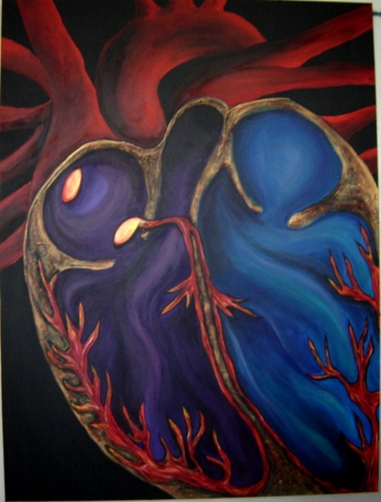
Peter Levine (1997) says, “While trauma can be hell on earth, trauma resolved is a gift of the gods-a heroic journey that belongs to each of us” (p.12).
“Unbreakable”

Slide 3
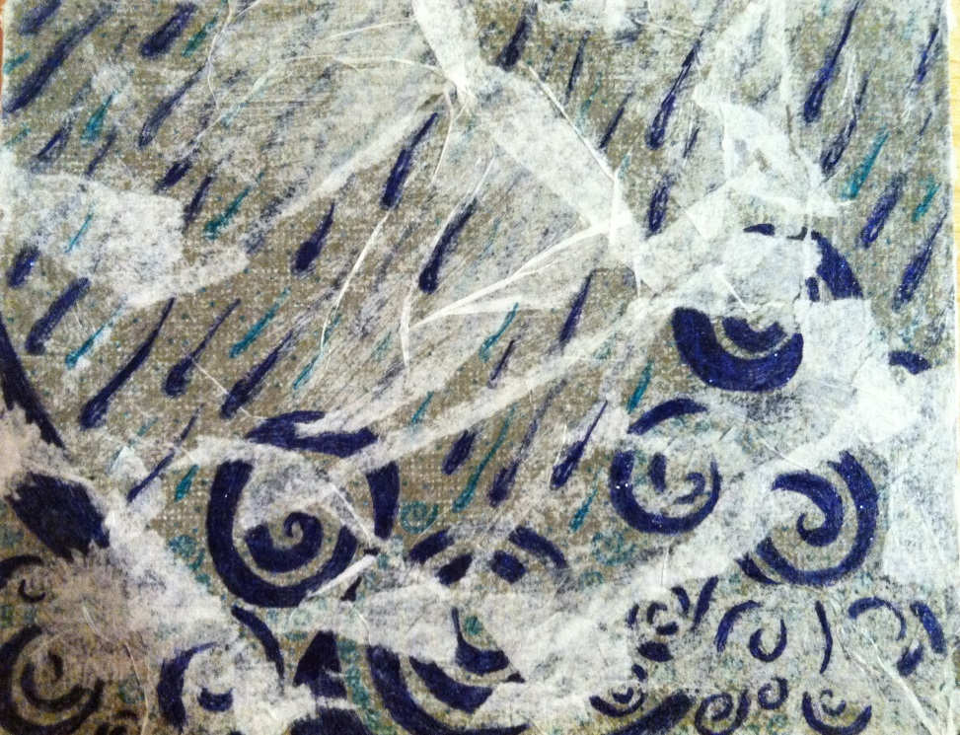
What To Expect
“Drowning in the storm”
Introduction
Compassion Fatigue Overview
Prevention and Recovery
Application in Homeless Service Teams

Slide 4
Think about the last person you spoke or worked with who was burned out.
How could you tell?

Slide 5
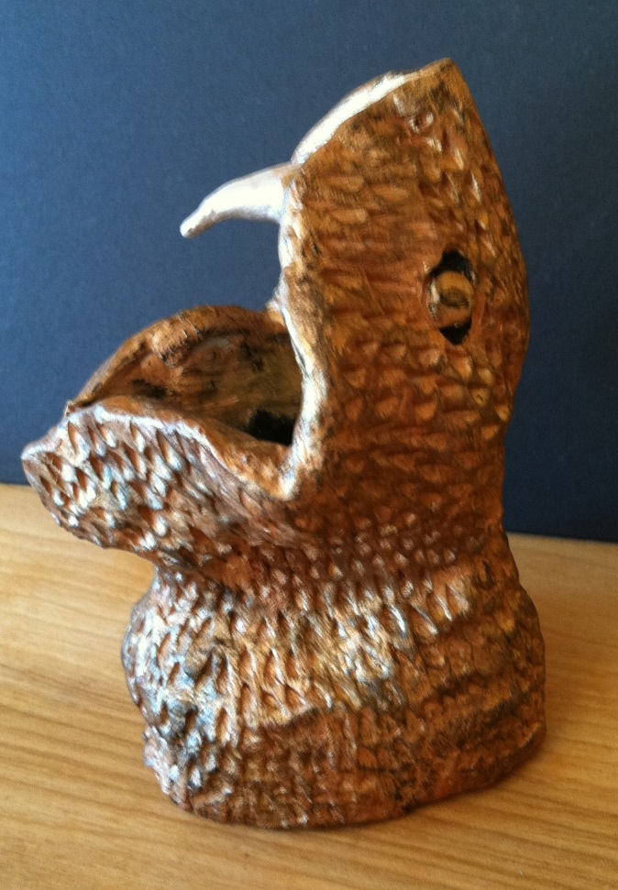
Definitions
“Reptilian Brain Biting”
Primary Trauma
Secondary Trauma
(Figley, 1995; Rothschild, 2006)

Slide 6
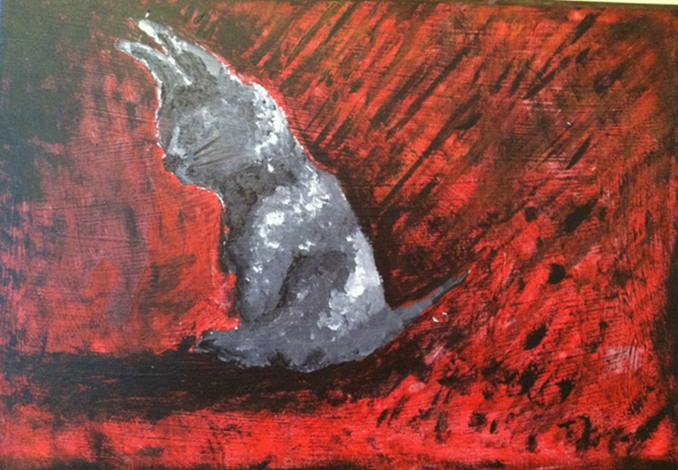
Definitions
“Traumatized”
Compassion Fatigue
Vicarious Trauma
Burn Out
(Adams & Riggs, 2008; Figley, 1995; Harrison & Westwood, 2009; McCann & Pealman, 1990).

Slide 7
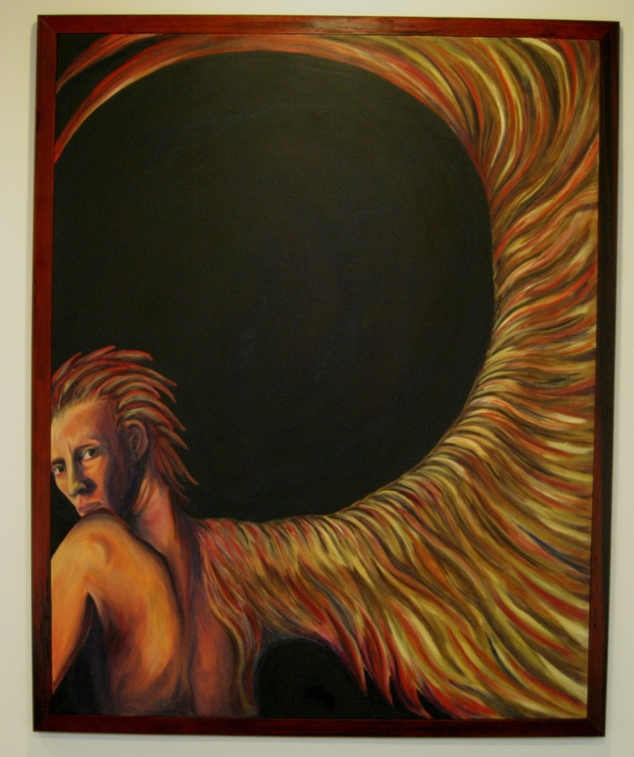
Influencing Factors
“Learning to Fly”
Organizational vs Interpersonal influences
Developmental influences
Historical influences
(Adams & Riggs, 2008; Figley, 1995; Harrison & Westwood, 2009; Pearlman & Saakvitne, 1995).

Slide 8
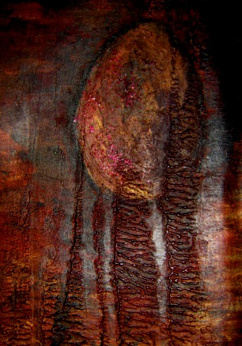
Areas impacted in Vicarious Trauma
“Incubating Potential”
Worldview
Spirituality
Identity
Self-Capacities
Ego Resources
(Pearlman & Saakvitne, 1995)
Body
(Rothschild, 2006)

Slide 9
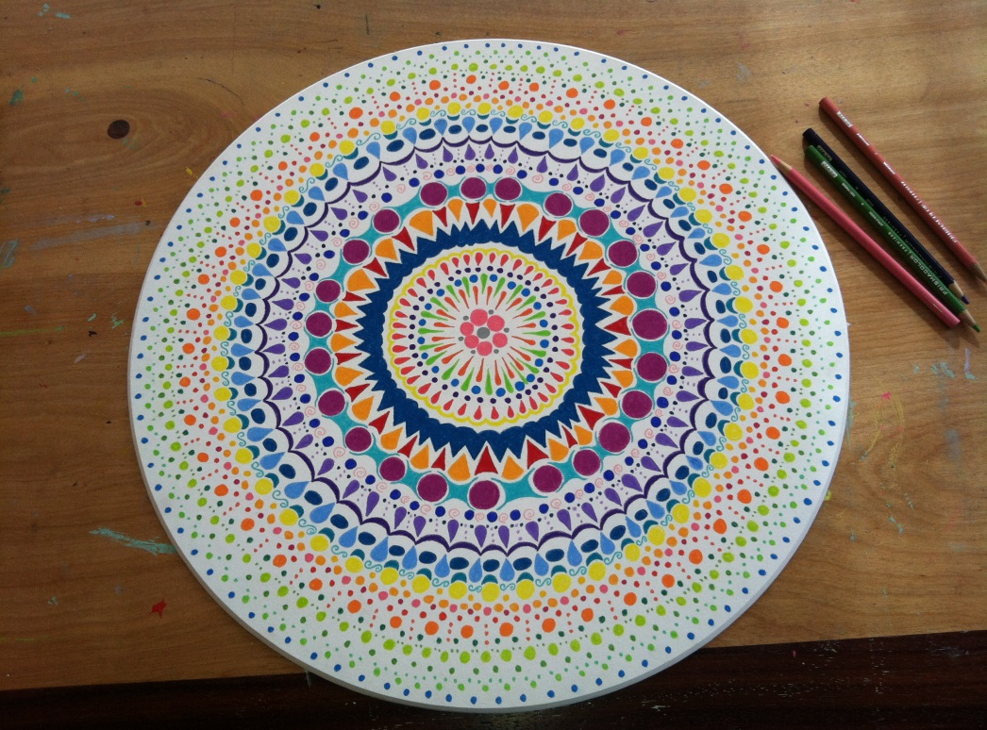
Notes on “Self Care”
“Mandala”
Awareness
Balance
Connection
(Pearlman & Saakvitne, 1995)

Slide 10
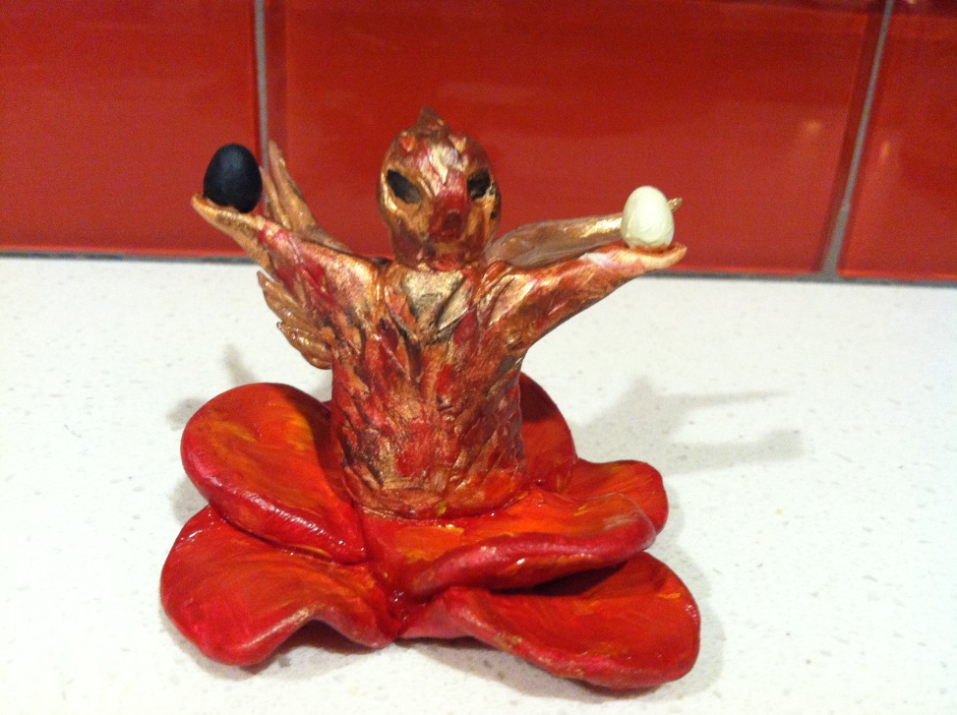
Worldview
“Holding duality”
Pessimistic or sarcastic
Hopeless
Lack of joy
Loss of vulnerability
Loss of spontaneity
Lack of generosity
Feeling overwhelmed by the negativity in this world
(Pearlman & Saakvitne, 1995)

Slide 11
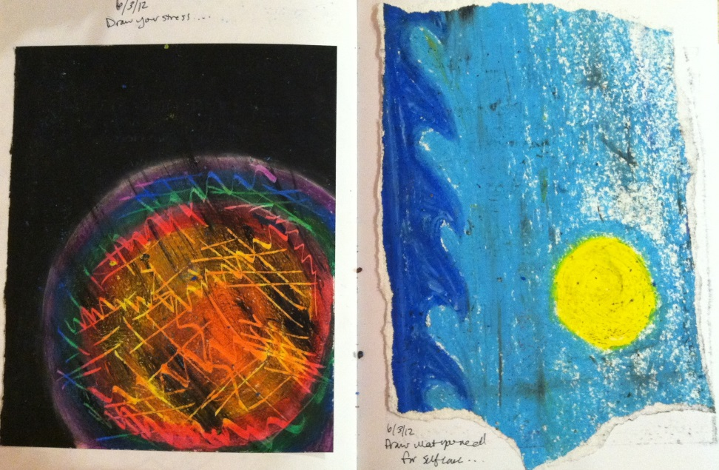
Balancing
“Draw your stress/
Draw what you need for self care”
Allowing for negative and positive experiences
Applied active optimism
Create meaning out of your work
Altruism
Gratitude
Resting in peaceful or joyous moments
Limit violent exposure/news hiatus
(Harrison & Westwood, 2009; Pearlman & Saakvitne, 1995, Rothschild, 2006)

Slide 12
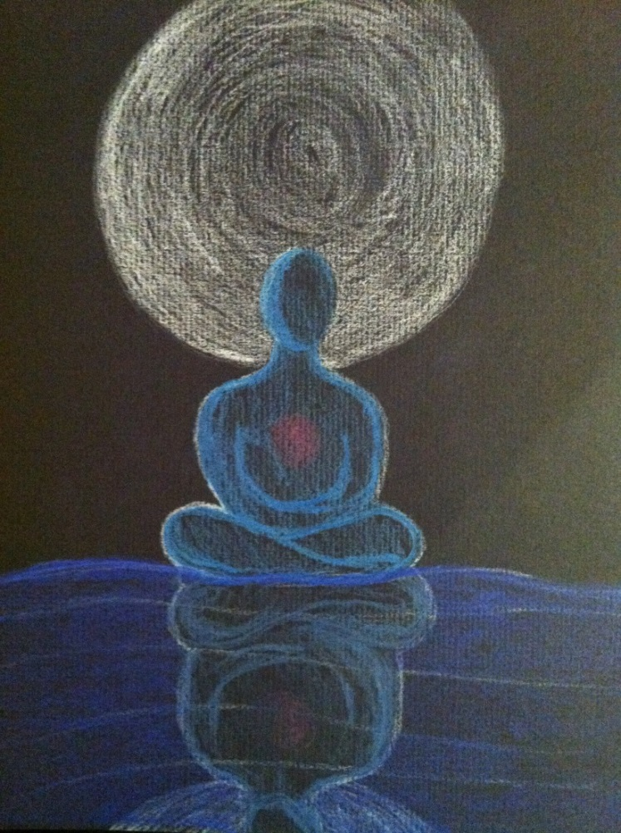
Spirituality
“Spiritual Reflection”
Meaninglessness
Isolation
Denial
Intellectualize
Numbing
Avoidance
Disillusionment
(Pearlman & Saakvitne, 1995)

Slide 13
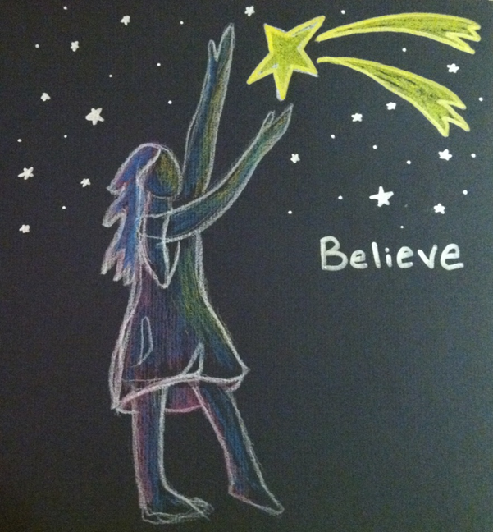
Cultivating
“Remembering”
Turn to your spiritual beliefs and practices
Cultivate Mindfulness
Spiritual Community
(Pearlman & Saakvitne, 1995, Rothschild, 2006)

Slide 14
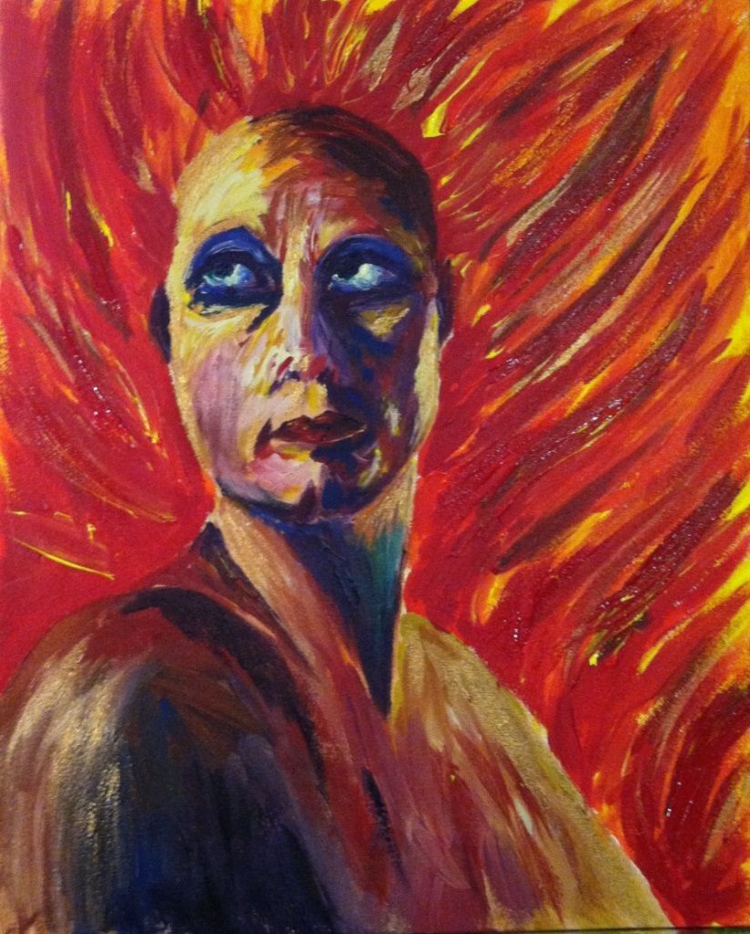
Identity
“Becoming Pele”
Lack of self-worth
Questioning identity
Questioning basic beliefs
Questioning roles
Interferes with personal life and relationships
Lack of enjoyment in meaningful activities
(Pearlman & Saakvitne, 1995)

Slide 15
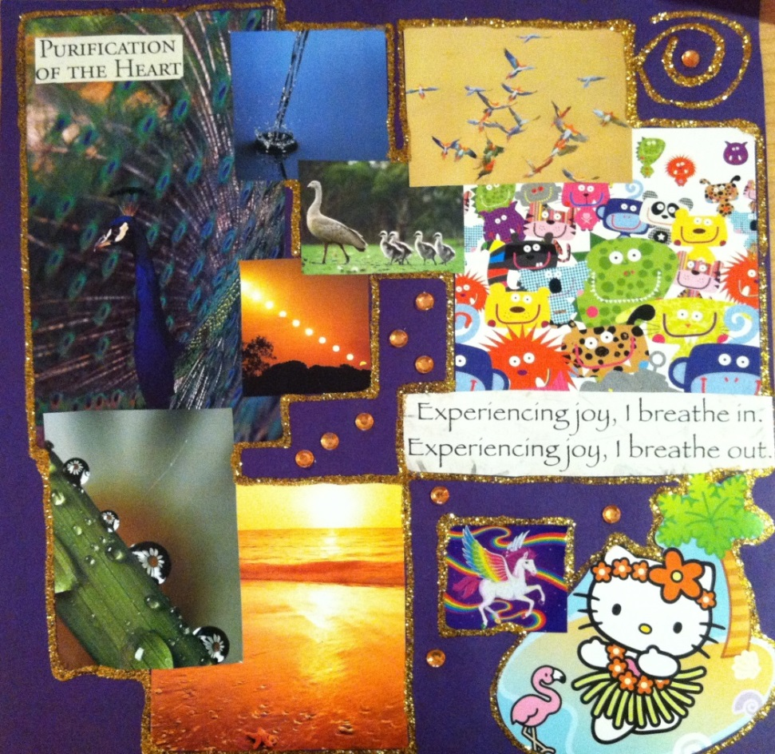
Strengthening
“Exploring Joy”
Evolve non-professional activities
Turn to friends and family
Avoid isolation
Incorporate things you enjoy into your day
Differentiation
(Harrison & Westwood, 2009; Pearlman & Saakvitne, 1995, Rothschild, 2006)

Slide 16
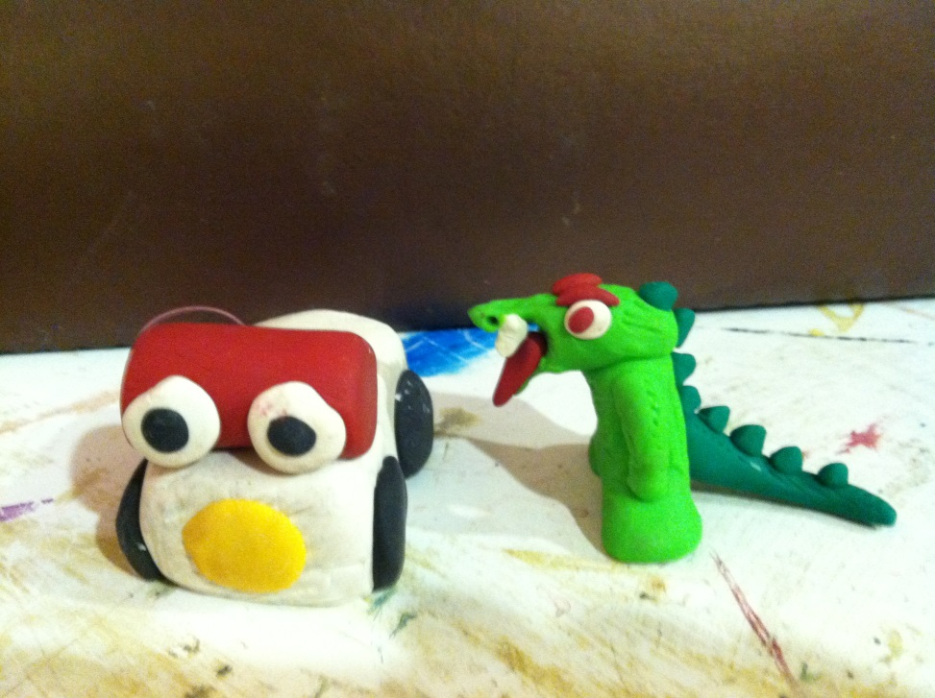
Self-Capacity
“Self Critic and Anxiety Train”
Difficulty self-soothing
Greater anxiety
Rumination on work
Self-criticism
Cannot tolerate strong emotions in self or others
Projection onto others
Aggression or irritability
Turning to addictions
(Pearlman & Saakvitne, 1995)

Slide 17
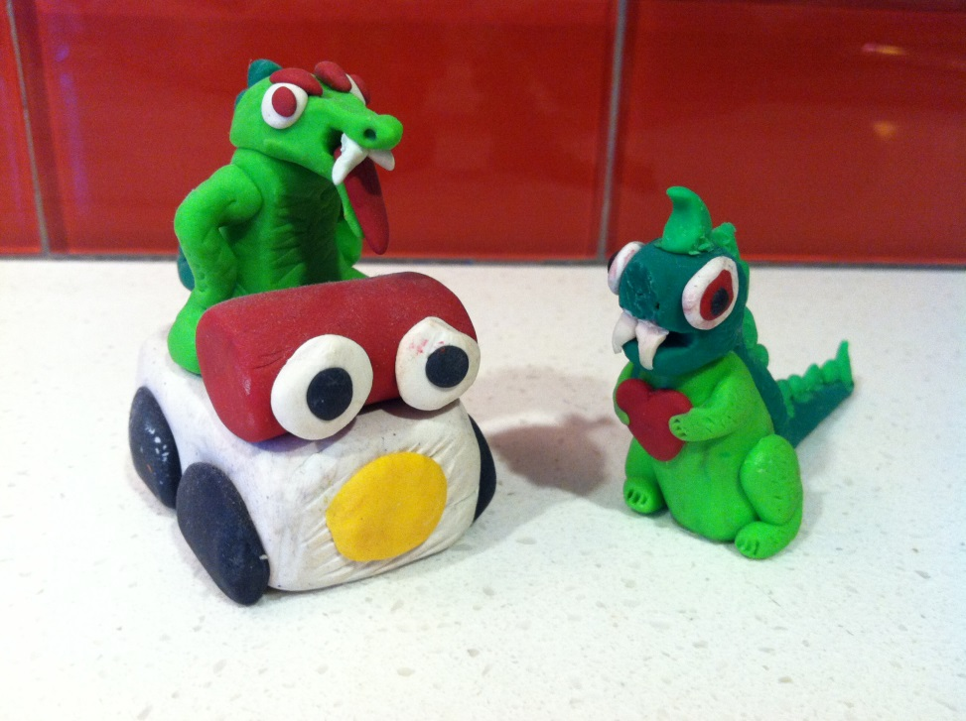
Nurturing
“Self Compassion Making Friends with Critic and Anxiety”
Do not visualize traumatic imagery
Avoid self-sacrificing styles
Make yourself a priority
Validation throughout the day
Ritual, rest, routine, repetition, rhythm and rhyme
Sensory activities
(Harrison & Westwood, 2009; Pearlman & Saakvitne, 1995, (Perry, Pollard, Blakely, Baker, and Vigilante, 1995; Rothschild, 2006)

Slide 18
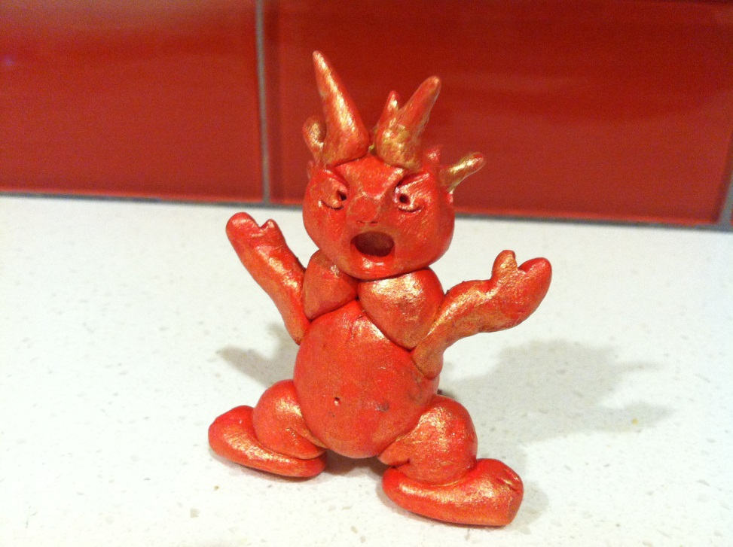
Ego-Resources
“I want to blow everything up”
Diminished ability to create boundaries
Difficulty making clear judgments
Lack of introspection
Lack of humor
Cognition becomes clouded
Over-committing
Overworking
Apathy
Lethargy
Stifling of personal growth
(Pearlman & Saakvitne, 1995)

Slide 19
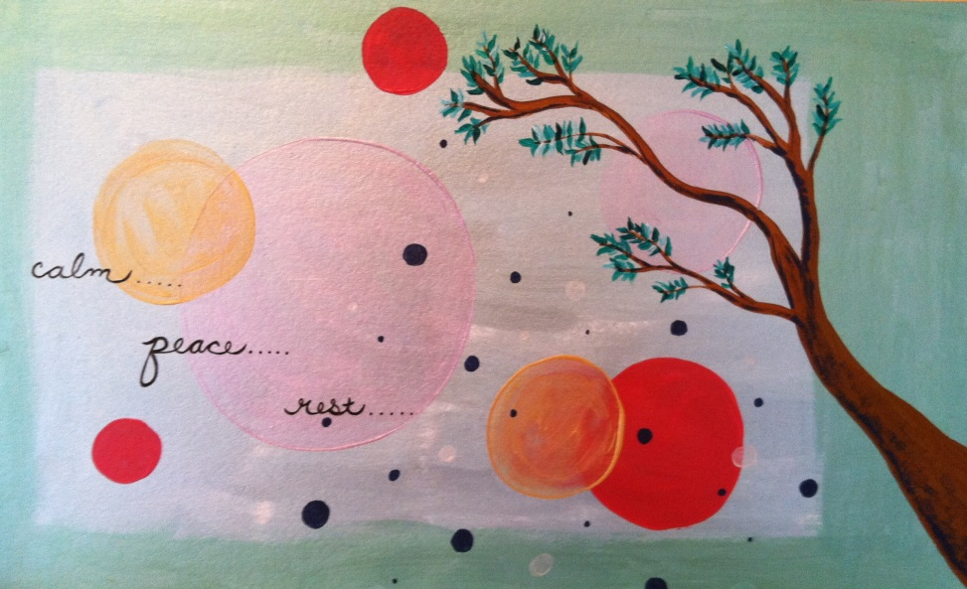
Resourcing
“Healthy Intentions”
Develop other professional aspects of yourself like advocating, teaching or writing
Go back to your theoretical foundation
Balance workload
Create internal and external boundaries
Supervision and personal therapy
(Harrison & Westwood, 2009; Pearlman & Saakvitne, 1995, Rothschild, 2006)

Slide 20
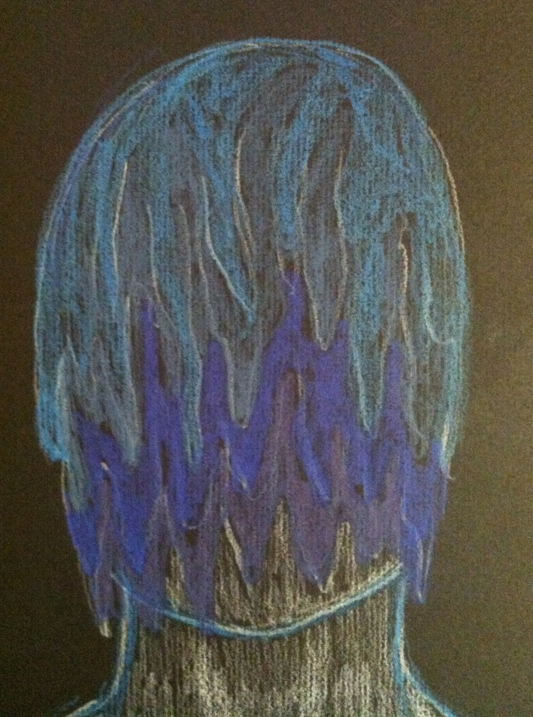
Body
“Melting with exhaustion”
Exhaustion
Tension
Headaches
Body aches
Ailments
Weaker immune system
Lack of or interrupted sleep
(Harrison & Westwood, 2009; Pearlman & Saakvitne, 1995, Rothschild, 2006)

Slide 21
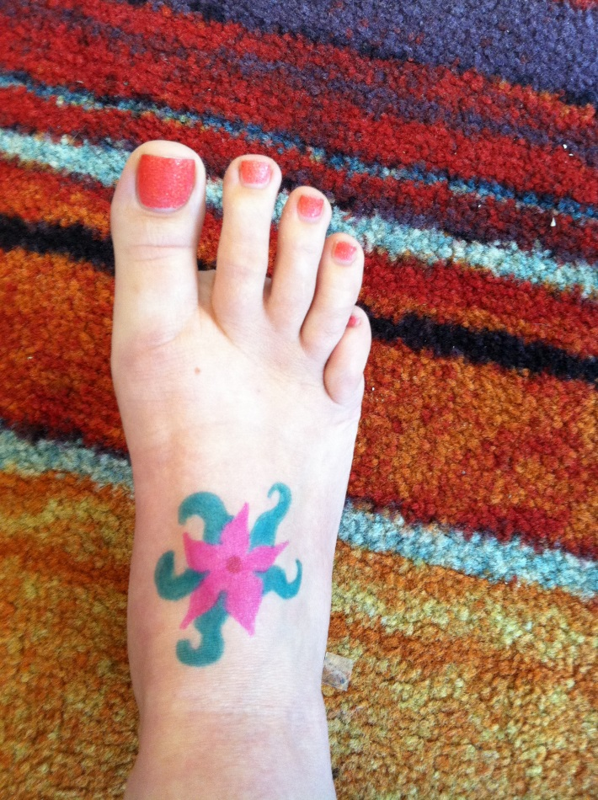
Health Focus
“Grounding Flowers”
Mindfulness of body posture mirroring and eye contact
Holistic health care
Body practices like massage/reiki
Drink more water
Eat protein frequently
Exercise regularly
(Harrison & Westwood, 2009; Pearlman & Saakvitne, 1995, Rothschild, 2006)

Slide 22
Healthy Leaders, Healthy Teams
When we aren’t at our best, it’s obvious. We may think we can hide it. We can’t.
We are responsible for modeling self-care.
We are responsible for identifying symptoms of burn out within our teams. No matter how we’re feeling, we have to keep a pulse on the team.
Notes:
Can’t hide it – it’s obvious in our reactions, our demeanor, our emails.
Identifying and empathizing with burnout when you’re burned out isn’t easy. Keep yourself healthy; your team will thank you.

Slide 23
What Can We Do For Our Team?
Work a reasonable number of hours.
Be intentional about team building. Build activities into regular meetings so people can really get to know each other.
Name it – when you see signs of burnout, talk with the team member right away. You’re coming from a place of compassion and it will likely be well-received.
Notes:
Hours – for yourself and for your team, this is critical. You need to take care of yourself, and your team needs to see that positive modeling.
Activities – Roses & Thorns (professional or personal, with boundaries in mind); “Brag Jar”; Bring in a consultant quarterly; Team walk for coffee;

Slide 24
What Can We Do For Our Team?
Talk about self care often.
Walk the talk.
Include a self-care section in performance evaluations, and do them regularly!
Build staff appreciation into your budget. Even if it’s $200 and it means taking the team to Starbucks twice a year, it will go a long way.
Notes:
Activities – Roses & Thorns (professional or personal, with boundaries in mind); “Brag Jar”;
Budget – team coffee breaks; small plant with a bright pot during rainy season; hand written cards! There were times when I was just done, but still had work that needed to be done. I left at a healthy time, bought some cards, and wrote a note of appreciation to each team member. I was reminded of how completely awesome the team is and what is going well around me. My self care contributed to theirs!

Slide 25
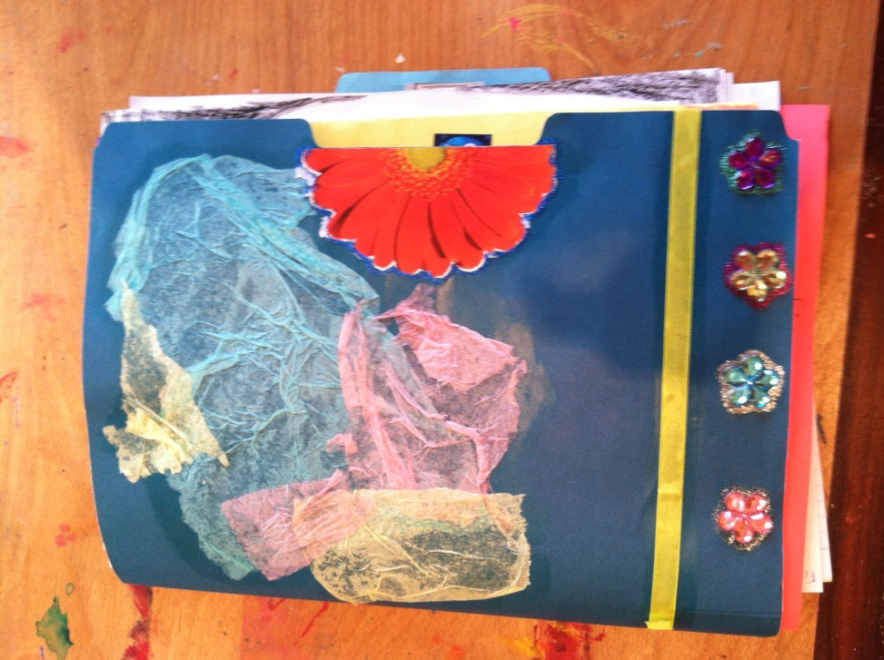
Gratitude
“Feel Good Folder”
I would like to thank you for the work you do. It is not easy, it takes a lot of courage and many skills. It is tremendously important, noble and fulfilling. May you plant and nourish many seeds within you and others that grow to heal our world. Namaste.

Slide 26
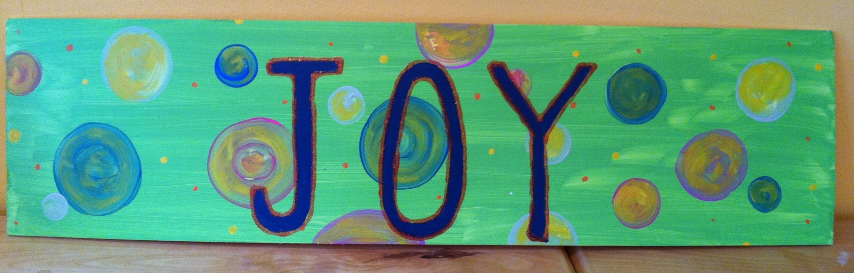
Questions?
“Cultivate Joy”

Slide 27
References
Adams, S.A., Riggs, S.A. (2008). An exploratory study of vicarious trauma among therapist trainees. Training and Education in Professional Psychology. 2(1), 26- 34. doi: 10.0137/1931-3918.2.1.26
Figley, C.R. (1995). Compassion fatigue as a secondary traumatic stress disorder: An overview. In C.R. Figley (Ed.) Compassion fatigue: Coping with secondary traumatic stress disorder in those who treat the traumatized. Levittown, PA: Brunner/Mazel.
Fishbane, M. (2007). Wired to connect: neuroscience, relationships, and therapy.
Family Process. [Electronic Version] 46(3), 395-412.
Harrison, R.L., Westwood, M.J. (2009). Preventing vicarious traumatization of mental health therapists: Identifying protective practices. Psychotherapy Theory, Research, Practice, Training. 46(2), 203-219. doi: 10.1037/a0016081
McCann, I.L., Pearlman, L.A. (1990). Vicarious traumatization: A contextual model for understanding the effects of trauma on helpers. Journal of Traumatic Stress, 3(1), 131-149.
Pearlman, L.A., Saakvitne, K.W. (1995). Trauma and the therapist: Countertransference and vicarious traumatization in psychotherapy with incest survivors. New York: W.W. Norton & Company, Inc.
Perry, BD, Pollard, R, Blakely, T, Baker, W, Vigilante, D. (1995). Childhood trauma, the neurobiology of adaptation and 'use-dependent' development of the brain: How "states" become "traits'". Infant Mental Health. [Electronic Version] J, 16 (4): 271-291.
Rothschild, B., (2006). Help for the helper. New York: W.W. Norton & Company, Inc.
Siegel, D. (2001). Toward an interpersonal neurobiology of the developing mind:
Attachment relationships, “mindsight,” and neural integration. [Electronic Version] Infant Mental Health Journal. 22(1-2), 67-94.

